Slide 1
1st Vice Chair Report Sept 2015 Bangkok
Date: 2015-09-14
Authors:

Slide 2
Abstract
This slide contains requested reports and status from the 802.11 1st Vice-Chair:
Monday:
  Meeting room locations
  Next meeting reminder
  Meeting registration
  Recording attendance
  File server
  Breakfast, breaks, social
Friday:
  Straw Poll of membership regarding this meeting location
  Future venues status and discussion

Slide 3
Monday–
802.11 Opening Plenary
802.11 First Vice Chair Report

Slide 4
M3.3 II Other WG meeting plans
802.11 802.15 802.18 802.19 802.21 802.24
Treasurer Report:
  https://mentor.ieee.org/802.11/dcn/15/11-15-0995-00-0000-joint-treasurers-report-Sept-2015.pptx
Patent policy (in IEEE-SA bylaws), patent policy (slide set), and antitrust guidelines

Slide 5
Online Calendar
This session’s meetings are also shown on the 802.11 calendar on the 802.11 home page (http://www.ieee802.org/11).
This is a Google calendar “802_11_calendar@ieee.org”
There are multiple ways of accessing this information, for example from a cell-phone, or as a remote calendar.
Note: the schedule on this calendar will be updated, but any room changes will probably not be. Online Meeting Schedule is most accurate. Room changes will be posted on rooms.

Slide 6
M3.4 Meeting Room Locations

Slide 7
M3.4 Meeting Room Locations

Slide 8
M3.5 Next WG Meetings
Next Plenary Meeting –
  IEEE 802 Plenary session – 9-13 Nov 2015
  Hyatt Regency, Dallas, TX, USA
For information and registration links, see
  Registration and Hotel Reservations https://802world.org/apps/session/93/register2

Slide 9
M3.7 Meeting Registration
EVENT STATISTICS REPORT
IEEE 2015 (1509045) IEEE 802 Wireless Interim Meeting 2015
Printed on Sun 13 September 15
CONFERENCE STATISTICS: Attendee
Conference Registration
  Centara Grand Hotel Registration - Early Bird 257 79%
  Centara Grand Hotel Registration – Standard 35
  Centara Grand Hotel Registration – Onsite 3
  Other Hotel Registration - Early Bird 20 6%
  Other Hotel Registration – Standard 10
  Other Hotel Registration – Onsite 1
GRAND TOTAL: 326
As of 08 September 2015

Slide 10
M3.7 Recording Attendance
It is a requirement that attendees record their participation at an 802.11 session and declare their affiliation. This record is usually made using the IMAT attendance system.
  If you wish to participate without recording attendance, send an email per session to the WG 1st vice chair declaring your participation and affiliation.
    However, You cannot gain or maintain 802.11 voting membership using this method.
You must record 75% attendance of eligible 802.11 slots in a session for that session to count towards gaining or maintaining 802.11 voting membership
  You need a single IEEE-SA web account
    The IEEE SA web account requires a working email address
    do not remove your email address from the account
  Use the email address associated with that web account when registering attendance
    If you change email addresses, update the web account, don’t create a new web account, or your membership status may not be calculated properly.
  Record attendance using this URL: https://imat.ieee.org/attendance

Slide 11
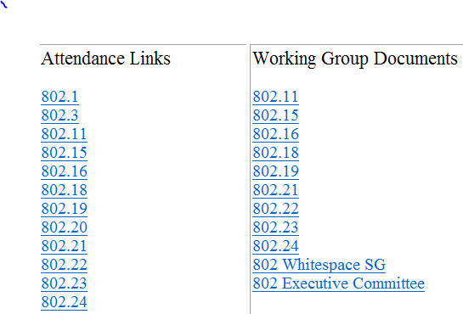
M3.9 Local File Document Server information
Local FTP server: ftp://griffin.events.ieee.org (anonymous)
External Document Server https://mentor.ieee.org/802.11/documents

Slide 12
M3.9 Synchronizing while at the meeting
While Particularly important when external bandwidth is limited and unreliable
Please Use anonymous ftp
  Host: ftp://griffin.events.ieee.org
  User: anonymous
  Password: <your-email-address-here>
  Destination directory: /802.11/15
Freeware tools are available, for example search for “syncback free” **
** Other tools are available. The IEEE does not endorse the use of any particular tool.

Slide 13
M3.10 FOOD & BEVERAGE
- Breakfast is included in your room rate if you booked via the IEEE link with the Centara
- Morning and Afternoon tea will be served in the foyer areas on level 23 and 22
- Lunch will be available from 1200 – 1330 will be served from the following locations:
Mon 14 – Wed 16 Sept (3 days) at: Delegate Bar, Level 22
Thurs 17 Sept at: Hotel Restaurant ‘The World & Ginger Restaurant’, Level 24

Slide 14
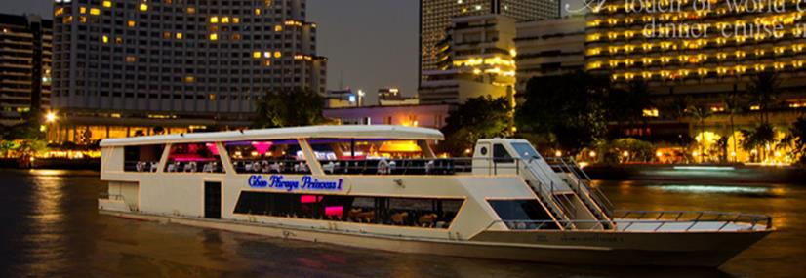
Social – Wednesday
Dinner Cruise on Bangkok River (Chao Phraya)
- Please note this is an optional function, please see the registration desk if you would like to purchase a ticket, spaces are limited. Ticket cost: US$80
- Included in the price of the ticket: return coaches, english speaking guides, international buffet, soft drinks, local cultural performances
- Meeting Point: 6pm, Level 23 Foyer. Buses depart from the Centara to the wharf
- Boat departs at 7pm, returns at 9pm, coach transfer back to the hotel.
- Any questions please see Sara or Daniel on the registration desk.

Slide 15
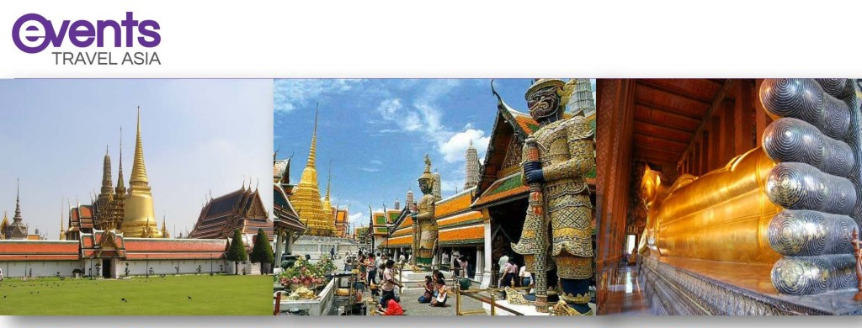
Daily Tours
- A list of private tours have been arranged for meeting attendees. Should you wish to book a tour or make an inquiry, please see a representative from the local touring company, Events Travel Asia, who will be at the registration desk.

Slide 16
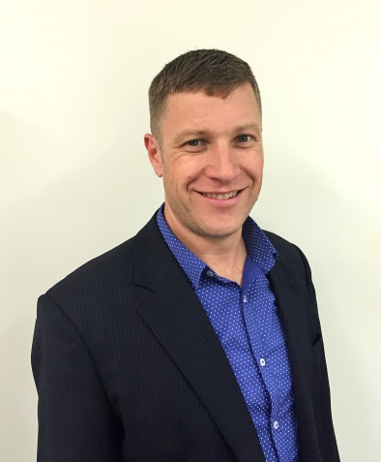
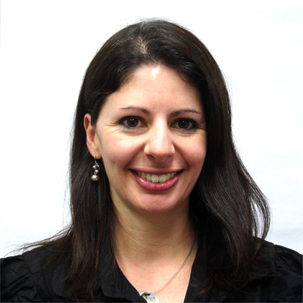
Any Questions
- Please see Daniel or Sara on the registration desk!

Slide 17
Wednesday –
802.11 Mid-Week Plenary
802.11 First Vice Chair Report

Slide 18
Friday –
802.11 Closing Plenary
802.11 First Vice Chair Report

Slide 19
802.11 Venue Strawpolls
Return to Bangkok?: Y: N:

Slide 20
Local Venue Information AdHoc
Next Plenary: Dallas, Texas – 8-13 Nov 2015
Please suggest Restaurants, methods of getting from Airport to Hotel, local attractions…
Send suggestions to Jon Rosdahl who will forward to the appropriate PCO.

