Slide 1
802.11 Working Group Opening Report
September 2015
Date: 2015-09-14
Authors:

Slide 2
Introduction
This presentation, together with the reports cited on the next slide, forms the opening report of the IEEE 802.11 Working Group for Sept 2015.
Subgroup status is reported in the “Snapshots” submission (see next slide for link). This is incorporated by reference into this opening report.
“Mx.y.z” terminology indicates that the item was on the tentative agenda for the Monday 802.11 plenary, and was agenda item x.y.z.

Slide 3
M2.3.1 Summary of new Liaisons
Liaison from ATIS on Emergency Location
  https://mentor.ieee.org/802.11/dcn/15/11-15-0992-00-0000-liaison-from-atis-on-emergency-location.pdf
  TGaz chair tasked with generating any necessary response
Incoming liaisons to 802 may generally be found at: http://www.ieee802.org/Communications.shtml
802.19 is responsible for responding to liaisons from 3GPP on LAA.

Slide 4
M2.3.1 Summary of ongoing Liaisons
NGMN Liaison and Whitepaper - Owned by REG SC
    The outgoing liaison approved in May invited NGMN to provide a speaker for the Tuesday panel session.
We have invited NGMN to send a participant on a panel discussion of 5G requirements for 802.11. We are hoping to have them present in Dallas (Nov), but have no commitment as yet.

Slide 5
M2.4 – Call for PUB SC chair
This is a final call for a volunteer to chair the publicity standing committee in its current scope (which includes generation of educational/tutorial material).
Failing any volunteer during this session, the SC will be disbanded.

Slide 6
M2.5 – Status of “802.11 as a component”
To the WG chair’s immense relief, two volunteers came forward to lead this effort in 802.11
Laurent Cariou (lead) and Joseph Levy
I will leave further initiatives on this topic in their capable hands

Slide 7
M2.6 – Notice of attendance recording
Attendance recording is apparently abused by ~10% of participants
  This is a guestimate based on occasional spot checks
We had a long debate on this topic a few sessions ago. When you record attendance you certify your actual presence in the meeting.
TG chairs will ensure that a count of people in the room is taken half way through each of their meeting slots.
If the physical counts differ significantly from the electronic counts, we might start randomly recording physical attendance in a future session.

Slide 8
M3.1 802.11 Working Group Session Documents
WG Session Reports
WG Agenda | https://mentor.ieee.org/802.11/dcn/11-15-0984
Opening report | https://mentor.ieee.org/802.11/dcn/11-15-0985
Snapshots | https://mentor.ieee.org/802.11/dcn/11-15-0975
Supplementary Material | https://mentor.ieee.org/802.11/dcn/11-15-0986
Motions | https://mentor.ieee.org/802.11/dcn/11-15-0977
Closing report | https://mentor.ieee.org/802.11/dcn/11-15-0978
1st vice chair | https://mentor.ieee.org/802.11/dcn/11-15-0994
Treasurer | https://mentor.ieee.org/802.11/dcn/11-15-0995
2nd vice chair | https://mentor.ieee.org/802.11/dcn/11-15-0976

Slide 9
M3.2 Joint meetings and Reciprocal Credit
Joint Meetings
  Thu am1: TGak, ARC
Reciprocal credit is provided to 802.11 voters for attendance at: 802.18, 802.19, 802.24, 802.1 and Privacy ECSG
  Reciprocal credit for 802.19 is for Coexistence in Unlicensed Bands Study Group
  Reciprocal credit for 802.1 is for 801.1Qbz, 802.1CF

Slide 10
M3.10 Topics for Wednesday plenary
Report on LTE-LAA coexistence activity – Myles
Review of Secretary’s Guidelines – Stanley
Still plenty of agenda time available

Slide 11
M3.11 802 EC and IEEE-SA Standards Board decisions
PARS
  P802.11az. PAR was approved in the July 802 EC closing plenary.
    PAR was approved in 2015-09-03 IEEE-SASB meeting.
  “Privacy ECSG” PAR was approved as project P802E, which will be run by 802.1.
Approval of draft standards
  None

Slide 12
M4.1.1 Type of Groups
Type of Group | Description
WG | Working Group
SC | Standing Committee
TG | Task Group
SG | Study Group

Slide 13
M4.1.1 Groups
Type | Group | Description
WG | WG11 | The IEEE 802.11 Working Group
SC | ARC | Architecture
SC | PAR | PAR review
SC | REG | Regulatory
SC | PUB | Publicity
SC | WNG | Wireless Next Generation
802 SC | JTC1 | ISO/IEC JTC1/SC6
TG | MC | Revision mc (REVmc)
TG | AH | Operation in 900 MHz bands (S1G)
TG | AI | Fast Initial Link Setup (FILS)
TG | AJ | China Milli-Meter Wave (CMMW)
TG | AQ | Pre-association Discovery (PAD)
TG | AK | General Link (GLK)
TG | AX | High Efficiency Wireless LAN (HEW)
TG | AY | Next Generation 60 GHz (NG60)
TG | AZ | Next Generation Positioning (NGP)

Slide 14
M4.1.2 PAR Expiration/Renewal Schedule
Project | PAR Expiration Date
AH | 31-DEC-2016
AI | 31-DEC-2016
MC | 31-DEC-2016
AJ | 31-DEC-2016
AK | 31-DEC-2016
AQ | 31-DEC-2016
AX | 31-DEC-2018
AY | 31-DEC-2019
AZ | 31-DEC-2019
http://www.ieee802.org/11/PARs/index.html

Slide 15
M4.1.3 802.11 WG Appointed positions
WG Secretary – Stephen McCann
Treasurer – Jon Rosdahl
Publicity – Open
  Call for publicity chair is currently open, based on the current SC scope, which includes the creation of education/tutorial material.
ANA Authority – Adrian Stephens
WG Technical Editors – Adrian Stephens, Peter Ecclesine

Slide 16
M4.1.3 Officers
Cat | Group | Chair | Vice Chair | Technical Editor | Secretary
WG |  | Adrian STEPHENS | Jon ROSDAHL Dorothy STANLEY | Adrian STEPHENS Peter ECCLESINE | Stephen MCCANN
SC | ARC | Mark HAMILTON | Joseph LEVY
SC | REG | Richard KENNEDY
SC | PAR | Jon ROSDAHL
SC | PUB | Open
SC | WNG | Jim LANSFORD | Open
TG | MC | Dorothy STANLEY | Mark HAMILTON Jon ROSDAHL | Adrian STEPHENS, Sub-editors Emily QI and Edward AU | Jon ROSDAHL
TG | AH | Yongho SEOK | Alfred ASTERJADHI Zander LEI | Yongho SEOK Alfred ASTERJADHI | Zander LEI
TG | AI | Hiroshi MANO | Marc EMMELMANN | Lee ARMSTRONG Ping FANG | Hitoshi MORIOKA
TG | AJ | Xiaoming PENG | Haiming WANG Jiamin CHEN | Jiamin CHEN | HAO Peng
TG | AK | Donald EASTLAKE | Mark HAMILTON | Donald EASTLAKE Norm FINN | Open
TG | AQ | Stephen MCCANN | Yunsong YANG | Open | Open
TG | AX | Osama ABOUL-MAGD | Simone MERLIN Ron PORAT | Robert STACEY | Yasuhiko INOUE
TG | AY | Edward AU | Open | Open | Open
TG | AZ | Jonathan SEGEV ** |  |  | Zhou Lan (TBC)
** = pro-tem

Slide 17
M4.1.3 Officers - present
Cat | Group | Chair | Vice Chair | Technical Editor | Secretary
WG |  | Adrian STEPHENS | Jon ROSDAHL Dorothy STANLEY | Adrian STEPHENS Peter ECCLESINE | Stephen MCCANN
SC | ARC | Mark HAMILTON | Joseph LEVY
SC | REG | Richard KENNEDY
SC | PAR | Jon ROSDAHL
SC | PUB | Open
SC | WNG | Jim LANSFORD | Open
TG | MC | Dorothy STANLEY | Mark HAMILTON Jon ROSDAHL | Adrian STEPHENS, Sub-editors Emily QI and Edward AU | Jon ROSDAHL
TG | AH | Yongho SEOK | Alfred ASTERJADHI Zander LEI | Yongho SEOK Alfred ASTERJADHI | Zander LEI
TG | AI | Hiroshi MANO | Marc EMMELMANN | Lee ARMSTRONG Ping FANG | Hitoshi MORIOKA
TG | AJ | Xiaoming PENG | Haiming WANG Jiamin CHEN | Jiamin CHEN | HAO Peng
TG | AK | Donald EASTLAKE | Mark HAMILTON | Donald EASTLAKE Norm FINN | Open
TG | AQ | Stephen MCCANN | Yunsong YANG | Open | Open
TG | AX | Osama ABOUL-MAGD | Simone MERLIN Ron PORAT | Robert STACEY | Yasuhiko INOUE
TG | AY | Edward AU | Open | Open | Open
TG | AZ | Jonathan SEGEV ** |  |  | Zhou Lan (TBC)
** = pro-tem

Slide 18
IEEE 802.11 Revisions
802.11
-2003
802.11
-2007
802.11
-2012
802.11
-2016 (TBC)
MAC
11k
RRM
11s
Mesh
11aa
Video Transport
11e
QoS
IEEE
Std
802.11
-1997
11h
DFS & TPC
11u
WIEN
11v
Network
Management
11ae
QoS Mgt Frames
11d
Intl roaming
11i
Security
11z
TDLS
11w
Management
Frame
Security
11f
Inter AP
11r
Fast Roam
11n
High
Throughput
(>100 Mbps)
11af
TV Whitespace
11a
54 Mbps
5GHz
11j
JP bands
11ac -VHT
>1 Gbps @ 5GHz
11b
11 Mbps
2.4GHz
11g
54 Mbps
2.4GHz
11p
WAVE
11y
Contention
Based
Protocol
11ad - VHT
>1 Gbps @ 60GHz
MAC
&
PHY
Notes:
doc.: IEEE 802.11-11/0483r0
May 2011
Bruce Kraemer (Marvell)
Page 18

Slide 19
IEEE 802.11 Standards Pipeline
MAC
802.11
-2016
802.11
-2012
802.11aq
PAD
802.11ak
GLK
802.11aa
Video Transport
802.11ae
QoS Mgt Frames
802.11ai
FILS
LRLP TIG
Long Range
Low Power
802.11az
NGP
WNG
802.11ax
HEW
802.11ah
< 1Ghz
802.11af
TVWS
802.11ac
VHT 5GHz
802.11ay
NG60
802.11ad
VHT 60 GHz
802.11aj
CMMW
MAC & PHY
Discussion Topics
TIG/Study
groups
TG without
Approved draft
WG
Letter Ballot
Sponsor
Ballot
Published
Amendment
Published
Standard
19
Notes:
doc.: IEEE 802.11-11/0483r0
May 2011
Bruce Kraemer (Marvell)
Page 19

Slide 20
M4.1.5 Summary of ballots and comment collections
Type | Label | Group | Opened (mm-dd) | Dur (d) | # Comments | Pool | Approve | Disapprove + invalid | Abstain | Return % | Approve % | Result
LB | 213 | TGai | 06-11 | 15 | 35 | 336 | 238 | 20+2 | 21 | 84 | 92 | P
CC | 22 | TGaj | 07-29 | 30 | 35

Slide 21
M4.1.6 Current Membership Status
Status | Number
Aspirant | 158
Potential Voter | 71
Voter | 347
Ex Officio Voter | 11
Definitions:
  Aspirant: a member who has attended 1 qualifying meeting
  Potential Voter: a member who has attended 2 qualifying meetings and will become a voter at the start of the next plenary they attend
  Ex Officio Voter: a voter who has voting rights by virtue of their membership of the 802 EC and has requested to be recorded as an ex officio voter in 802.11
Data as of 2015-05-10

Slide 22
M4.1.6 Recent voting member history

Slide 23
M4.1.7 ANA Status
The latest database is 11-11/0270r32 (Aug 2015)
Changes since last meeting:
  r32: TGmc
TGmc approved changes for CID 5959 that include the allocation of a (non-extended) Element ID. I believe that the resolution of this comment will be changed to not require a non-extended Element ID. Otherwise, a motion would need to be brought in the WG before a non-extended Element ID can be allocated.

Slide 24
background data

Slide 25
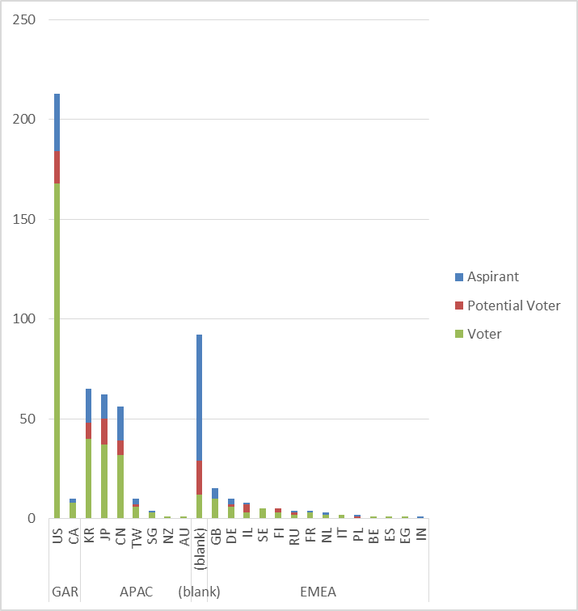
Membership by Country and Region

Slide 26
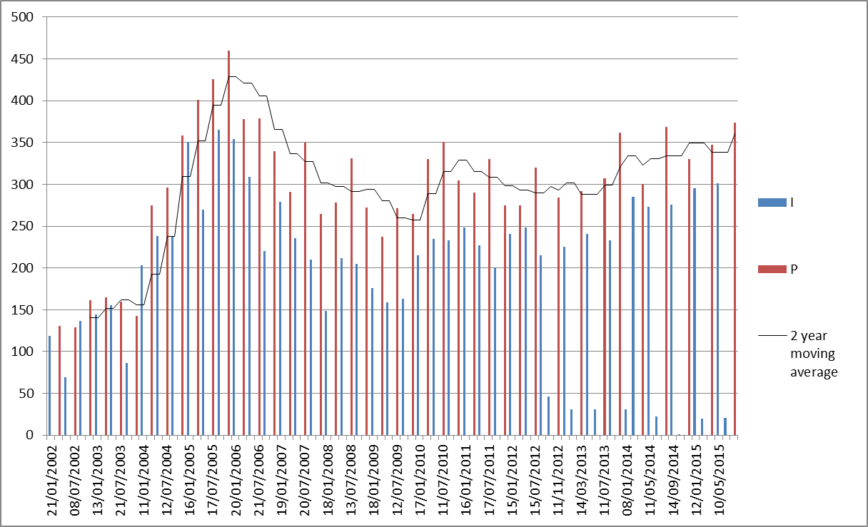
Meeting Attendance – Historic Data

Slide 27
Membership – Historic Data

