Slide 1
Enlarged minimal contention window size
Date: 2015-07-14
Authors:

Slide 2
Abstract
802.11 OFDM PHYs foresee a minimal Contention Window size of 15. With many stations contending for access to the wireless medium (WM), this initial Contention Window might be too small.
A simple approach is presented that increases the number of contention slots without impacting any performance relevant aspects.

Slide 3
Minimal Contention Window size, 2.4 GHz band
802.11-1997
DSSS & FHSS
CWmin = 31
802.11b-1999
HR/DSSS
CWmin = 31
802.11g-2003
Long slot time mode
CWmin = 31
Short slot time mode
CWmin = 15
802.11 DSSS set baseline in 2.4 GHz
Most 802.11g deployments in “compatibility” mode
Use of CWmin = 31 prevailing
802.11n-2009 uses CWmin = 15 in 2.4 GHz

Slide 4
Minimal Contention Window size, 5 GHz band
802.11a-1999
First use of OFDM
CWmin = 15
802.11n-2009
MIMO upgrade
CWmin = 15
802.11ac-2013
802.11n upgrade
CWmin = 15
All 802.11 standards for the 5 GHz band use CWmin = 15

Slide 5
802.11e – Quality of Service
802.11e introduces support for QoS
Distributed Coordination Function (DCF) replaced by Enhanced Distributed Channel Access (EDCA)
EDCA introduces four priorities
EDCA priorities use different minimal and maximal contention window sizes
Priorities adapt scaled CWmin value
All 802.11n & 802.11ac STAs implement EDCA
All priority values derived from CWmin
Apart from AIFSN

Slide 6
CWmin design
A small, initial Contention Window causes high collision probability
Airtime waste, growing contention windows, high jitter, retransmissions, …
Compromise: Single STA (peak) performance vs. optimal performance with many STAs
No One-fits-all value

Slide 7
Dense deployments
One BSS may serve many STAs
With EDCA, AP can enlarge CWmin per priority
Reduces peak performance
Reduces collision probability & may increase performance
Current default values target single BSS performance
EDCA parameter set adjustment seldom used
Some implementations do not adopt parameters signaled by AP
No influence on EDCA parameter set selection in neighboring BSSs

Slide 8
How to reduce collision probability?
Enlarge CWmin
Helps to reduce collision probability
How to select optimal value?
Dynamic, adaptive process needed
How to signal/agree needed CWmin between different BSSs?
Enlarging default CWmin with 802.11ax
Introduces coexistence problem
PHYs prior to 802.11ax use CWmin = 15
Would decrease 802.11ax access probability compared to prior PHYs

Slide 9
Enlarge CWmin AND reduce aSlotTime
Consider 5 GHz
aSlotTime = 9 µs
CWmin = 15
9 µs × 16/2 = 72 µs
Select 802.11ax aSlot & CWmin to achieve mean wait duration as previous PHYs
Const = aSlotTime × (CWmin + 1)/2
802.11ax default set
aSlotTime = 4.5 µs
CWmin = 31
Twice the number of contention slots compared to 802.11n & 802.11ac
Mean wait duration: 4.5 µs × 32/2 = 72 µs

Slide 10
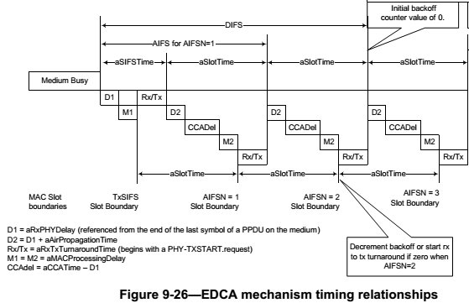
aSlotTime definition
aSlotTime = aRxTxTurnaroundTime + aMACProcessingDelay + aAirPropagationTime + aCCATime
Implementation dependent with 802.11ac
aCCATime
aMACProcessingDelay
aRxTxTurnaroundTime
Static (range dependent)
aAirPropagationTime

Slide 11
802.11ax aSlotTime = 4.5 µs
Assume 300 m range
aAirPropagationTime = 1 µs
Thus today, aCCATime + aMACProcessingDelay + aRxTxTurnaroundTime ≤ 8 µs
To meet aSlotTime goal reduce previous sum from 8 µs to 3.5 µs
Save 5 µs to sustain 300 m range assumption
aCCATime
< 4 µs with 802.11a-1999
aMACProcessingDelay
< 2 µs with 802.11a-1999
aRxTxTurnaroundTime
< 2 µs with 802.11a-1999
With 802.11-2012, all values are noted as implementation dependent
Only values for interoperability specified anymore

Slide 12
Feasibility study
aMACProcessingDelay
Max time for MAC to issue PHY-TXSTART.request
Today’s hardware is more powerful than 802.11a hardware in 1999
aRxTxTurnaroundTime
Max time to change from Rx to Tx
Hardware evolution provides for substantially faster turnaround than in 1999
aCCATime
Max time that CCA has available to detect start of a valid IEEE 802.11 transmission
Major part in aSlotTime
Today’s hardware needs less time than previous implementations
aSlotTime = 4.5 µs seems possible

Slide 13
Further changes, observations
AIFS = SIFS + n × aSlotTime
With 802.11ax double n to compensate for halved aSlotTime
Keep Duration (AIFS_{802.11ac}) = Duration (AIFS_{802.11ax})
With enlarged CWmin & reduced aSlotTime 802.11ax STAs achieve advantage over non-802.11ax STAs
802.11ax STAs may access earlier
Acceptable “penalty” on legacy STAs to be discussed

Slide 14
Conclusion
aSlotTime = 4.5 µs seems possible with 802.11ax
Increases Contention Window, reduces collision probability
Suitable with dense deployments = 802.11ax scope
Halved aSlotTime gives earlier access to 802.11ax STAs
Simulations to follow to show impact
Can be balanced with legacy devices
Simple and non-intrusive approach

