Slide 1
Effective Noise Figure in Hybrid BF system
Date: YYYY-MM-DD
Authors:

Slide 2
Abstract
This contribution presents the theoretical results of noise figure (NF) and gain in hybrid beamforming systems.

Slide 3
Motivation
In hybrid beamforming systems, the received signals from multiple antennas are phase corrected by phase shifter and then combined in RF combiner, usually before down-converting at RX.
The additional RF blocks (i.e., phase shifter and combiner) are added to RF chain, which increases noise figure.
Note that the RF combiner has multiple input signals and single output signals (multi-to-one RF path).
In this case, the NF should be appropriately considered for the calculation of carrier to noise ratio (CNR).

Slide 4
Block Diagram of Hybrid Beamforming
LNA
Phase
shifter
Down-converting
Low-pass filter
ADC
Baseband
Space-time
processing
LNA
Phase
shifter
Down-converting
Low-pass filter
ADC
The received signals from each antenna are phase-shifted by phase shifter and combined by combiner after LNA.
At baseband, the conventional MIMO space-time processing is performed for multiplexing gain or/and diversity gain.

Slide 5

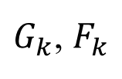
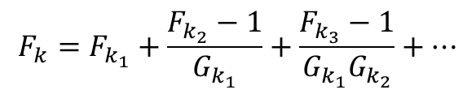




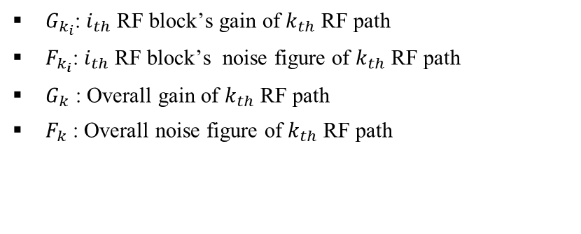
Noise Figure Calculation
Phase
shifter
LNA
$$G_{k_{1}},F_{k_{1}}$$
$$G_{k_{2}},F_{k_{2}}$$
$G_{k}$, $F_{k}$
$k_{th}$ RF chain
Equivalent $k_{th}$ RF chain
$G_{k_{i}}$: $i_{th}$ RF block’s gain of $k_{th}$ RF path
$F_{k_{i}}$: $i_{th}$ RF block’s noise figure of $k_{th}$ RF path
$G_{k}$ : Overall gain of $k_{th}$ RF path
$F_{k}$ : Overall noise figure of $k_{th}$ RF path
Overall Noise Figure
(Friis Equation)
Overall Gain
$$G_{k}=G_{k_{1}}G_{k_{2}}⋯G_{k_{N}}$$
$$F_{k}=F_{k_{1}}+\frac{F_{k_{2}}−1}{G_{k_{1}}}+\frac{F_{k_{3}}−1}{G_{k_{1}}G_{k_{2}}}+⋯$$

Slide 6


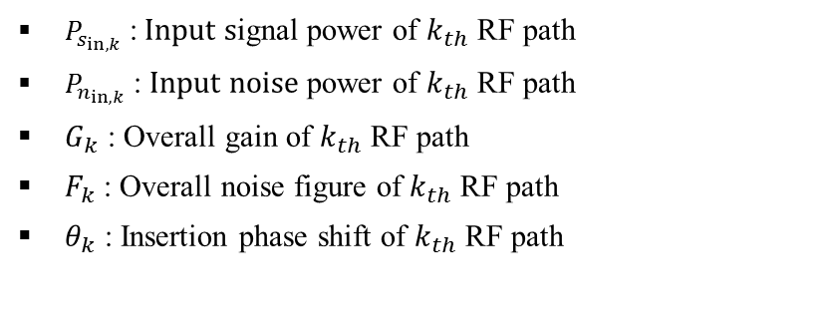

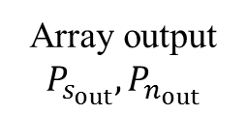



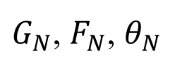


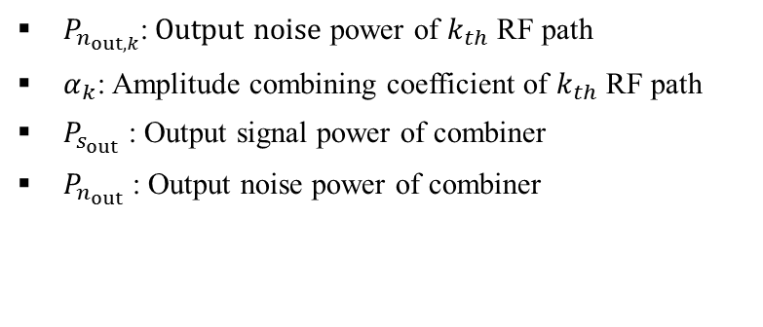



Multi-to-One Path system
Combiner
$$P_{s_{in,1}},P_{n_{in,1}}$$
$$P_{n_{out,1}}$$
$G_{1}$, $F_{1}$, $θ_{1}$
$$α_{1}$$
$$P_{s_{in,2}},P_{n_{in,2}}$$
$G_{2}$, $F_{2}$, $θ_{2}$
$$P_{n_{out,2}}$$
$$α_{2}$$
Array output
$$P_{s_{out}},P_{n_{out}}$$
$$α_{N}$$
$$P_{s_{in,N}},P_{n_{in,N}}$$
$G_{N}$, $F_{N}$, $θ_{N}$
$$P_{n_{out,N}}$$
$P_{s_{in,k}}$ : Input signal power of $k_{th}$ RF path
$P_{n_{in,k}}$ : Input noise power of $k_{th}$ RF path
$G_{k}$ : Overall gain of $k_{th}$ RF path
$F_{k}$ : Overall noise figure of $k_{th}$ RF path
$θ_{k}$ : Insertion phase shift of $k_{th}$ RF path
$P_{n_{out,k}}$: Output noise power of $k_{th}$ RF path
$α_{k}$: Amplitude combining coefficient of $k_{th}$ RF path
$P_{s_{out}}$ : Output signal power of combiner
$P_{n_{out}}$ : Output noise power of combiner

Slide 7





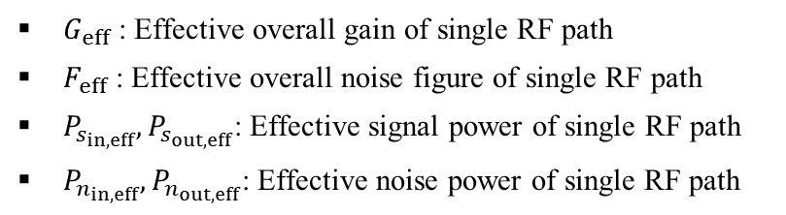








Equivalent Single-Path system
$$P_{s_{in,1}},P_{n_{in,1}}$$
$G_{1}$, $F_{1}$, $θ_{1}$
$$α_{1}$$
$$P_{s_{in,2}},P_{n_{in,2}}$$
$G_{2}$, $F_{2}$, $θ_{2}$
$$α_{2}$$
Array output
$$P_{s_{out}},P_{n_{out}}$$
$$P_{s_{in,eff}},P_{n_{in,eff}}$$
$G_{eff}$, $F_{eff}$
Array output
$$P_{s_{out,eff}},P_{n_{out,eff}}$$
$$P_{s_{in,N}},P_{n_{in,N}}$$
$$α_{N}$$
$G_{eff}$ : Effective overall gain of single RF path
$F_{eff}$ : Effective overall noise figure of single RF path
$P_{s_{in,eff}},P_{s_{out,eff}}$: Effective signal power of single RF path
$P_{n_{in,eff}},P_{n_{out,eff}}$: Effective noise power of single RF path
$G_{N}$, $F_{N}$, $θ_{N}$
  For an analysis purpose, a multi-to-one path system is converted into an equivalent single-path system.
  We assume that the total input, output power of multi-to-one-path system and equivalent single-path system are identical, such that the above two figures are equivalent.

Slide 8
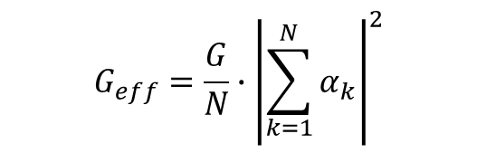

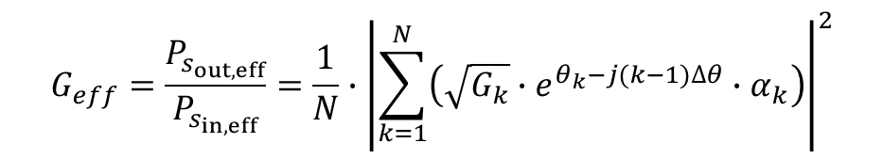

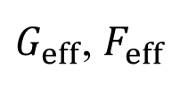


Effective Gain
$$P_{s_{in,eff}},P_{n_{in,eff}}$$
Array output
$$P_{s_{out,eff}},P_{n_{out,eff}}$$
$G_{eff}$, $F_{eff}$
The effective gain of the array system is given to be [1]
If all signal paths are identical ($G_{1}=G_{2}=⋯G_{N}=G$), we have
If all the $α_{k}$ are 1 ($α_{1}=α_{2}=⋯=α_{N}=1)$, we have
$$G_{eff}=\frac{P_{s_{out,eff}}}{P_{s_{in,eff}}}=\frac{1}{N}∙{\left|\sum_{k=1}^{N}{\left(\sqrt{G_{k}}∙e^{θ_{k}−j(k−1)∆θ}∙α_{k}\right)}\right|}^{2}$$
$$G_{eff}=\frac{G}{N}∙{\left|\sum_{k=1}^{N}{α_{k}}\right|}^{2}$$
$$G_{eff}=G$$

Slide 9
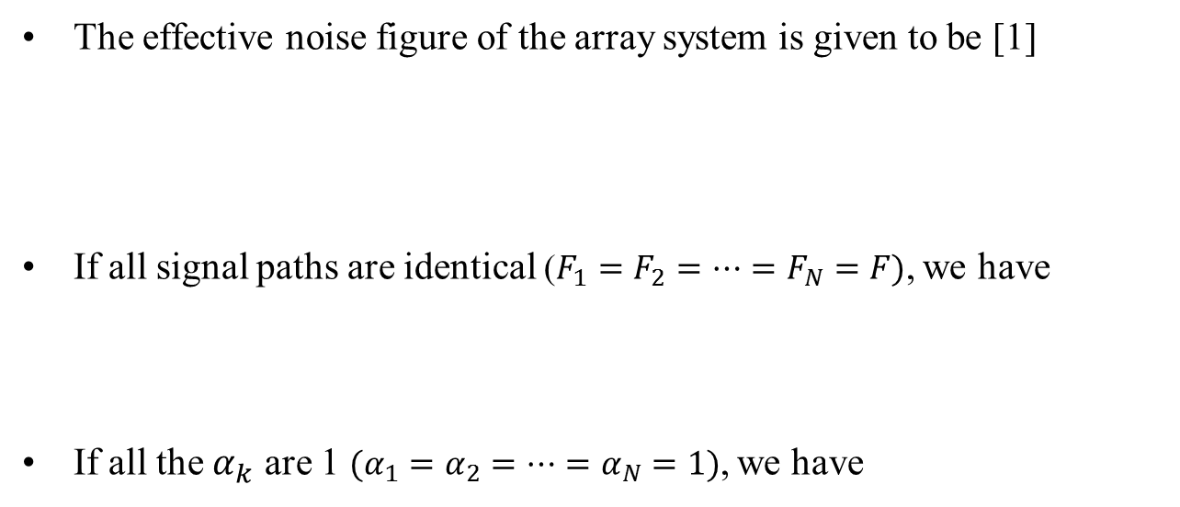

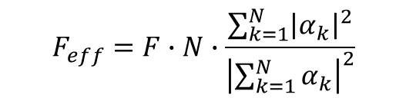
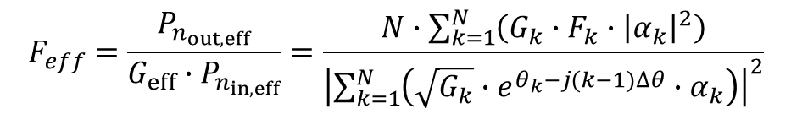
Effective Noise Figure
$$P_{s_{in,eff}},P_{n_{in,eff}}$$
Array output
$$P_{s_{out,eff}},P_{n_{out,eff}}$$
$G_{eff}$, $F_{eff}$
The effective noise figure of the array system is given to be [1]
If all signal paths are identical ($F_{1}=F_{2}=⋯=F_{N}=F)$, we have
If all the $α_{k}$ are 1 ($α_{1}=α_{2}=⋯=α_{N}=1)$, we have
$$F_{eff}=\frac{P_{n_{out,eff}}}{G_{eff}∙P_{n_{in,eff}}}=\frac{N∙\sum_{k=1}^{N}{\left(G_{k}∙F_{k}∙{\left|α_{k}\right|}^{2}\right)}}{{\left|\sum_{k=1}^{N}{\left(\sqrt{G_{k}}∙e^{θ_{k}−j(k−1)∆θ}∙α_{k}\right)}\right|}^{2}}$$
$$F_{eff}=F∙N∙\frac{\sum_{k=1}^{N}{{\left|α_{k}\right|}^{2}}}{{\left|\sum_{k=1}^{N}{α_{k}}\right|}^{2}}$$
$$F_{eff}=F$$

Slide 10
Conclusion
We contribute to calculating the noise figure and gain in hybrid beamforming system.

Slide 11
References
Junghyun Kim, Jinho Jeong, and Sanggeun Jeon, "Improvement of Noise Performance in Phased-Array Receivers", ETRI Journal, vol. 33, no.2, pp. 176-183, April (2011)

