Slide 1
Box 5 Calibration Result
Date: 2015-07-12
Authors:

Slide 2
Abstract
This presentation describes MediaTek’s Box 5 calibration results.
Applying 1 BSS UL test case.

Slide 3
Background
Performance differences are found and results are not aligned since members providing results from Sep. 2014.
Box 5 simulation members agreed to focus on aligning single BSS UL test case in the Mar. 2015 IEEE meeting.

Slide 4
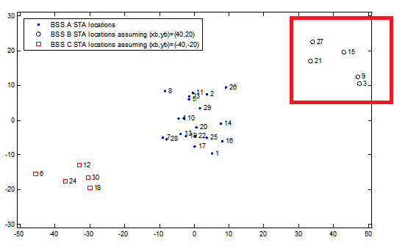
Single BSS Calibration Case
No Shadowing:
Fixed MCS 5:
To avoid path-loss dependent transmission failure due to using MCS 7.
5 Combinations:
All DL.
Single STA.
STA 3, STA9.
STA 3, STA15.
STA 3, STA 27.
STA 3, STA 9, STA 15.
STA 3, STA 9, STA 27.
BSS B, UL traffic.
AP B | (40,20)
STA3 | (7.5+xb, ‑9.5+yb)
STA9 | (7+xb, -7.5+yb)
STA15 | (3+xb, -0.5+yb)
STA21 | (-6.5+xb, -3+yb)
STA27 | (‑6+xb, 2.5+yb)

Slide 5
PHY Parameters
PHY parameters
BW | All BSSs at 5GHz [80 MHz, no dynamic bandwidth]
Channel model | TGac D NLOS per link
Shadow fading | iid log-normal shadowing (5 dB standard deviation) per link
Data Preamble Type | [5GHz, 11ac], always decoded correctly after successful reception, duration is considered.
STA TX Power | 15 dBm per antenna
AP TX Power | 20 dBm per antenna
AP number of TX/RX antennas | 1/1
STA number of TX /RX antennas | 1/1
AP antenna gain | 0 dBi
STA antenna gain | -2 dBi
Noise Figure | 7dB
CCA threshold | -56 dBm (measured across the entire bandwidth after large-scale fading)
Rx sensitivity | -76 dBm
Link Adaption | Fixed MCS =5 (234.0 Mbps)
Channel estimation | ideal
PHY abstraction | RBIR, BCC [1, 5]
Channel correlation | Independent or time-correlated channel per packet

Slide 6
MAC Parameters
MAC parameters
Access protocol | [EDCA, AC_BE with default parameters] [CWmin = 15, CWmax = 1023, AIFSn=3 ]
Queue length | A single queue for each traffic link is set inside AP/STA sized of 2000 packets
Traffic type | UDP CBR with rate 10^8bps (may not enough to model full buffer)
MPDU size | 1538 Bytes (1472 Data + 28 IP header + 8 bytes LLC + 30 MAC header)
Aggregation | [A-MPDU / max aggregation size / BA window size, No A-MSDU, with immediate BA], Max aggregation: 32 MPDUs with 4-byte MPDU delimiter
Max number of retries | 10
Beacon | Disabled
RTS/CTS | OFF
Traffic direction | UL Only

Slide 7
Simulation Results
Case | STA | Throughput (Mbps)
all DL | 3 | 40.542
 | 9 | 40.427
 | 15 | 40.056
 | 21 | 39.468
 | 27 | 38.914
 | sum | 199.407
UL 1 STA | 3 | 99.983
 | 9 | 99.923
 | 15 | 100.001
 | 21 | 99.972
 | 27 | 99.922
UL 3+9 | 3 | 99.815
 | 9 | 99.826
 | sum | 199.641
UL 3+15 | 3 | 99.906
 | 15 | 99.797
 | sum | 199.703
UL 3+27 | 3 | 99.841
 | 27 | 99.737
 | sum | 199.578
UL 3+9+15 | 3 | 70.928
 | 9 | 63.202
 | 15 | 59.371
 | sum | 193.501
Ul 3+9+27 | 3 | 63.196
 | 9 | 68.249
 | 27 | 62.656
 | sum | 194.101

Slide 8
Conclusions
Update MTK’s Box 5 calibration results on single BSS test case.

Slide 9
References
R. Porat et al, “Evaluation Methodology”, IEEE 11-14/571r9.
S. Merlin et al, “Simulation Scenarios”, IEEE 11-14/980r12.
P. Loc et al, “TGac Functional Requirements and Evaluation Methodology”, IEEE 11-09/0451r16.

