Slide 1
Efficiency enhancement for 802.11ax
Date: 2015-07-06
Authors:

Slide 2
Abstract
802.11ax will introduce major innovations to achieve a minimal performance increase of 4× as envisaged in the PAR
  These improvements do not necessarily resolve current issues
Although peak performance increase helps to improve efficiency, it does not tackle the goal of “improving metrics that reflect user experience.”
  Management overhead negatively impacts user experience
Introduce a set of mandatory, overhead reducing 802.11 features for HE (High Efficiency) STAs

Slide 3
Quality-of-service (QoS) management frame (QMF) support
QMF enables QoS support for management frames
Without QMF, all management frames are transmitted using the highest Access Category (Voice, AC VO)
  Not all management frames need high priority handling
  Previous studies revealed that management traffic is severe in dense deployments [6]
Therefore, HE STAs shall support QMF
  dot11QMFActivated is true in [8]

Slide 4
Proxy ARP support
ARP requests occur frequently
  Glue between IP and layer 2
Dense deployments can see a large number of ARP messages
  “Who is X.Y.Z.N?” requests
Proxy ARP mechanism prevents ARP messages from “hitting” the wireless medium
  STAs can stay longer in power-save mode
  Overall traffic traffic in WLAN
Therefore, HE APs shall act as ARP proxy
  See 10.24.14 in [8]

Slide 5
Intra-access category prioritization support
The current QoS capabilities are coarse
In dense deployments, several Video and/or Voice services may concurrently share the wireless medium
  E.g. Video conferencing and video streaming services
  Some services or stream elements have a higher drop tolerance than others
Therefore, HE STAs shall implement intra-access category prioritization
  dot11AlternateEDCAActivated is true in [8]

Slide 6
Follow 802.1Q mapping
Studies at different organizations revealed that VoIP traffic often (almost always) is not carried in 802.11’s Access Category (AC) Voice
  More and more voice conversations occur over 802.11
  The 802.11 standard is well prepared for VoIP, wrong mapping should not impact this market opportunity (e.g. “Wi-Fi calling”)
Vendors might implement their own (correct) mapping
  However, standards should enable cohesive behavior without too much vendor tweaking
  Strengthen 802.11 (as a brand) so that it meets customers’ expectations regarding VoIP regardless of vendor “tweaks”

Slide 7
QoS mapping
IPv4 example
  Deprecated “Precedence” [1] equals three Most Significant Bits (MSBs) of DSCP [2]
1:1 mapping
  Most implementations map DSCP’s three MSBs to 802.11 User Priorities (UPs)

Slide 8
Voice over IP
VoIP call consists of
  Audio
  Signaling
Audio is latency & loss sensitive
  Special marking of IP packets
DSCP setting for packets carrying audio [3]
  Expedited Forwarding (EF)
  DSCP(EF) = 101110₂
  101₂ = 5₁₀
  UP (5₁₀) = AC Video (!)
Mismatch between VoIP DSCP & 802.11 UP

Slide 9
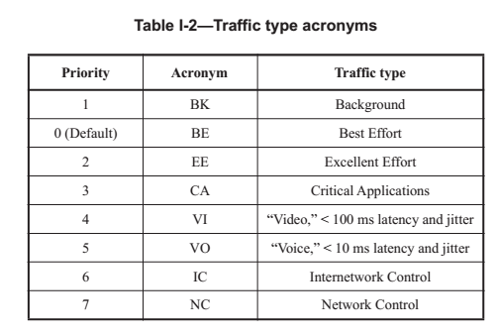
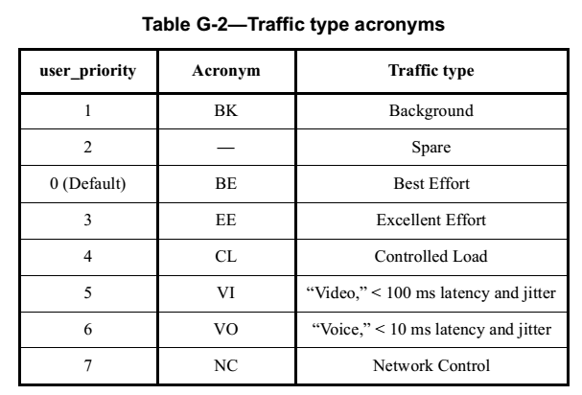
Expedited Forwarding (EF) & 802.11
802.1D-2004, “Media Access Control (MAC) Bridges” [10]
  Basis for 802.11
802.1Q-2014, “Bridges and Bridged Networks” [9]
  Basis for 802.11ax?

Slide 10
Why is 802.1Q-2014 different?
Already 802.1Q-2011 [11] introduces text in the right column
  IEEE 802 is fully aware of the interaction between DSCP and UP
Therefore, HE STAs shall comply with 802.1Q-2014 priority mapping
  See [9]
“This discussion of traffic types, and the suggested association of each with a priority value, differs from […] Annex G of IEEE Std 802.1D-2004 and prior revisions of that standard. […] this annex better aligns with current practice; in particular, Voice is associated with priority 5, matching the setting of the relevant bits for Expedited Forwarding (EF) in the DSCP […] for IP”
“Standards for DSCPs are believed to be the prime reference for use of priority by end stations […].”

Slide 11
BSS load element
802.11ax addresses dense deployments
  It is important to support STAs in selecting the best AP among many candidate APs
  Equally distributing traffic helps to develop bottlenecks
Among others, the BSS load element is an important hint for AP selection
  Therefore HE APs shall integrate the BSS load element in beacon frames
    See 8.4.2.27 in [8]

Slide 12
Channel Usage Information
802.11ax simulation scenario document [4] introduces Enterprise scenario with peer to peer (P2P) groups
  Wi-Fi Direct or similar technologies used in P2P BSS
  No AP control over P2P BSS
Dense (managed) deployments can severely suffer from uncoordinated P2P use
APs can guide P2P networks
  10.24.15 in [8] “The Channel Usage information provided by the AP to the non-AP STA is to advise the STA on how to co-exist with the infrastructure network.”
Therefore, HE STAs shall implement Channel Usage procedures

Slide 13
Multiple BSSID element
Virtual LANs (VLANs) are an essential part of “all current” Ethernet (802.3) deployments
  VLANs provide a logical L2 separation
  Infrastructure sharing
AP virtualization is tied to VLAN usage in wired infrastructure
  One SSID per VLAN served
n beacon frames for n VLANs in dense WLAN deployments causes huge airtime consumption
  SSID information can be collapsed in a single Beacon transmission
Therefore, HE STAs shall support the Multiple BSSID Set
  See 10.11.14 in [8]

Slide 14
Straw Polls

Slide 15
Straw Poll 1
Do you agree to add the following to the IEEE 802.11 TGax Specification Framework?
  Add to the end of Clause 6 (MAC): “The amendment shall define a HE STA to be a QMF STA.”

Slide 16
Straw Poll 2
Do you agree to add the following to the IEEE 802.11 TGax Specification Framework?
  Add to the end of Clause 6 (MAC): “The amendment shall define a HE AP to implement Proxy ARP capability.”

Slide 17
Straw Poll 3
Do you agree to add the following to the IEEE 802.11 TGax Specification Framework?
  Add to the end of Clause 6 (MAC): “The amendment shall define a HE STA to implement intra-access category prioritization.”

Slide 18
Straw Poll 4
Do you agree to add the following to the IEEE 802.11 TGax Specification Framework?
  Add to the end of Clause 6 (MAC): “The amendment shall define an 802.1Q-2014 compliant UP to AC mapping.”

Slide 19
Straw Poll 5
Do you agree to add the following to the IEEE 802.11 TGax Specification Framework?
  Add to the end of Clause 6 (MAC): “HE APs shall integrate the BSS load element in beacon frames.”

Slide 20
Straw Poll 6
Do you agree to add the following to the IEEE 802.11 TGax Specification Framework?
  Add to the end of Clause 6 (MAC): “HE STAs shall implement Channel Usage procedures.”

Slide 21
Straw Poll 7
Do you agree to add the following to the IEEE 802.11 TGax Specification Framework?
  Add to the end of Clause 6 (MAC): “HE STAs shall support the Multiple BSSID Set.”

Slide 22
Motions
Transform each successful straw poll into a motion

Slide 23
Motion 1
Moved to add to the end of Clause 6 (MAC) of the IEEE 802.11 TGax Specification Framework:
  “The amendment shall define a HE STA to be a QMF STA.”
  Moved by:
  Seconded:

Slide 24
Motion 2
Moved to add to the end of Clause 6 (MAC) of the IEEE 802.11 TGax Specification Framework:
  “The amendment shall define a HE AP to implement Proxy ARP capability.”
  Moved by:
  Seconded:

Slide 25
Motion 3
Moved to add to the end of Clause 6 (MAC) of the IEEE 802.11 TGax Specification Framework:
  “The amendment shall define a HE STA to implement intra-access category prioritization.”
  Moved by:
  Seconded:

Slide 26
Motion 4
Moved to add to the end of Clause 6 (MAC) of the IEEE 802.11 TGax Specification Framework:
  “The amendment shall define an 802.1Q-2014 compliant UP to AC mapping.”
  Moved by:
  Seconded:

Slide 27
Motion 5
Moved to add to the end of Clause 6 (MAC) of the IEEE 802.11 TGax Specification Framework:
  “HE APs shall integrate the BSS load element in beacon frames.”
  Moved by:
  Seconded:

Slide 28
Motion 6
Moved to add to the end of Clause 6 (MAC) of the IEEE 802.11 TGax Specification Framework:
  “HE STAs shall implement Channel Usage procedures.”
  Moved by:
  Seconded:

Slide 29
Motion 7
Moved to add to the end of Clause 6 (MAC) of the IEEE 802.11 TGax Specification Framework:
  “HE STAs shall support the Multiple BSSID Set.”
  Moved by:
  Seconded:

Slide 30
References
IETF, “Internet Protocol,” IETF RFC 791
K. Nichols et al., “Definition of the Differentiated Services Field (DS Field) in the IPv4 and IPv6 Headers,” IETF RFC 2474
J. Babiarz et al., “Configuration Guidelines for DiffServ Service Classes,” IETF RFC 4594
S. Merlin et al., “TGax Simulation Scenarios,” 11-14/980
B. Hart, “Renewing 2.4 GHz,” 11-13/1397
K. Yunoki et al., “Understanding Current Situation of Public Wi-Fi Usage - Possible Requirements for HEW,” 11-13/523
V.-P. Ketonen, “WLAN QoE, End User Perspective Opportunities to Improve,” 11-13/545
IEEE 802.11, “IEEE P802.11-REVmc/D4.0”
IEEE, “IEEE Standard for Local and metropolitan area networks—Bridges and Bridged Networks,” IEEE 802.1Q-2014
IEEE, “IEEE Standard for Local and metropolitan area networks—Media Access Control (MAC) Bridges,” IEEE 802.1D-2004
IEEE, “IEEE Standard for Local and metropolitan area networks—Media Access Control (MAC) Bridges and Virtual Bridged Local Area Networks ,” IEEE 802.1Q-2011

