Slide 1
OFDMA and VoIP Capacity
Date: 2015-07-03
Authors:

Slide 2
Abstract
The capacity of VoIP by introducing OFDMA for 802.11ax has been investigated. The delay and packet loss for each user is the metrics evaluated.
It is shown that the delay and loss are significantly reduced using OFDMA. At around 60 VoIP users/AP, the delay is reduced such that the desired value of maximum of 50 ms of delay is achieved.
Using OFDMA yields less channel utilisation (30%) increasing the possibility for other uses of the channel.

Slide 3
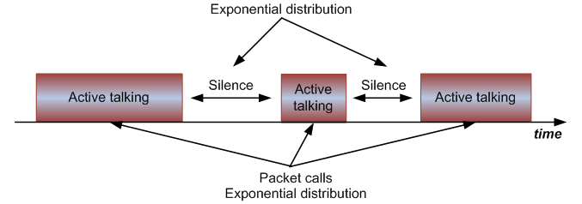
Background
For small packets, OFDMA has shown great potential w.r.t user throughput, [1].
Since VoIP contains small packets, OFDMA may improve VoIP capacity.
VoIP traffic model consists of periods of active talking (33 Bytes) with a period of 20ms and silence (7 Bytes) with a period of 160ms, [2].

Slide 4
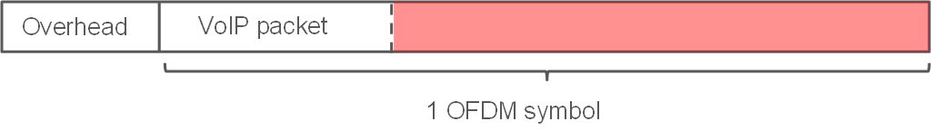
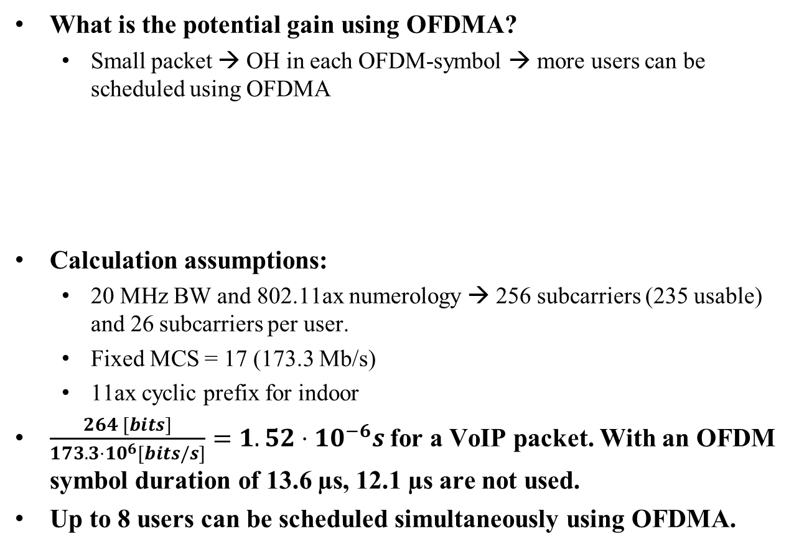
Background (cont.)
What is the potential gain using OFDMA?
  Small packet → OH in each OFDM-symbol → more users can be scheduled using OFDMA
Calculation assumptions:
  20 MHz BW and 802.11ax numerology → 256 subcarriers (235 usable) and 26 subcarriers per user.
  Fixed MCS = 17 (173.3 Mb/s)
  11ax cyclic prefix for indoor
$\frac{264 [bits]}{173.3⋅{10}^{6}[bits/s]}=1.52⋅{10}^{−6}s$for a VoIP packet. With an OFDM symbol duration of 13.6 µs, 12.1 µs are not used.
Up to 8 users can be scheduled simultaneously using OFDMA.

Slide 5
Performance Metrics
User satisfaction is measured in terms of delay and packet loss.
  According to ITU, see [3], the delay (excluding decoding and encoding delay) should be below 50ms for satisfactory results.
  Packet loss could occur either due to collision, low channel quality or packets arriving later than 50ms.
  A user is being in outage if more than 2% of the packets are loss resulting in dissatisfied users.

Slide 6
Simulations
The simulations consist of:
  1 AP and fixed no of VoIP users
  Each call lasts for 20 s.
The following assumptions were used for all simulations:
  20 MHz BW with ax-numerology → 256 subcarriers (235 usable) and 26 subcarriers per OFDMA user, and indoor cyclic prefix
  Both UL and DL (OFDMA in DL)
  Adaptive auto-rate fallback link adaptation algorithm
Analysis are performed for each user in the BSS where the mean delay and packet loss for each user is used for evaluation.

Slide 7
Results – Packet Delay
The delay is reduced using OFDMA. For values below 60 users the delay is not dissatisfactory but for values up to 80, the mean delay is reduced to desirable values
The 98th percentile of packet delay is reduced to ~70 users

Slide 8
Result – Packet loss
No packet loss below 60 users
The mean and 98th percentile of lost packets is significantly reduced using OFDMA

Slide 9
Results – Utilisation
No OFDMA: congestion at around 60 to 70 VoIP users
OFDMA occupies less, at 60 users ~30% less is used and can be used by other media such as file download, video streaming etc.

Slide 10
Conclusion
The impact of OFDMA on VoIP calls has been evaluated
The results show that the packet delay and packet loss are decreased using OFDMA for high number of users
The channel usage is decreased using OFDMA freeing up the channel for other users or APs to be used for e.g. file download and video streaming

Slide 11
References
[1] 11-15/0383r3, “Impact of number of sub-channels in OFDMA”.
[2] 11-14/0875r0, “VoIP Traffic Model Content for 11ax TG Simulation Scenarios and Evaluation Methodology”
[3] Report ITU-R M.2135-1, “Guidelines for evaluation of radio interface technologies for IMT-Advanced”.

