Slide 1
Impact of Frequency Selective Scheduling Feedback for OFDMA
Date: 2015-07-03
Authors:

Slide 2
Abstract
In this contribution, the impact of choice of feedback for frequency selective scheduling (FSS) has been evaluated.
Three feedback options were used for evaluation purpose by simulations and compared to a baseline of no FSS used.
The results show that UL-OFDMA is needed to obtain FSS gain.

Slide 3
Introduction
Frequency selective scheduling (FSS) allows for OFDMA scheduling to multiple users based on different optimisation criteria
Channel quality feedback is required to enable FSS
FSS is expected to give user throughput gains
Three feedback options have been evaluated by simulation, with the focus on the impact of
  Feedback overhead
  Channel time variation within feedback delay

Slide 4
Objectives
Evaluate different feedback options for FSS in OFDMA
3 different feedback options are evaluated:
  FB-AC: based on 802.11ac beamformee feedback for Null Data Packet (NDP) based sounding
  FB-AX: UL OFDMA feedback
  PIG: Based on 802.11n beamformee feedback for non-NDP sounding
The feedback methods are then compared with the following scenarios:
  IDEAL: assuming full channel knowledge with no feedback overhead, leading to optimal Resource Units (RU) allocation
  NO-FSS: assuming no channel knowledge and users randomly allocated to RUs

Slide 5
Feedback Method – FB-AC
11ac Beamforming Feedback
AP
STA1
STA2
STA3
ACK
Data
Null data packet (NDP)
NDP announcement
Action-FB
Poll

Slide 6
Feedback method – FB-AX
UL-OFMDA Feedback
AP
AP
2500
STA1
54
STA1
STA2
STA2
STA3
STA3
ACK
Data
Null data packet (NDP)
NDP announcement
Action-FB
Poll

Slide 7
Feedback method – PIG
Piggyback Feedback
AP
STA1
STA2
STA3
ACK
Data
Null data packet (NDP)
NDP announcement
Action-FB
Poll

Slide 8
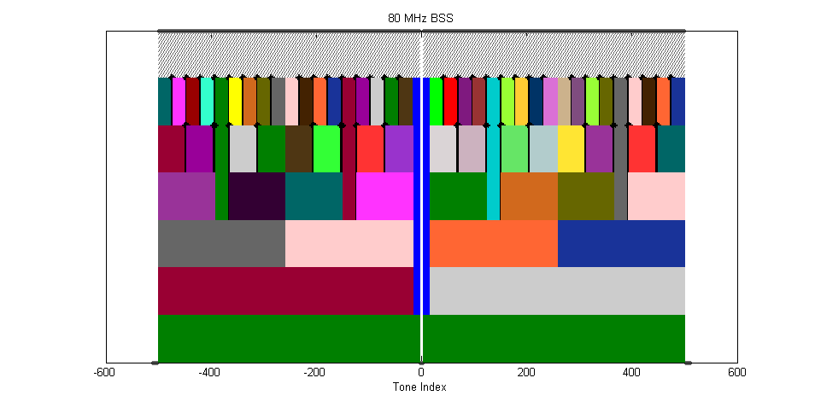
System Assumptions
Feedback format and accuracy
  One Channel Quality Index (CQI) per RU
  CQI: SINR
  Size: 1 OFDM symbol assumed
Other system assumptions and configurations
  Contiguous resource allocation
  Equal share of RUs
  Maximum rate scheduling
  ‘Ideal’ link adaptation:
  perfect channel knowledge
  right before transmission

Slide 9
Simulation Scenario
Deployment, 2 scenarios
  1 AP, 2 to 9 stationary STAs
    All STAs have the same average SNR of 12 dB
  3 AP, 6 to 27 stationary STAs
    Uniformly distributed
System configuration
  BW: 80 MHz → 36 RUs
  PHY preamble and header: 45.6 µs as current 11ax assumption
  2x2 MIMO
Traffic modelling
  Full buffer UDP file downloading
Multipath channel model
  IEEE TGn-D
  Multipath speed: 3 km/h

Slide 10
Mean User Throughput Gain – FB-AC
FB-AC does not provide gains due to high overhead
NO-FSS: 2 STAs
NO-FSS: 4 STAs
NO-FSS: 9 STAs
IDEAL: 2 STAs
IDEAL: 4 STAs
IDEAL: 9 STAs
FB-AC: 2 STAs
FB-AC: 4 STAs
FB-AC: 9 STAs
1
60
0.8
50
0.6
40
0.4
User throughput [Mbps]
User throughput gain
30
0.2
20
0
10
-0.2
-0.4
0
0.5
1
2
5
Data frame duration [ms]
0.5
1
2
5
Data frame duration [ms]

Slide 11
Mean user Throughput Gain – 2 STAs
No feedback option provides gains with 2 STAs
Less FSS options
1
60
0.8
50
0.6
40
0.4
User throughput [Mbps]
NO-FSS: 2 STAs
30
User throughput gain
IDEAL: 2 STAs
0.2
FB-AX: 2 STAs
20
PIG: 2 STAs
0
FB-AC: 2 STAs
10
-0.2
-0.4
0
0.5
1
2
5
Data frame duration [ms]
0.5
1
2
5
Data frame duration [ms]

Slide 12
Mean user Throughput Gain – 4 and 9 STAs
FB-AX: overall the best, but overhead is still high with short frame duration (0.5ms: 20%)
Piggyback: the least overhead; poor with long frame durations due to large feedback delay
1
60
NO-FSS: 4 STAs
NO-FSS: 9 STAs
IDEAL: 4 STAs
IDEAL: 9 STAs
0.8
50
FB-AX: 4 STAs
FB-AX: 9 STAs
PIG: 4 STAs
PIG: 9 STAs
0.6
40
0.4
User throughput [Mbps]
User throughput gain
30
0.2
20
0
10
-0.2
-0.4
0
0.5
1
2
5
0.5
1
2
5
Data frame duration [ms]
Data frame duration [ms]

Slide 13
Impact of channel time variation
Data frame duration: 1 ms
The piggyback feedback is quite sensitive to channel time variation
Feedback delay (from the channel is measured to the start of transmission) :
  FB-AX: around 0.1 ms
  Piggyback: 1 ms (data frame) + around 0.2 ms (ACK+IFS)
1.6
1.4
1.2
1
NO-FSS: 4 STAs
NO-FSS: 9 STAs
0.8
User throughput gain
IDEAL: 4 STAs
IDEAL: 9 STAs
0.6
FB-AX: 4 STAs
FB-AX: 9 STAs
0.4
PIG: 4 STAs
PIG: 9 STAs
0.2
0
-0.2
-0.4
0
0.5
1
3
Multipath speed [m/s]

Slide 14
Multi-BSS scenarios
3 AP, 6, 12 and 27 stationary STAs
Users are distributed uniformly
No gain with 6 STAs in any feedback option (curves not shown)
No gains with Piggyback due to long feedback delay (curves not shown)

Slide 15
Conclusions
Three feedback options have been evaluated using simulations with the focus of studying the impact of feedback overhead and delay
Main conclusions
  FB-AC does not provide gains due to high overhead
  Feedback options provides no gain with 2 STAs (single BSS) and 6 STAs in the multi-BSS scenario
  FSS with piggyback feedback provides gain for small packets but is quite sensitive to channel time variation, especially for long packets
  No gains with Piggyback due to long feedback delay in the multi-BSS scenario
  → UL-OFDMA is therefore needed to obtain FSS gain
  → FB-AX is overall the best, but overhead is still considerable with short frame durations

