Slide 1
Discussion of ACI performance and ACI requirements for IEEE 802.11ax
Date: 2015-07-13
Authors:

Slide 2
Abstract
Adjacent Channel Interference (ACI) performance is essentially determined by the Adjacent Channel Leakage Ratio (ACLR) and Adajcent Channel Selection (ACS)
The impact of ACLR was discussed in [2] using the TX spectrum mask for a fixed MCS and in [3] using MCS dependent ACLR. In this contribution we discuss the need for also including ACS and a possible way to do so
ACI performance is also of vital importance for inter-standard coexistence. In this contribution we compare with LTE and discuss the feasibility to improve 802.11ax in this respect

Slide 3
Outline
Methodology for evaluation
ACI performance – required and simulated
A rough comparison with LTE
Possible improvements?
Conclusions

Slide 4
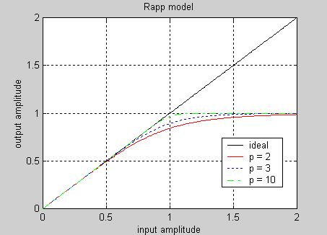
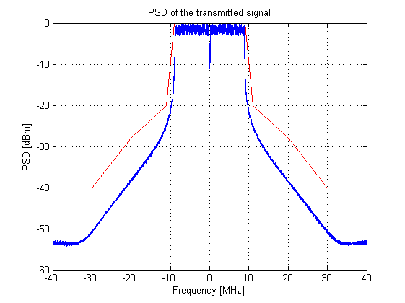
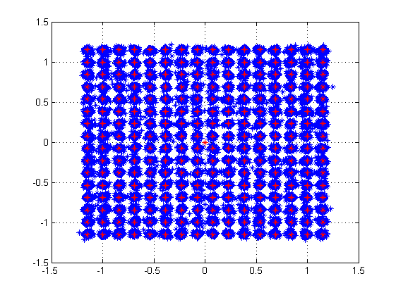


Methodology for evaluation
Spectrum analyzer
OFDM
Shaping
PA
+
+
CSF
OFDM
SINR
OFDM
Shaping
PA
X
WGN
$$e^{i2πft}$$
$$e^{i2πft}$$
The evaluation is done in a simplified test bench, where the metrics are based on the estimated SINR (-EVM) in the IQ-diagram
The simulations are only done for the 20 MHz channel
The PA non-linearity is modelled using Rapp’s model with p = 3 and different values of OBO

Slide 5
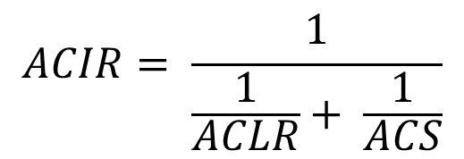
ACI Performance - Terminology
$$ACIR= \frac{1}{\frac{1}{ACLR}+ \frac{1}{ACS}}$$
ACIR = Adjacent Channel Interference Ratio
ACLR = Adjacent Channel Leakage Ratio
ACS = Adjacent Channel Selectivity
In related contributions, ACLR (conservatively) considered but ACS neglected
Here ACIR is instead found directly from specification and by simulations

Slide 6
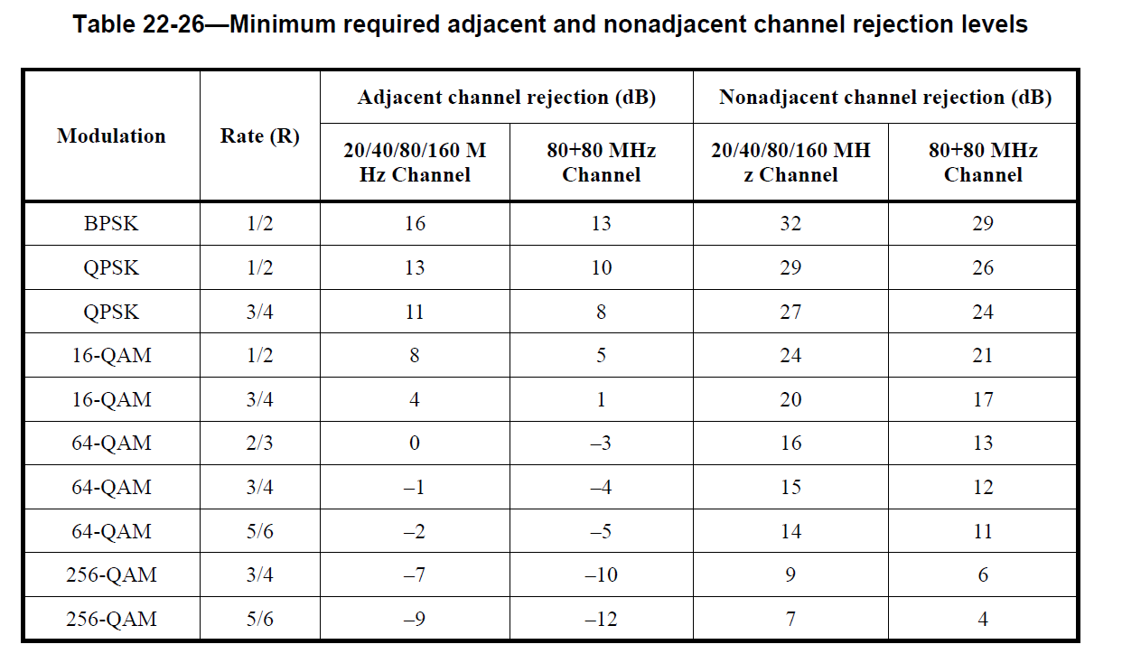
ACI Performance
MCS | Required effective SNR [dB]
MCS = 0 | 1
MCS = 1 | 4
MCS = 2 | 7
MCS = 3 | 10
MCS = 4 | 13
MCS = 5 | 17
MCS = 6 | 19
MCS = 7 | 20
MCS = 8 | 24
MCS = 9 | 26
The required C/I is obtained from Table 22-26
The effective SNR requirement for the corresponding MCS is taken from the EMD. The used values for BCC are to the right. LDPC 2 dB better (simpler)
The effective SNR (-EVM) is estimated in the IQ-diagram
The effective SNR – C/I (in dB) is the estimated ACIR
SNR is set to 35 dB

Slide 7
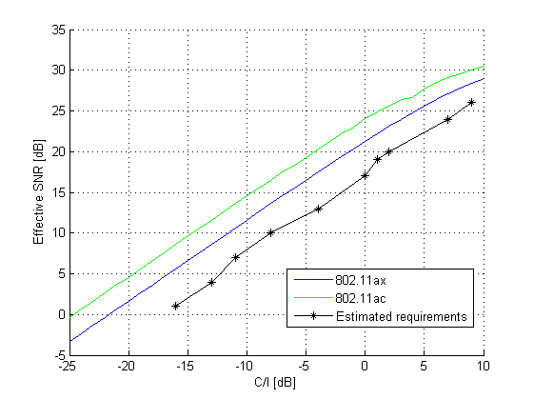
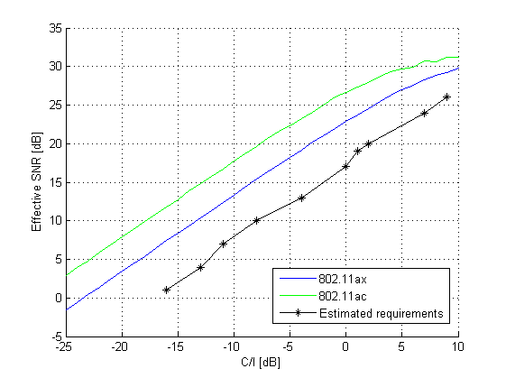
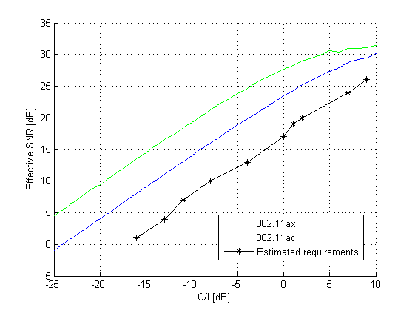
ACI Performance - Simulated
OBO = 5dB
OBO = 7dB
OBO = 9dB
The BW of the channel selective filter (CSF) is 9 MHz and 9.6 MHz for 802.11ac and 802.11ax, respectively. In all cases a 6th order Chebychev filter
The OBO for the desired signal is 9 dB in all cases, the impact of OBO of the interfering signal is shown above. Small impact for 802.11ax => ACS is limiting.
Note that the ”ideal” gain by using a larger FFT in 802.11ax compared to 802.11ac is not really seen

Slide 8
Including ACI Performance in System Simulations
In [2] it was shown that ACI had an impact, although only ACLR was considered
If ACI is to be included, also ACS needs to be modelled
Using the ACIR performance estimated from specification a singel number can be used
However, if the margin for real implementations is as huge as for sensitivity it would give too pessimistic results

Slide 9
ACI and Inter-standard Coexistence
There is currently discussion about coexistence between LAA and Wi-Fi
Initially it was mainly about sharing the same channel in a fair way, but lately also impact of ACI has been considered e.g. [4]
LTE has an advantange compared to 802.11ax due to
  2k FFT instead of 256 point, allowing better ACLR
  1 MHz guardband instead of about 400 kHz, allowing better ACS
In addition, LTE has fundamentally different requirements for the eNB and the UE

Slide 10
ACI and Inter-standard Coexistence
The ACIR requirements for 802.11ac is about 18 dB (based on C/I performance and SNReff requirements)
For LTE eNB, ACLR = 45 dB and ACS = 45 dB
For LTE UE, ACLR = 30 dB and ACS = 27 dB
  =>ACIR eNB = 30 dB
  =>ACIR UE = 27 dB
In operator deployed scenarios where the AP may have considerably higher TX power, allowing very relaxed ACLR and ACS may
  Degrade system performance
  Make 802.11 look bad compared to competing standards

Slide 11
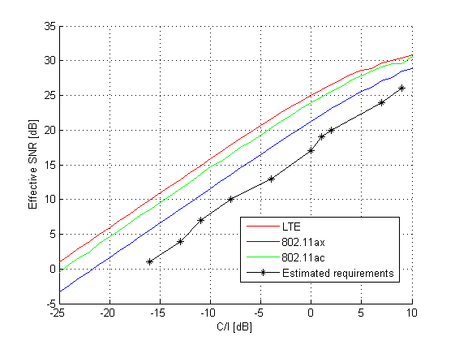
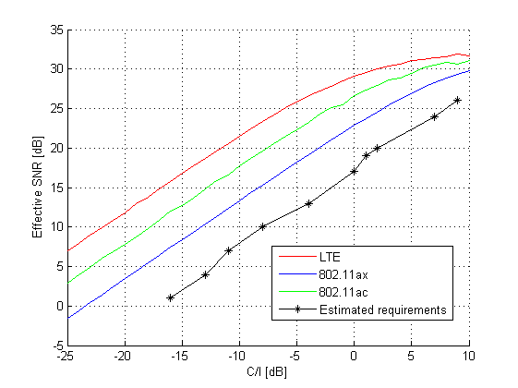
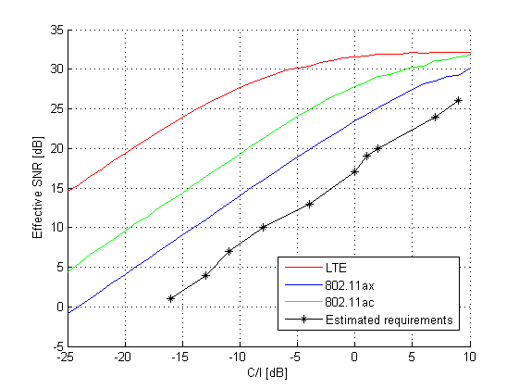
ACI and Inter-standard Coexistence
OBO = 5dB
OBO = 7dB
OBO = 9dB
For 802.11ax, the ACIR only depends slightly on OBO, as it is largely determined by the ACS
Although ACS is very implementation dependent and can be enhanced, with a too relaxed specification it seems there is a risk 802.11ax may have a significant disadvantage in comparison with e.g. LTE
Based on preliminary evaluations, there seems to be about 10 dB difference

Slide 12
Possible Improvements?
In cellular systems like LTE, the radio requirements are typically very different for the eNB and the UE, e.g. concerning ACLR and ACS
With 802.11ax targeting similar use cases, it seems reasonable to consider a similar approach where APs, especially in case of high TX power, have more strict requirements

Slide 13
Conclusions
ACI performance for 802.11ax is expected to be limited by ACS rather than ACLR for most cases
  => ACI performance can’t be studied just looking at ACLR
Competing technologies are considerably better. It is possible to decrease this gap e.g. by having more stringent radio requirements for APs with high TX power

Slide 14
Straw Poll
Should ACI performance be included in Evaluation Methodology Document?
Y/N/A:

Slide 15
Straw Poll
Would it be desirable to have different radio requriements (ACLR and ACS) for high TX power APs and non-AP STAs if this results in better performance?
Y/N/A:

Slide 16
References
11-15/0330r1, “OFDMA Numerology and Structure”
11-15/0564,“802.11ax Calibration and Modeling Adjacent Channel Interference”
11-14/00865r1, “ACI and AACI for 802.11ax System Simulations”
R4-153538, “Adjacent channel coexistence evaluations for LAA-LAA deployment scenario”

Slide 17
Methodology for evaluation, cont’d
Channel estimation is done on one noise and interference free symbol (only impacted by PA and CSF), as assuming a too simplistic channel estimation algorithm under realistic conditions will give too poor results
The IFFT is run at 80 MHz
A simple 1 sample window is used to meet the TX spectrum far out. No additional shaping
One concern by widening the TX spectrum mask is that the ACI performance may degrade. The ACI performance is compared to 802.11ac and evaluated against the 802.11ac requirements
A 6th order (analog) Chebychev filter is assumed, before down-sampling to Nyquist. 3dB BW equal to passband of desired signal. No additional filtering is used.

Slide 18
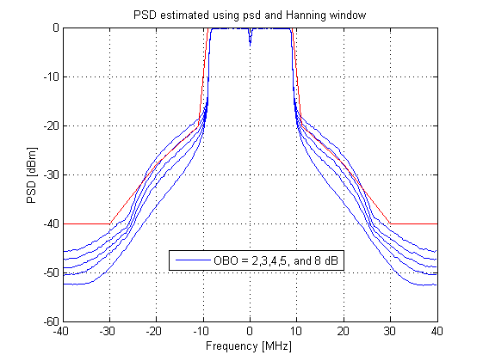
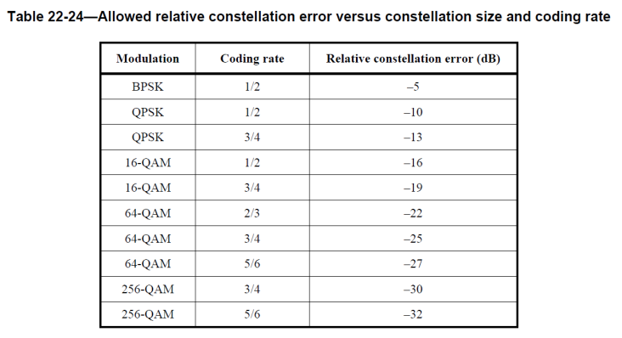
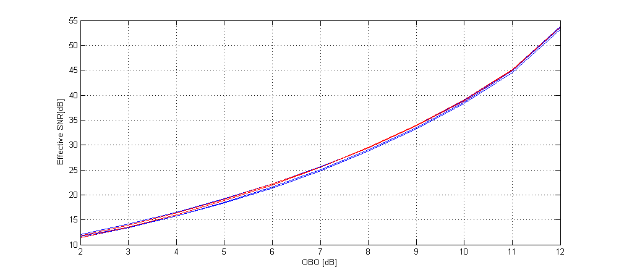
Impact of OBO
EVM requirement very dependent on MCS. Corresponding OBO requirement:
  QPSK ~ 3dB, 16QAM ~ 5dB, 64QAM ~ 8dB, and 256QAM ~ 9dB
=>Using spectrum mask to determine ACLR for high MCS is very pessimistic

Slide 19
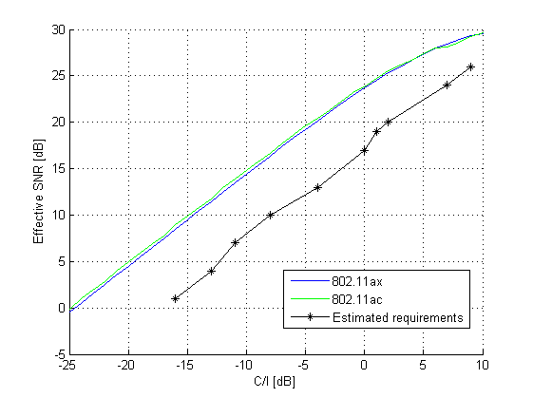
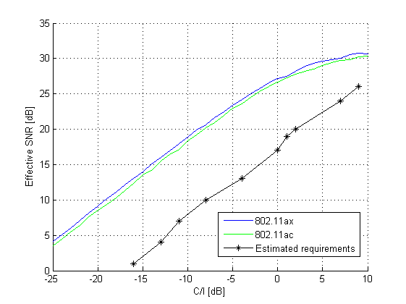
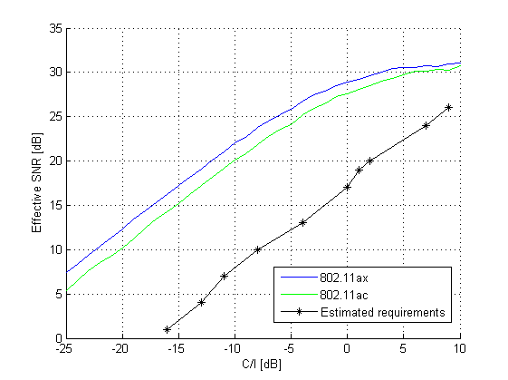
ACI Performance - Simulated
OBO = 5dB
OBO = 7dB
OBO = 9dB
The same simulations as on the previous page, but now with a 10th order filter in order to obtain very high ACS and study ACLR.
ACLR may be better for 802.11ax, but this seems to be true only for large OBO

