Slide 1
11ay Functional Requirements for Channel Bonding
Date: 2015-07-13
Authors:

Slide 2
Purpose
Channel bonding is a key technology to meet the data rates required for 11ay usage models.
We propose that 11ay allow to bond two or more contiguous channels and that 11ay functional requirement specify it.

Slide 3
Channel bonding from data rate perspective
Most 11ay usage models require at least 20 Gbps at MAC SAP.
Roughly at least 30Gbps peak rate, considering 70% MAC efficiency
The following table shows potential 11ay peak rate considering Channel Bonding and MIMO.
→Necessary to support channel bonding of at least three CHs to support 11ay usage models even with 2 stream MIMO
: 30 Gbps feasible
 |  | Channel Bonding
 |  | 1 CH | 2CH | 3CH | 4CH
MIMO | 1 stream | 6.7 (1X) | 13.4 (2X) | 20.1 (3X) | 26.8 (4X)
 | 2 stream | 13.4 (2X) | 26.8 (4X) | 40.2 (6X) | 53.6 (8X)
 | 3 stream | 20.1 (3X) | 40.2 (6X) | 60.3 (9X) | 80.4 (12X)
 | 4 stream | 26.8 (4X) | 53.6 (8X) | 80.4 (12X) | 107.2 (16X)

Slide 4
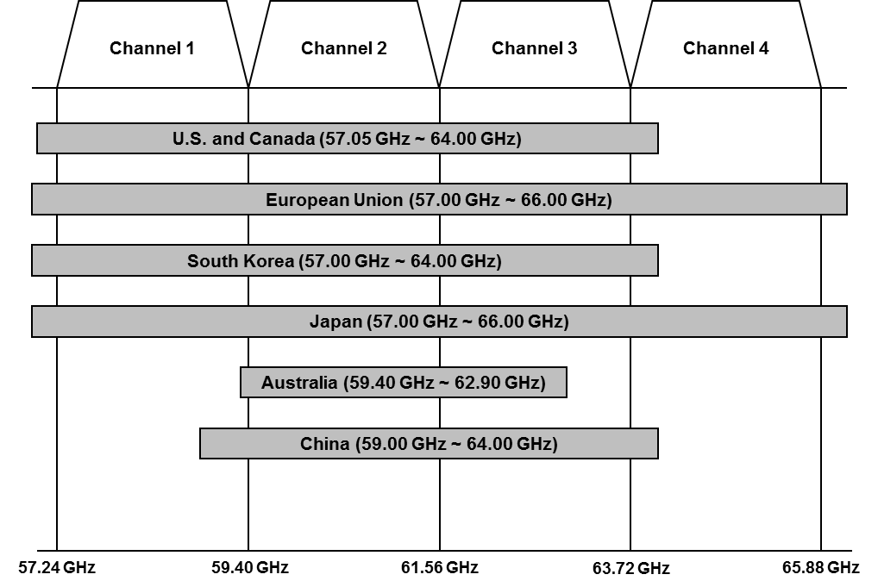
Channel bonding from regulation perspective
11ay channel bonding can be used in most territories
Most countries allow at least two 60GHz channels.
Many countries have equal to or more than three channels
→ It would be good to support contiguous channel bonding of three or four channels to increase maximum data rate under regulation circumstances (important from the marketing perspective)

Slide 5
Proposed text on 11ay functional requirement for channel bonding
Channel bonding
11ay system supports the operation of contiguous channel bonding of two or more channels.

Slide 6
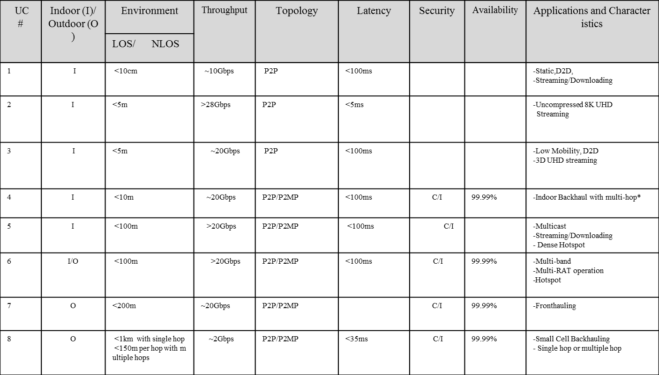
Back up
Reference of usage models from “IEEE 802.11-2015/0625r2 IEEE 802.11 TGay Usage Scenarios”

