Slide 1
Simulation Results for Box5 Calibration
Date: 2015-07-12
Authors:

Slide 2
Abstract
During IEEE 802.11 May meeting, the agreement on Box5 detail simulation parameters was presented in [1].
Based on the agreed simulation conditions, we provide two sets of test results from the Box5 test cases:
Results of max 64 MPDU per A-MPDU to be presented in the contribution;
Results of max 32 MPDU per A-MPDU was combined into the joint-contribution 11-15/0802
Comparison of results with those of partners [2] shows good alignment

Slide 3
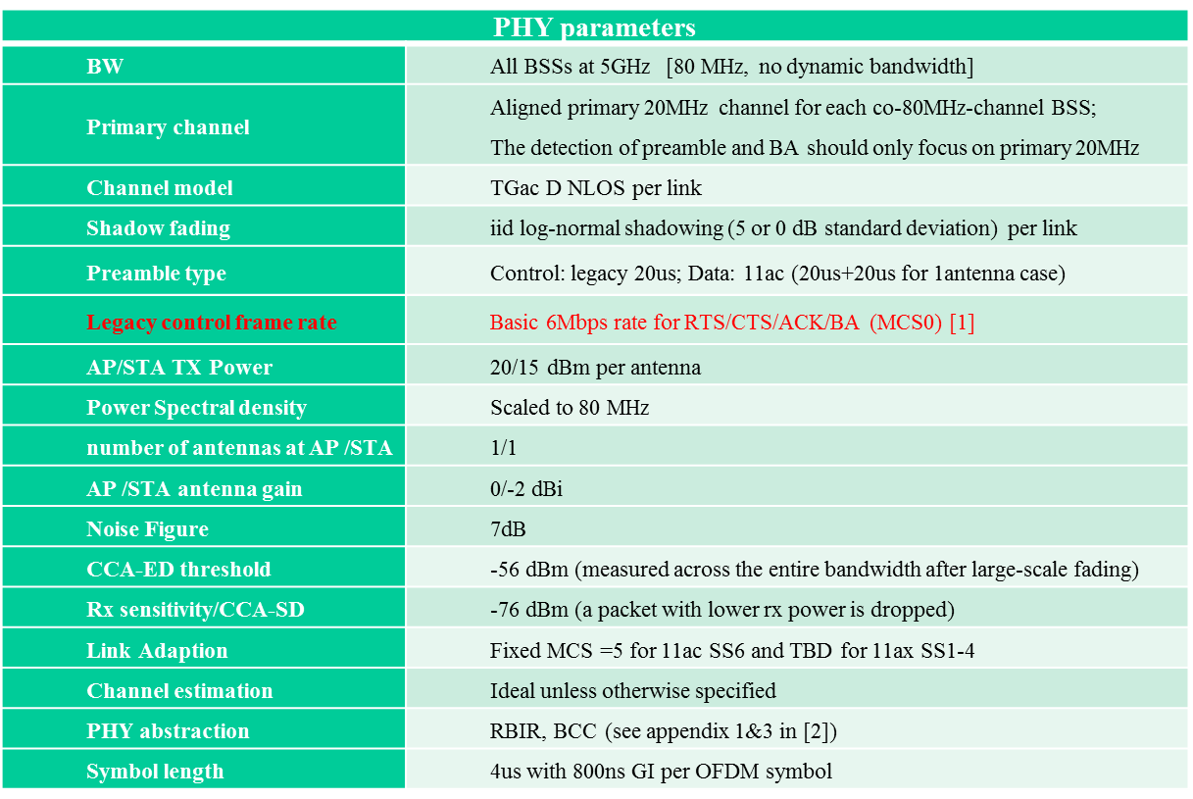
PHY Parameters

Slide 4
MAC Parameters
MAC parameters
Access protocol | [EDCA, AC_BE with default parameters] [CWmin = 15, CWmax = 1023, AIFSn=3 ]
Queue length | A single queue for each traffic link is set inside AP/STA sized of 2000 packets
Traffic type | UDP CBR with rate 10^8bps Random start time during a 10ms interval
MPDU size | 1544 Bytes (1472 Data + 28 IP header + 8 LLC header + 30 MAC header + 4 delimiter + 2 padding)
Aggregation | [A-MPDU / max aggregation size / BA window size, No A-MSDU, immediate BA without explicit request], Max aggregation: 32 or 64 MPDUs
Max number of retries | 10
Beacon | Disabled
RTS/CTS | OFF
Running time | 200s per drop, 30 drops per data
Output metric | -CDF or Histogram of per non-AP STA throughput (received bits/overall simulation time) -PER of all AP/STA (1 - # of success subframes / # of transmitted subframes)

Slide 5
11ac Scenario 6 – OBSS Enterprise
Fixed Location and Association
STA1 | (5,-9.5)
STA2 | (3.5,7.5)
STA4 | (-4.5,0.5)
STA5 | (-1.5,6)
STA7 | (-9,-5)
STA8 | (-8.5,8.5)
STA10 | (-3,0.5)
STA11 | (-0.5,8)
STA13 | (-4,-4)
STA14 | (7.5,-1)
STA16 | (8,-6)
STA17 | (0,-7.5)
STA19 | (-2.5,-4.5)
STA20 | (0.5,-2)
STA22 | (0,-4.5)
STA23 | (-1.5,7)
STA25 | (3.5,-5)
STA26 | (9,9.5)
STA28 | (-8,-5.5)
STA29 | (1.5,3.5)
AP A | (0,0)
AP B | (40,20)
AP C | (-40,-20)
STA3 | (7.5+xb, ‑9.5+yb)
STA9 | (7+xb, -7.5+yb)
STA15 | (3+xb, -0.5+yb)
STA21 | (-6.5+xb, -3+yb)
STA27 | (‑6+xb, 2.5+yb)
STA6 | (-5.5+xc,4.5+yc)
STA12 | (7+xc,7+yc)
STA18 | (10+xc,0.5+yc)
STA24 | (3+xc,2.5+yc)
STA30 | (9.5+xc,3.5+yc)

Slide 6
11ac SS6 Traffic Flow Model
DL/UL traffic assigned for each STA
STA | DL | UL | STA | DL | UL
STA1 | y | y | STA23 | n | y
STA2 | y | y | STA25 | y | y
STA4 | y | y | STA26 | y | y
STA5 | y | y | STA28 | y | y
STA7 | y | y | STA29 | y | y
STA8 | y | y | STA3 | y | y
STA10 | y | n | STA9 | y | n
STA11 | y | n | STA15 | y | n
STA13 | y | n | STA21 | n | y
STA14 | y | n | STA27 | y | y
STA16 | y | n | STA6 | y | y
STA17 | y | n | STA12 | y | n
STA19 | y | n | STA18 | y | n
STA20 | y | n | STA24 | n | y
STA22 | n | y | STA30 | y | y
“y” means having DL/UL traffic flow; “no” means not having DL/UL traffic flow

Slide 7
Test Cases for Step-by-Step Calibration of 11ac SS6
1 BSS (upper-right corner BSS B)
DL only case
UL only case
1 STA: each STA-AP
2 STAs: 3+9, 3+15, 3+27
3 STAs: 3+9+15, 3+9+27
DL & UL case
2 BSS (A+B)
Both DL only
Both UL only
A DL and B UL
B UL and A DL
3 BSS
DL only
UL only
Mixed DL & UL

Slide 8
Single BSS Simulation Results (max 64 MPDU per A-MPDU)
 | STA#3 |  | STA#9 |  | STA#15 |  | STA#21 |  | STA#27 |  | Sum (Mbps)
 | Tput (Mbps) | PER | Tput (Mbps) | PER | Tput (Mbps) | PER | Tput (Mbps) | PER | Tput (Mbps) | PER
DL | 41.12 | 0.00 | 42.03 | 0.00 | 41.16 | 0.00 | 42.05 | 0.00 | 42.03 | 0.00 | 208.39
UL - One STA Only | 99.97 | 0.00 |  |  |  |  |  |  |  |  | 99.97
 |  |  | 99.98 | 0.00 |  |  |  |  |  |  | 99.98
 |  |  |  |  | 99.78 | 0.00 |  |  |  |  | 99.78
 |  |  |  |  |  |  | 97.94 | 0.00 |  |  | 97.94
 |  |  |  |  |  |  |  |  | 99.78 | 0.00 | 99.78
UL - Two STA | 98.64 | 0.10 | 97.38 | 0.11 |  |  |  |  |  |  | 196.02
 | 98.75 | 0.10 |  |  | 97.65 | 0.10 |  |  |  |  | 196.40
 | 98.80 | 0.10 |  |  |  |  |  |  | 97.34 | 0.11 | 196.14
UL - 3 STA | 60.00 | 0.17 | 60.63 | 0.17 | 60.19 | 0.17 |  |  |  |  | 180.82
 | 65.71 | 0.17 | 62.83 | 0.17 |  |  |  |  | 60.23 | 0.18 | 188.77

Slide 9
2 BSS (A+B) Simulation Results DL-Only (Max.64 MPDU)

Slide 10
2 BSS (A+B) Simulation Results UL-Only(Max.64 MPDU)

Slide 11
2 BSS (A+B) Simulation Results A-DL / B – UL (Max.64 MPDU)

Slide 12
2 BSS (A+B) Simulation Results A-UL / B - DL(Max.64 MPDU)

Slide 13
3 BSS DL-Only Simulation Results (Max.64 MPDU)

Slide 14
3 BSS UL-Only Simulation Results (Max.64 MPDU)

Slide 15
Box5 Test Cases Results Comparison Max.32 vs. Max.64 MPDU Aggregation

Slide 16
Conclusion
Box5 Calibration results (11-15/0802) show good alignment on the condition of Max.32 MPDU aggregation.
However, due to obvious performance gap by MPDU aggregation, Max.64 MPDU aggregation is recommended as default condition for next Box5 calibration.

Slide 17
Reference
[1] 11-15/0680r2 Reference Box5 Calibration Assumptions and Parameters
[2] 11-15/0802r0 Box5 Calibration Result of SS6

Slide 18
Backup - Intel Results of max 32 MPDU per A-MPDU

Slide 19
Single BSS Simulation Results (max 32 MPDU per A-MPDU)
 | STA#3 |  | STA#9 |  | STA#15 |  | STA#21 |  | STA#27 |  | Sum (Mbps)
 | Tput (Mbps) | PER | Tput (Mbps) | PER | Tput (Mbps) | PER | Tput (Mbps) | PER | Tput (Mbps) | PER
DL | 39.73 | 0.00 | 38.61 | 0.00 | 39.13 | 0.00 | 38.02 | 0.00 | 40.28 | 0.00 | 195.76
UL - One STA Only | 99.78 | 0.00 |  |  |  |  |  |  |  |  | 99.78
 |  |  | 99.78 | 0.00 |  |  |  |  |  |  | 99.78
 |  |  |  |  | 99.77 | 0.00 |  |  |  |  | 99.77
 |  |  |  |  |  |  | 98.03 | 0.00 |  |  | 98.03
 |  |  |  |  |  |  |  |  | 99.77 | 0.00 | 99.77
UL - Two STA | 93.77 | 0.11 | 93.12 | 0.11 |  |  |  |  |  |  | 186.89
 | 93.13 | 0.11 |  |  | 95.62 | 0.09 |  |  |  |  | 188.75
 | 93.63 | 0.11 |  |  |  |  |  |  | 93.35 | 0.11 | 186.98

Slide 20
Single BSS Simulation Results (cont.) (max 32 MPDU per A-MPDU)
 | STA#3 |  | STA#9 |  | STA#15 |  | STA#21 |  | STA#27 |  | Sum (Mbps)
 | Tput (Mbps) | PER | Tput (Mbps) | PER | Tput (Mbps) | PER | Tput (Mbps) | PER | Tput (Mbps) | PER
UL - 3 STA | 60.46 | 0.17 | 59.23 | 0.17 | 61.47 | 0.16 |  |  |  |  | 181.16
 | 54.62 | 0.17 | 63.26 | 0.17 |  |  |  |  | 63.21 | 0.16 | 181.09

Slide 21
2 BSS (A+B) Simulation Results DL-Only (Max.32 MPDU)

Slide 22
2 BSS (A+B) Simulation Results UL-Only(Max.32 MPDU)

Slide 23
2 BSS (A+B) Simulation Results A-DL / B – UL (Max.32 MPDU)

Slide 24
2 BSS (A+B) Simulation Results A-UL / B - DL(Max.32 MPDU)

Slide 25
3 BSS DL-Only Simulation Results (Max.32 MPDU)

Slide 26
3 BSS UL-Only Simulation Results (Max.32 MPDU)

