Slide 1
Simulation Results for Box5 Calibration
Date: 2015-07-12
Authors:

Slide 2
Abstract
During IEEE 802.11 May meeting, the agreement on Box5 detail simulation parameters was presented in [1].
Based on the agreed simulation conditions, we provide the two set of test results from the Box5 test cases;
  Results of max 64 MPDU per A-MPDU to be presented in the contribution;
  Results of max 32 MPDU per A-MPDU was combined into the joint-contribution 11-15/0802
Single BSS results comparison with partners’ show good alignment;

Slide 3
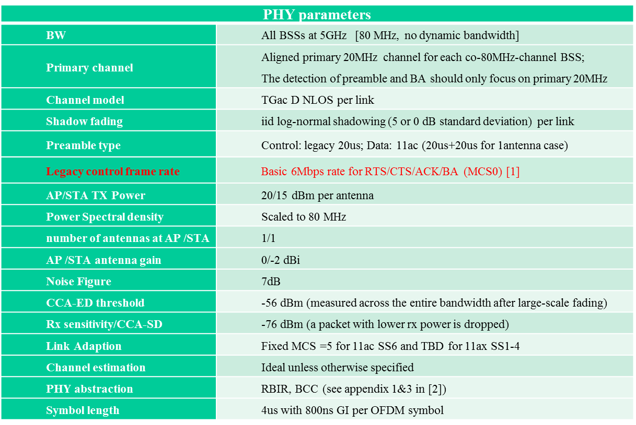
PHY Parameters

Slide 4
MAC Parameters
MAC parameters
Access protocol | [EDCA, AC_BE with default parameters] [CWmin = 15, CWmax = 1023, AIFSn=3 ]
Queue length | A single queue for each traffic link is set inside AP/STA sized of 2000 packets
Traffic type | UDP CBR with rate 10^8bps Random start time during a 10ms interval
MPDU size | 1544 Bytes (1472 Data + 28 IP header + 8 LLC header + 30 MAC header + 4 delimiter + 2 padding)
Aggregation | [A-MPDU / max aggregation size / BA window size, No A-MSDU, immediate BA without explicit request], Max aggregation: 32 or 64 MPDUs
Max number of retries | 10
Beacon | Disabled
RTS/CTS | OFF
Running time | 200s per drop, 30 drops per data
Output metric | -CDF or Histogram of per non-AP STA throughput (received bits/overall simulation time) -PER of all AP/STA (1 - # of success subframes / # of transmitted subframes)

Slide 5
11ac Scenario 6 – OBSS Enterprise
Fixed Location and Association
STA1 | (5,-9.5)
STA2 | (3.5,7.5)
STA4 | (-4.5,0.5)
STA5 | (-1.5,6)
STA7 | (-9,-5)
STA8 | (-8.5,8.5)
STA10 | (-3,0.5)
STA11 | (-0.5,8)
STA13 | (-4,-4)
STA14 | (7.5,-1)
STA16 | (8,-6)
STA17 | (0,-7.5)
STA19 | (-2.5,-4.5)
STA20 | (0.5,-2)
STA22 | (0,-4.5)
STA23 | (-1.5,7)
STA25 | (3.5,-5)
STA26 | (9,9.5)
STA28 | (-8,-5.5)
STA29 | (1.5,3.5)
AP A | (0,0)
AP B | (40,20)
AP C | (-40,-20)
STA3 | (7.5+xb, ‑9.5+yb)
STA9 | (7+xb, -7.5+yb)
STA15 | (3+xb, -0.5+yb)
STA21 | (-6.5+xb, -3+yb)
STA27 | (‑6+xb, 2.5+yb)
STA6 | (-5.5+xc,4.5+yc)
STA12 | (7+xc,7+yc)
STA18 | (10+xc,0.5+yc)
STA24 | (3+xc,2.5+yc)
STA30 | (9.5+xc,3.5+yc)

Slide 6
11ac SS6 Traffic Flow Model
DL/UL traffic assigned for each STA
STA | DL | UL | STA | DL | UL
STA1 | y | y | STA23 | n | y
STA2 | y | y | STA25 | y | y
STA4 | y | y | STA26 | y | y
STA5 | y | y | STA28 | y | y
STA7 | y | y | STA29 | y | y
STA8 | y | y | STA3 | y | y
STA10 | y | n | STA9 | y | n
STA11 | y | n | STA15 | y | n
STA13 | y | n | STA21 | n | y
STA14 | y | n | STA27 | y | y
STA16 | y | n | STA6 | y | y
STA17 | y | n | STA12 | y | n
STA19 | y | n | STA18 | y | n
STA20 | y | n | STA24 | n | y
STA22 | n | y | STA30 | y | y
“y” means having DL/UL traffic flow; “no” means not having DL/UL traffic flow

Slide 7
Test Cases for
Step-by-Step Calibration of 11ac SS6
1 BSS (upper-right corner BSS B)
  DL only case
  UL only case
    1 STA: each STA-AP
    2 STAs: 3+9, 3+15, 3+27
    3 STAs: 3+9+15, 3+9+27
  DL & UL case
2 BSS (A+B)
  Both DL only
  Both UL only
  A DL and B UL
  B UL and A DL
3 BSS
  DL only
  UL only
  Mixed DL & UL

Slide 8
Single BSS Simulation Results
(max 64 MPDU per A-MPDU)
 | STA#3 |  | STA#9 |  | STA#15 |  | STA#21 |  | STA#27 |  | Sum (Mbps)
 | Tput (Mbps) | PER | Tput (Mbps) | PER | Tput (Mbps) | PER | Tput (Mbps) | PER | Tput (Mbps) | PER
DL | 41.12 | 0.00 | 42.03 | 0.00 | 41.16 | 0.00 | 42.05 | 0.00 | 42.03 | 0.00 | 208.39
UL - One STA Only | 99.97 | 0.00 |  |  |  |  |  |  |  |  | 99.97
 |  |  | 99.98 | 0.00 |  |  |  |  |  |  | 99.98
 |  |  |  |  | 99.78 | 0.00 |  |  |  |  | 99.78
 |  |  |  |  |  |  | 97.94 | 0.00 |  |  | 97.94
 |  |  |  |  |  |  |  |  | 99.78 | 0.00 | 99.78
UL - Two STA | 98.64 | 0.10 | 97.38 | 0.11 |  |  |  |  |  |  | 196.02
 | 98.75 | 0.10 |  |  | 97.65 | 0.10 |  |  |  |  | 196.40
 | 98.80 | 0.10 |  |  |  |  |  |  | 97.34 | 0.11 | 196.14
UL - 3 STA | 60.00 | 0.17 | 60.63 | 0.17 | 60.19 | 0.17 |  |  |  |  | 180.82
 | 65.71 | 0.17 | 62.83 | 0.17 |  |  |  |  | 60.23 | 0.18 | 188.77

Slide 9
2 BSS (A+B) Simulation Results
DL-Only (Max.64 MPDU)

Slide 10
2 BSS (A+B) Simulation Results
UL-Only(Max.64 MPDU)

Slide 11
2 BSS (A+B) Simulation Results
A-DL / B – UL (Max.64 MPDU)

Slide 12
2 BSS (A+B) Simulation Results
A-UL / B - DL(Max.64 MPDU)

Slide 13
3 BSS DL-Only Simulation Results
(Max.64 MPDU)

Slide 14
3 BSS UL-Only Simulation Results
(Max.64 MPDU)

Slide 15
Box5 Test Cases Results Comparison
Max.32 vs. Max.64 MPDU Aggregation

Slide 16
Conclusion
Box5 Calibration results (11-15/0802) show good alignment on the condition of Max.32 MPDU aggregation;
However, due to obvious performance gap by MPDU aggregation, Max.64 MPDU aggregation is recommended as default condition for next Box5 calibration.

Slide 17
Reference
[1] 11-15/0680r2 Reference Box5 Calibration Assumptions and Parameters
[2]

Slide 18
Backup -
Intel Results of max 32 MPDU per A-MPDU

Slide 19
Single BSS Simulation Results
(max 32 MPDU per A-MPDU)
 | STA#3 |  | STA#9 |  | STA#15 |  | STA#21 |  | STA#27 |  | Sum (Mbps)
 | Tput (Mbps) | PER | Tput (Mbps) | PER | Tput (Mbps) | PER | Tput (Mbps) | PER | Tput (Mbps) | PER
DL | 39.73 | 0.00 | 38.61 | 0.00 | 39.13 | 0.00 | 38.02 | 0.00 | 40.28 | 0.00 | 195.76
UL - One STA Only | 99.78 | 0.00 |  |  |  |  |  |  |  |  | 99.78
 |  |  | 99.78 | 0.00 |  |  |  |  |  |  | 99.78
 |  |  |  |  | 99.77 | 0.00 |  |  |  |  | 99.77
 |  |  |  |  |  |  | 98.03 | 0.00 |  |  | 98.03
 |  |  |  |  |  |  |  |  | 99.77 | 0.00 | 99.77
UL - Two STA | 93.77 | 0.11 | 93.12 | 0.11 |  |  |  |  |  |  | 186.89
 | 93.13 | 0.11 |  |  | 95.62 | 0.09 |  |  |  |  | 188.75
 | 93.63 | 0.11 |  |  |  |  |  |  | 93.35 | 0.11 | 186.98

Slide 20
Single BSS Simulation Results (cont.)
(max 32 MPDU per A-MPDU)
 | STA#3 |  | STA#9 |  | STA#15 |  | STA#21 |  | STA#27 |  | Sum (Mbps)
 | Tput (Mbps) | PER | Tput (Mbps) | PER | Tput (Mbps) | PER | Tput (Mbps) | PER | Tput (Mbps) | PER
UL - 3 STA | 60.46 | 0.17 | 59.23 | 0.17 | 61.47 | 0.16 |  |  |  |  | 181.16
 | 54.62 | 0.17 | 63.26 | 0.17 |  |  |  |  | 63.21 | 0.16 | 181.09

Slide 21
2 BSS (A+B) Simulation Results
DL-Only (Max.32 MPDU)

Slide 22
2 BSS (A+B) Simulation Results
UL-Only(Max.32 MPDU)

Slide 23
2 BSS (A+B) Simulation Results
A-DL / B – UL (Max.32 MPDU)

Slide 24
2 BSS (A+B) Simulation Results
A-UL / B - DL(Max.32 MPDU)

Slide 25
3 BSS DL-Only Simulation Results
(Max.32 MPDU)

Slide 26
3 BSS UL-Only Simulation Results
(Max.32 MPDU)

