Slide 1
Performance evaluation of SU/MU-MIMO in OFDMA
Date: 2015-07-12
Authors:
Name | Affiliation | Address | Phone | Email
Jiyong Pang | Huawei | 5B-N8, No.2222 Xinjinqiao Road, Pudong, Shanghai |  | pangjiyong@huawei.com
Jiayin Zhang |  | 5B-N8, No.2222 Xinjinqiao Road, Pudong, Shanghai |  | zhangjiayin@huawei.com
Le Liu |  | F1-17, Huawei Base, Bantian, Shenzhen |  | liule@huawei.com
Jun Luo |  | 5B-N8, No.2222 Xinjinqiao Road, Pudong, Shanghai |  | jun.l@huawei.com
Yi Luo |  | F1-17, Huawei Base, Bantian, Shenzhen |  | Roy.luoyi@huawei.com
Yingpei Lin |  | 5B-N8, No.2222 Xinjinqiao Road, Pudong, Shanghai |  | linyingpei@huawei.com
Jun Zhu |  | 5B-N8, No.2222 Xinjinqiao Road, Pudong, Shanghai |  | zhujun75@huawei.com
Zhigang Rong |  | 10180 Telesis Court, Suite 365, San Diego, CA 92121 NA |  | zhigang.rong@huawei.com
Rob Sun |  | 303 Terry Fox, Suite 400 Kanata, Ottawa, Canada |  | Rob.Sun@huawei.com
David X. Yang |  | F1-17, Huawei Base, Bantian, Shenzhen |  | david.yangxun@huawei.com

Slide 2
Authors (continued)
Name | Affiliation | Address | Phone | Email
Yunsong Yang | Huawei | 10180 Telesis Court, Suite 365, San Diego, CA 92121 NA |  | yangyunsong@huawei.com
Junghoon Suh |  | 303 Terry Fox, Suite 400 Kanata, Ottawa, Canada |  | Junghoon.Suh@huawei.com
Peter Loc |  |  |  | peterloc@iwirelesstech.com
Name | Affiliation | Address | Phone | Email
Hongyuan Zhang | Marvell | 5488 Marvell Lane, Santa Clara, CA, 95054 | 408-222-2500 | hongyuan@marvell.com
Yakun Sun |  |  |  | yakunsun@marvell.com
Lei Wang |  |  |  | Leileiw@marvell.com
Liwen Chu |  |  |  | liwenchu@marvell.com
Jinjing Jiang |  |  |  | jinjing@marvell.com
Yan Zhang |  |  |  | yzhang@marvell.com
Rui Cao |  |  |  | ruicao@marvell.com
Jie Huang |  |  |  | jiehuang@marvell.com
Sudhir Srinivasa |  |  |  | sudhirs@marvell.com
Saga Tamhane |  |  |  | sagar@marvell.com
Mao Yu |  |  |  | my@marvel..com
Edward Au |  |  |  | edwardau@marvell.com
Hui-Ling Lou |  |  |  | hlou@marvell.com

Slide 3
Authors (continued)
Name | Affiliation | Address | Phone | Email
Albert Van Zelst | Qualcomm | Straatweg 66-S Breukelen, 3621 BR Netherlands |  | allert@qti.qualcomm.com
Alfred Asterjadhi |  | 5775 Morehouse Dr. San Diego, CA, USA |  | aasterja@qti.qualcomm.com
Bin Tian |  | 5775 Morehouse Dr. San Diego, CA, USA |  | btian@qti.qualcomm.com
Carlos Aldana |  | 1700 Technology Drive San Jose, CA 95110, USA |  | caldana@qca.qualcomm.com
George Cherian |  | 5775 Morehouse Dr. San Diego, CA, USA |  | gcherian@qti.qualcomm.com
Gwendolyn Barriac |  | 5775 Morehouse Dr. San Diego, CA, USA |  | gbarriac@qti.qualcomm.com
Hemanth Sampath |  | 5775 Morehouse Dr. San Diego, CA, USA |  | hsampath@qti.qualcomm.com
Menzo Wentink |  | Straatweg 66-S Breukelen, 3621 BR Netherlands |  | mwentink@qti.qualcomm.com
Richard Van Nee |  | Straatweg 66-S Breukelen, 3621 BR Netherlands |  | rvannee@qti.qualcomm.com
Rolf De Vegt |  | 1700 Technology Drive San Jose, CA 95110, USA |  | rolfv@qca.qualcomm.com
Sameer Vermani |  | 5775 Morehouse Dr. San Diego, CA, USA |  | svverman@qti.qualcomm.com
Simone Merlin |  | 5775 Morehouse Dr. San Diego, CA, USA |  | smerlin@qti.qualcomm.com
Tevfik Yucek |  | 1700 Technology Drive San Jose, CA 95110, USA |  | tyucek@qca.qualcomm.com
VK Jones |  | 1700 Technology Drive San Jose, CA 95110, USA |  | vkjones@qca.qualcomm.com
Youhan Kim |  | 1700 Technology Drive San Jose, CA 95110, USA |  | youhank@qca.qualcomm.com

Slide 4
Authors (continued)
Name | Affiliation | Address | Phone | Email
James Yee | Mediatek | No. 1 Dusing 1st Road, Hsinchu, Taiwan | +886-3-567-0766 | james.yee@mediatek.com
Alan Jauh |  |  |  | alan.jauh@mediatek.com
Chingwa Hu |  |  |  | chinghwa.yu@mediatek.com
Frank Hsu |  |  |  | frank.hsu@mediatek.com
Thomas Pare | Mediatek USA | 2860 Junction Ave, San Jose, CA 95134, USA | +1-408-526-1899 | thomas.pare@mediatek.com
ChaoChun Wang |  |  |  | chaochun.wang@mediatek.com
James Wang |  |  |  | james.wang@mediatek.com
Jianhan Liu |  |  |  | Jianhan.Liu@mediatek.com
Tianyu Wu |  |  |  | tianyu.wu@mediatek.com
Russell Huang |  |  |  | russell.huang@mediatek.com
Joonsuk Kim | Apple |  |  | joonsuk@apple.com
Aon Mujtaba |  |  |  | mujtaba@apple.com
Guoqing Li |  |  |  | guoqing_li@apple.com
Eric Wong |  |  |  | ericwong@apple.com
Chris Hartman |  |  |  | chartman@apple.com

Slide 5
Authors (continued)
Name | Affiliation | Address | Phone | Email
Ron Porat | Broadcom |  |  | rporat@broadcom.com
Sriram Venkateswaran |  |  |  | mfischer@broadcom.com
Matthew Fischer
Leo Montreuil
Andrew Blanksby
Vinko Erceg
Robert Stacey | Intel | 2111 NE 25th Ave, Hillsboro OR 97124, USA | +1-503-724-893 | robert.stacey@intel.com
Eldad Perahia |  |  |  | eldad.perahia@intel.com
Shahrnaz Azizi |  |  |  | shahrnaz.azizi@intel.com
Po-Kai Huang |  |  |  | po-kai.huang@intel.com
Qinghua Li |  |  |  | quinghua.li@intel.com
Xiaogang Chen |  |  |  | xiaogang.c.chen@intel.com
Chitto Ghosh |  |  |  | chittabrata.ghosh@intel.com
Laurent cariou |  |  |  | laurent.cariou@intel.com
Rongzhen Yang |  |  |  | rongzhen.yang@intel.com

Slide 6
Authors (continued)
Name | Affiliation | Address | Phone | Email
Kiseon Ryu | LG Electronics | 19, Yangjae-daero 11gil, Seocho-gu, Seoul 137-130, Korea |  | kiseon.ryu@lge.com
Jinyoung Chun |  |  |  | jiny.chun@lge.com
Jinsoo Choi |  |  |  | js.choi@lge.com
Jeongki Kim |  |  |  | jeongki.kim@lge.com
Giwon Park |  |  |  | giwon.park@lge.com
Dongguk Lim |  |  |  | dongguk.lim@lge.com
Suhwook Kim |  |  |  | suhwook.kim@lge.com
Eunsung Park |  |  |  | esung.park@lge.com
HanGyu Cho |  |  |  | hg.cho@lge.com
Thomas Derham | Orange |  |  | thomas.derham@orange.com
Bo Sun | ZTE | #9 Wuxingduan, Xifeng Rd., Xi'an, China |  | sun.bo1@zte.com.cn
Kaiying Lv |  |  |  | lv.kaiying@zte.com.cn
Yonggang Fang |  |  |  | yfang@ztetx.com
Ke Yao |  |  |  | yao.ke5@zte.com.cn
Weimin Xing |  |  |  | xing.weimin@zte.com.cn
Brian Hart | Cisco Systems | 170 W Tasman Dr, San Jose, CA 95134 |  | brianh@cisco.com
Pooya Monajemi |  |  |  | pmonajem@cisco.com

Slide 7
Authors (continued)
Name | Affiliation | Address | Phone | Email
Fei Tong | Samsung | Innovation Park, Cambridge CB4 0DS (U.K.) | +44 1223 434633 | f.tong@samsung.com
Hyunjeong Kang |  | Maetan 3-dong; Yongtong-Gu Suwon; South Korea | +82-31-279-9028 | hyunjeong.kang@samsung.com
Kaushik Josiam |  | 1301, E. Lookout Dr, Richardson TX 75070 | (972) 761 7437 | k.josiam@samsung.com
Mark Rison |  | Innovation Park, Cambridge CB4 0DS (U.K.) | +44 1223 434600 | m.rison@samsung.com
Rakesh Taori |  | 1301, E. Lookout Dr, Richardson TX 75070 | (972) 761 7470 | rakesh.taori@samsung.com
Sanghyun Chang |  | Maetan 3-dong; Yongtong-Gu Suwon; South Korea | +82-10-8864-1751 | s29.chang@samsung.com
Yasushi Takatori | NTT | 1-1 Hikari-no-oka, Yokosuka, Kanagawa 239-0847 Japan |  | takatori.yasushi@lab.ntt.co.jp
Yasuhiko Inoue |  |  |  | inoue.yasuhiko@lab.ntt.co.jp
Yusuke Asai |  |  |  | asai.yusuke@lab.ntt.co.jp
Koichi Ishihara |  |  |  | ishihara.koichi@lab.ntt.co.jp
Akira Kishida |  |  |  | kishida.akira@lab.ntt.co.jp
Akira Yamada | NTT DOCOMO | 3-6, Hikarinooka, Yokosuka-shi, Kanagawa, 239-8536, Japan |  | yamadaakira@nttdocomo.com
Fujio Watanabe |  | 3240 Hillview Ave, Palo Alto, CA 94304 |  | watanabe@docomoinnovations.com
Haralabos Papadopoulos |  |  |  | hpapadopoulos@docomoinnovations.com

Slide 8
Abstract
In 11ax, OFDMA and UL MU MIMO are introduced in WLAN system to improve the throughput and efficiency in dense scenario.
For 11ax OFDMA transmission, several issues impact much on the system performance and also the HE-SIG-B signaling design.
For SU MIMO per RU, what is the performance loss by limiting the number of spatial streams?
For MU, what is the performance gain by integrating MU and OFDMA?
For MU OFDMA, how does the RU size impact the performance?
Larger RU size needs smaller overhead
Smaller RU size means larger frequency/MU diversity and higher scheduling flexibility
In this proposal, we give some initial evaluation of the above problems via our integrated SLS.

Slide 9
Simulation Assumption
11ax scenario 3 (indoor, Channel D) [1]
Channel Usage
Each BSS independently contends the channel
After successful contention, AP schedules 5 DL transmission within a fixed-length TXOP
PF scheduling on each RU (min 26 tones) with full buffer traffic
Nonideal CSI feedback

Slide 10
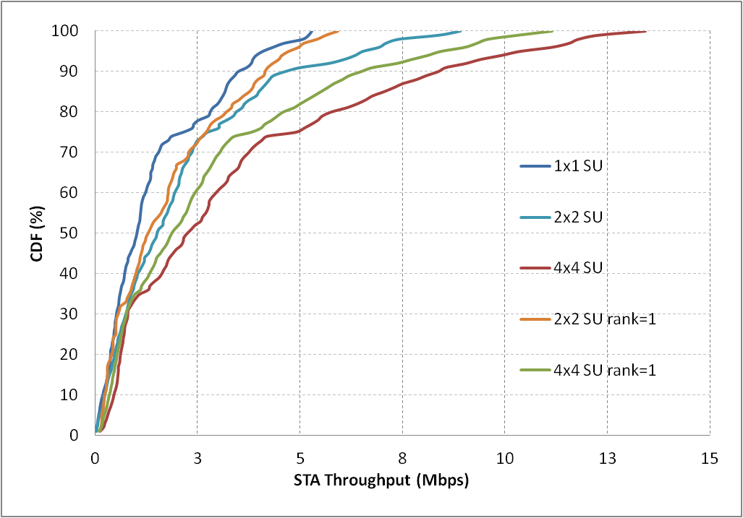
SU MIMO + OFDMA
For the SU OFDMA case,
MIMO spatial multiplexing could provide significant gain
Limiting the number of spatial streams (SS) degrades much the performance
SU cases (80M channel) | edge |  | mean
1*1 | 0.08 |  | 1.01
2*2 | 0.12 | 9.1% | 1.51 | 17.1%
2*2 fixed 1 SS | 0.11 | 0 | 1.29 | 0
4*4 | 0.28 | 12% | 2.24 | 20.4%
4*4 fixed 1 SS | 0.25 | 0 | 1.86 | 0

Slide 11
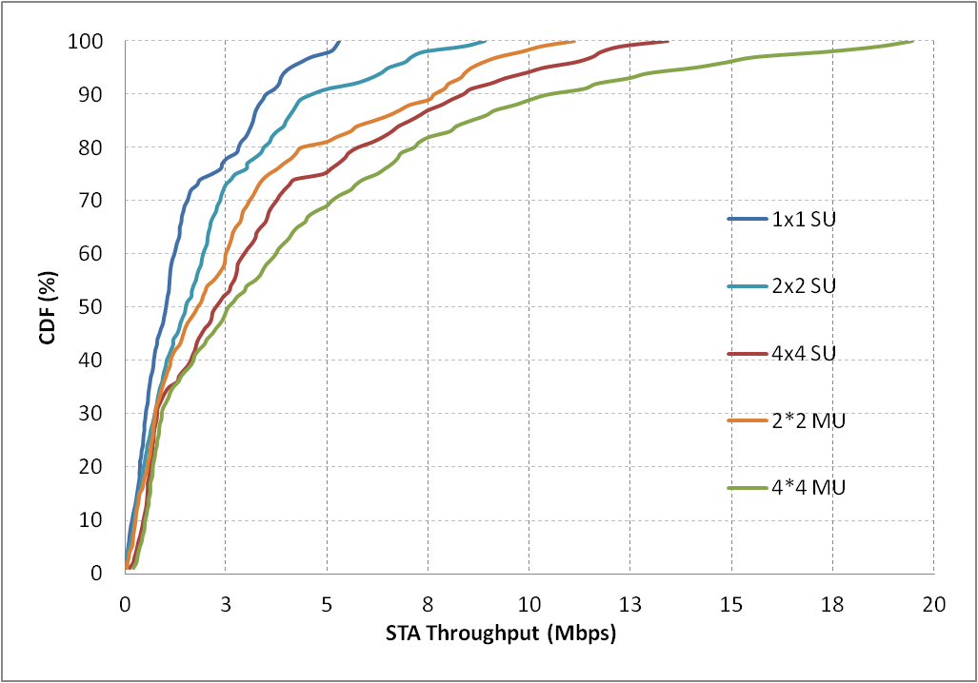
MU MIMO + OFDMA
OFDMA throughput could be further enhanced via MU transmission
Max 2 STAs (for simplicity) are multiplexed on each RU via ZF beamforming with MRC receiver
AP and STA have the same number (2 or 4) of antennas
Greedy sum_rate maximization
SU/MU (80M channel) | edge |  | mean |  | MU RU %
1*1 SU | 0.08 |  | 1.01 |  | -
2*2 SU | 0.13 | 0 | 1.51 | 0 | -
2*2 MU | 0.17 | 30.8% | 1.79 | 18.5% | ~60%
4*4 SU | 0.30 | 0 | 2.24 | 0 | -
4*4 MU | 0.37 | 23.3% | 2.55 | 13.8% | ~70%

Slide 12
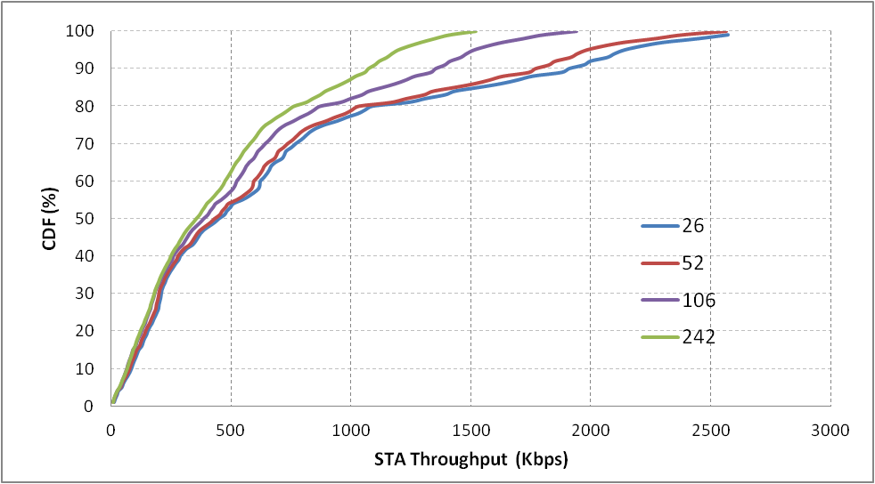
MU RU Size (1)
Full buffer (20M Channel)
The gain of smaller RU size comes from larger frequency/MU diversity and PF scheduling gain
Larger gain could be obtained
for UL transmission due to more fluctuant interference
under UMi channel due to larger frequency selectivity
RU size | edge |  | mean
26 | 42.34 | 28.2% | 457.52 | 29.3%
52 | 40.92 | 23.9% | 431.89 | 22.1%
106 | 36.19 | 9.6% | 385.06 | 8.8%
242 | 33.03 | 0 | 353.84 | 0

Slide 13
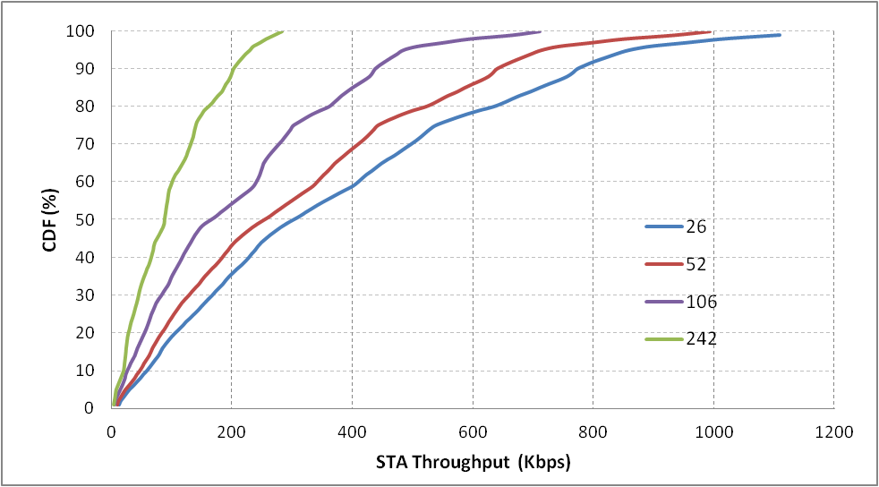
MU RU Size (2)
Small packet (100 bytes)
The extreme loss of larger RU size mainly comes from resource waste
To avoid too much time resource waste, here we set one TXOP having only 1 DL frame consisting of 5 time segments (108.8us data duration per segment)
RU size | edge |  | mean
26 | 28.29 | 261% | 301.03 | 242%
52 | 22.37 | 185% | 252.45 | 186%
106 | 14.54 | 85.69% | 164.46 | 86.9%
242 | 7.83 | 0% | 87.99 | 0%

Slide 14
Minimum BW of an MU-MIMO allocation
Still good to place a minimum limit on the RU size where MU-MIMO can be done
To limit signaling overhead and the resulting number of SIG-B symbols
MU-MIMO on very small RU sizes causes large overhead to feedback accurate CSI for multiple STA
Good to utilize the CSI when fresh over the widest BW possible
Recommend using MU-MIMO for RU-size >=106 tones
Still allows some mixing of OFDMA and MU-MIMO for 20MHz PPDUs

Slide 15
Conclusion
In this contribution, we showed some basic SLS evaluation results of 11ax SS3 to illustrate the following observations
For SU-MIMO OFDMA, there is no benefit to limit the number of spatial streams
Integrating MU upon OFDMA outperforms better than SU OFDMA
MU upon smaller RU provides higher throughput
Which also implies that MU OFDMA is superior to pure MU OFDM
Considering the signaling and CSI feedback overhead, MU-MIMO allocations only for RU sizes>=106 tones could be a better tradeoff.

Slide 16
Straw Poll
Do you agree that MU-MIMO shall only be supported on allocations sizes>=106 tones
Y/N/A

Slide 17
References
[1] 11-14-0980-12-00ax-simulation-scenarios

