Slide 1
Uplink ACK and BA Multiplexing
Authors:
Name | Affiliations | Address | Phone | email
Reza Hedayat Young Hoon Kwon Yongho Seok Vida Ferdowsi | Newracom | 9008 Research Drive, Irvine, CA 92618 |  | reza.hedayat at newracom.com younghoon.kwon at newracom.com yongho.seok at newracom.com vida.ferdowsi at newracom.com

Slide 2
Background
TGax adopted DL OFDMA, and with DL MU MIMO there are now two DL MU mechanisms
The efficiency of DL OFDMA is enhanced significantly if multiple ACK/BAs are multiplexed in response to a DL OFDMA PPDU
11ax SFD: “The amendment shall include a mechanism to multiplex BA/ACK responses to DL MU transmission. ”
In this contribution some details on how ACK/BA frames could be multiplexed in response to a DL MU MIMO are presented

Slide 3
ACK/BA Frame Attributes in Legacy Designs
Content of L-SIG, SIG-A and SIG-B
  In legacy amendments, these fields are decided by each STA as specified by the spec
ACK/BA frame size
  ACK: 14B
  Compressed BA: 32B
  Multi-TID BA: 22B + 12B per each TID
MCS and NSS
  Under current rules and designs MCS and NSS are selected by the STA
Guard Interval (GI)
  Under current rules and designs GI is selected by the STA: 0.8us or 0.4us

Slide 4
MU ACK: UL ACK/BA Multiplexing
PHY/MAC attributes of each ACK/BA frame in an UL OFDMA frame
Content of L-SIG and HE SIG
  Need to be set by all STAs with the same values
MCS and NSS
  Could be decided by each STA as currently done, or
  AP could require all STAs to use a robust MCS and NSS choices
GI, LTF compression, …
  AP need to mandate that all STAs use the same values for these parameters
Sub-band assignment
  Assignments for the sub-bands of each ACK/BA frame need to be given by the AP (next slides)

Slide 5
Contents of L-SIG and HE SIG
Content of L-SIG
  STAs need to set L_LENGTH with a duration value that is in the preceding DL MU frame, e.g. the duration of the MU ACK that is specified by the AP.
Content of HE SIG
  Currently the content of SIG-A is not decided
  STAs may copy some of the content of the preceding DL MU PPDU’s SIG-A to the SIG-A of the MU ACK, but some other contents might be set with pre-defined/reserved values

Slide 6
Selection of MCS and NSS
MCS selection
  Currently a STA selects its MCS for ACK/BA frame independently
  But if there is no HE SIG-B/C in UL MU, the MCS selection need to be settled before transmission of MU ACK frame
  AP needs to signal MCS for each ACK/BA separately, or a given MCS for all ACK/BAs at once
  Alternatively, if SIG-C exists the STA can indicate the MCS in SIG-C
NSS selection
  Currently a STA can select NSS>1 for ACK/BA frame, though not beneficial throughput-wise
  However in MU ACK, the presence of NSS>1 complicates the UL MU frame unnecessarily
  One choice is to disallow MU ACK with NSS>1
  Alternatively if SIG-C is present, the AP can indicate an NSS>1 in the Trigger frame or the preceding DL MU frame, after which the STAs would have appropriate number of LTF symbols and indicate their NSS

Slide 7
Other Parameters that all STAs follow
GI, LTF compression, …
  These set of parameters need to be set by all STAs to the same values, otherwise MU ACK frame cannot be decoded correctly
  Selection of some of these parameters, such as GI, are environment-dependent, hence it’d be good to let AP set these values
  So an option is that the AP sets these values specifically in the Trigger frame or the preceding DL MU frame, or the STAs use the same GI and LTF compression values from the preceding DL MU frame

Slide 8
Sub-band Assignment for ACK/BA Multiplexing
Explicit sub-band assignment
  In each DL OFDMA PPDU, AP can explicitly indicate what sub-band to be used by the STA for placing the ACK/BA
  If the ACK Policy subfield of QoS Control is set to “No ACK”, then the AP does not assign any sub-band to the STA
  Explicit assignment allows the AP to assign best/better sub-bands for each STA
Implicit sub-band assignment
  STAs might pick up a sub-band (from the set of the sub-bands) based on some order that avoids two STAs selecting the same sub-band
  For instance, based on the same order that their DL assignment appears in the preceding DL OFDMA PPDU, or the same order as in the GID of the preceding DL MU MIMO PPDU
  For this case, the bandwidth of sub-bands used for ACK/BA need to be known to STAs e.g. be pre-announced in the preceding DL OFDMA frame etc

Slide 9
Options for ACK/BA Sub-band Assignment
Using same sub-band as DL payload
One option is to let each STA use the same sub-band(s) as its DL payload, e.g. a STA that has a 2MHz sub-band uses the same 2MHz sub-band for UL, and a STA that has an 8MHz sub-band uses the same 8MHz sub-band.
However, the bandwidth required for ACK/BA frames are mostly different with the bandwidth used for DL payload. Hence, the variance of sub-bands’ bandwidth assigned to DL payloads is larger than that of ACK/BA
STA1
STA1 ACK/BA
STA2
STA2 ACK/BA
HE SIG-B
STA3
IFS
STA3 ACK/BA
L-STF/LTF/SIG, SIG-A
HE STF/LTF
L-STF/LTF/SIG, HE SIG
STA4
STA4 ACK/BA

Slide 10
Options for ACK/BA Sub-band Assignment
Using same sub-band as DL payload
Using 2MHz and 4MHz sub-bands for ACK/BA frames requires:
    For 2 MHz sub-band, ACK payload size is 10/5/4/3/2/… symbols for MCS0-9
    For 4 MHz sub-band, ACK payload is 5/3/2/2/1/… symbols for MCS0-9
    For 2 MHz sub-band, BA payload size is 22/11/8/6/4/3/3/3… symbols for MCS0-9
    For 4 MHz sub-band, BA payload size is 11/6/4/3/2/2/2… symbols for MCS0-9
Using same sub-bands as in the DL OFDMA frame could cause some ACK/BA frames to takes several symbols while other ACK/BA frames to pad excessively
STA1
STA1 ACK/BA
STA2
STA2 ACK/BA
HE SIG-B
STA3
IFS
STA3 ACK/BA
L-STF/LTF/SIG, SIG-A
HE STF/LTF
L-STF/LTF/SIG, HE SIG
STA4
STA4 ACK/BA

Slide 11
Options for ACK/BA Sub-band Assignment
Implicit indication
Sub-bands of 2MHz, 4MHz, or 8MHz are chosen by the AP for ACK and BA frames and indicates the unit BW of ACK/BA sub-bands in SIG-B of the DL PPDU
Sub-bands are assigned to STAs implicitly; each STA picks the sub-band that has the same order as its assignment in DL OFDMA
Pros and cons:
  As long as DL PPDU/SIG-B is received correctly the UL sub-band assignment is known to the STAs
  AP has limited role in UL sub-band assignment hence more likelihood of lengthier multiplexed ACK/BA response
  Some STAs might have their sub-band for ACK/BA frame in deep fade
SIG-B shows the DL assignments in this order:STA1, STA2, STA3, STA4
Unit BW of ACK/BA frames indicated in SIG-B
Each STA picks the sub-band with the indicated BW and same order as its DL assignment
STA1
STA1 ACK/BA
Example:
PPDU BW = 20MHz
ACK/BA BW = 4MHz
STA2
STA2 ACK/BA
HE SIG-B
IFS
L-STF/LTF/SIG, SIG-A
HE STF/LTF
L-STF/LTF/SIG, HE SIG
STA3
STA3 ACK/BA
STA4
STA4 ACK/BA

Slide 12
Options for ACK/BA Sub-band Assignment
Explicit indication in SIG-B
AP indicates the index of each ACK/BA sub-band in SIG-B of the DL PPDU
  Unlike implicit assignment, AP can assign sub-bands with possibly varying bandwidth to ACK and BA depending on what it expects
Pros and cons:
  As long as DL PPDU/SIG-B is received correctly the UL assignment is known to the STAs
  It requires multiple exchanges within MAC and PHY entities: AP-MAC indicates the assigned sub-bands to AP-PHY, then STA-PHY passes the parameter to STA-MAC, and finally STA-MAC let the STA-PHY know what sub-band to use for placing the ACK/BA.
In SIG-B, each DL assignment has a sub-band assignment for ACK/BA
Each STA picks the assigned sub-band
STA1
STA4 ACK
STA2
STA2 BA
HE SIG-B
IFS
L-STF/LTF/SIG, SIG-A
HE STF/LTF
L-STF/LTF/SIG, HE SIG
STA3
STA1 BA
STA4
STA3 ACK

Slide 13
Options for ACK/BA Sub-band Assignment
Explicit indication in MAC Header
AP indicates the index of each ACK/BA sub-band in the MAC header of the MPDUs in DL OFDMA assignment, as long as the ACK policy is set to Normal ACK or Implicit BAR
Pros and cons:
  As long as one MPDU is received correctly the UL assignment is known to the STA
  The added field in MAC header appears in all MPDUs and could be high overhead in large AMPDUs
In MAC header, sub-band assignment for ACK/BA frames are indicated
Each STA picks the assigned sub-band
STA1
STA4 ACK
STA2
STA2 BA
HE SIG-B
IFS
L-STF/LTF/SIG, SIG-A
HE STF/LTF
L-STF/LTF/SIG, HE SIG
STA3
STA1 BA
STA4
STA3 ACK

Slide 14
Options for ACK/BA Sub-band Assignment
Explicit indication in a Trigger MPDU
AP adds a Trigger MPDU to each DL assignment, preferably as the first MPDU.
The Trigger MPDU indicates the index of the expected ACK/BA sub-band
Pros and cons:
  More aligned with Trigger frame concept and role
  If Trigger MPDU is lost then the opportunity to send ACK/BA is lost, hence the DL payload has to be retransmitted
For each DL payload there is a single-STA Trigger frame
STA1
STA4 ACK
Each STA picks the assigned sub-band from its Trigger MPDU
STA2
STA2 BA
HE SIG-B
IFS
L-STF/LTF/SIG, SIG-A
HE STF/LTF
L-STF/LTF/SIG, HE SIG
STA3
STA1 BA
STA4
STA3 ACK

Slide 15
Options for ACK/BA Sub-band Assignment
Trigger Frame/MU BAR
AP sets the ACK policy for all the MPDUs in a DL MU frame to Block ACK, hence all the STAs wait for a BAR. Then AP sends a Trigger frame and specifics sub-band assignment
Pros and cons:
  More aligned with the Trigger frame concept and role
  Additional overhead due to appearance of a separate Trigger/BAR frame
STA1
Trigger Frame,
MU BAR
STA4 ACK
STA2
STA2 BA
HE SIG-B
IFS
IFS
L-STF/LTF/SIG, SIG-A
HE STF/LTF
L-STF/LTF/SIG, HE SIG
STA3
STA1 BA
STA4
STA3 ACK

Slide 16
Comparison of ACK/BA Sub-band Assignment Options
Implicit indication from the HE SIG-B of the preceding DL MU frame
  Robust
  Less indication overhead
  More likelihood of lengthier multiplexed ACK/BA frames
Explicit indication in the HE SIG-B of the preceding DL MU frame
  Robust
Sub-band indication in MAC header in each MPDU of a DL Payload
  Robust
  By indication in each MPDU the overhead is potentially duplicated multiple times
Addition of a Trigger frame to each DL payload
  Less robust, in case of erroneous Trigger frame
  More overhead due to additional frame and IFS

Slide 17
Conclusion
Some of the details UL ACK/BA multiplexing that should be provided by the AP are: sub-band assignment, and the duration
Sub-band assignment in an UL MU frame that carries multiplexed ACK/BA could be done in multiple ways among which are:
  Implicit indication using the HE SIG-B of the preceding DL MU frame
  Explicit indication in the HE SIG-B of the preceding DL MU frame
  Indication in MAC header
  Addition of a Trigger MPDU to each DL payload
The tradeoffs among above methods are robustness, overhead, and complexity

Slide 18
Strawpoll
Do you agree to add the following to 11ax SFD:
  4.x Multi-user (MU) features
  The HE SIG-B of each DL MU PPDU may carry an indication of the frame length of the multiplexed ACK/BA responses

Slide 19
Strawpoll
Do you agree to add the following to 11ax SFD:
  4.x Multi-user (MU) features
  The HE SIG-B of each DL MU PPDU may carry the information that enables sub-band assignment for the multiplexed ACK/BA responses

Slide 20
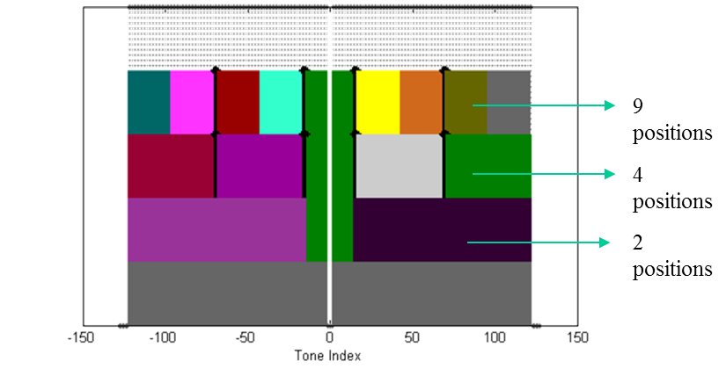
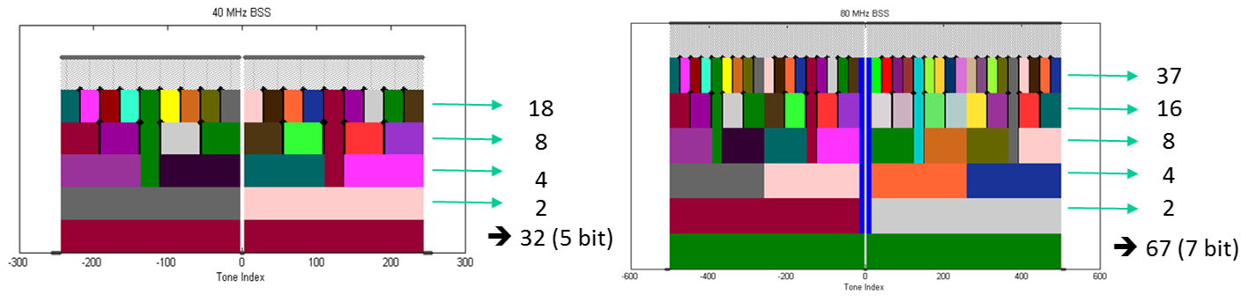
Appendix: OFDMA Numerology
Number of tones in each sub-band
  2 MHz: 26-tone with 2 pilots
  4 MHz: 52-tone with 4 pilots
  8 MHz: 106-tone with 4 pilots
  16 MHz: 242-tone with 8 pilots

