Slide 1
Considerations on HE-SIG-A/B
Date: 2015-07-15
Authors:

Slide 2
Abstract
This submission shows the following considerations on HE-SIG-A and HE-SIG-B for DL-OFDMA:
#1 Possible contents for HE-SIG-B
#2 HE-SIG-B configurations
#3 Possible decoding optimization

Slide 3
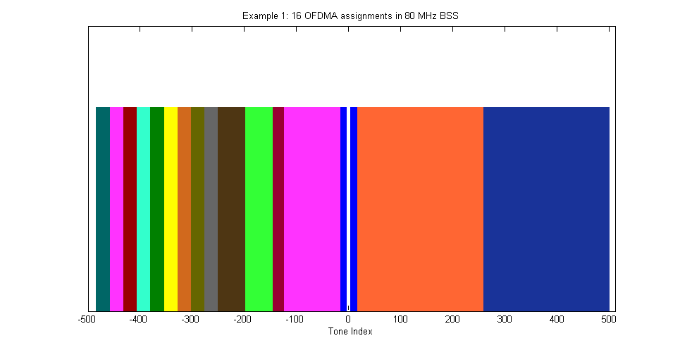
Consideration #1: MCS per OFDMA Resource Unit
We agreed some patterns for OFDMA building blocks at May 2015 meeting. [2]
It is preferable for each resource unit to use different MCS for better efficiency. Combination of resource units also should be identified for each transmission.
e.g. Combination of resource units
16 OFDMA assignments in 80MHz BSS (ref: slide 30 of 15/330r5)
Proposal #1:
Resource unit assignment and MCS for respective resource unit will be contents in HE-SIG-B.

Slide 4
Consideration #1: e.g. Expression of HE-SIG-B
RU = Resource Unit
RU QTTY
RU Info #1
RU Info #2
….
RU Info #n
Bits:
8
8
8
8
RU
width
MCS
RU width:
0: SU
1: 26 tones
2: 52 tones
3: 106 tones
4: 242 tones
5: 484 tones
MCS:
MCS index for 11ac are 0~9.
Bits:
3
4
1
reserved
4 bits will be enough.
This is just an example.
It can be optimized more.
It can be expressed in 3 bits.

Slide 5
Consideration #2: Possible Configurations of HE-SIG-B [3][4]
Option-A. Duplicated HE-SIG-B per 20MHz
Option-B. Non-duplicated HE-SIG-B per 20MHz
variable
variable
[5]
Primary
20MHz
L-Part
HE-
SIG-A
HE-
SIG-B
...
Primary
20MHz
L-Part
HE-
SIG-A
HE-
SIG-B
1
...
Dup.
L-Part
Dup.
HE-
SIG-A
Dup.
HE-
SIG-B
Dup.
L-Part
Dup.
HE-
SIG-A
HE-
SIG-B
2
Dup.
L-Part
Dup.
HE-
SIG-A
Dup.
HE-
SIG-B
Dup.
L-Part
Dup.
HE-
SIG-A
HE-
SIG-B
3
Dup.
L-Part
Dup.
HE-
SIG-A
Dup.
HE-
SIG-B
Dup.
L-Part
Dup.
HE-
SIG-A
HE-
SIG-B
4
Option-C. Entire-channel HE-SIG-B
Option-D. HE-SIG-B per resource unit
variable
frequency
4µs per OFDM Symbol
16µs per OFDM Symbol
Primary
20MHz
L-Part
HE-
SIG-A
HE-
SIG-B
...
…
HE- SIG-A
…
HE-SIG-B
10MHz
…
Dup.
L-Part
Dup.
HE-
SIG-A
HE-SIG-B
10MHz
HE- SIG-A
HE-SIG-B
20MHz
Dup.
L-Part
Dup.
HE-
SIG-A
time
Dup.
L-Part
Dup.
HE-
SIG-A
HE-SIG-A needs to have segment information of resource units. → It’s not feasible.
That big information will not fit in HE-SIG-A.

Slide 6
Consideration #2: Required OFDM Symbols
BW | Max. QTTY of RU | Max. size of HE-SIG-B (required bits) | Required OFDM symbols for HE-SIG-B (64FFT) *
 |  |  | A | B | C
20M | 9 | 80 | 4 | 4 | 4
40M | 18 | 152 | 7 | 4 | 4
80M | 37 | 304 | 13 | 4 * | 4
160M | 74 | 600 | 25 | 4 * | 4
Note-1) HE-SIG-B structure on Slide-4 is assumed.
Note-2) 48 available subcarriers and coding rate = 1/2 are assumed per 20MHz.
* It’s subject how to express the resource units across two 20MHz. (next slide)
Option-A isn’t efficient. It may not be practical.
Proposal #2:
HE-SIG-B should not be duplicated in every 20MHz as Option-A.

Slide 7
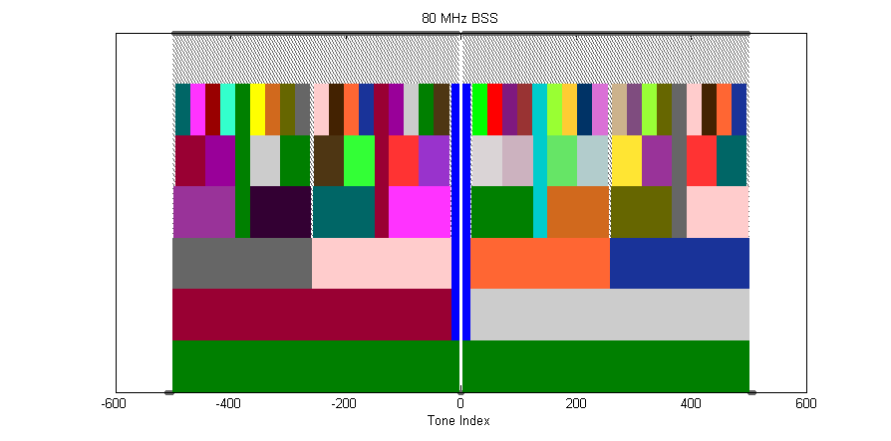
Consideration #2: An Issue on Option-B
Some resource units are across two 20MHz sub-bands.
→ How can we express these resource units in Option-B case??

Slide 8
Consideration #3: Decoding Issue for DL-OFDMA??
Definitive destination address will be acquired from decoded MAC frame.
A receiving STA has to decode all resource units to pick up a desired MAC frame.
: Minimum required portion for decoding
Option-B.
Option-C.
Primary
20MHz
L-Part
HE-
SIG-A
HE-
SIG-B
1
...
Primary
20MHz
L-Part
HE-
SIG-A
HE-
SIG-B
...
Dup.
L-Part
Dup.
HE-
SIG-A
HE-
SIG-B
2
Dup.
L-Part
Dup.
HE-
SIG-A
Dup.
L-Part
Dup.
HE-
SIG-A
HE-
SIG-B
3
Dup.
L-Part
Dup.
HE-
SIG-A
Dup.
L-Part
Dup.
HE-
SIG-A
HE-
SIG-B
4
Dup.
L-Part
Dup.
HE-
SIG-A
It may be complicated for a receiving STA to decode the entire DL-OFDMA frame of multi-resource units with various MCSs and resource segmentations.

Slide 9
Consideration #3: Possible Optimization for Decoding Schemes
When HE-SIG-A has an indication for sub-band selection, a receiving STA may be able to limit decoding portion just for a specific 20MHz.
That indication will be with Multi-Access (MA) group ID. (Need further studies)
: Minimum required portion for decoding
Figures below are examples that are indicated in HE-SIG-A as 2nd 20M to be decoded.
Option-B.
Indication for
sub-band selection
Option-C.
Doc. 15/821r0
A kind of group ID in common field
Not well-optimized
Primary
20MHz
L-Part
HE-
SIG-A
HE-
SIG-B
1
...
Primary
20MHz
L-Part
HE-
SIG-A
HE-
SIG-B
...
Primary
20MHz
L-Part
HE-
SIG-A
HE-
SIG-B
1
...
Dup.
L-Part
Dup.
HE-
SIG-A
HE-
SIG-B
2
Dup.
L-Part
Dup.
HE-
SIG-A
Dup.
L-Part
Dup.
HE-
SIG-A
HE-
SIG-B
2
Dup.
L-Part
Dup.
HE-
SIG-A
HE-
SIG-B
3
Dup.
L-Part
Dup.
HE-
SIG-A
Dup.
L-Part
Dup.
HE-
SIG-A
HE-
SIG-B
3
Dup.
L-Part
Dup.
HE-
SIG-A
HE-
SIG-B
4
Dup.
L-Part
Dup.
HE-
SIG-A
Dup.
L-Part
Dup.
HE-
SIG-A
HE-
SIG-B
4
This optimization may reduce required processing power to decode DL-OFDMA frame on a receiving STA.

Slide 10
Consideration #3: Issues
MA Group Indication:
How to make up the group for each sub-band?
Resource units across two 20MHz sub-bands:
The same issue as Slide-7
Channel estimation
Maybe HE-LTF/STF will help it.
Others?

Slide 11
Conclusion
Some contents of HE-SIG-B are proposed for DL-OFDMA PPDU.
Resource unit assignment (e.g. RU QTTY,RU width)
MCS per RU
HE-SIG-B should not be duplicated on every 20MHz sub-band for better efficiency.
Sub-band selection measure was proposed as a potential optimization.
It may possibly reduce required processing power to decode DL-OFDMA PPDU on a receiving STA.

Slide 12
Straw Poll #1
Do you agree to add the following text into 11ax SFD?
3.2.3 HE-SIG-B
HE-SIG-B includes resource unit assignment and MCS per resource unit for DL-OFDMA PPDU.
Y/N/A =

Slide 13
Straw Poll 2
Do you agree to add the following text into 11ax SFD?
3.2 HE preamble
3.2.1 General
Sub-band selection measure is provided in HE-SIG-A or HE-SIG-B for DL-OFDMA PPDU reception.
Note: It is necessary to study appropriate position of that information.
Y/N/A =

Slide 14
References
[1] doc. 11-15/132r5, “Specification Framework for TGax”
[2] doc. 11-15/330r5, “OFDMA Numerology and Structure”
[3] doc. 11-15/621r2, “Design Principles for HE Preamble”
[4] doc. 11-15/557r0, “Preamble Structure in 802.11ax”
[5] doc. 11-15/821r0, “HE-SIG-B Structure”

