Slide 1
HE-SIGA transmission for range extension
Date: 2015-07-12
Authors:
Name | Affiliation | Address | Phone | Email
Jiayin Zhang | Huawei | 5B-N8, No.2222 Xinjinqiao Road, Pudong, Shanghai | +86-18601656691 | zhangjiayin@huawei.com
Jun Zhu |  |  |  | zhujun75@huawei.com
Le Liu |  | F1-17, Huawei Base, Bantian, Shenzhen | +86-18601656691 | liule@huawei.com
Jun Luo |  | 5B-N8, No.2222 Xinjinqiao Road, Pudong, Shanghai |  | jun.l@huawei.com
Yi Luo |  | F1-17, Huawei Base, Bantian, Shenzhen | +86-18665891036 | Roy.luoyi@huawei.com
Yingpei Lin |  | 5B-N8, No.2222 Xinjinqiao Road, Pudong, Shanghai |  | linyingpei@huawei.com
Jiyong Pang |  | 5B-N8, No.2222 Xinjinqiao Road, Pudong, Shanghai |  | pangjiyong@huawei.com
Zhigang Rong |  | 10180 Telesis Court, Suite 365, San Diego, CA 92121 NA |  | zhigang.rong@huawei.com
Rob Sun |  | 303 Terry Fox, Suite 400 Kanata, Ottawa, Canada |  | Rob.Sun@huawei.com
David X. Yang |  | F1-17, Huawei Base, Bantian, Shenzhen |  | david.yangxun@huawei.com

Slide 2
Authors (continued)
Name | Affiliation | Address | Phone | Email
Yunsong Yang | Huawei | 10180 Telesis Court, Suite 365, San Diego, CA 92121 NA |  | yangyunsong@huawei.com
Junghoon Suh |  | 303 Terry Fox, Suite 400 Kanata, Ottawa, Canada |  | Junghoon.Suh@huawei.com
Peter Loc |  |  |  | peterloc@iwirelesstech.com
Name | Affiliation | Address | Phone | Email
Hongyuan Zhang | Marvell | 5488 Marvell Lane, Santa Clara, CA, 95054 | 408-222-2500 | hongyuan@marvell.com
Yakun Sun |  |  |  | yakunsun@marvell.com
Lei Wang |  |  |  | Leileiw@marvell.com
Liwen Chu |  |  |  | liwenchu@marvell.com
Jinjing Jiang |  |  |  | jinjing@marvell.com
Yan Zhang |  |  |  | yzhang@marvell.com
Rui Cao |  |  |  | ruicao@marvell.com
Jie Huang |  |  |  | jiehuang@marvell.com
Sudhir Srinivasa |  |  |  | sudhirs@marvell.com
Saga Tamhane |  |  |  | sagar@marvell.com
Mao Yu |  |  |  | my@marvel..com
Edward Au |  |  |  | edwardau@marvell.com
Hui-Ling Lou |  |  |  | hlou@marvell.com

Slide 3
Authors (continued)
Name | Affiliation | Address | Phone | Email
Albert Van Zelst | Qualcomm | Straatweg 66-S Breukelen, 3621 BR Netherlands |  | allert@qti.qualcomm.com
Alfred Asterjadhi |  | 5775 Morehouse Dr. San Diego, CA, USA |  | aasterja@qti.qualcomm.com
Bin Tian |  | 5775 Morehouse Dr. San Diego, CA, USA |  | btian@qti.qualcomm.com
Carlos Aldana |  | 1700 Technology Drive San Jose, CA 95110, USA |  | caldana@qca.qualcomm.com
George Cherian |  | 5775 Morehouse Dr. San Diego, CA, USA |  | gcherian@qti.qualcomm.com
Gwendolyn Barriac |  | 5775 Morehouse Dr. San Diego, CA, USA |  | gbarriac@qti.qualcomm.com
Hemanth Sampath |  | 5775 Morehouse Dr. San Diego, CA, USA |  | hsampath@qti.qualcomm.com
Menzo Wentink |  | Straatweg 66-S Breukelen, 3621 BR Netherlands |  | mwentink@qti.qualcomm.com
Richard Van Nee |  | Straatweg 66-S Breukelen, 3621 BR Netherlands |  | rvannee@qti.qualcomm.com
Rolf De Vegt |  | 1700 Technology Drive San Jose, CA 95110, USA |  | rolfv@qca.qualcomm.com
Sameer Vermani |  | 5775 Morehouse Dr. San Diego, CA, USA |  | svverman@qti.qualcomm.com
Simone Merlin |  | 5775 Morehouse Dr. San Diego, CA, USA |  | smerlin@qti.qualcomm.com
Tevfik Yucek |  | 1700 Technology Drive San Jose, CA 95110, USA |  | tyucek@qca.qualcomm.com
VK Jones |  | 1700 Technology Drive San Jose, CA 95110, USA |  | vkjones@qca.qualcomm.com
Youhan Kim |  | 1700 Technology Drive San Jose, CA 95110, USA |  | youhank@qca.qualcomm.com

Slide 4
Authors (continued)
Name | Affiliation | Address | Phone | Email
James Yee | Mediatek | No. 1 Dusing 1st Road, Hsinchu, Taiwan | +886-3-567-0766 | james.yee@mediatek.com
Alan Jauh |  |  |  | alan.jauh@mediatek.com
Chingwa Hu |  |  |  | chinghwa.yu@mediatek.com
Frank Hsu |  |  |  | frank.hsu@mediatek.com
Thomas Pare | Mediatek USA | 2860 Junction Ave, San Jose, CA 95134, USA | +1-408-526-1899 | thomas.pare@mediatek.com
ChaoChun Wang |  |  |  | chaochun.wang@mediatek.com
James Wang |  |  |  | james.wang@mediatek.com
Jianhan Liu |  |  |  | Jianhan.Liu@mediatek.com
Tianyu Wu |  |  |  | tianyu.wu@mediatek.com
Russell Huang |  |  |  | russell.huang@mediatek.com
Joonsuk Kim | Apple |  |  | joonsuk@apple.com
Aon Mujtaba |  |  |  | mujtaba@apple.com
Guoqing Li |  |  |  | guoqing_li@apple.com
Eric Wong |  |  |  | ericwong@apple.com
Chris Hartman |  |  |  | chartman@apple.com

Slide 5
Authors (continued)
Name | Affiliation | Address | Phone | Email
Ron Porat | Broadcom |  |  | rporat@broadcom.com
Sriram Venkateswaran |  |  |  | mfischer@broadcom.com
Matthew Fischer
Leo Montreuil
Andrew Blanksby
Vinko Erceg
Robert Stacey | Intel | 2111 NE 25th Ave, Hillsboro OR 97124, USA | +1-503-724-893 | robert.stacey@intel.com
Eldad Perahia |  |  |  | eldad.perahia@intel.com
Shahrnaz Azizi |  |  |  | shahrnaz.azizi@intel.com
Po-Kai Huang |  |  |  | po-kai.huang@intel.com
Qinghua Li |  |  |  | quinghua.li@intel.com
Xiaogang Chen |  |  |  | xiaogang.c.chen@intel.com
Chitto Ghosh |  |  |  | chittabrata.ghosh@intel.com
Laurent cariou |  |  |  | laurent.cariou@intel.com
Rongzhen Yang |  |  |  | rongzhen.yang@intel.com

Slide 6
Authors (continued)
Name | Affiliation | Address | Phone | Email
Kiseon Ryu | LG Electronics | 19, Yangjae-daero 11gil, Seocho-gu, Seoul 137-130, Korea |  | kiseon.ryu@lge.com
Jinyoung Chun |  |  |  | jiny.chun@lge.com
Jinsoo Choi |  |  |  | js.choi@lge.com
Jeongki Kim |  |  |  | jeongki.kim@lge.com
Giwon Park |  |  |  | giwon.park@lge.com
Dongguk Lim |  |  |  | dongguk.lim@lge.com
Suhwook Kim |  |  |  | suhwook.kim@lge.com
Eunsung Park |  |  |  | esung.park@lge.com
HanGyu Cho |  |  |  | hg.cho@lge.com
Thomas Derham | Orange |  |  | thomas.derham@orange.com
Bo Sun | ZTE | #9 Wuxingduan, Xifeng Rd., Xi'an, China |  | sun.bo1@zte.com.cn
Kaiying Lv |  |  |  | lv.kaiying@zte.com.cn
Yonggang Fang |  |  |  | yfang@ztetx.com
Ke Yao |  |  |  | yao.ke5@zte.com.cn
Weimin Xing |  |  |  | xing.weimin@zte.com.cn
Brian Hart | Cisco Systems | 170 W Tasman Dr, San Jose, CA 95134 |  | brianh@cisco.com
Pooya Monajemi |  |  |  | pmonajem@cisco.com

Slide 7
Authors (continued)
Name | Affiliation | Address | Phone | Email
Fei Tong | Samsung | Innovation Park, Cambridge CB4 0DS (U.K.) | +44 1223 434633 | f.tong@samsung.com
Hyunjeong Kang |  | Maetan 3-dong; Yongtong-Gu Suwon; South Korea | +82-31-279-9028 | hyunjeong.kang@samsung.com
Kaushik Josiam |  | 1301, E. Lookout Dr, Richardson TX 75070 | (972) 761 7437 | k.josiam@samsung.com
Mark Rison |  | Innovation Park, Cambridge CB4 0DS (U.K.) | +44 1223 434600 | m.rison@samsung.com
Rakesh Taori |  | 1301, E. Lookout Dr, Richardson TX 75070 | (972) 761 7470 | rakesh.taori@samsung.com
Sanghyun Chang |  | Maetan 3-dong; Yongtong-Gu Suwon; South Korea | +82-10-8864-1751 | s29.chang@samsung.com
Yasushi Takatori | NTT | 1-1 Hikari-no-oka, Yokosuka, Kanagawa 239-0847 Japan |  | takatori.yasushi@lab.ntt.co.jp
Yasuhiko Inoue |  |  |  | inoue.yasuhiko@lab.ntt.co.jp
Yusuke Asai |  |  |  | asai.yusuke@lab.ntt.co.jp
Koichi Ishihara |  |  |  | ishihara.koichi@lab.ntt.co.jp
Akira Kishida |  |  |  | kishida.akira@lab.ntt.co.jp
Akira Yamada | NTT DOCOMO | 3-6, Hikarinooka, Yokosuka-shi, Kanagawa, 239-8536, Japan |  | yamadaakira@nttdocomo.com
Fujio Watanabe |  | 3240 Hillview Ave, Palo Alto, CA 94304 |  | watanabe@docomoinnovations.com
Haralabos Papadopoulos |  |  |  | hpapadopoulos@docomoinnovations.com

Slide 8
Abstract
Outdoor hotspot is one of 11ax scenarios defined in [1], where receivers suffer larger pathloss and channel delay spread in 2.4 and 5GHz channel than in previous standards.
In [2][3], the HE preamble structures are proposed. In this presentation, we investigate the PER of HE-SIG-A performance in UMi NLOS scenarios.
A time repetition mode with different tone mapping scheme for HE-SIG-A symbols is proposed for range extension.
In r2, we provide further performance comparison of different range extension schemes. The potential indication methods of repetition mode are discussed.

Slide 9
HE preamble structure
In 11ax SFD[4], HE preamble includes the legacy preamble (L-STF, L-LTF and L-SIG), HE-SIG-A.
In [2], an RLSIG is proposed for the purpose of 11ax PPDU auto-detection and L-SIG PER enhancement.
In [3], it is proposed that HE-SIG-A is present in all 11ax packets and contains two OFDM symbols long when it uses MCS0.

Slide 10
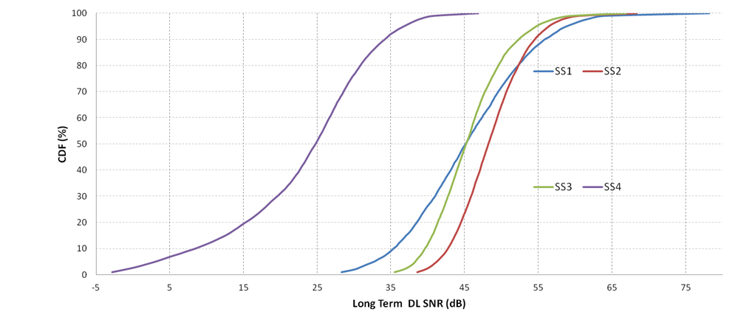
Link budgets
In SS4, 95% BSS STAs have long term SNR in DL larger than 3dB, according to the calibrated system level simulation.
Scenario | 5% percentile long term DL SNR (dB)
SS1 | 32.45
SS2 | 39.58
SS3 | 36.6
SS4 | 3

Slide 11
PER evaluation in UMi NLOS
We observed HE-SIG-A is not reliable compared with repeated L-SIG, if HE-SIG-A is 2 symbols long and use MCS0.
Assumptions:
SISO
UMi-NLOS
Real Channel Estimation
Real T/F sync
CFO/PN switch on

Slide 12
Range extension mode with repetition
  The time repetition (similar as L-SIG repetition) can only achieve power gain by soft combining the successively received signals.
    2 successive OFDM symbol almost suffers same channel fading due to almost static environment.
  HE-SIG-A requires more SNR gain than L-SIG considering HE-SIG-A will have twice the packet length of L-SIG.
  Additional frequency diversity gain can be achieved if the repeated HE-SIG-A symbols have different tone mapping.

Slide 13
Transmitter of HE-SIG-A
We propose to use the time repetition and bypassing the bit interleaver of repeated HE-SIG-A symbols to enhance robustness of HE-SIG-A in outdoor scenarios.

Slide 14
Receiver of HE-SIG-A
Correspondingly, the receiver can reuse the existing hardware as much as possible
  It can bypass the de-interleaver for the repeated symbol
  The soft combining is same as that in the L-SIG repetition scheme agreed in the group.

Slide 15
Performance evaluation
Some observations from simulation
  The proposed HE-SIGA RE mode can provide at most 3.5dB gain @10% PER(and 6 dB gain @ 1% PER) .
  The proposed HE-SIGA RE mode can provide balanced performance with L-SIG+RL-SIG.

Slide 16
Performance with 2TX and 4TX
We observed similar performance gain in 2Tx and 4Tx scenario when legacy CSD value is used.

Slide 17
Mode indication
The 2-symbol HE-SIG-A with MCS0 can meet the requirement for most BSS STA in indoor scenarios , such as SS1~3.
Range extension of HE-SIG-A is required in outdoor scenario (SS4) or large coverage scenario, at the cost of more overhead.
AP can decide whether using range extension according to the network deployment or channel measurement.
Range extension mode should be indicated before HE-SIGA.
Normal
Range extension mode

Slide 18
R2 updates:
Different range extension schemes
We compare several schemes to enhance the PER performance of HE-SIG-A
  Using long GI (Opt 1): can only reduce the PER error floor by ISI mitigation;
  Time Repetition (Opt 2): can enhance PER by power gain;
  Time repetition with long GI (Opt 3): can enhance PER by power gain and ISI mitigation;
  Proposed scheme in page 15 (Opt 4)
We found the proposed scheme have best PER performance in the interested SNR range.

Slide 19
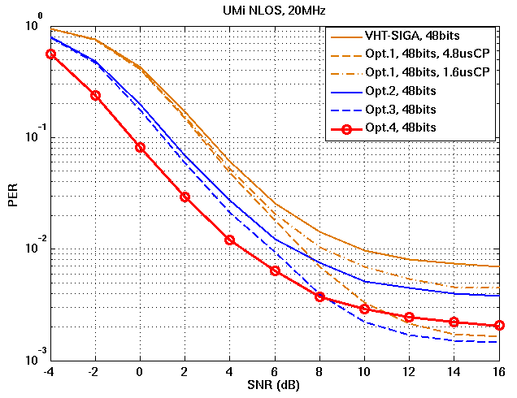
R2 updates:
Performance comparsion

Slide 20
R2 updates:
Potential indication methods
Opt 1:remainder of L-LENGTH
  11ac have the L-LENGTH always dividable by 3.
  In [5], the authors proposed to check the content of RLSIG to further reduce the false alarm, e.g. the L-LENGTH not dividable by 3 for 11ax PPDU.
  Range extension can be indicated by the remainder after division.
Opt2:scrambling sequences on RLSIG
  In [5], bipolar sequence scrambled on the RLSIG was proposed for future standard extension.
  It is also possible to use different scrambling sequences to carry addition bits
Opt3:reserved bit in RLSIG

Slide 21
Conclusion
Repeated HE-SIGA is needed in many use cases including range extension and outdoor channel operation.
An implementation friendly repetition method is proposed to harvest the frequency diversity gain.

Slide 22
Straw Poll
Do you support that HE-SIG-A have a repetition mode for range extension?
  In the repetition mode, HE-SIG-A symbols are repeated once in time. The bit interleaver is bypassed in the repeated HE-SIG-A symbols?
  The repetition mode is indicated before HE-SIG-A.

Slide 23
References
[1] 11-14-0980-12-00ax-simulation-scenarios
[2] 11-15-0579-00-00ax preamble design and autodetection
[3] 11-15-0822-00-00ax-SIG-A Structure in 11ax Preamble
[4] 11-15-0132-06-00ax-spec-framework
[5] 11-15-0579-03-00ax-preamble-design-and-autodetection

