Slide 1
Pilot Design for 11ax Downlink Transmissions
Date: 2015-07-13
Authors:

Slide 2
Background
HE-LTF compression and OFDMA numerology have been introduced in SFD [1] for 802.11ax
Both 4x HE-LTF and 2x HE-LTF
HE-LTF symbol duration of 12.8 µs excluding GI
HE-LTF symbol duration of 6.4 µs excluding GI
Equivalent to modulating every other tone in an OFDM symbol of 12.8 µs excluding GI, and then removing the second half of the OFDM symbol in time domain
Different size of OFDMA resource units (RU)
Number of pilot tones in data OFDM symbol decided
E.g.) With 20MHz OFDMA building blocks, 26-tone with 2 pilots, 52-tones with 4 pilots, 106-tone with 4 pilots and 242 tones with 8 pilots
This contribution shows performance gap in accordance with different number of pilot tones in 2x HE-LTF

Slide 3
Pilot Tones in LTF
LTF Tones are pilots that aid channel estimation
In case LTF spans over multiple OFDM symbols (i.e. LTF sequence spanning more than 2 spatial streams), VHT PPDU contains few number of single spatial stream tones
Obviously single spatial stream tones cannot be used for channel estimation of multi-stream transmission
The single spatial stream tones aid frequency offset and phase tracking during LTF OFDM symbol reception, similar to what pilot tone within data OFDM symbol does
The single spatial stream tones and pilot tones in data are frequency aligned such that single spatial stream LTF tones can aid pilot tracking in the data OFDM symbols
We will denote these single spatial stream tones as “pilot” tones within LTF

Slide 4
Considerations on HE-LTF
Pilot tones might make an impact on channel estimation performance while interpolating on 2x HE-LTF at a receiver
2x HE-LTF
OFDM Symbol
Data
OFDM Symbol
pilot tone
…
Case 1
Case 2
Interpolation between right adjacent tones to non-sampled LTF tones
Interpolation between tones as close to non-sampled LTF tones as possible
reconstructed
LTF tone
pilot tone

Slide 5
Considerations on HE-LTF (cont’d)
Single stream pilot tones improve MIMO channel estimation under the (residual) carrier frequency offset and drift
Improvements in channel estimation for high-order QAM
Improvements in tracking carrier frequency offset/drift in longer LTF OFDM symbol duration (compared to VHT) and high-order MIMO
Part of pilot tones might be missing on 2x HE-LTF depending on its position on 4x HE-LTF
missing pilot tone
pilot tone
2xLTF
OFDM Symbol
…
…
Data
OFDM Symbol
…
…
Note: Example of Pilot tone location in 2xLTE OFDM symbols identical to those in data OFDM symbols

Slide 6
Simulation Environments
Parameters
20MHz
250 bytes/packet for 26-tone
500 bytes/packet for 52-tone
1000 bytes/packet for 106-tone
2500 bytes/packet for 242-tone
4x4 4SS & 4x4 1SS
Both using 4 LTF OFDM Symbols (assumes OFDMA multi-user SU-MIMO operations)
64QAM, ¾ rate
TGac D
40ppm CFO, -41dBc phase noise, and 0 or 25 Hz/us CF drift
Channel interpolation on 2x HE-LTFs
Pilot sequence of 20/40/80MHz in VHT
Number of pilots in data OFDM symbols fixed to:
2/4/4/8 pilot tones in 26/52/106/242 tone RU

Slide 7
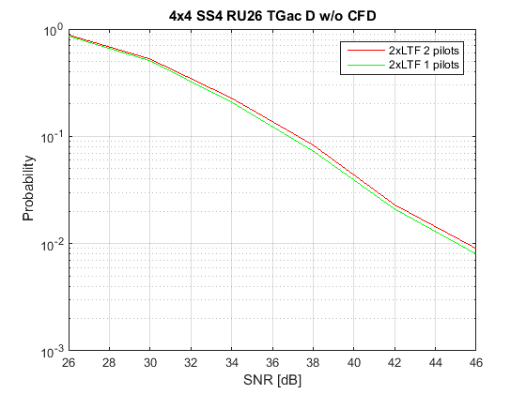
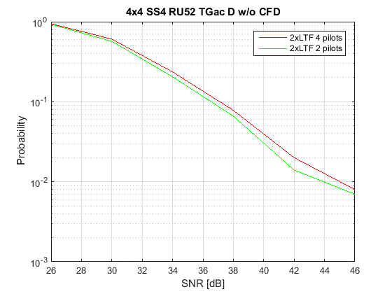
Simulations 4x4 SS4 TGac D without CF drift
Performance comparison between different number of pilot tones on 2x HE-LTF in RU 26 & RU 52
Performance of the half number of pilot tones on 2x HE-LTF is slightly better than using whole pilot tones because of interpolation improvements during channel estimation

Slide 8
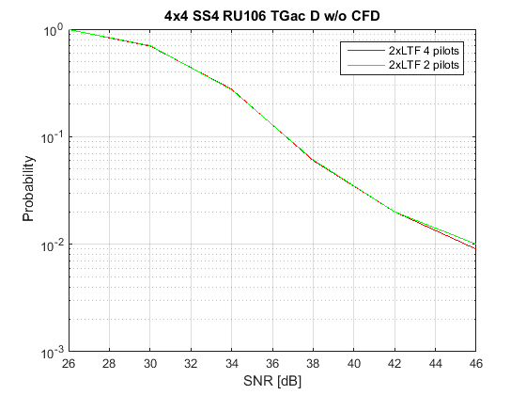
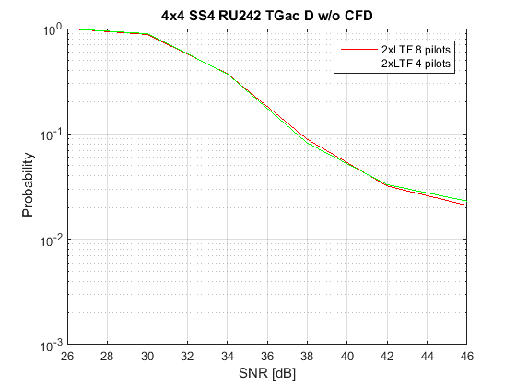
Simulations (cont’d) 4x4 SS4 TGac D without CF drift
Performance comparison of the number of pilot tones on 2x HE-LTF in RU 106 & RU 242
Performance between half number of pilot tones and entire number of pilot tones on 2x HE-LTF is similar
Interpolation gain averaged out with enough number of tones

Slide 9
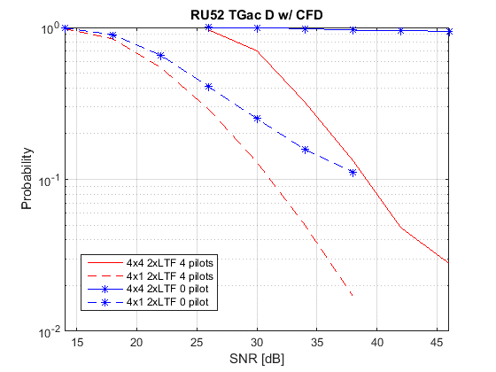
Simulations (cont’d) TGac D with CFD 25 Hz/us
4 spatial stream
4 LTF OFDM symbols
4 spatial stream
4 LTF OFDM symbols
1 spatial stream
4 LTF OFDM symbols
1 spatial stream
4 LTF OFDM symbols
5 dB
8 dB
4x4 users with 4 HE-LTFs and 4x1 users with 4 HE-LTFs
Note that data OFDM symbols still contain pilots even if LTF symbols do not
Having carrier frequency offset/phase tracking in LTF OFDM symbol is critical to performance, especially with receiver impairments
0 pilot on 2x LTF shows severe performance loss
More critical in case of higher order MIMO

Slide 10
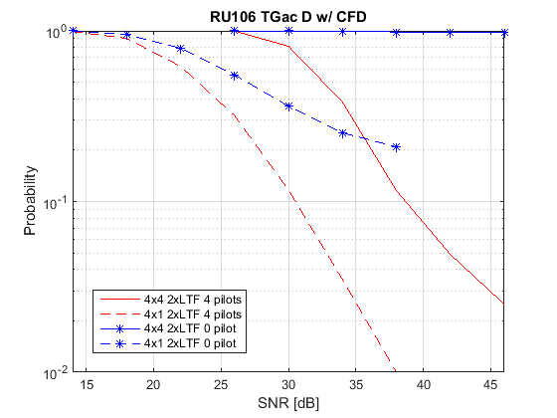
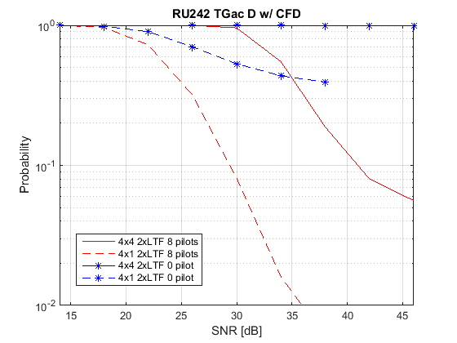
Simulations (cont’d) TGac D with CFD 25 Hz/us
4 spatial stream
4 LTF OFDM symbols
1 spatial stream
4 LTF OFDM symbols
1 spatial stream
4 LTF OFDM symbols
4 spatial stream
4 LTF OFDM symbols
4x4 users with 4 HE-LTFs and 4x1 users with 4 HE-LTFs
Same trend can be observed in 106 and 242 RU sizes.

Slide 11
Summary
Number of pilot tones on 2xLTF have critical impact on performance
Complex trade off between carrier frequency offset/phase tracking and channel estimation performance.
More critical in case of higher order MIMO
Pilot design in both number and position requires careful consideration

Slide 12
References
[1] 11-15-0132r5, Specification Framework for TGax

Slide 13
Appendix

Slide 14
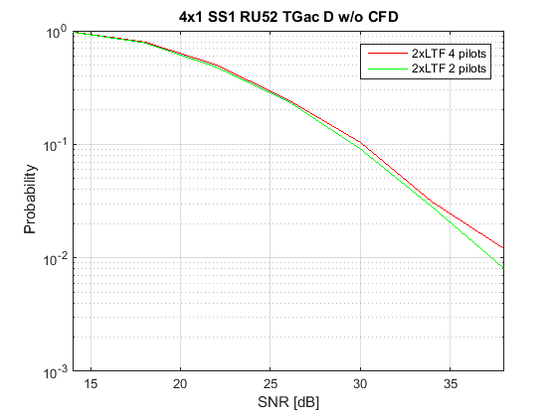
Simulations 4x1 SS1 TGac D without CF drift
Same trend can be observed

Slide 15
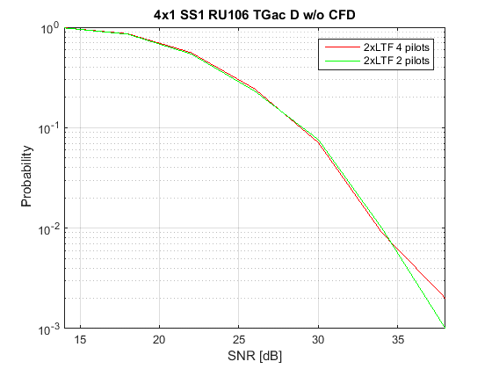
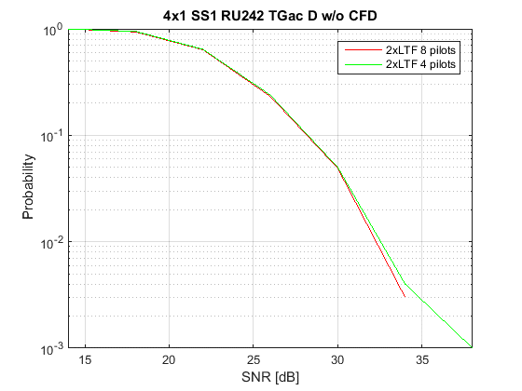
Simulations (cont’d) 4x1 SS1 TGac D without CF drift
Same trend can be observed

Slide 16
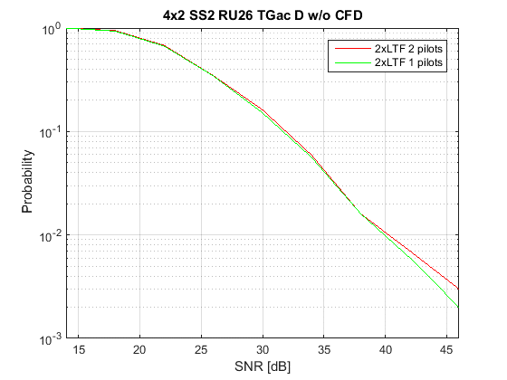
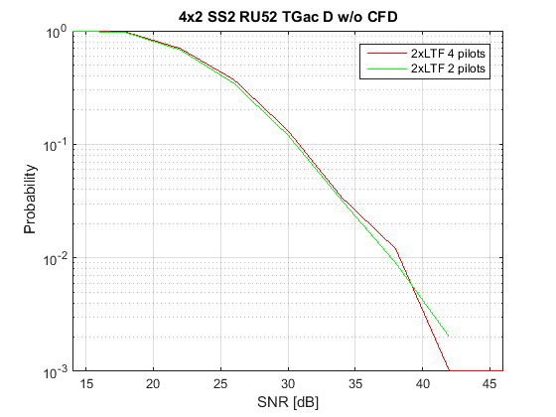
Simulations (cont’d) 4x2 SS2 TGac D without CF drift
Same trend can be observed

Slide 17
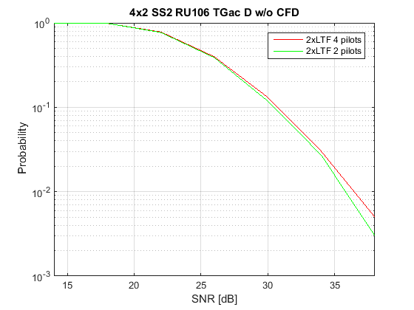
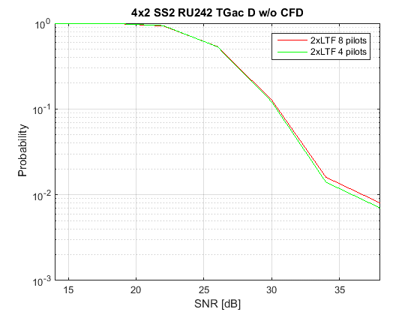
Simulations (cont’d) 4x2 SS2 TGac D without CF drift
Same trend can be observed

Slide 18
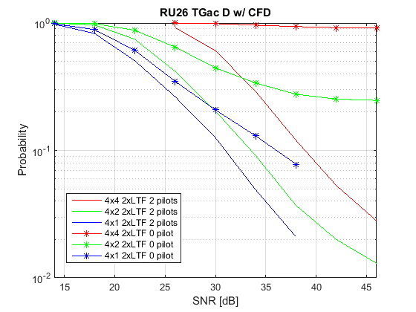
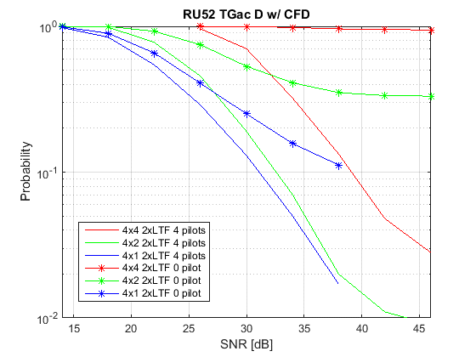
Simulations (cont’d) TGac D with CFD 25 Hz/us
Same trend can be observed

Slide 19
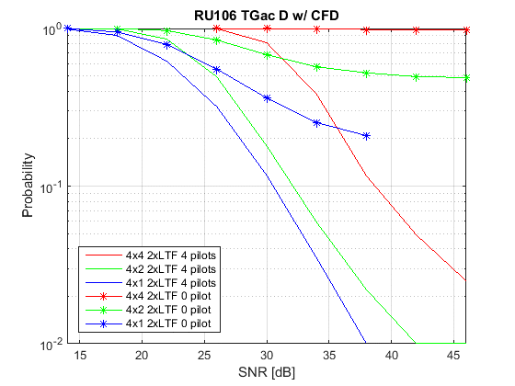
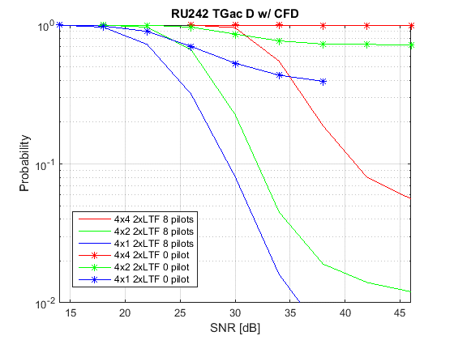
Simulations (cont’d) TGac D with CFD 25 Hz/us
Same trend can be observed

