Slide 1
WLAN Positioning for Smart Home Portable Devices
Date: 2015-07-11
Authors:

Slide 2
Use case
NGP SG is now discussing use cases for next generation positioning.
Now some use cases are proposed.
  Positioning for Home Audio
  Navigation in public buildings
This presentation proposes a new use case: positioning for smart home portable devices.

Slide 3

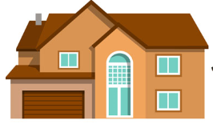
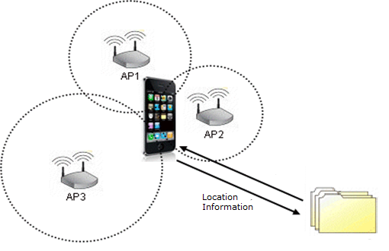
Scenario

Slide 4
Positioning for Portable Devices
Background:
    Portable devices with Wi-Fi such as iTouch, iPAD, MP3 player, and other devices. Sometimes people couldn’t remember where they put it and can’t find those devices. Depending on WLAN positioning, it’s easy to find them.
User:
  Family members
Environment:
  Smart home with 1 AP or multiple APs coverage.
  AP supporting .11n, .11ac, and NGP

Slide 5
Requirements
Positioning requirements
 | use case
Horizontal accuracy | <= 20cm
Vertical accuracy | not required
Latency | <= 100ms
Refresh rate | 2-3 per second
Number of simultaneous users | <=5
Frequency | All 802.11 bands
AP density | N/A

Slide 6
Suggestions
To add the new use case to NGP use case.

Slide 7
References
Thomas Handte, Sony, 11-15-0561-01-0ngp, Selected use cases for next generation positioning.

