Slide 1
Further Analysis of Feedback and Frequency Selective Scheduling (FSS) for TGax OFDMA
Date: 2015-07-12
Authors:

Slide 2
Outline
Motivation
Feedback Granularity (FG)/ Resource Unit Granularity (RG)
System Throughput Simulation Assumptions
System Throughput Results
Effect of Quantization, Feedback Overhead and Latency
Conclusions
References

Slide 3
Abstract
This contribution quantifies the potential resource unit (RU) selection gains for OFDMA transmissions for different granularities, TGax channels and TGax simulation scenarios.
The effects of feedback granularity (FG), RU granularity (RG), quantization, latency and feedback overhead on the selection gains are studied.
The gains achieved from RU scheduling for TGax OFDMA motivate the need for efficient RU-based feedback.

Slide 4
Motivation
  The 11ax specification framework has already defined UL/DL OFDMA as one of the key 11ax MU features [1].
  An RU numerology has been agreed upon [4]
OFDMA may exploit the channel selectivity to maximize frequency selective multiplexing gain in dense network conditions [5][6][7][13].
  Results from [13] are updated based on the newly agreed numerology [4]
  We quantify the gains for resource unit (RU) scheduling in OFDMA transmissions
    over different TGax channels [2][3]
    in different TGax simulation scenarios [8]
    using different RU/FG granularities
    for different feedback SNR quantization levels
    for different feedback latencies

Slide 5
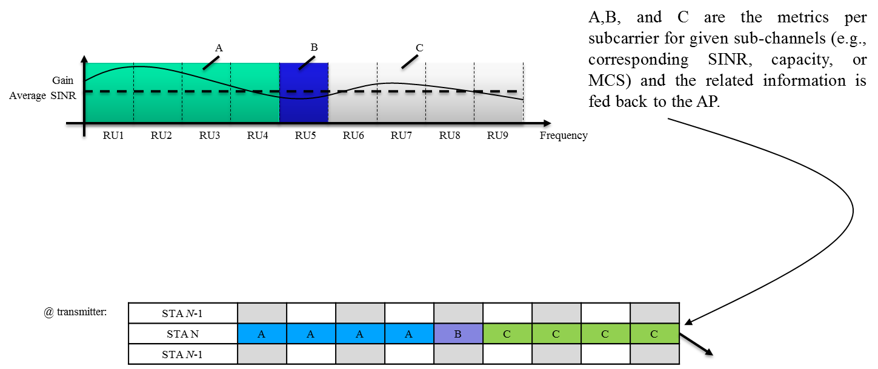
Granularity Definition
@ Receiver: Instantaneous rates on the sub-channels (based on feedback granularity (FG)) are calculated and fed back to the transmitter.
@ Transmitter: Instantaneous rates on the RUs (based on RU granularity (RG)) are calculated for each station and proportional fair scheduling is performed.
Other users may use different granularity.

Slide 6
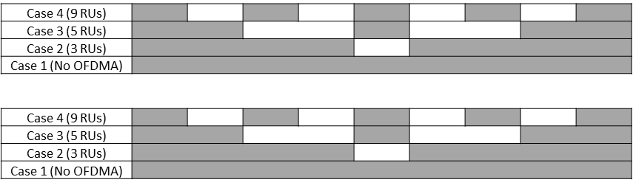
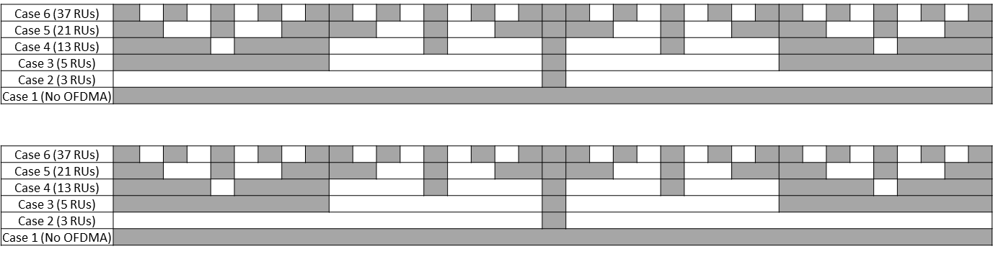
RG and FG for 20 MHz and 80 MHz
Feedback granularity (FG):
RU granularity (RG):
20 MHz Granularity
Feedback granularity (FG):
RU granularity (RG):
80 MHz Granularity

Slide 7
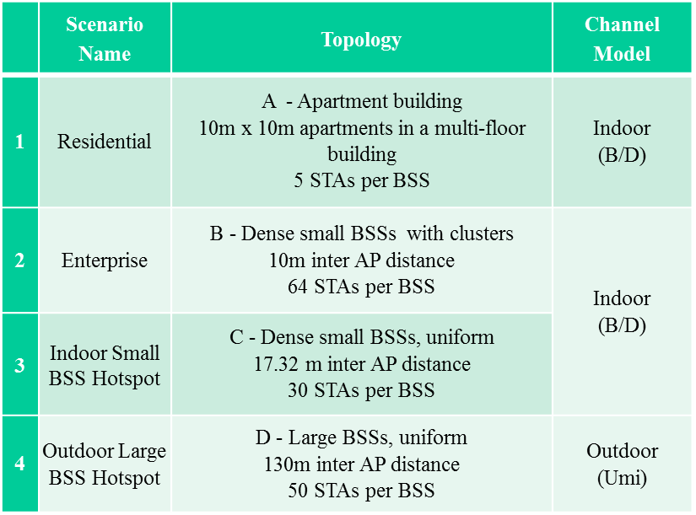
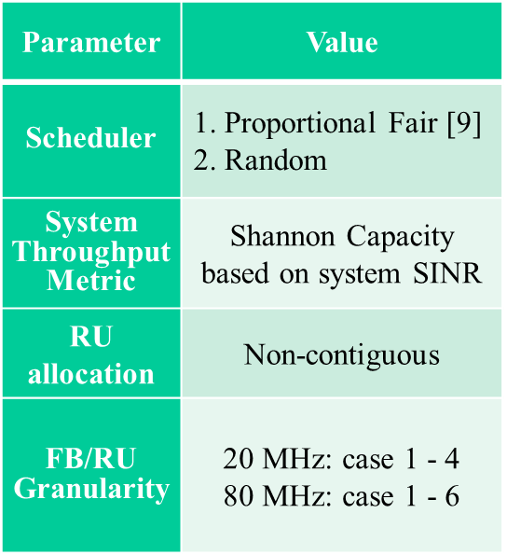
System Throughput Simulation Assumptions
No MAC protocol overhead assumed
STAs are located based on specific TGax simulation scenarios [8]
Non-continuous resource allocation was allowed
Table derived from [8]

Slide 8
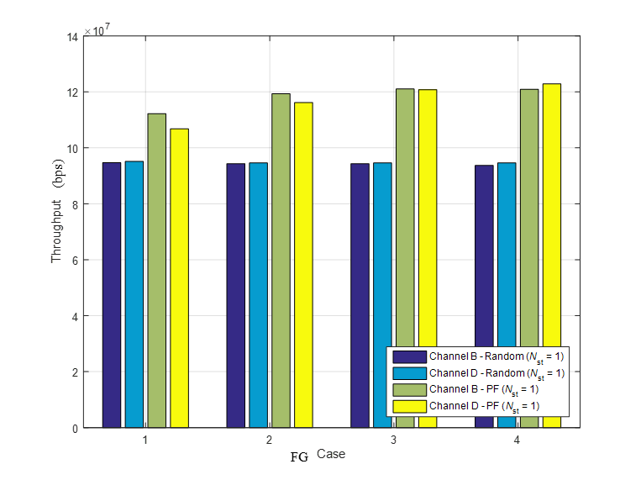
Exemplary Simulation Results (20 MHz): SS1
Throughput
Random vs PF Gain (%)
FG: Case1 to Case 4; RG: Fixed (Case 4)
FG: Case1 to Case 4; Channel D
RG determines the throughput performance. FG should match RG
  For a fixed RG, throughput saturates with increase in FG based on channel type
  Ch B:large initial gains, saturates quickly/ Ch D/Umi: gains saturate more slowly

Slide 9
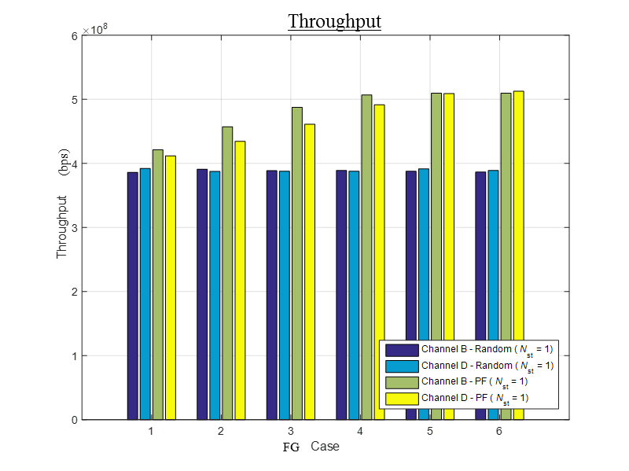
Exemplary Simulation (80 MHz): SS1
FB Granularity : Case1 to Case 6
Random vs PF Gain (%)
RG: Fixed (Case 6)
Channel Model: Channel B/D
FG: Case1 to Case 6
Channel Model: Channel D
  More gain in 80 MHz than 20 MHz due to large frequency selectivity available
Similar saturation behavior and RG/FG relationships as 20 MHz transmission
Appendix: Large system throughput gains for scenarios with low baseline throughputs
  SS3 ≈ 40% (20 MHz); SS3 ≈ 45 %(80 MHz) ; SS4 ≈ 60% in 20 MHz transmission

Slide 10
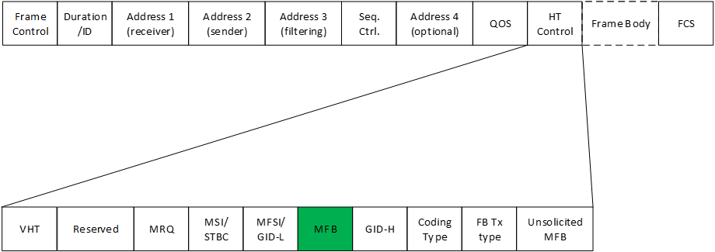
Quantization, Overhead and Delay
802.11ac MCS Feedback Mechanism (VHT variant HT Control field) as baseline
MCS Feedback (MFB) field contains:
NUM_STS: recommended number of Space Time Streams
VHT-MCS: recommended MCS; unsigned integer from 0 to 9
BW: bandwidth for which the recommended VHT-MCS is intended
  unsigned integer from 0 to 3
SNR: SNR averaged over all data subcarriers and space-time streams
  6-bit integer covering -10dB to 53 dB in 1 dB steps

Slide 11

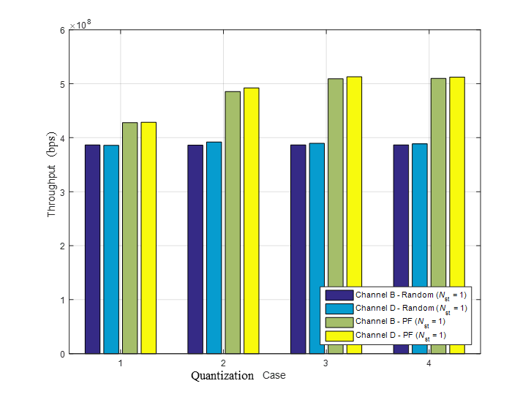
Effect of Feedback Quantization
Quantify effect of SINR quantization on scheduling gains
20 MHz: FG = RG = 9 RUs
80 MHz: FG = RG = 37 RUs
Case1: 1 bit; Case2: 3 bits ; Case3: 6 bits; Case4: No quantization
SINR value quantized and fed back to the transmitter. [-10,53] dB mapped to 2^{N -1} values
6-bit quantization of SINR for each RU (equivalent to MFB:SNR quantization in 802.11ac [14, Table 8-13b].) is sufficient to extract scheduling gains

Slide 12
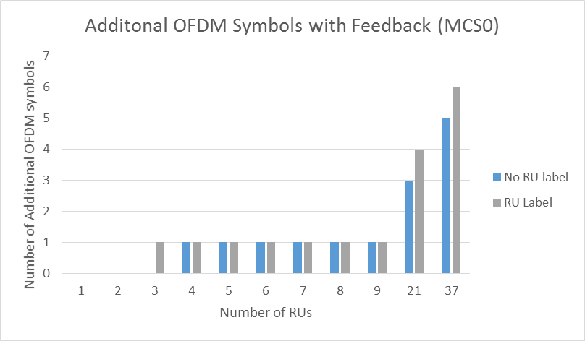
Feedback Overhead
Quantify feedback overhead in number of OFDM symbols assuming MCS0 transmission and 802.11ac MFB mechanism
1 additional OFDM symbol needed for 20 MHz with 4 to 9 FB granularity
3 or 4 additional OFDM symbols needed for 80 MHz with 21 FB granularity
  no performance loss compared with 37 FB granularity

Slide 13
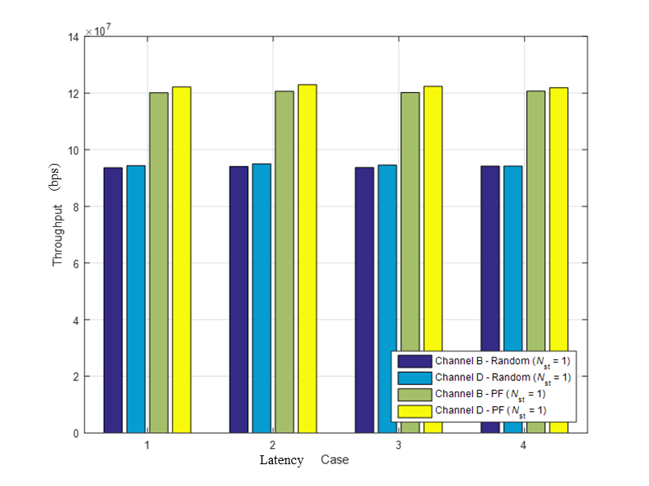
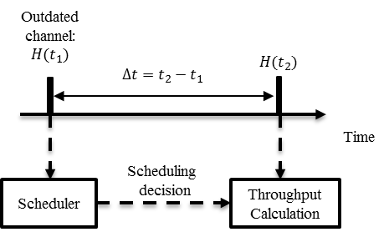
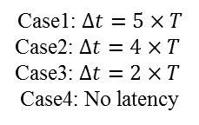
Latency - Simulation Scenario 1 @ 20 MHz
Quantify effect of latency between feedback measurement and scheduling on scheduling gains
Case1: $Δt=5×T$
Case2: $Δt=4×T$
Case3: $Δt=2×T$
Case4: No latency
FB Granularity : Case 4
RU Granularity: Case 4
Bandwidth: 20 MHz
Quantization: Ideal
Number of users: 5
T = Duration(NDPA) +
Duration(NDP) +
Duration (Feedback)
In this scenario, latency does not affect scheduling gains

Slide 14
Conclusions
With CSI-based RU selection, OFDMA may maximize the system throughput gain in TGax scenarios.
We quantify the potential resource unit (RU) selection gains for TGax OFDMA transmissions with different RU sizes, bandwidths, channels and simulation scenarios.
  The effects of feedback granularity, quantization, delay and feedback overhead on the selection gains are also studied.
  System throughput gains of up to ≈40% in indoor scenarios and ≈ 60% in outdoor scenarios may be seen by using CSI-based RU selection as opposed to a random allocation method.
Efficient RU based feedback is needed at the transmitter to realize these gains.

Slide 15
Straw Poll #1
Do you agree to add to the TG Specification Framework?
4.x.y The amendment shall include a mechanism for Resource Unit (RU) based feedback
Y/N/A

Slide 16
References
[1] IEEE 802.11-15/132r6 Spec Framework, Intel
[2] IEEE 802.11-14/882r4, TGax Channel Model Document, Mediatek
[3] Report ITU-R M.2135-1, (12/2009), Guidelines for evaluation of radio interface technologies for IMT-Advanced
[4] IEEE 802.11-15/330r5, OFDMA Numerology and Structure, Intel
[5] IEEE 802.11-14/858r1, Analysis on Multiplexing Schemes exploiting frequency selectivity in WLAN Systems, Samsung
[6] IEEE 802.11-14/1227r2, OFDMA Performance Analysis, Mediatek
[7] IEEE 802.11-15/383r0, Impact of number of sub-channels in OFDMA, Ericsson
[8] IEEE 802.11-15/980r12, Simulation Scenarios, Qualcomm
[9] Zhishui Sun; Changchuan Yin; Guangxin Yue, "Reduced-Complexity Proportional Fair Scheduling for OFDMA Systems,“ Proc. IEEE International Conference on Communications, Circuits and Systems (ICCCAS), vol.2, pp.1221-1225, 2006
[10] IEEE P802.11ac™/D7.0, Draft STANDARD Part 11: Wireless LAN Medium Access Control (MAC) and Physical Layer (PHY) specifications Amendment 4: Enhancements for Very High Throughput for Operation in Bands below 6 GHz
[11] IEEE 802.11-14/571r9, Evaluation Methodologies, Broadcom
[12] IEEE 802.11-15/125r2, Box 1 and Box 2 Calibration Results, Broadcom
[13] IEEE 802.11-15/568r2, Frequency Selective Scheduling (FSS) for TGax OFDMA. InterDigital
[14] Wireless LAN Medium Access Control (MAC) and Physical Layer (PHY) specifications
Amendment 4: Enhancements for Very High Throughput for Operation in Bands below 6 GHz

Slide 17
Additional Material

Slide 18
Summary of System Throughput Analysis
FB Granularity
RG @ 20 MHz: Fixed (Case 4)
RG @ 80 MHz: Fixed (Case 6)

Slide 19
Feedback Overhead Analysis

Slide 20
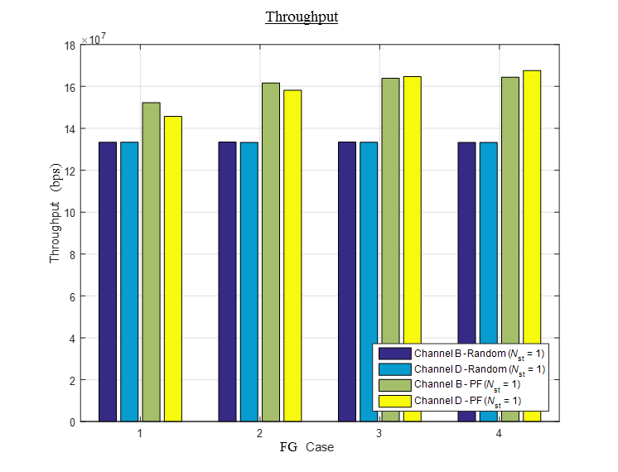
Simulation: Simulation Scenario 2 : 20 MHz
Random vs PF Gain (%)
FB Granularity : Case1 to Case 4
RU Granularity: Fixed (Case 4)
FB Granularity : Case1 to Case 4
Bandwidth: 20 MHz
Bandwidth: 20 MHz
Channel Model: Channel D

Slide 21
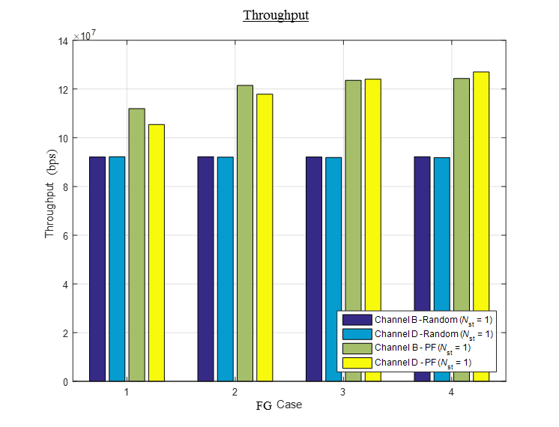
Simulation: Simulation Scenario 3 : 20 MHz
Random vs PF Gain (%)
FB Granularity : Case1 to Case 4
FB Granularity : Case1 to Case 4
RU Granularity: Fixed (Case 4)
Bandwidth: 20 MHz
Bandwidth: 20 MHz
Channel Model: Channel D

Slide 22
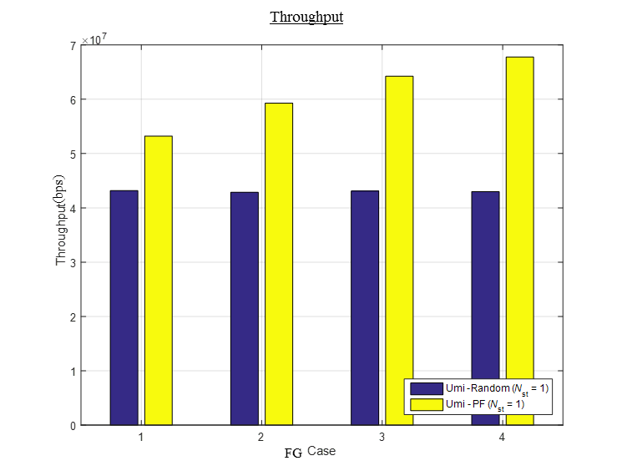
Simulation: Simulation Scenario 4 : 20 MHz
Random vs PF Gain (%)
FB Granularity : Case1 to Case 4
FB Granularity : Case1 to Case 4
RU Granularity: Case1 to Case 4
RU Granularity: Fixed (Case 4)
Bandwidth: 20 MHz
Bandwidth: 20 MHz
Channel Model: UMi

Slide 23
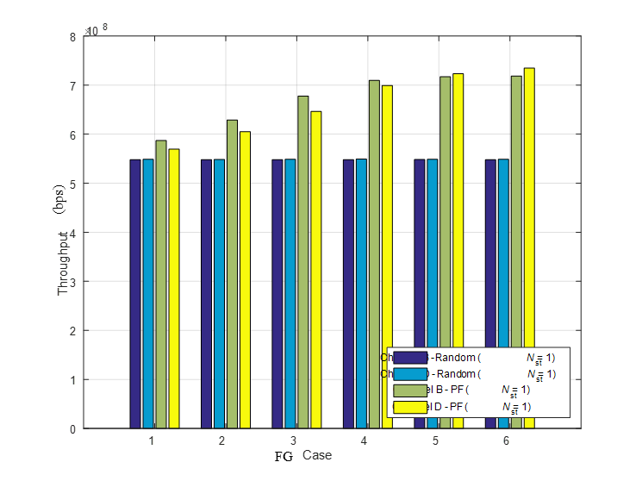
Simulation: Simulation Scenario 2 : 80 MHz
Throughput
FB Granularity : Case1 to Case 6
RU Granularity: Fixed (Case 6)
Bandwidth: 80 MHz

Slide 24
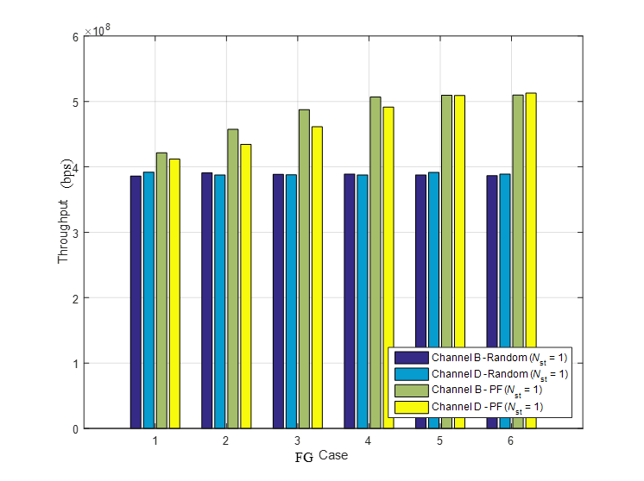
Simulation: Simulation Scenario 3 : 80 MHz
Throughput
FB Granularity : Case1 to Case 6
RU Granularity: Fixed (Case 6)
Bandwidth: 80 MHz

Slide 25
Simulation Methodology of System Throughput
Obtain per tone SINR of STAs based on path loss and shadowing of specific simulation scenario [12] and fading channel [2]
Estimate effective SINR of sub-channels based on the specific numerology using the capacity mapping in [11] at the receiver
Send these to the transmitter using the desired FG
Perform proportional fair scheduling at the transmitter based on effective SINR of different sub-channels at the desired RG [9]
Assign users to sub-channels
Estimate PHY layer system throughput based on capacity of chosen users
Average over multiple drops

