Slide 1
mmWave Small Cell Reconfigurable Backhauling with Steerable Lens-Array Antennas (LAA)
Date: 2015-07-12
Authors:

Slide 2
Abstract
The IEEE 802.11ay group proposed the wireless backhauling as one of the eight use cases for future mmWave systems, [1].
In that scenario 11ay Access Points (APs) are interconnected into the network exploiting a point-to-point or point-to-multi point wireless backhauling topologies. It is proposed to be used as a replacement of the legacy core fiber networks to provide small cell connectivity.
This presentation proposes a solution for the antenna technology named as Lens-Array Antenna (LAA).
It provides high gain transmission, sector sweep beamforming capabilities, and implementation using cost efficient CMOS technology suitable for massive market production.
In this work the results of experimental measurements for the considered LAA design are provided. It includes radiation pattern measurements, beamforming sector sweep capabilities verification, feasibility study of backhaul point-to-point transmission using LAA and IEEE 802.11ad PHY protocol, and channel measurement results.

Slide 3
Phased Antenna Array (PAA)
Figures on the left show Phased Antenna Array (PAA) and associated system of coordinates.
Main parameters:
  8 x 2 active elements rectangular geometry
  25 mm x 9 mm geometrical size
  Vertical polarization, E field vector is parallel to the short edge of the array
  Total transmit power P_{TX} = 10 dBm
  Antenna gain G_{ant} = 15 dBi

Slide 4
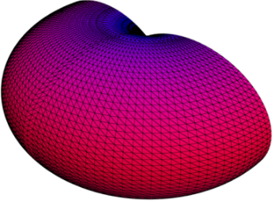
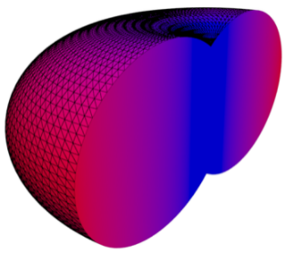
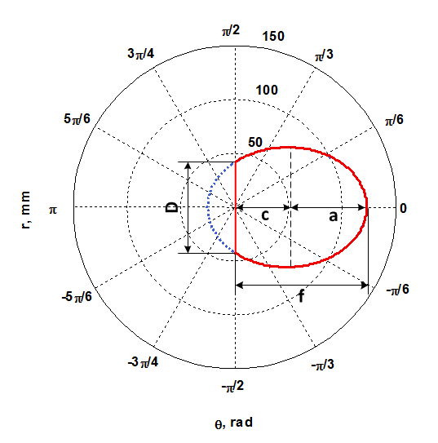
Toroidal Dielectric Lens
3D lens geometry
Toroidal dielectric lens parameters
Parameter | Value
Material properties
Material | Polyethylene
Dielectric permittivity, ε | 2.3
Geometry – truncated ellipse (elevation plane)
Aperture, D | 112.3 mm
Radius, f | 123.0 mm
Focal length, c | 48.7 mm
Semi-major axis, a | 74.3 mm
Lens geometry in elevation plane

Slide 5

Lens-Array Antenna (LAA)
Lens-Array Antenna (LAA) solution integrates PAA and dielectric lens in the entire antenna system as shown in figure below.
The PAA is mounted at the back side of the lens in such a way that its geometrical center is collocated with the focus point of the lens and aperture D is parallel to the Z axis of the system of coordinate associated with PAA.

Slide 6
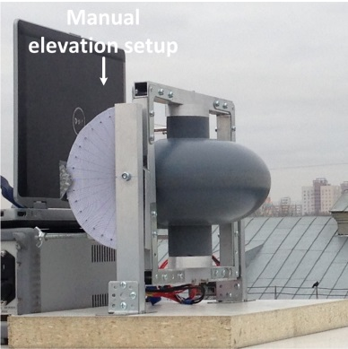
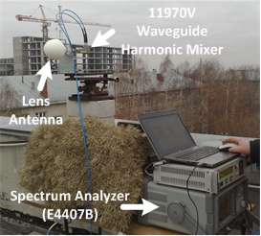
Radiation Pattern Measurement Setup
Lens-Array Antenna
Transmitter LAA setup – θ = 0⁰
Receiver setup

Slide 7
Summary of Main Parameters
Tables below provide a summary of the main parameters of the considered experimental setup.
Transmitter parameters
Receiver parameters
Parameter | Value
PAA (can be positioned in space)
Aperture (vertical by horizontal size) | 9 mm x 25 mm
Half Power Beam Width (HPBW) for azimuth and elevation | To be estimated
Radio Frequency (RF) channel #2 | F_{c} = 60.48 GHz ΔF = 2.16 GHz
Positioning system
Elevation angle step (manual setup) / range | 1⁰ / {-60⁰,60⁰}
Azimuth angle step (using rotation machine HD-2002U CT-308) / range | 0.416⁰ / {-90⁰,90⁰}
Angular speed | ω = 0.4162 deg/с
Parameter | Value
Receiver antenna (has fixed position)
Aperture (diameter) | 100 mm
Gain | 34.5 dBi
HPBW for azimuth and elevation | ϕ_{HPBW} = θ_{HPBW} = 3⁰
Agilent Technologies ESA-E Series Spectrum Analyzer (E4407B)
Start frequency | 59.4 GHz
Stop frequency | 61.56 GHz
Channel power band | 2.16 GHz
Sweep time | 26 ms
Resolution Band Width (RBW) | 3 MHz
Video Band Width (VBW) | 3 MHz

Slide 8
Measured PAA Radiation Pattern
Half Power Beam Width (HPBW):
  In azimuth: 14.0⁰
  In elevation: 41.0⁰

Slide 9
Measured LAA Radiation Pattern
HPBW:
  In azimuth: 9.0⁰
  In elevation: 3.0⁰
Maximum lens gain:
  G_{lens}= 12.0 dB

Slide 10
Beamforming Sector Sweep Capabilities
Phased Antenna Array (PAA)
Lens-Array Antenna (LAA)
Beamforming sector sweep capabilities:
PAA sector sweeping: ±60⁰
  LAA sector sweeping: ±45⁰

Slide 11
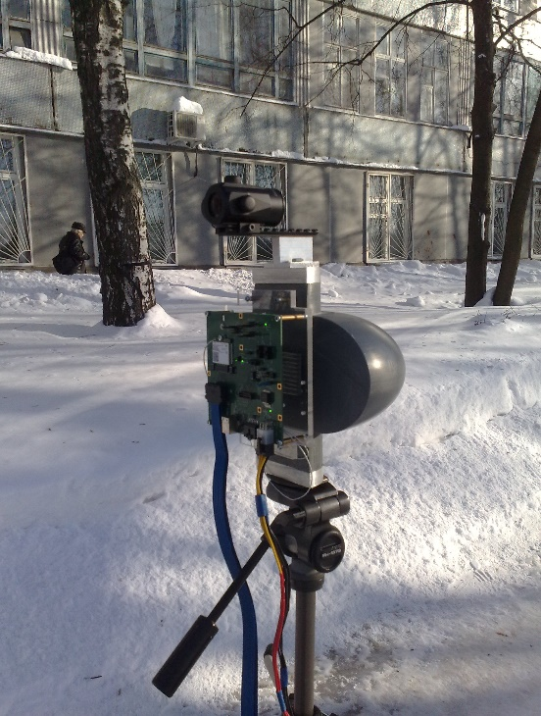
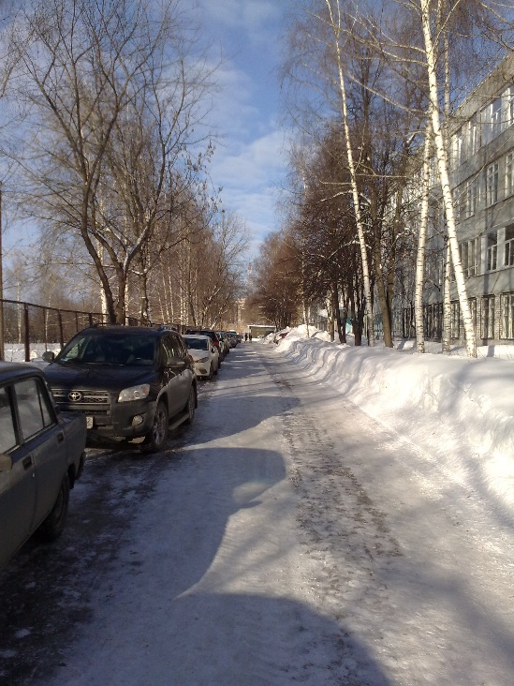
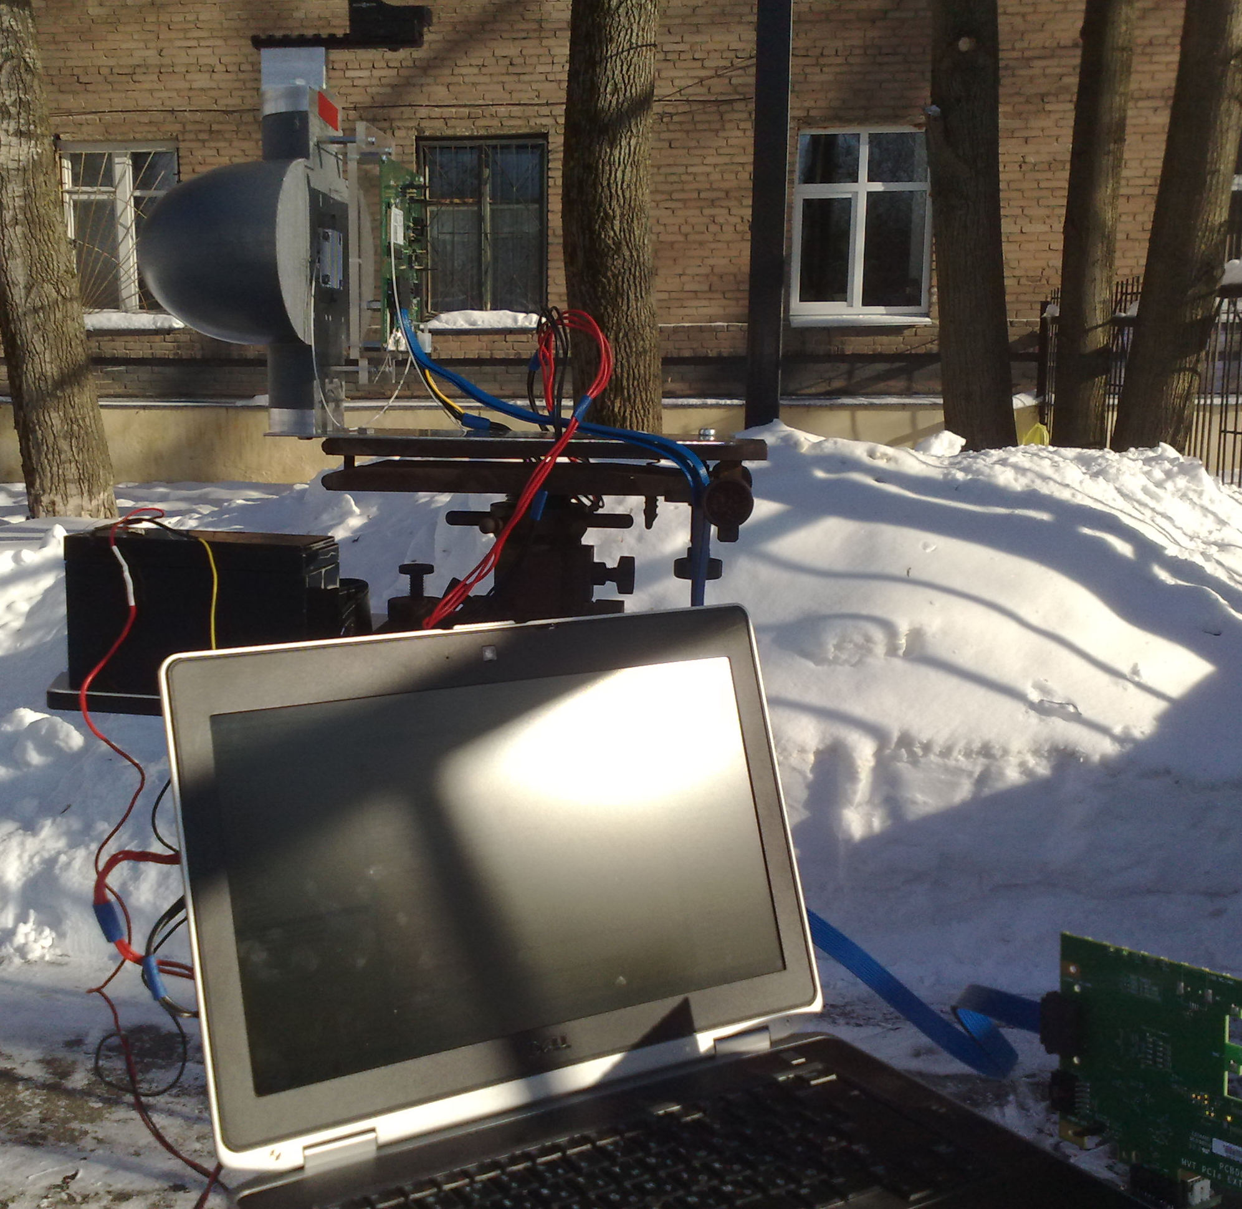
Backhaul Street Level Measurement Setup

Slide 12
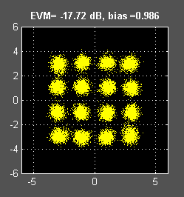
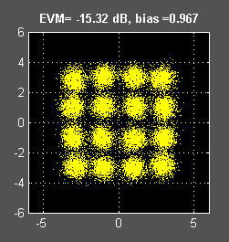
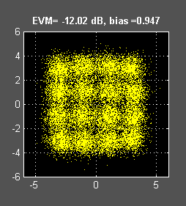
Backhaul Packet Transmission
Receiver constellation scattering diagrams for WiGig/11ad Single Carrier (SC) PHY 16QAM constellation:
d = 100 m
d = 150 m
d = 200 m
Receiver Error Vector Magnitude (EVM) characteristic degrades from -17.7 dB to -12.0 dB with increasing of the distance between transmitter and receiver from 100 to 200 meters accordingly.
However even for 200 meters it allows encoded transmission with very low Packet Error Rate (PER ~0) for the data rate 4.62 Gbps using implemented IEEE 802.11ad PHY air protocol.

Slide 13
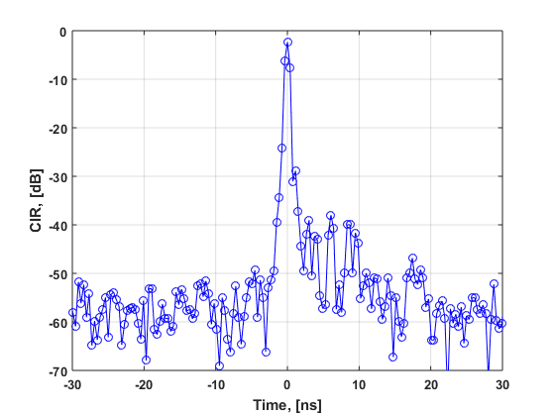
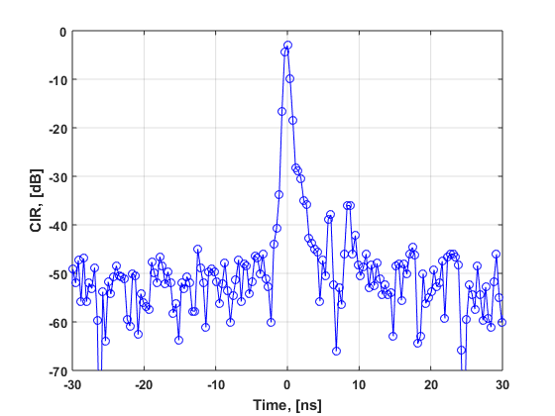
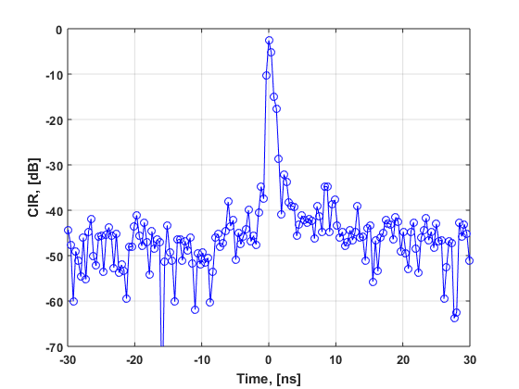
Backhaul Channel Measurements
Figures below show measured Channel Impulse Responses (CIRs) for different distances between transmitter and receiver, equal to 100 m, 150 m , and 200 m accordingly.
The transmitter and receiver LAA antennas are placed at the height of ~1.7 m above the ground level.
Sampling is done @ 2.64 GHz sample rate. The time for CIR peak is assigned to zero value. All CIRs are normalized to unit power.
d = 100 m
d = 150 m
d = 200 m

Slide 14
Conclusions
In this work Lens-Array Antenna (LAA) technology is proposed to be used for future mmWave wireless backhaul application.
The experimental measurements presented in this work show that dielectric lens provides in total 24.0 dB (12.0 dB + 12.0 dB) additional gain for transmitter and receiver.
The feasibility study of the packet transmission in point-to-point link configuration show that the current IEEE 802.11ad SC PHY protocol can be used to achieve 200 meters in single hop topology with maximum data rate equal to 4.62 Gbps.
The LAA design allows sector sweep beamforming capabilities in the ±45.0⁰ azimuthal sector and can be used for adaptive routing and point-to-multi point data transmission. 4 LLA units guarantee full 360⁰ space coverage in azimuth plane.

Slide 15
References
R. Sun, “IEEE 802.11 TGay Use Cases,” IEEE doc. 11-15/0625r2.

