Slide 1
HE PHY Padding and Packet Extension
Date: 2015-09-12
Authors:
Name | Affiliation | Address | Phone | Email
Hongyuan Zhang | Marvell | 5488 Marvell Lane, Santa Clara, CA, 95054 | 408-222-2500 | hongyuan@marvell.com
Yakun Sun |  |  |  | yakunsun@marvell.com
Lei Wang |  |  |  | Leileiw@marvell.com
Liwen Chu |  |  |  | liwenchu@marvell.com
Jinjing Jiang |  |  |  | jinjing@marvell.com
Yan Zhang |  |  |  | yzhang@marvell.com
Rui Cao |  |  |  | ruicao@marvell.com
Bo Yu |  |  |  | jiehuang@marvell.com
Sudhir Srinivasa |  |  |  | sudhirs@marvell.com
Saga Tamhane |  |  |  | sagar@marvell.com
Mao Yu |  |  |  | my@marvel..com
Edward Au |  |  |  | edwardau@marvell.com
Hui-Ling Lou |  |  |  | hlou@marvell.com

Slide 2
Authors (continued)
Name | Affiliation | Address | Phone | Email
Albert Van Zelst | Qualcomm | Straatweg 66-S Breukelen, 3621 BR Netherlands |  | allert@qti.qualcomm.com
Alfred Asterjadhi |  | 5775 Morehouse Dr. San Diego, CA, USA |  | aasterja@qti.qualcomm.com
Arjun Bharadwaj |  | 5775 Morehouse Dr. San Diego, CA, USA |  | arjunb@qti.qualcomm.com
Bin Tian |  | 5775 Morehouse Dr. San Diego, CA, USA |  | btian@qti.qualcomm.com
Carlos Aldana |  | 1700 Technology Drive San Jose, CA 95110, USA |  | caldana@qca.qualcomm.com
George Cherian |  | 5775 Morehouse Dr. San Diego, CA, USA |  | gcherian@qti.qualcomm.com
Gwendolyn Barriac |  | 5775 Morehouse Dr. San Diego, CA, USA |  | gbarriac@qti.qualcomm.com
Hemanth Sampath |  | 5775 Morehouse Dr. San Diego, CA, USA |  | hsampath@qti.qualcomm.com
Menzo Wentink |  | Straatweg 66-S Breukelen, 3621 BR Netherlands |  | mwentink@qti.qualcomm.com
Richard Van Nee |  | Straatweg 66-S Breukelen, 3621 BR Netherlands |  | rvannee@qti.qualcomm.com
Rolf De Vegt |  | 1700 Technology Drive San Jose, CA 95110, USA |  | rolfv@qca.qualcomm.com
Sameer Vermani |  | 5775 Morehouse Dr. San Diego, CA, USA |  | svverman@qti.qualcomm.com
Simone Merlin |  | 5775 Morehouse Dr. San Diego, CA, USA |  | smerlin@qti.qualcomm.com
Tevfik Yucek |  | 1700 Technology Drive San Jose, CA 95110, USA |  | tyucek@qca.qualcomm.com
VK Jones |  | 1700 Technology Drive San Jose, CA 95110, USA |  | vkjones@qca.qualcomm.com
Youhan Kim |  | 1700 Technology Drive San Jose, CA 95110, USA |  | youhank@qca.qualcomm.com

Slide 3
Authors (continued)
Name | Affiliation | Address | Phone | Email
Robert Stacey | Intel | 2111 NE 25th Ave, Hillsboro OR 97124, USA | +1-503-724-893 | robert.stacey@intel.com
Eldad Perahia |  |  |  | eldad.perahia@intel.com
Shahrnaz Azizi |  |  |  | shahrnaz.azizi@intel.com
Po-Kai Huang |  |  |  | po-kai.huang@intel.com
Qinghua Li |  |  |  | quinghua.li@intel.com
Xiaogang Chen |  |  |  | xiaogang.c.chen@intel.com
Chitto Ghosh |  |  |  | chittabrata.ghosh@intel.com
Laurent cariou |  |  |  | laurent.cariou@intel.com
Rongzhen Yang |  |  |  | rongzhen.yang@intel.com
Ron Porat | Broadcom |  |  | rporat@broadcom.com
Matthew Fischer |  |  |  | mfischer@broadcom.com
Sriram Venkateswaran
Andrew Blanksby
Matthias Korb
Tu Nguyen
Vinko Erceg

Slide 4
Authors (continued)
Name | Affiliation | Address | Phone | Email
James Yee | Mediatek | No. 1 Dusing 1st Road, Hsinchu, Taiwan | +886-3-567-0766 | james.yee@mediatek.com
Alan Jauh |  |  |  | alan.jauh@mediatek.com
Chingwa Hu |  |  |  | chinghwa.yu@mediatek.com
Frank Hsu |  |  |  | frank.hsu@mediatek.com
Thomas Pare | Mediatek USA | 2860 Junction Ave, San Jose, CA 95134, USA | +1-408-526-1899 | thomas.pare@mediatek.com
ChaoChun Wang |  |  |  | chaochun.wang@mediatek.com
James Wang |  |  |  | james.wang@mediatek.com
Jianhan Liu |  |  |  | Jianhan.Liu@mediatek.com
Tianyu Wu |  |  |  | tianyu.wu@mediatek.com
Russell Huang |  |  |  | russell.huang@mediatek.com
Joonsuk Kim | Apple |  |  | joonsuk@apple.com
Aon Mujtaba |  |  |  | mujtaba@apple.com
Guoqing Li |  |  |  | guoqing_li@apple.com
Eric Wong |  |  |  | ericwong@apple.com
Chris Hartman |  |  |  | chartman@apple.com

Slide 5
Authors (continued)
Name | Affiliation | Address | Phone | Email
Phillip Barber | Huawei | The Lone Star State, TX |  | pbarber@broadbandmobiletech.com
Peter Loc |  |  |  | peterloc@iwirelesstech.com
Le Liu |  | F1-17, Huawei Base, Bantian, Shenzhen | +86-18601656691 | liule@huawei.com
Jun Luo |  | 5B-N8, No.2222 Xinjinqiao Road, Pudong, Shanghai |  | jun.l@huawei.com
Yi Luo |  | F1-17, Huawei Base, Bantian, Shenzhen | +86-18665891036 | Roy.luoyi@huawei.com
Yingpei Lin |  | 5B-N8, No.2222 Xinjinqiao Road, Pudong, Shanghai |  | linyingpei@huawei.com
Jiyong Pang |  | 5B-N8, No.2222 Xinjinqiao Road, Pudong, Shanghai |  | pangjiyong@huawei.com
Zhigang Rong |  | 10180 Telesis Court, Suite 365, San Diego, CA 92121 NA |  | zhigang.rong@huawei.com
Rob Sun |  | 303 Terry Fox, Suite 400 Kanata, Ottawa, Canada |  | Rob.Sun@huawei.com
David X. Yang |  | F1-17, Huawei Base, Bantian, Shenzhen |  | david.yangxun@huawei.com
Yunsong Yang |  | 10180 Telesis Court, Suite 365, San Diego, CA 92121 NA |  | yangyunsong@huawei.com
Zhou Lan |  | F1-17, Huawei Base, Bantian, SHenzhen | +86-18565826350 | Lanzhou1@huawei.com
Junghoon Suh |  | 303 Terry Fox, Suite 400 Kanata, Ottawa, Canada |  | Junghoon.Suh@huawei.com
Jiayin Zhang |  | 5B-N8, No.2222 Xinjinqiao Road, Pudong, Shanghai | +86-18601656691 | zhangjiayin@huawei.com

Slide 6
Authors (continued)
Name | Affiliation | Address | Phone | Email
Hyeyoung Choi | LG Electronics | 19, Yangjae-daero 11gil, Seocho-gu, Seoul 137-130, Korea |  | hy0117.choi@lge.com
Kiseon Ryu |  |  |  | kiseon.ryu@lge.com
Jinyoung Chun |  |  |  | jiny.chun@lge.com
Jinsoo Choi |  |  |  | js.choi@lge.com
Jeongki Kim |  |  |  | jeongki.kim@lge.com
Giwon Park |  |  |  | giwon.park@lge.com
Dongguk Lim |  |  |  | dongguk.lim@lge.com
Suhwook Kim |  |  |  | suhwook.kim@lge.com
Eunsung Park |  |  |  | esung.park@lge.com
HanGyu Cho |  |  |  | hg.cho@lge.com
Thomas Derham | Orange |  |  | thomas.derham@orange.com
Bo Sun | ZTE | #9 Wuxingduan, Xifeng Rd., Xi'an, China |  | sun.bo1@zte.com.cn
Kaiying Lv |  |  |  | lv.kaiying@zte.com.cn
Yonggang Fang |  |  |  | yfang@ztetx.com
Ke Yao |  |  |  | yao.ke5@zte.com.cn
Weimin Xing |  |  |  | xing.weimin@zte.com.cn
Brian Hart | Cisco Systems | 170 W Tasman Dr, San Jose, CA 95134 |  | brianh@cisco.com
Pooya Monajemi |  |  |  | pmonajem@cisco.com

Slide 7
Authors (continued)
Name | Affiliation | Address | Phone | Email
Fei Tong | Samsung | Innovation Park, Cambridge CB4 0DS (U.K.) | +44 1223 434633 | f.tong@samsung.com
Hyunjeong Kang |  | Maetan 3-dong; Yongtong-Gu Suwon; South Korea | +82-31-279-9028 | hyunjeong.kang@samsung.com
Kaushik Josiam |  | 1301, E. Lookout Dr, Richardson TX 75070 | (972) 761 7437 | k.josiam@samsung.com
Mark Rison |  | Innovation Park, Cambridge CB4 0DS (U.K.) | +44 1223 434600 | m.rison@samsung.com
Rakesh Taori |  | 1301, E. Lookout Dr, Richardson TX 75070 | (972) 761 7470 | rakesh.taori@samsung.com
Sanghyun Chang |  | Maetan 3-dong; Yongtong-Gu Suwon; South Korea | +82-10-8864-1751 | s29.chang@samsung.com
Yasushi Takatori | NTT | 1-1 Hikari-no-oka, Yokosuka, Kanagawa 239-0847 Japan |  | takatori.yasushi@lab.ntt.co.jp
Yasuhiko Inoue |  |  |  | inoue.yasuhiko@lab.ntt.co.jp
Yusuke Asai |  |  |  | asai.yusuke@lab.ntt.co.jp
Koichi Ishihara |  |  |  | ishihara.koichi@lab.ntt.co.jp
Akira Kishida |  |  |  | kishida.akira@lab.ntt.co.jp
Akira Yamada | NTT DOCOMO | 3-6, Hikarinooka, Yokosuka-shi, Kanagawa, 239-8536, Japan |  | yamadaakira@nttdocomo.com
Fujio Watanabe |  | 3240 Hillview Ave, Palo Alto, CA 94304 |  | watanabe@docomoinnovations.com
Haralabos Papadopoulos |  |  |  | hpapadopoulos@docomoinnovations.com

Slide 8
Overview
HE PHY adopts 4x Numerology [1], mainly for: facilitate OFDMA design, facilitate outdoor channel support, increase PHY efficiency.
Area Penalty: ~4x NDBPS compared with 11ac with same BW.
  Lead to big area or implementation complexity concern, if SIFS time duration is unchanged.
    ~4x processing speed is required for the last OFDM symbol, for Rx→Tx turn-around within SIFS (FFT, MIMO-EQ, Decoding, MAC, Tx).
    Especially at peak data rates (e.g. 256AM).
Overhead Penalty: on the other hand, increasing SIFS or equivalently adding long packet extension (PE) may offset the throughput gain of 4x numerology.
Tradeoffs between Area and Overhead:
  Challenging to optimize both at the same time.
  Different options give different levels of tradeoffs, with different solution for either reducing area/complexity or reducing overhead.

Slide 9
Proposed HE Padding and Packet Extension
The last mSTBC symbol(s) have 4x duration like other data symbols (12.8us+GI).
Apply a two-step padding method in the last mSTBC OFDM symbol(s), i.e.: “Pre-FEC” padding, and “post-FEC” padding.
  Four possible pre-FEC padding segment boundaries (“a –factor”) are defined in the last OFDM symbol(s).
    Based on number of excess info bits in the last symbol(s), pre-FEC pad (the same MAC/PHY padding as in 11ac) toward the nearest boundaries in the last symbol(s).
  For LDPC, if “LDPC extra symbol” is needed after puncturing, increment one segment (a = ainit+1), instead of one long symbol.
  After FEC, insert post-FEC padding bits to fill up the symbol(s).
    Post FEC padding is added by PHY and does not need to be decoded by the receiver
A Packet Extension (PE) field is applied at the end of PPDU, and its duration is a function of the followings:
  The pre-FEC padding boundaries in the last mSTBC OFDM symbols (“a – factor”).
  Receiving STA’s capability on its required PE duration, for the current {BW, NSS, Constellation} combination.

Slide 10
Bit Stream Illustration
Bit stream of the last OFDM symbol (non-STBC)
a = 1:
Excess
Info bits
Pre-FEC
padding bits
+
Post-FEC Padding Bits
PE1
a = 2:
Receiver decoding stops here
Excess Info bits
Pre-FEC
padding bits
+
Post-FEC Padding Bits
PE2
a = 3:
Receiver decoding stops here
Excess Info bits
Pre-FEC
padding bits
+
Post-FEC Padding Bits
PE3
a = 4:
Receiver decoding stops here
Excess Info bits
Pre-FEC
padding bits
+
PE4
Receiver decoding stops here
Refer to Appendix for the Math

Slide 11
LDPC Encoding Illustration
Use a=1 and LDPC case as an example.
Constellation
Mapper
LDPC
Tone
Mapper
Segment
Parser
…..
Bit stream of size NDBPS.SHORT
in the last OFDM symbol,
LDPC
Encoder
NCBPS.SHORT bits
Excess
Info bits
Pre-FEC
padding bits
:
:
Stream Parser
Post-FEC Padding bits
(NCBPS - NCBPS.SHORT) bits
Constellation
Mapper
LDPC
Tone
Mapper
Segment
Parser
…..
where
Stream/Segment Parsers are all FIFO on
the bits stream, therefore the info and pre-FEC
padding bits are contained in the first NSD.SHORT
tones before LDPC tone mapper

Slide 12
Processing Delay
For LDPC:
  4x FFT →4x Tone Demapper → Only take the first NSD.SHORT tones → FD processing (MIMO Equalizer, LDPC Decoder)→MAC processing.
  Post-FEC padding bits are not processed.
For BCC:
  Almost all tones need to be processed due to interleaver.
  However, we propose to disallow BCC in 40MHz, 80MHz and 160MHz. See [2] for more details.

Slide 13
Packet Extension Field
PE durations for different pre-FEC padding boundaries (a-factor values).
  Based on decoding capability of the device.
  An Example where max PE duration is 16us:
    TPE1 = 4us, or ~¼ long symbol (a=1)
    TPE2 = 8us , or ~1/2 long symbol (a=2)
    TPE3 = 12us, or ~3/4 long symbol (a=3)
    TPE4 = 16us, or ~1 long symbol (a=4)
  TPE values are multiple of 4us, for easier L-LENGTH signaling and legacy spoofing.
A non-zero signal with the same average power as the data should be transmitted in PE field.
  To avoid legacy receiver’s early termination of CCA-Busy status, due to “carrier lost”.
a = 4:
Excess Info bits
Pre-FEC
padding bits
PE4
Duration 16us

Slide 14
Packet Extension Field—cont’d
Each STA may claim its PE Capability for receiving PPDUs for different {BW, NSS, Constellation} combinations.
  Defining two constellation thresholds per {BW, Nss} to split MCSs into 3 groups, corresponding to 0us, and two non-zero max PE durations (equivalent to max PE durations of 8us and 16us respectively).
    To be clear, the 3 categories are:
      “0us”: TPE = [0 0 0 0]us, for a=1~4 respectively
      “8us”: TPE = [0 0 4 8]us, for a=1~4 respectively
      “16us”: TPE = [4 8 12 16]us, for a=1~4 respectively
When STA indicates 80MHz capability or higher, 0µs PE is applied for RU≤20MHz
  No capability indicated for RU ≤ 20MHz in this case
  Otherwise, PE capability is indicated down to TBD RU sizes.

Slide 15
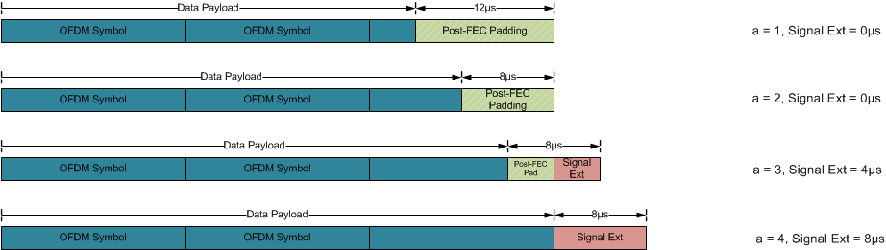
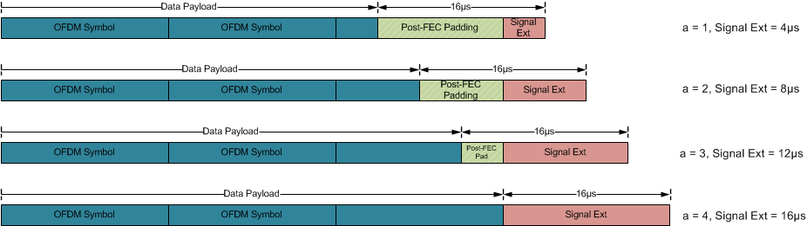
PE Capability—Illustration
Max PE 8µs
mode
Max PE 16µs
mode

Slide 16
Constellation Thresholds for PE Capability (i)
HE device capability for determining PE duration is based on two constellation thresholds per{NSS, BW}
If constellation ≥ threshold₁₆ apply max PE 16µs mode, else if constellation ≥ threshold₈ apply max PE 8µs mode, else no packet extension
The encoding constellation thresholds:
Example: max PE 8us for 64QAM, max PE 16us for 256QAM and 1024QAM (TBD)
constellation | HE capability encoding
BPSK | 000
QPSK | 001
16QAM | 010
64QAM | 011
256QAM | 100
1024QAM (TBD) | 101
None | 111
BPSK | QPSK | 16QAM | 64QAM | 256QAM | 1024QAM (TBD)
threshold8
threshold16

Slide 17
Constellation Thresholds for PE Capability (ii)
Some special cases are as follows:
  If no PE is required both threshold₈ and threshold₁₆ are set to 111
  If only max PE 8µs mode is used, set threshold₁₆ to be 111, and threshold₈ to be the constellation at which max PE 8µs mode starts
  If only max PE 16µs mode is used, set threshold₁₆ to be the constellation at which max PE 16µs mode starts, and threshold₈ to be 111

Slide 18
Padding Parameters to Avoid MCS Exclusion
If we strictly choose ¼ number of tones, for certain BW and MCS, N_{CBPS,short} and N_{DBPS,short} (or N_{DBPS,Short}/N_{ES}) are not integers.
The simplest approach to avoid excluding MCS: define a compatible N_{SD.SHORT} for the last symbol.
  Suggested N_{SD,short} for each RU size as shown in the table below:
    Integer N_{CBPS,short}, N_{DBPS,short} and N_{DBPS,short}/N_{ES} for 20MHz and below (≤242-RU )
    Integer N_{CPBS,short} and N_{DBPS,short} for 40MHz and above (LDPC only).
  The pre-FEC symbol segments become slightly uneven between a=1~3 and a=4 for some RU. But the performance difference should be very negligible.
  Encoding procedure described in Appendix starts by:
RU Size | N_{SD,Short}
26 | 6
52 | 12
106 | 24
242 | 60
484 | 120
996 | 240
996x2 | 492

Slide 19
DL-MU Padding Method (1)
All user’s data fields end at the same time in the DL-MU PPDU.
All users share the same PE duration.
All users share a common a-factor across all users, based on the user with the longest span.
  Clean design, simple signaling, simple padding as in 11ac.
  Minimize SIG field overhead, no per-user fields needed.
    No per-user a-factor field.
    As in 11ac DLMU, there is only 1 common bit needed for all users indicating “LDPC extra symbol”, even if some users are doing BCC!
Based on a-factor value and each user’s PE capabilities, AP computes the PE duration for each user TPE,u, and the PE duration of the whole DL-MU PPDU is .
For DL-MU, AP indicates common Nsym , a-factor , LDPC Extra Symbol indication, and T_{PE} in the HE-SIG field for all users.

Slide 20
DL-MU Padding Method (2)
Illustration (DL-OFDMA)
Symbol - NSYM -1
Symbol – NSYM (a=2)
User-1
…
Info bits
Info bits
Pre-FEC
Post-FEC
PE
User-2
(longest span)
…
Pre-FEC
Post-FEC
Info bits
Info bits
PE
…
Info bits
Pre-FEC
Pre-FEC
Post-FEC
User-3
PE
…
Info bits
Pre-FEC
Pre-FEC
Post-FEC
User-4
PE

Slide 21
UL-MU Padding Method
In UL-MU, AP does not have exact number of bytes in each user’s buffer—hence cannot compute a-factor on a per user basis like SU and DL-MU. However, the STA can use pre-FEC padding to fill Nsym long symbols + a-factor short segments.
Prefer a common a-factor design similar to DL-MU, i.e.
  AP indicates common Nsym , a-factor , LDPC Extra Symbol indication, and TPE for all users, in the trigger frame.
  BCC users always pre-FEC pad to the pre-determined a-factor.
  LDPC users:
    If LDPC Extra Symbol = 1, always pre-FEC pad to ainit = a-1 in the last symbol(s), and always apply LDPC extra symbol using the last symbol segment (a=ainit+1).
    If LDPC Extra Symbol = 0, always pre-FEC pad to ainit = a in the last symbol(s), and always do not apply LDPC extra symbol.

Slide 22
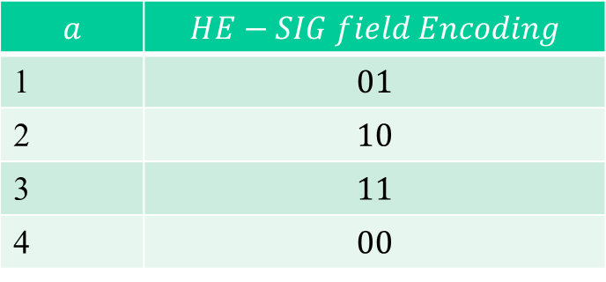
SIG Field Signaling (1)
HE-SIG Field:
  2-bits for a-factor .
  1 bit for PE dis-ambiguity .
    For receiver to derive correct TPE and NSYM without ambiguity.
a-factor field definition:
1
2
3
4

Slide 23
SIG Field Signaling (2)
Timing Parameters:
L-SIG:
where

Slide 24
SIG Field Signaling (3)
,
HE-SIG-A: “PE-Disambiguity” Field:
  Tx: if the following is met, set this field to 1; otherwise, set to 0.
Rx Side Computation:

Slide 25
Simulations: LDPC Performance Sanity Check
Simulate the same MCS for 11ax and 11ac.
80MHz, 4 Rx 3SS, LDPC, DNLOS channel.
For sanity check purpose, we tried different packet sizes to trigger difference scenarios:
  L=16K Bytes, MCS9-3SS.
    11ax padding Op4: 7 symbols, a = 3, no LDPC additional symbol;
    11ac: 28 symbols , no additional symbol.
  L=15000 bits, MCS7-3SS
    11ax padding Op4: 2 symbols, a = 1, no LDPC additional symbol;
    11ac: 5 symbols , no LDPC additional symbol.
  L= 5000 bits, MCS7-3SS
    11ax padding Op4: 1 symbols, a = 3, with LDPC additional symbol;
    11ac: 3 symbols , with LDPC additional symbol.
  L= 3150 bits, MCS7-3SS
    11ax padding Op4: 1 symbols, a = 3, with LDPC additional symbol;
    11ac: 2 symbols , with LDPC additional symbol.

Slide 26
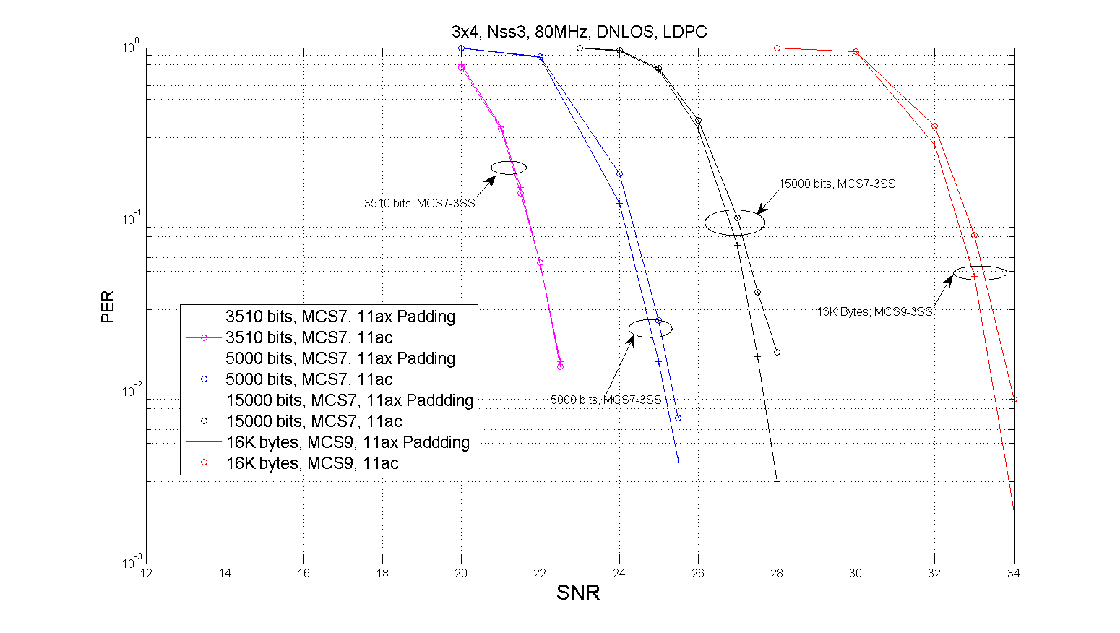
Results

Slide 27
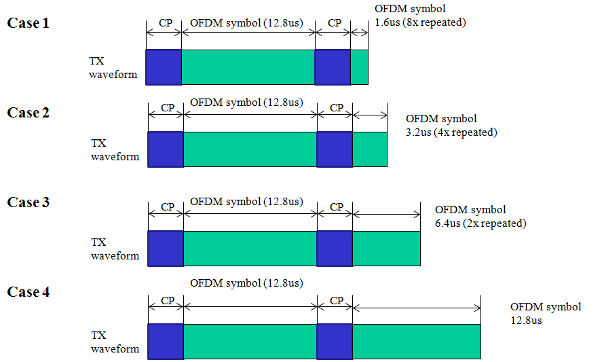
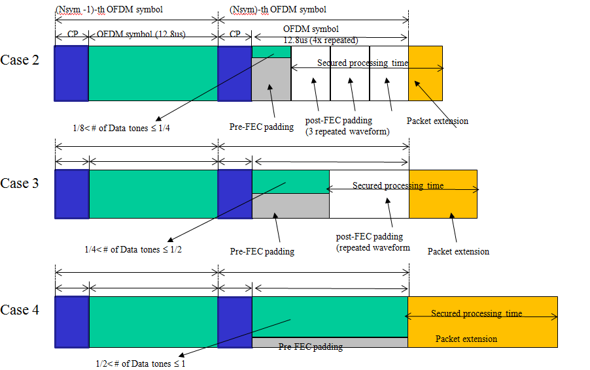
Discussions of Alternative Methods-1
An alternative method of reducing OFDM symbol durations was proposed in [3].
It seems that [3] mentioned two different methods:
  1. Use short symbols (1/2x, 1x, 2x, 4x), no PE.
  2. Use short symbols ((1/2x),1x, 2x, 4x), but repeat to 4x, with PE.
Case 1 ???
Method-1 in [3]
Method-2 in [3]

Slide 28
Discussions of Alternative Methods-2
Assuming that in [3] method-1 is used for low BW or MCS, while method-2 is used for high BW or MCS, we have the following issues:
  Method-1 requires OFDM symbol duration switching all the time, which complicates the receiver design.
  Although Method-2 may be realized by always using 4x symbol duration, but there is no efficiency gain over our method!
  It is undesirable to introduce different padding flows for different PHY configurations (BW, MCS, Nss, etc), which was never seen in previous generations (11a/n/ac).
    With STBC and LDPC extra symbol, the number of modes will “explode” (e.g. 1/2x, 1x, 2x, 4x, two 1x, two 2x, two 4x, four 1x, four 2x, two 1/2x, four 1/2x)!
  It is hard to address LDPC extra symbol: e.g. what happens if 2x is selected at beginning but requires LDPC extra symbol? Same for 1/2x and 4x symbols.—may skew the effective coding rates.
  What is 1.6us OFDM symbol (1/2x)? Does it appear in method-2?
  Uneven bit splitting (1/2x, 1x, 2x, 4x).
  Unsure about 1/2x and 1x symbol performance in outdoor channels.
Our proposal is a unified approach for all PHY modes that balances efficiency and implementation complexity.

Slide 29
Conclusions
A HE PHY padding and Packet Extension method is proposed to address the area and overhead concern caused by 11ax 4x OFDM numerology.
The two-step padding and variable PE duration properly addresses the tradeoff between implementation complexity and HE-PHY overhead.
Further discussions on detailed padding parameters; PE capability definition; MU padding methods; and PHY signaling in HE-SIG.

Slide 30
Straw Poll #1
Do you agree to add the following text into Section 3.4 HE Data Field of the current SFD:
  An 11ax SU PPDU should apply the MAC/PHY pre-FEC padding scheme as in 11ac, to pad toward the nearest of the four possible boundaries (“a” factor) in the last Data OFDM symbol(s), and then use post-FEC padding bits to fill up the last OFDM symbol(s).
    Packet Extension (PE) field is defined at the end of 11ax PPDUs.
    PE should have the same average power as data field.

Slide 31
Straw Poll #2
Do you agree to add the following text into SFD:
  11ax shall define the max packet extension modes of 8µs and 16µs, correspond to the short symbol segment padding boundaries (“a-factor”) according to the following PE duration (TPE) values:
    Max packet extension mode 8 µs: TPE = [0 0 4 8] µs for a = 1~4 respectively;
    Max packet extension mode 16 µs: TPE = [4 8 12 16] µs for a = 1~4 respectively.
  HE Capability field shall define two constellation level thresholds (threshold16 and threshold8) for a given {NSS, BW} combination, to determine if and when max packet extension modes 8 µs and 16 µs are applied, i.e.
    3 bits are used to specify each threshold as the table below.
    If constellation ≥ threshold₁₆ apply max PE 16 µs mode, else if constellation ≥ threshold₈ apply max PE 8 µs mode, else no packet extension.
    If no PE is required for all constellations both threshold₈ and threshold₁₆ are set to 111
    If only max PE 8 µs mode is required, set threshold₁₆ to be 111, and threshold₈ to be the constellation at which max PE 8 µs mode starts
    If only max PE 16µs mode is required, set threshold₁₆ to be the constellation at which max PE 16µs mode starts, and threshold₈ to be 111
    When ≥80 MHz is supported, no thresholds are defined for RU size less than or equal to 242 tones (20 MHz); otherwise, thresholds are defined down to a TBD RU size.
Constellation | Threshold Encoding in HE Capability
BPSK | 000
QPSK | 001
16QAM | 010
64QAM | 011
256QAM | 100
1024QAM (TBD) | 101
None | 111

Slide 32
Straw Poll #3
Do you agree to add the following text into SFD:
  The number of uncoded bits for each of the first 3 short symbol segments (a=1~3) equals to the number of uncoded bits corresponding to N_{SD.short} subcarriers as specified by the following table, and the number of uncoded bits for the last short symbol segment (a=4) equals to the number of bits of the whole OFDM symbol subtracting the total number of uncoded bits of the first three short symbol segments.
RU Size | NSD.short
26 | 6
52 | 12
106 | 24
242 | 60
484 | 120
996 | 240
996x2 | 492

Slide 33
Straw Poll #4
Do you agree to add the following text (this page and next page) into SFD:
  HE-SIG-A field contains a “a-factor” field of 2 bits, and a “PE-Disambiguity” field of 1 bit, with setting methods as blow:
  In L-SIG, the L-LENGTH field is set by:
  In HE-SIG-A:
  a-factor field:
,
a-factor value | a-factor field encoding
1 | 01
2 | 10
3 | 11
4 | 00

Slide 34
SP4—cont’d
  PE Dis-ambiguity Field:
    If , where , set this field to 1; otherwise, set to 0.
    At receiver side, the following equations may be run to compute NSYM and TPE respectively:

Slide 35
Straw Poll #5
Do you agree to add the following text into SFD:
  When the AP transmits DL-MU packets:
    All users use the same NSYM and a-factor values according to the user with the longest span.
    Based on a-factor value and each user’s PE capabilities, compute the PE duration for each user TPE,u, and the PE duration of the whole DL-MU PPDU is TPE = maxu(TPE,u).
    In HE-SIG-A field, the “a-factor” field, the “PE Disambiguity” field, and the “LDPC extra symbol” field, are common for all users.

Slide 36
Straw Poll #6
Do you agree to add the following text into SFD:
  For UL-MU packet transmission:
    AP indicates its desired Nsym, a-factor, LDPC Extra Symbol indication and PE duration values in trigger frame.
    Possible PE values for UL-MU are TBD.
    Each user when transmitting the UL-MU PPDU, shall encode and conduct PHY padding using the parameters:
    N_{SYM} as indicated in the trigger frame;
    a-factor as indicated in the trigger frame;
    LDPC Extra Symbol as indicated in the trigger frame;
    Append PE specified in the trigger frame.

Slide 37
Appendix: Example Math for SU Padding

Slide 38
Initiating Parameters
Where NSD.short is defined as in below table:
RU Size | N_{SD,Short}
26 | 6
52 | 12
106 | 24
242 | 60
484 | 120
996 | 240
996x2 | 492

Slide 39
Step-1
Compute initial number of payload symbols.
  BCC:
  LDPC:

Slide 40
Step-2
Compute initial numbers of data bits and coded bits in the last symbol and initial excess factor a value, based on number of excess bits:
  BCC:
  LDPC:
  Initial a-factor value:

Slide 41
Step-3
Compute number of (pre-FEC) MAC/PHY padding bits as below, and conduct MAC/PHY Padding as in 11ac.
  BCC:
  LDPC:

Slide 42
Step-4
FEC coding and Compute final NSYM and a-factor:
  BCC:
    Then conduct regular BCC coding based on these parameters.
  LDPC:
    Compute LDPC encoding parameters {LLDPC, NCW, Nshrt, Npunc} as in 802.11n (clause 20.3.11.7.5) starting from Navbits.
    In step d) of clause 20.3.11.7.5, if the condition for “LDPC Extra Symbol” is met, then

Slide 43
Step-4 (Cont’d)
    (LDPC Cont’d) if the above mentioned “LDPC Extra Symbol” condition is not met:
    Conduct Regular LDPC encoding using these parameters.
  Finally, update below:

Slide 44
Step-5
Post-FEC padding and remaining Tx steps:
  Pad NPAD.POST-FEC bits after encoded bits in each of the last mSTBC OFDM symbols, and then continue with the following transmission steps

Slide 45
Step-6
Packet Extension Insertion:
  Insert Packet Extension Field at the end of the PPDU, according to a-factor value, the MCS, BW and Nss parameters used in the data field, and the PE capability of the intended recipient of the PPDU

Slide 46
References
[1] 11-15-0132-02-00ax-spec-framework
[2] 11-15-0580-02-00ax 11ax coding discussion
[3] 11-15-0887-03-00ax-effcient-padding-for-last-ofdm-symbol

