Slide 1
TG ax
DSC Summary
Date: 2015-05
Authors:

Slide 2
Background
Previous presentations have analyzed DSC and the various scenarios:
Dense Apartments 13/1487r2, 14/0328r2
Airport capacity 13/1489r5
Pico Cell 14/0058r1
E_Education 14/0045r2
Enterprise Scenario 15/0548r0
DSC and Roaming 15/0025r0
DSC Practical Usage 14/0779r2
DSC Channel Select and Legacy sharing 14/0294r0
Dynamic Sensitivity Control 13/1012r4, 13/1290r1
Outdoor Enterprise Scenario and DSC 15/0804r0
This presentation looks at all the DSC results

Slide 3
Apartment Complex
13/1487r2 and 14/0328r2

Slide 4
Single Apartment complex

Slide 5
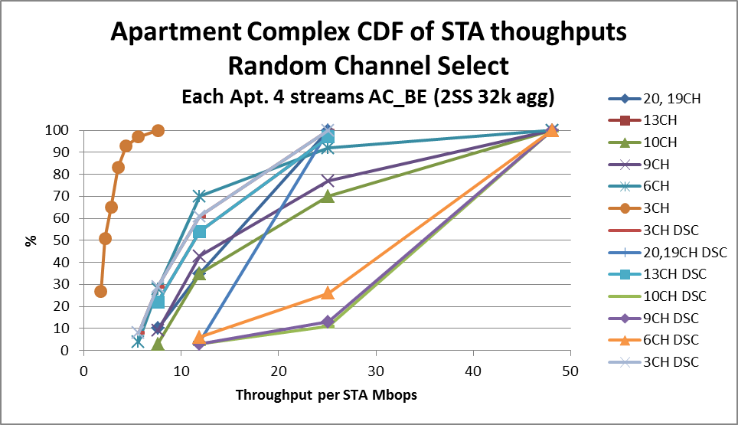
Results CDF (using average TP per STA)
~3x improvement

Slide 6
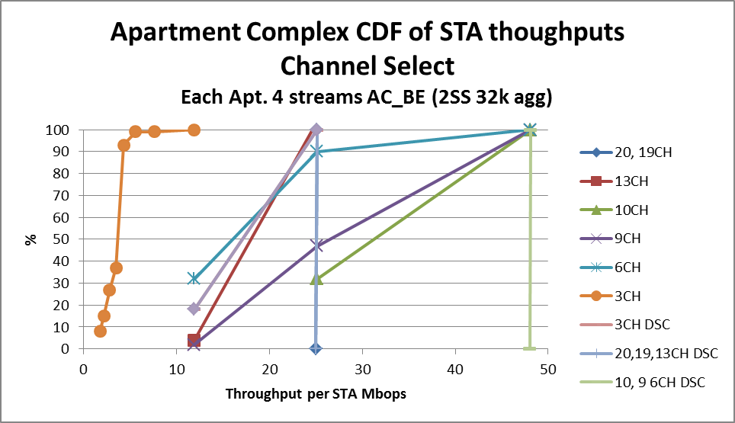
Results CDF (using average TP per STA)
X2 to x3 improvement

Slide 7
Pico Cells 13/1290r1

Slide 8
Coverage and Capacity - Conventional
Fixed CCA
19/37 cells @ 117Mbps and 18/37 cells at 52Mbps
  Throughput is 19/37*74.5 + 18.37*37.7 = 56.6Mbps
Assume 7 APs on different channels
Throughput over total 37 cells is 396.5Mbps (56.6 x 7)
DSC
All traffic at 117Mbs,
Throughput over 37 cells is 3004.8Mbps (81.2 x 37)
An improvement of 7.58 in capacity

Slide 9
E-education
14/0045r2

Slide 10
E-Education
Assuming 2SS for the STA, and using SU MIMO
With DSC 10 Channels (40MHz)
Without DSC 20 Channels (20MHz)
Signal strength within each class is >-45dBm hence can use 256 QAM 5/6
  11ac PHY Rate for 40MHz, 2SS is 400Mbps (10 Channels)
    Max Throughput 344Mbps (131k agg)
    Say 240Mbps throughput*
  11ac PHY Rate for 20MHz, 2SS is 173Mbps (3/4 rate, 5/6 is excluded)
    Max Throughput 150Mbps (65k agg – 131k exceeds length)
    Say 105Mbps throughput*
Improvement is 2.28 Downlink could use MU-MIMO?
*Assuming EDCA Overhead.

Slide 11
Enterprise – 15/0548r0
AP Layout 4 CH
4 Channel Re-Use
  All APs and ALL STAs on same channel are overlapping.
  With DSC about 30% of STAs overlap, and AP SNIR is low for signals from ~45% of STAs
  What is the throughput difference? x2
9 Channel Re-Use
  All APs and ALL STAs on same channel are overlapping.
  With DSC APs do not overlap STAs do not overlap
  What is throughput difference compared to 4 channel and 9 channel?
  Throughput must be improved if DSC is employed
  At least x4

Slide 12
Outdoor Enterprise 15/0804r0
Reduce Cell size
Increase throughput

Slide 13
Summary
It has been shown that in many scenarios DSC can enable frequency re-use and improve the throughput.
It is a simple concept and can be employed quickly with SW changes only and no HW changes required.
DSC is NOT fixing the CCA Threshold, it is dynamic and takes care of itself enhancing not only frequency re-use and throughput but also roaming.

Slide 14
Straw Poll
Do you agree to add to the Spec Framework Document:
“Frequency Re-use:
The amendment shall include one or more mechanisms to improve frequency re-use by adjustment of the sensitivity and/or CCA threshold levels.”

