Slide 1
Protection for MU Transmission
Date: 2015-07-13
Authors:

Slide 2
Background
In case of MU transmission (either DL or UL), as there are more than two STAs involved, conventional RTS/CTS mechanism may not work properly.
In previous contributions [1], lots of different protection mechanisms were proposed, but none of the mechanisms was free of issues.
In this contribution, we propose protection mechanism for MU transmission that can work in 11ax operation scenario.

Slide 3
Basic Principle
As UL MU transmission is accepted in 11ax SFD, it is reasonable to assume that multiple STAs sending its own frame simultaneously to a single target STA is implementable.
Under this assumption, we propose to reconsider the concept of RF-Combined CTS frame for MU transmission.

Slide 4
Basic Operation
Simultaneous CTS transmission with identical waveform
AP sends RTS frame to a group of STAs.
All STAs within the group send back CTS frame with identical waveform.
CTS frame will be RF-combined at the receiver side.
DATA to STA1
AP1
RTS
DATA to STA2
STA1
Example:
DL Transmission
CTS
BA
STA2
CTS
BA
AP1
RTS
Trigger
ACK
STA1
CTS
DATA from STA1
Example:
UL Transmission
STA2
CTS
DATA from STA2

Slide 5
Possible Issues
RTS frame has to indicate more than one STA as target receivers.
All CTS frame transmitted simultaneously have to use the same MCS level and scrambling seed.
As CTS frames are RF-combined, AP does not know which STA sent CTS and which STA didn’t.
Unlike UL MU transmission, in most cases CTS frame uses non-HT (duplicate) frame format whose GI value is 0.8 usec. Therefore, GI of 0.8 usec may not be enough to compensate for propagation delay difference between different participating STAs.

Slide 6
Possible Issues
Indicating more than one STA in RTS frame
RA field indicates MAC address that identifies the intended immediate recipient STA.
For RF-Combined CTS transmission, several ways are possible to indicate more than one STAs:
Define a new MAC address allocation scheme such that more than one STAs can be identified using conventional 6 Byte MAC address form.
Define a new protocol that RF-combined CTS frame is sent in response to a frame that is sent in non-HT (duplicate) format and the contents of the frame indicate multiple RAs such as
New RTS frame
Trigger frame indicating that CTS frame needs to be sent first before UL frame

Slide 7
Possible Issues
Use of same MCS and scrambling seed
When a STA receives a RTS frame that soliciting RF-combined CTS frame, the STA can identify that more than one STA may send back CTS frame.
Therefore, MCS/scrambling seed can be either implicitly or explicitly indicated by the RTS frame
We may define a new rule such as
Implicit indication
If RA of RTS indicates more than one target STAs, every participating STA shall use predetermined MCS and scrambling seed.
Dynamic bandwidth shall be set to a predetermined value such as Static or use of RTS frame’s bandwidth
Explicit indication
If RF-combined CTS frame is triggered by a new frame, such as Trigger frame, contents of the new frame can explicitly indicate the MCS/scrambling seed value for CTS frame transmission.

Slide 8
Possible Issues
How can AP know which STA sent CTS frame?
With RF-combined CTS itself, there’s no way an AP can figure out which STA sent and which STA didn’t send.
However, regardless of protection mechanism, AP may need to have another round of frame exchange before actual MU data transmission such as:
Frequency selective channel selection and/or sounding
UL request and buffer status check (UL transmission)
PS-Poll/Ack for checking if STAs are in Active state (for DL transmission)
Therefore, with these frame exchanges happening after RF-combined CTS frame transmission, the AP can identify who sent CTS frame and finalize DL/UL scheduling.
AP1
RTS
Trigger
ACK/
Trigger
ACK
STA1
CTS
REQ
DATA
STA2
STA2
CTS
REQ
DATA

Slide 9
Possible Issues
Is 0.8 usec GI enough for RF-combined CTS frame?
Delay spread of received RF-combined CTS frame includes:
Delay spread of wireless channel for each CTS frame
Transmission time jitter among participating STAs
Propagation delay difference among participating STAs
Transmission time jitter
Currently, SIFS transmission tolerance is ±10%.
Each participating STA’s transmission time has difference of upto 20% of SIFS time, which is way bigger than 0.8 usec GI.
However, RF-combined CTS frame will be sent only by those STAs that supports UL MU transmission.
To work properly in UL MU transmission, the transmission time jitter for UL MU transmission shall be far less than ±10%.

Slide 10
Possible Issues
Is 0.8 usec GI enough for RF-combined CTS frame?
Propagation delay difference
In indoor environment, as delay difference is small and delay spread is small, it is OK.
For outdoor environment, if all participating STAs are close together, it will not be an issue, or similar to the issue of L-SIG detection.
If there’s big difference in the distance to AP:
CTS frame from far away STA (STA2) will arrive at the AP at later time.
However, as STA2 is far away from the AP, the received power from STA2 is far less than that from STA1.
Therefore, actual impact from STA2 to effective delay spread is not severe.

Slide 11
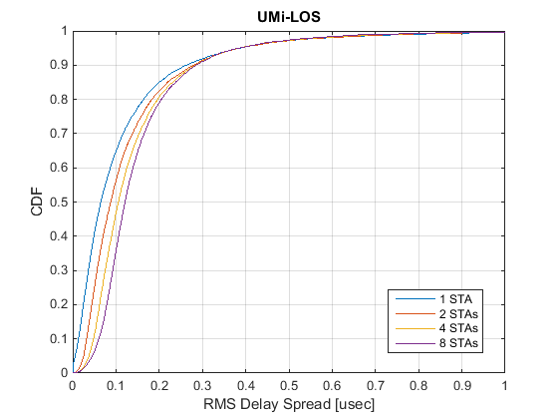
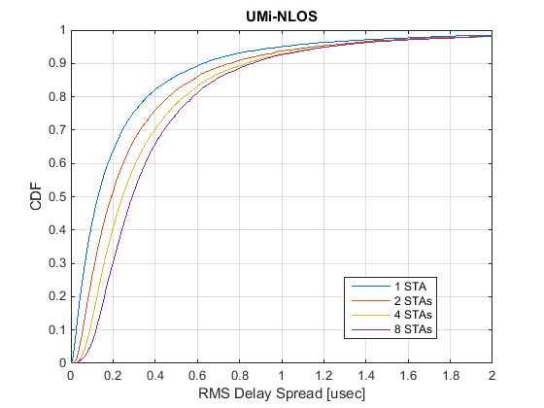
Possible Issues
Is 0.8 usec GI enough for RF-combined CTS frame?
Simulation results for channel RMS delay
In terms of the probability that RMS delay spread approaches to 0.8usec:
No difference whether or not multiple STAs are transmitting in UMi-LOS channel.
Less than 10% difference between single STA transmission and 2-8 STAs simultaneous transmission in UMi-NLOS channel.

Slide 12
Summary
Use of RF-combined CTS frame for protection of MU transmission is proposed and possible issues are investigated.
Indicating more than one STA in RTS frame
Use of same MCS and scrambling seed
How can AP know which STA sent CTS frame?
Is 0.8 usec GI enough for RF-combined CTS frame?
Based on our analysis, RF-combined CTS frame can work properly in 11ax operation scenario, and thus, can protect MU transmission with reasonable protocol overhead.

Slide 13
Straw Poll
Do you agree to add to the TG Specification Framework:
4.y.z Two or more STAs are allowed to send CTS frame simultaneously for protection of MU transmission.

Slide 14
References
[1] 11-14-1431r1, “Issues on UL OFDMA”

