Slide 1
Frame Collision Information Management
Date: 2015-07-15
Authors:

Slide 2
Abstract
Interference in 11ax scenarios is a severe problem, which is an obstacle to realizing the goals of 11ax.
We proposed that supporting the use of Frame Collision Information(FCI) would be useful for reducing interference by management and control in 11ax.[1]
In this contribution, we propose methods for management of FCI and show an example of use case.

Slide 3
Background
In high density scenarios, frame collisions will increase due to many hidden terminals, and many terminals finish backoff at the same time.
Frame Collision Detection (FCD) can be useful for deciding countermeasures to reduce interference, such as for site survey, multi-rate control, DSC.
FCD methods using energy detection were introduced in [1].
  Compare signal power with noise level before and after frame
  Evaluate the power changes during frame
Other FCD methods are also possible
  Detect change of SYNC or BER during reception [2, 3]

Slide 4
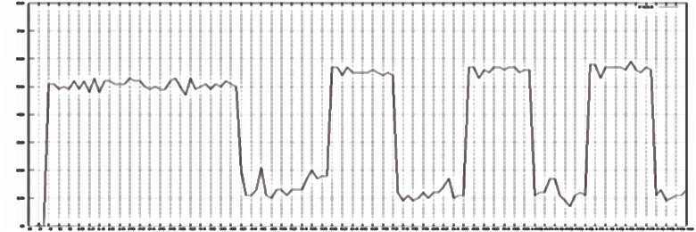
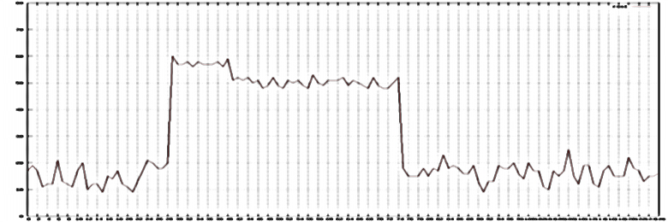
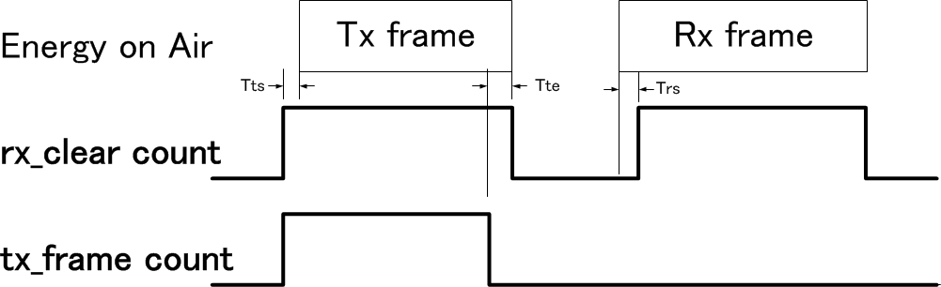
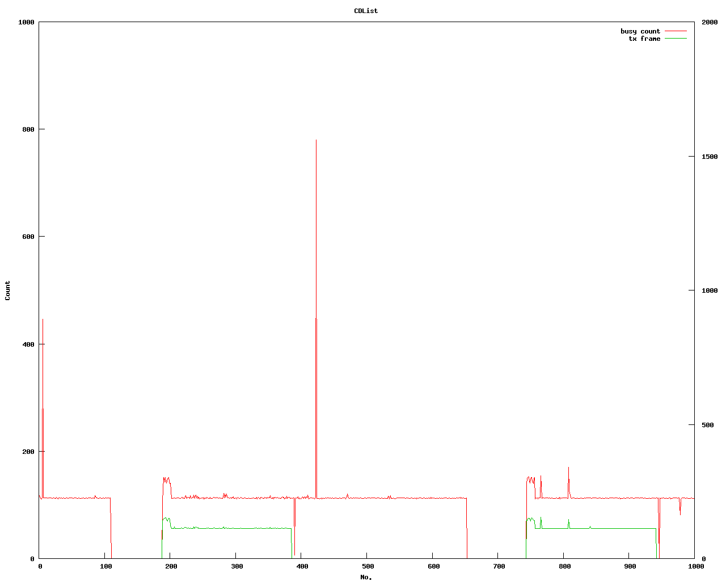
Brush up(1):Examples of FCD[1]
RSSI signal from power signal sensor [4] or spectral scan mode of WLAN card [5]
PHY state signal from WLAN card [6]
No collisions
Collision
power
power
RSSI
RSSI
Frame-B
Frame-A
Frame-A
Frame-A
Frame-A + Frame-B
time
time
count
tx_frame/2
Collision
rx_clear
time

Slide 5
Brush up(2): Frame Collision Information (FCI)[1]
Frame Collision Information includes information about the timing of the collision.
Timing information can be useful for identifying collision cause, allowing better choice of control countermeasures.
Example of collision type | Collision cause
Type I: | Cause I: transmitter of frame B cannot sense frame A
Type II: | Cause II: transmitters of A and B finish backoff at the same time
Type III: | Cause III: transmitter of frame A cannot sense frame B
A
B
A
B
A
B
A : target frame B : interference frame

Slide 6
FCI Management
Zones for Collision Detection in frame
Header
Payload
frame
B0:Pre-frame Zone
B2:Frame Zone
B3:Post-Frame Zone
B1:Frame Start Zone

Slide 7
FCI Management(cont.)
Proposal for per-packet FCI
  Meta-information:
    indicate the frame zones which were tested
  FCD result:
    indicate the result of each target zone:
      1: interference detected in zone
      0: interference NOT detected in zone
 | Meta-information | FCD result

Slide 8
FCI Management(cont.)
Example: 2-bit FCI
Detection of collisions in 2 zones: Pre-frame and Post-frame zones.
 | Meta-information | FCD result
 | B0, B3 | 0/1(B0) | B1 | B2 | 0/1(B3)
frame
B0:Pre-frame Zone
B3:Post-Frame Zone

Slide 9
FCI Management(cont.)
Example: 2-bit FCI
Detection of collisions in 2 zones: Pre-frame and Frame zones.
 | Meta-information | FCD result
 | B0, B2 | 0/1(B0) | B1 | 0/1(B2) | B3
frame
B0:Pre-frame Zone
B2:Frame Zone

Slide 10
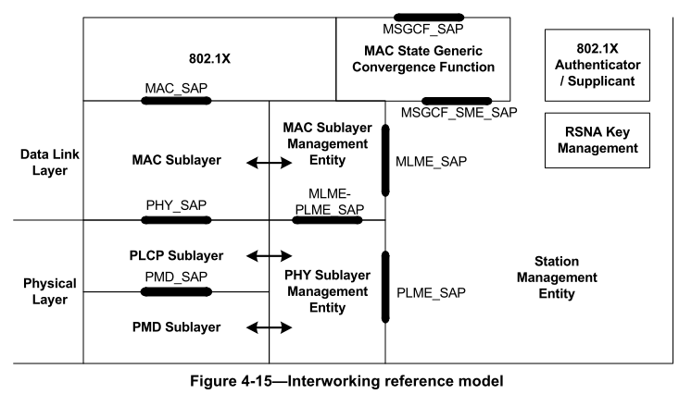
FCI management in PHY/MAC layer
Frame transmission/reception uses PHY-SAP and PMD_SAP primitives between sub-layers in PHY/MAC layer.
We propose to add 2 primitives “PHY-FCI” and “PMD-FCI”.
[7]

Slide 11
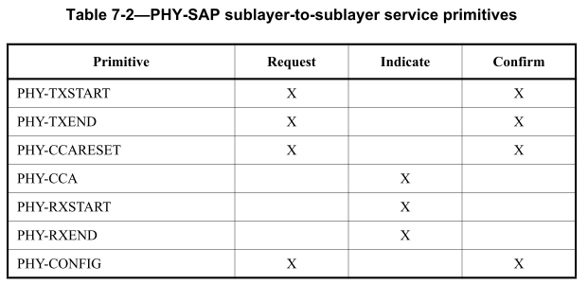
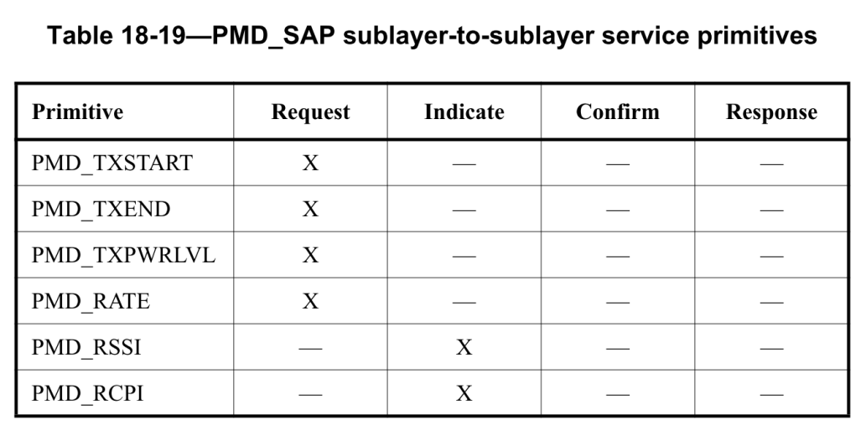
Proposal for additional service primitives
“Request/Confirm” primitives should be included for on-demand communication from upper layer and “Indicate” primitive is also included for urgent indication from lower layer
[7]
[7]
PHY-FCI | X | X | X
PMD-FCI | X | X | X | -

Slide 12
Example for additional service primitives
PMD primitives are used to gather 4 FCD bits from PHY layer
PHY primitives are used to generate 4-bit FCI from 4 FCD bits
PHY_FCI.request
PHY_FCI.confirm
meta-information
4-FCD results from
B0, B1, B2 and B3
MAC
Collision Detection during B1 and B2
PHY
PLCP
B1
B2
PMD_FCI.req/conf
PMD_FCI.req/conf
frame
PHY
PMD
Energy Detection
during
B0
Energy Detection during
B3
frame
B0:Pre-frame Zone B1:Frame Start Zone B2:Frame Zone B3:Post-Frame Zone

Slide 13
Add FCI statistics report
For evaluating the network collision status in a certain period, we propose to add “FCI statistics report” to Measurement Report Set in the primitive “MLME-MEASURE.confirm” so SME(Station Management Entity) can access FCI.
[7]

Slide 14
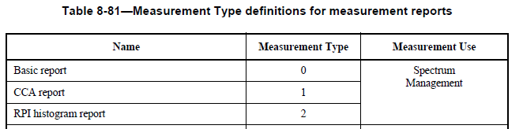
Add FCI statistics report(Cont.)
[7]
…
FCI statistics report | 13 | Radio Measurement and WNM
Add “FCI statistics report”

Slide 15
FCI Use Case
Frame collisions caused by hidden terminals.
Identify most likely collision cause from FCI, and decide corresponding countermeasure to achieve higher throughput in collision environment[8].
Collision Type | FCI(*) | Inferred Collision Cause | Effective Countermeasure
Type I: | 0011 | Cause I: transmitter of frame B cannot sense frame A | Increase Tx Power
Type III: | 1111 | Cause III: transmitter of frame A cannot sense frame B | Reduce CCA level
A
B
A
B
A :target frame. B : interference frame
(*) 4-bit FCI indicates the zone where interference is detected

Slide 16
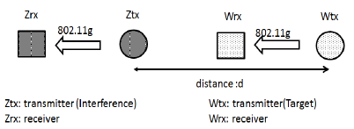
FCI Use Case (2)
Simulation Scenario
Flow Z
Flow W
Transmission parameters setting:
Scenario | Wtx-Ztx Distance[m] | Tx power[dBm] |  | CCA [dBm] |  | Cwmin of Wtx and Ztx
 |  | Wtx | Ztx | Wtx | Ztx
1 | 50 | -10~20 | 10 | -80 | -80 | 7
2 | 50 | 10 | 0 | -60 ~ -100 | -80 | 7

Slide 17
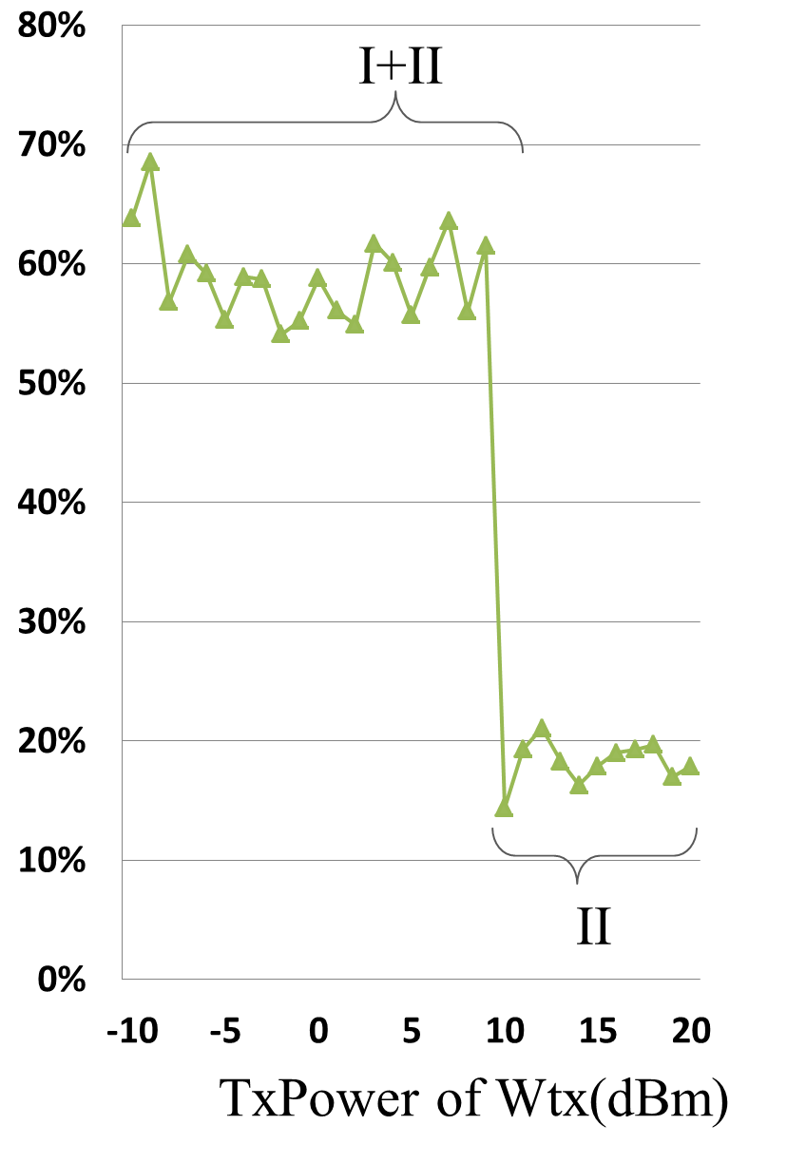
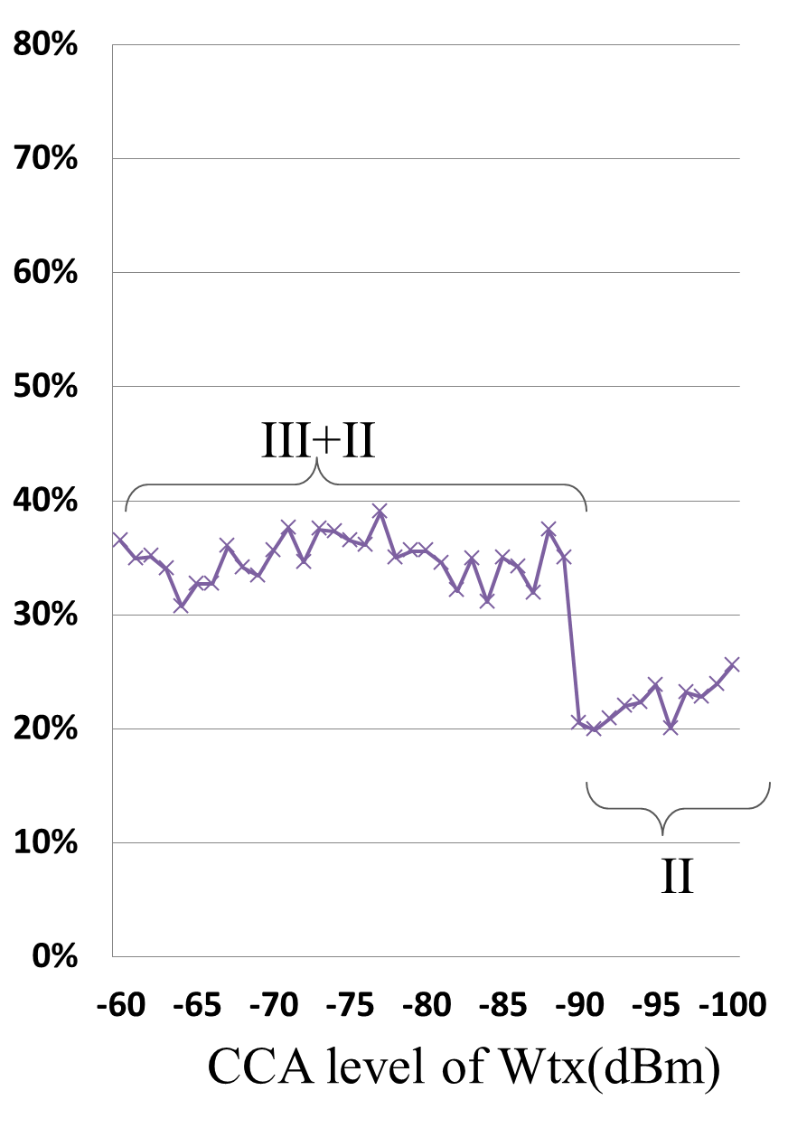
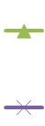
FCI Use Case (3)
Simulation Result
Scenario 1
Scenario 2
Collision Ratio (%)
Collision Ratio (%)
Wtx
Ztx
:Type I
Wtx
Ztx
:Type II
Wtx
Ztx
:Type III
CONTROL RULE :
If many Type I detected,
then increase Tx power
If many type III detected,
then decrease CCA level

Slide 18
Summary
Proposal of management of Frame Collision Information(FCI)
  The format of per-packet FCI
  FCI management in PHY/MAC layer
  Addition of “Service Primitives” and “Statistics Report” for FCI management
Example of FCI use case.
  Reduce interference by transmission control depending on detected collision type.

Slide 19
References
[1] 11-14/1106r1:“WLAN Frame Collision Information”.
[2]K. Whitehouse, “Exploiting the Capture Effect tor Collision Detection and Recovery”, EmNet 2005.
[3]S, Rayanchu, “Diagnosing Wireless Packet Losses in 802.11: Separating Collision from Weak Signal”, ftp://ftp.cs.wisc.edu/pub/techreports/2007/TR1597.pdf
[4] IEICE Technical Report, SIP2012-125, p259-264, March 2014 , P. Shao.
[5]“ath9k spectral scan”, http://wireless.kernel.org/en/users/Drivers/ath9k/spectral_scan/
[6]“Fwd: FW: Channel busy cycles”, ath9k-devel ML, http://article.gmane.org/gmane.linux.drivers.
ath9k.devel/9887/
[7]“ IEEE Std 802.11TM-2012, Wireless LAN medium access control (MAC) and physical layer (PHY) specifications”, 2012.
[8]Y. Baba, “Wireless LAN frame collision control using collision type information,” 2015 ICECCT, EC4015, pp. 1361-1367, March, 2015.

Slide 20
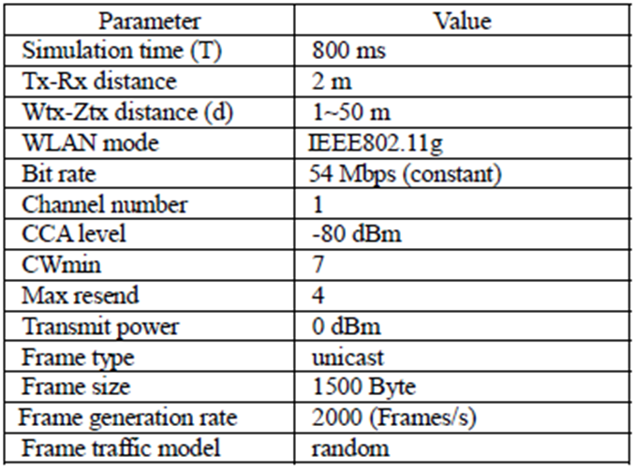
Appendix 1: Simulation Conditions
Simulation conditions in slide 16

Slide 21
Appendix 2: Example of rx_clear count
power
time
Result of CCA
0
2
4
4
4
4
2
0
time
rx_clear count
time
:0
:1

Slide 22
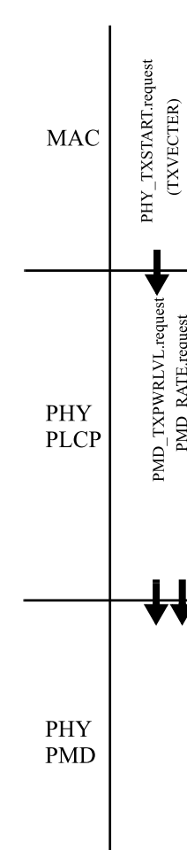
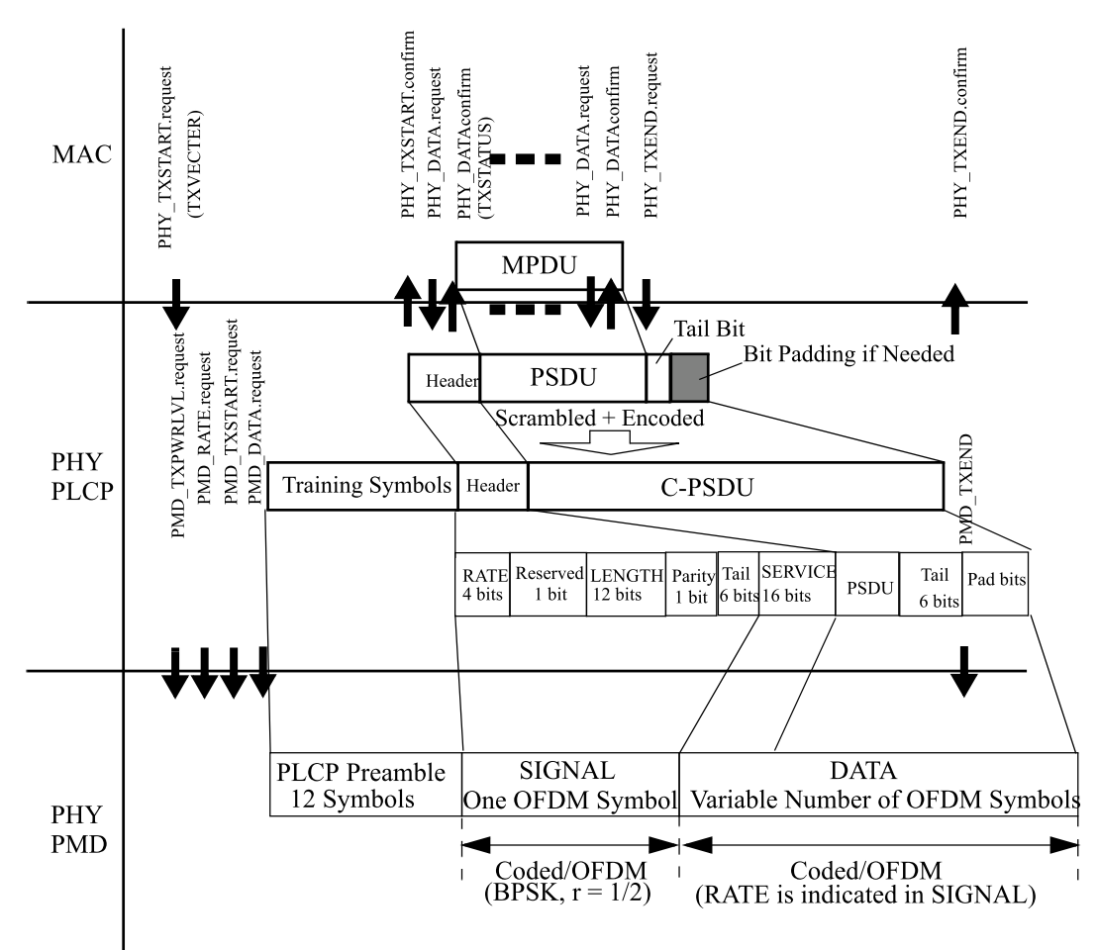
Appendix 3 : requesting FCI from MAC and indicating FCI to MAC with Tx frame
PHY_FCI.indication
PHY_FCI.indication
PHY_FCI.request
PHY_FCI.indication
PHY_FCI.confirm
PMD_FCI.conf
PMD_FCI.req
PMD_FCI.req
PMD_FCI.ind
PMD_FCI.ind
PMD_FCI.conf
(3)
(1)
(4)
(2)
(1):Pre-frame Zone (2):Frame Start Zone (3):Frame Zone (4):Post-Frame Zone

Slide 23
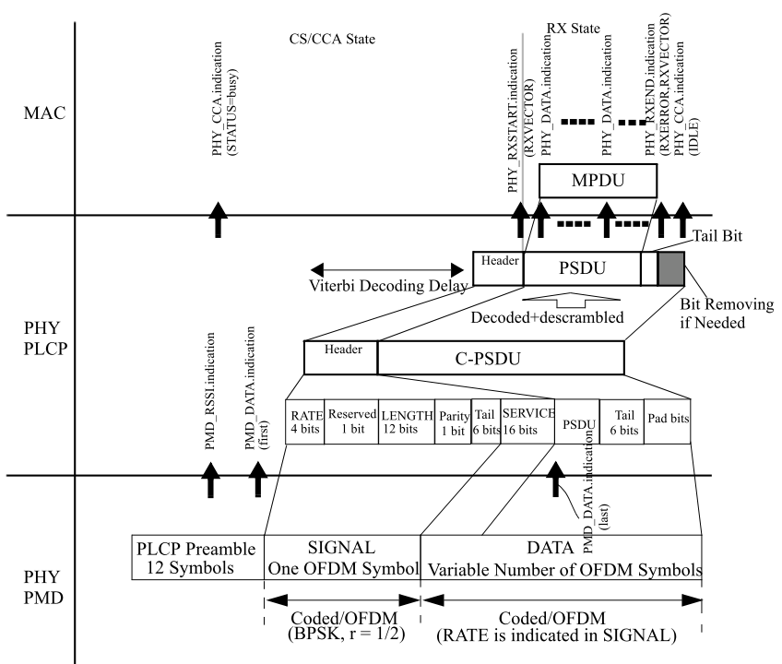
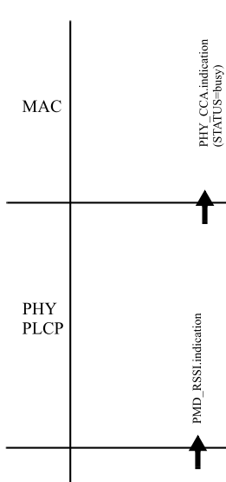
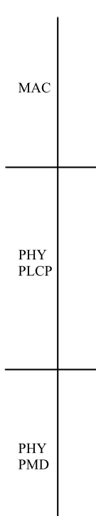
Appendix 4 : indicating FCI to MAC with Rx frame
PHY_FCI.indication
PHY_FCI.indication
PHY_FCI.indication
PHY_FCI.indication
PMD_FCI.conf
PMD_FCI.ind
PMD_FCI.conf
PMD_FCI.req
PMD_FCI.ind
PMD_FCI.req
(3)
(1)
(4)
(2)

Slide 24
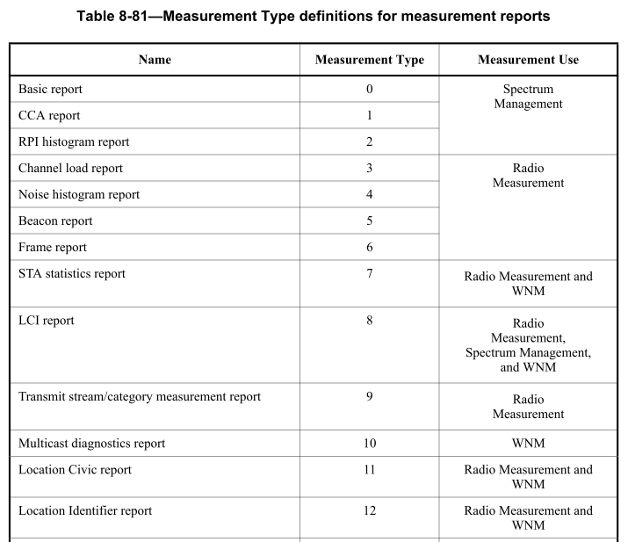
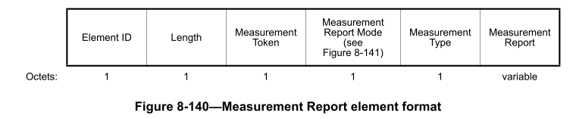
Appendix 5: Adding FCI statistics report to Measurement Report Set
802.11 standards already have various reports in a measurement report set.
We propose to add “FCI statistics report” to Measurement Type definitions.
  Fig. 8-140 shows Measurement Report element format and Table 8-81 shows Measurement Type definitions for measurement reports.
FCI statistics report | 13 | Radio Measurement and WNM
14

Slide 25
Appendix 6 :Example of FCI Statistics Report
The format of the Measurement Report field corresponding to a “FCI statistics Report” is shown:
Tx Collision Indicator = Integer((Tx collision count/Tx count)×255)
Rx Collision Indicator = Integer((Rx collision count/Rx count)×255)
Channel Number indicates the channel number for which the measurement report applies. Actual Measurement Start Time is set to the value of the measuring STA’s TSF timer at the time the measurement started. Measurement Duration is set to the duration over which the FCI Report was measured, expressed in units of TUs. TU is equal to 1024us.
 | Operating Class | Channel Number | Actual Measurement Start Time | Measurement duration | Tx Count | Rx Count | Tx Collision Indicator during B0
Octets: | 1 | 1 | 8 | 2 | 4 | 4 | 1
 | Tx Collision Indicator during B1 | Tx Collision Indicator during B2 | Tx Collision Indicator during B3 | Rx Collision Indicator during B0 | Rx Collision Indicator during B1 | Rx Collision Indicator during B2 | Rx Collision Indicator during B3
 | 1 | 1 | 1 | 1 | 1 | 1 | 1

