Slide 1
Discussion on MU-MIMO based on Hybrid Beamforming System in 802.11ay
Date: YYYY-MM-DD
Authors:

Slide 2
Abstract
In [1], MU-MIMO scheme for 802.11ay was introduced.
In this presentation, we further discuss on the need for MU-MIMO and the parameters which should be determined to support MU-MIMO in 802.11ay.
Also, we consider codebooks for hybrid beamforming to support MU-MIMO.

Slide 3
Need for MU-MIMO in 802.11ay
802.11ay considers many usage scenarios as follows [2].
  Ultra short range (USR) communications
  Augmented reality and virtual reality
  Video/mass-data distribution/video on demand system
  Etc.
In order to use 802.11ay for a scenario such as video/mass-data distribution/video on demand system, 802.11ay may support multiuser transmission.

Slide 4
Hybrid Beamforming for MU-MIMO
System model

Slide 5
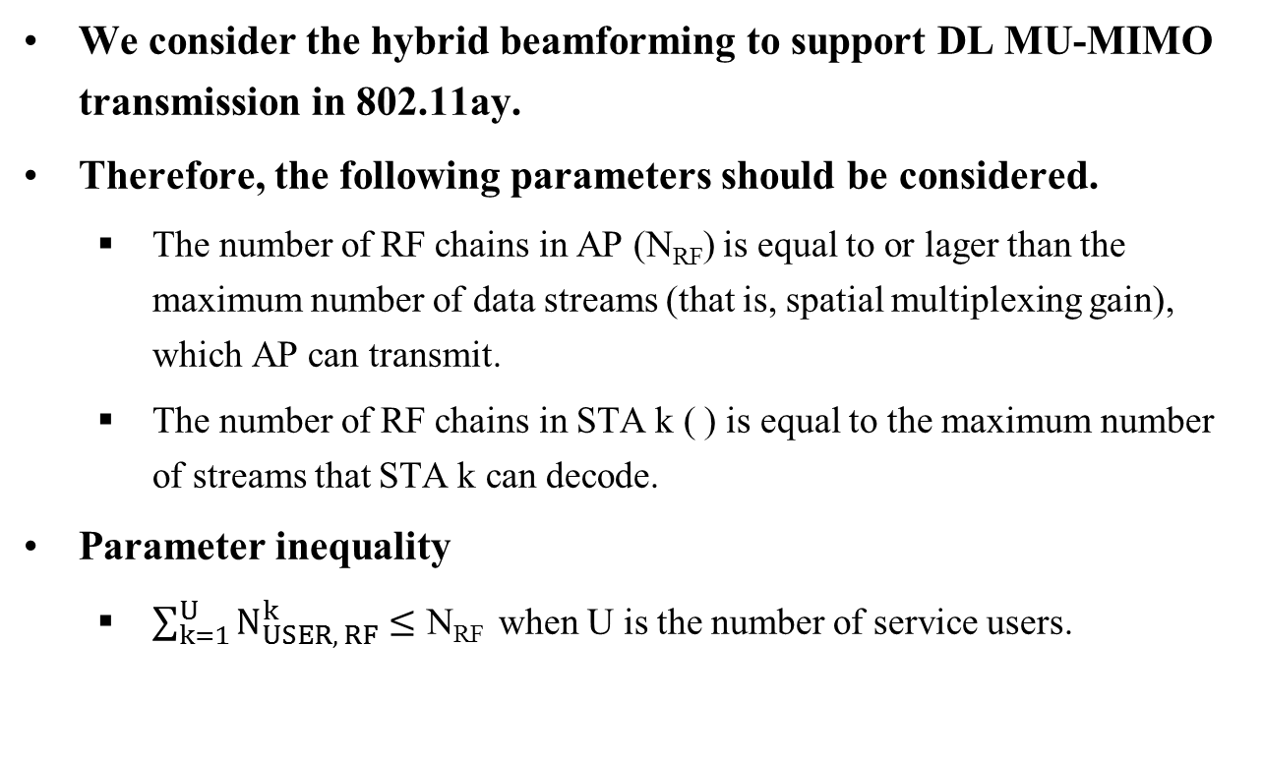
Parameters for MU-MIMO in 802.11ay
We consider the hybrid beamforming to support DL MU-MIMO transmission in 802.11ay.
Therefore, the following parameters should be considered.
  The number of RF chains in AP (N_{RF}) is equal to or lager than the maximum number of data streams (that is, spatial multiplexing gain), which AP can transmit.
  The number of RF chains in STA k ( ) is equal to the maximum number of streams that STA k can decode.
Parameter inequality
  $\sum_{k=1}^{U}{N_{USER, RF}^{k}}≤\text{N}\text{RF}$ when U is the number of service users.

Slide 6
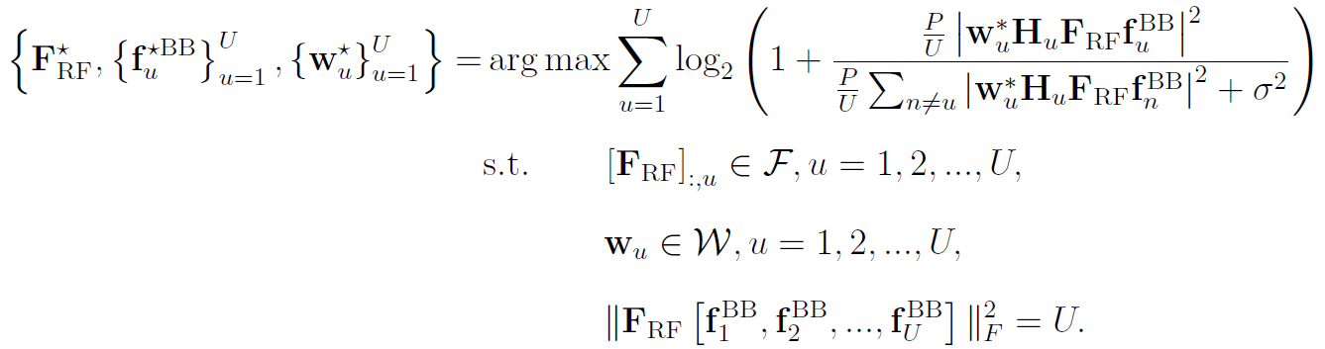
Beamforming Design Problem for MU-MIMO
Hybrid Beamforming
Problem formulation
As the number of STAs and the size of codebook increase, the overhead required to determine the RF/digital beams exponentially increases.
Low complexity and low overhead hybrid beamformming algorithm is required!

Slide 7
Codebooks for Hybrid Beamforming
Different codebooks may be considered for RF/digital beamforming due to their respective properties.
Candidate codebooks for RF beam
  Codebook in IEEE 802.15.3c (WPAN)
  DFT-based codebook
  Beamsteering codebook
Candidate codebook for digital beam
  Grassmannian codebook

Slide 8
Procedure of Designing MU-MIMO
Hybrid Beamforming (1/2)
1
2
3
Determination of RF beamforming/filter
Feedback of effective channel information
Design of digital beamforming/filter

Slide 9
Procedure of Designing MU-MIMO
Hybrid Beamforming (1/2)
Stage 1: Determination of RF beamforming/filter
  Without considering the effect of digital beamforming/filter, RF beamforming/filters for each user are selected based on the beam training.
Stage 2: Feedback of effective channel information
  AP sends the pilot sequence.
  Each STA estimates and quantizes its effective channel (the product of full channel matrix and RF beamforming/filters).
  Each STA feeds back the index of the quantized channel to AP.
Stage 3: Obtaining digital beamforming/filter
  AP calculates the digital beamforming/filter based on the quantized channels and forwards the digital filters to STAs.

Slide 10
Conclusion
We discussed on the need for MU-MIMO and the parameters which should be determined to support multiuser in 802.11ay.
We suggested the procedure to design the hybrid beamforming for DL MU transmission.

Slide 11
References
[1] IEEE 802.11-15/0356r0, “MU-MIMO schemes for NG60”
[2] IEEE 802.11-15/0328r4, “NG 60 Use Cases”

