Slide 1
NAV Operation for Spatial Reuse
Date: 2015-07-10
Authors:

Slide 2
Introduction
TGax Specification Framework [2]
  5.1 Features for operation in dense environments [802.11ax SFD]
  This section describes features that improve overlapping BSS (OBSS) operation in dense environments. This includes features such as deferral rules and CCA levels.
Previous contributions [3][4] presented that 802.11ax can achieve a spatial reuse gain by increasing a physical carrier sense (CCA) threshold
This document further discusses the NAV operation issue based on the previous spatial reuse contributions

Slide 3
Recap of spatial reuse contributions
HE STA that receives a frame from OBSS indicates a channel busy for the received frame at <TBD> dBm that is greater than a minimum CCA sensitivity level (e.g., -82dBm)
  COLOR field of PHY header, Address field of MAC header is used to identify whether the received frame is transmitted from OBSS

Slide 4
Discussion
Current NAV operation states that all 3rd party STA receiving RTS/CTS shall set the NAV regardless of BSS
It means that 3rd party HE STA also sets its NAV from the RTS/CTS transmitted from OBSS and setting the NAV causes to disturbs the spatial reuse

Slide 5
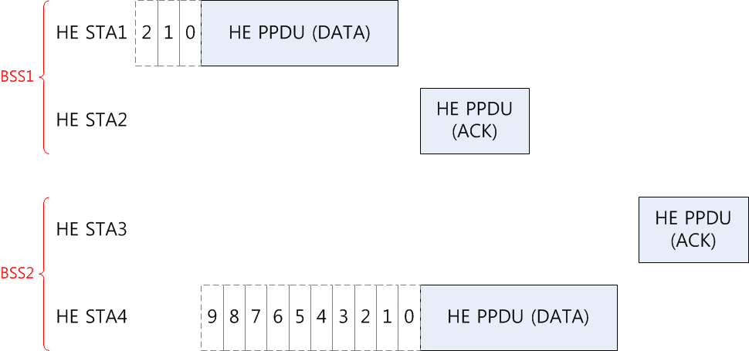
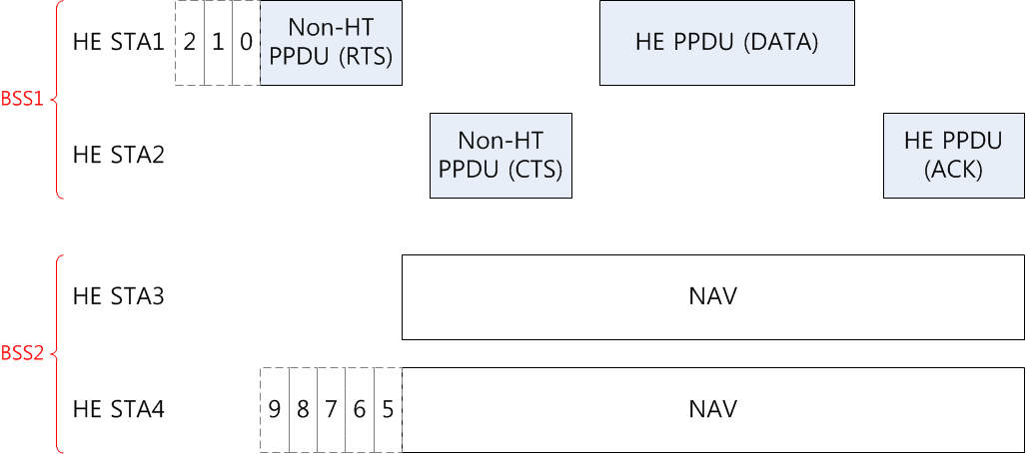
Spatial reuse frame exchange sequences
Without RTS/CTS
- Show a spatial reuse gain
With RTS/CTS
- No spatial reuse gain

Slide 6
Proposed Solution
HE STA has different NAV update rules depending on whether a received RTS/CTS is transmitted from OBSS
  For example, HE STA updates its NAV from a received RTS/CTS transmitted from My BSS
  But, it discards a RTS/CTS transmitted from OBSS

Slide 7
Proposed Solution
RTS/CTS frames need to carry an information (such as BSSID) for identifying whether a received frame is transmitted from OBSS
  RTS carries the BSSID information in either RA or TA, except for the DLS and TDLS transmission
  CTS addressed to non-AP STA carries no BSSID information

Slide 8
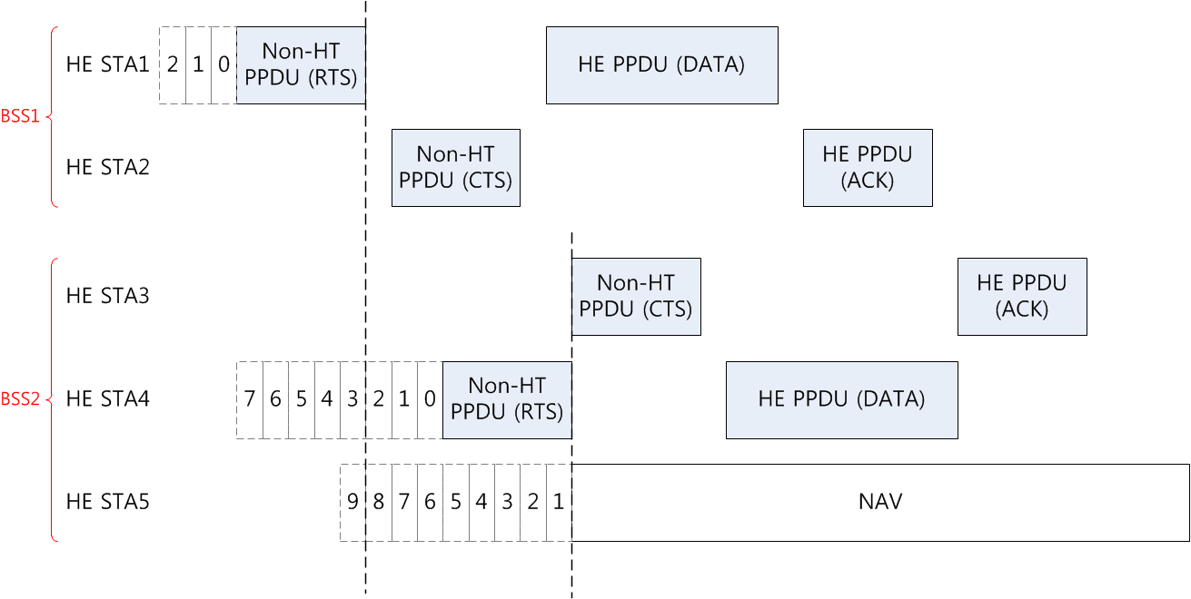
Proposed spatial reuse frame exchange sequences
STA5 does not update NAV
because RTS is transmitted from OBSS
STA5 updates NAV
because RTS is transmitted from its associated BSS

Slide 9
Performance Evaluation
Simulation environment
  Scenario 1: Residential Scenario [1]
    Number of AP: 100
    Number of STA per AP: 1
    Number of channels: 3 x 20MHz non-overlapping channels
    Full buffer traffic
  Protocol parameters
    RTS/CTS: ON
    Legacy physical CCA threshold: -82 dBm
    11ax spatial reuse (SR) physical CCA threshold : -62 dBm

Slide 10
Performance Evaluation
Simulation results
  When the RTS/CTS exchange is used, increasing the physical CCA threshold does not show any spatial reuse gain. The RTS/CTS exchange disturbs the spatial reuse of HE STA in OBSS because it sets the NAV
  But, by discarding the RTS/CTS transmitted from OBSS (i.e., SR virtual CCA in a below table), we can see the original spatial reuse gain achieved from increasing the physical CCA threshold
 | legacy virtual CCA with legacy physical CCA (-82dBm) | legacy virtual CCA with 11ax SR physical CCA (-62dBm) | SR virtual CCA with 11ax SR physical CCA (-82dBm)
10th percentile throughput (Mbps) | 0.36 | 0.876 | 0.036
50th percentile throughput (Mbps) | 4.032 | 3.18 | 13.536
90th percentile throughput (Mbps) | 9.264 | 6.108 | 20.352

Slide 11
Conclusion
Previous discussion shows that increasing physical CCA threshold in dense environment can have a spatial reuse gain
But, the current NAV operation can diminish the spatial reuse gain achieved from increasing the physical CCA threshold
The RTS/CTS received from OBSS should have additional restriction for updating the NAV

Slide 12
References
[1] https://mentor.ieee.org/802.11/dcn/14/11-14-0980-12-00ax-simulation-scenarios.docx
[2] https://mentor.ieee.org/802.11/dcn/15/11-15-0132-05-00ax-spec-framework.docx
[3] https://mentor.ieee.org/802.11/dcn/15/11-15-0548-00-00ax-enterprise-scenario-and-dsc.pptx
[4] https://mentor.ieee.org/802.11/dcn/15/11-15-0357-04-00ax-scenario-1-cca-simulation.pptx

Slide 13
Straw Poll 1
Do you agree to add the TGax Specification Framework:
  5.1 Features for operation in dense environments [802.11ax SFD]
  HE STA has different NAV update rules depending on whether a received RTS/CTS is transmitted from an OBSS HE STA

Slide 14
Straw Poll 2
Do you agree to add the TGax Specification Framework:
  5.1 Features for operation in dense environments [802.11ax SFD]
  RTS/CTS frames sent from HE STA carry an information (such as BSSID) for identifying whether a received frame is transmitted from OBSS

