Slide 1
802.11 July 2015 Closing Reports
Date: 2015-07-17
Authors:

Slide 2
Abstract
This document is a digest of the closing reports of all 802.11 sub-groups for presentation at the July 2015 closing plenary meeting. Attendance information and liaison reports are also included.

Slide 3
Attendance

Slide 4
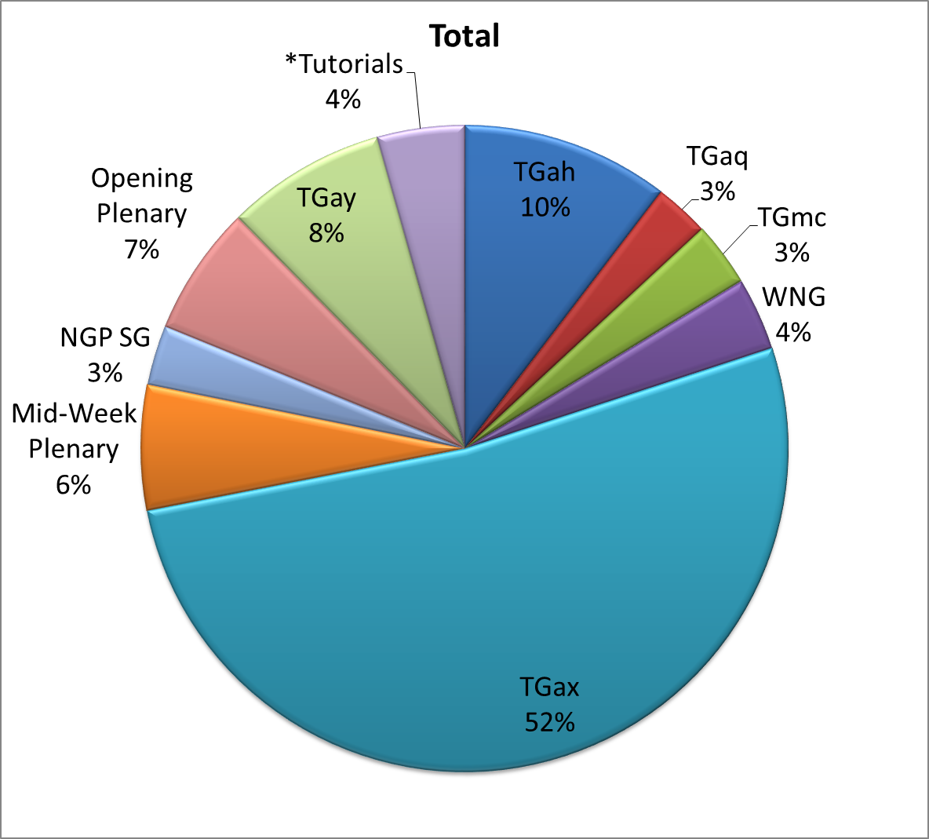
Attendance Total

Slide 5
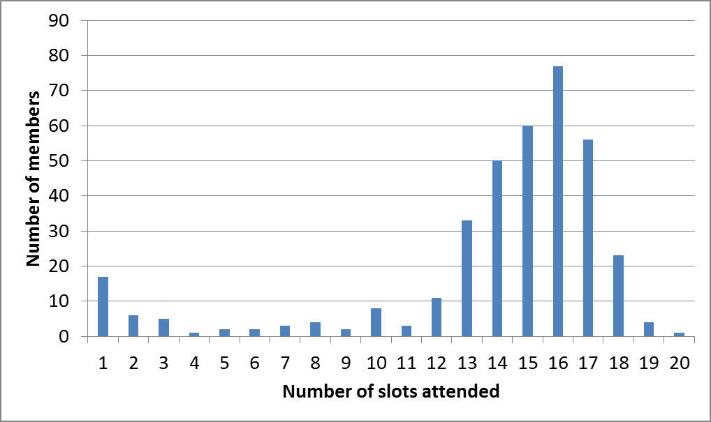
Attendance Histogram (Thu)

Slide 6
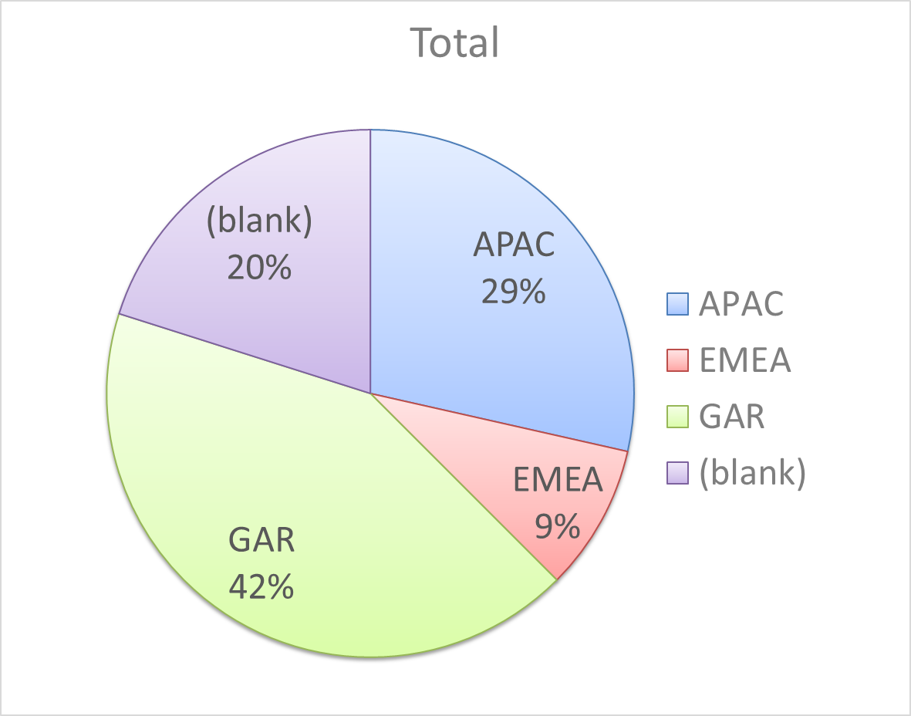
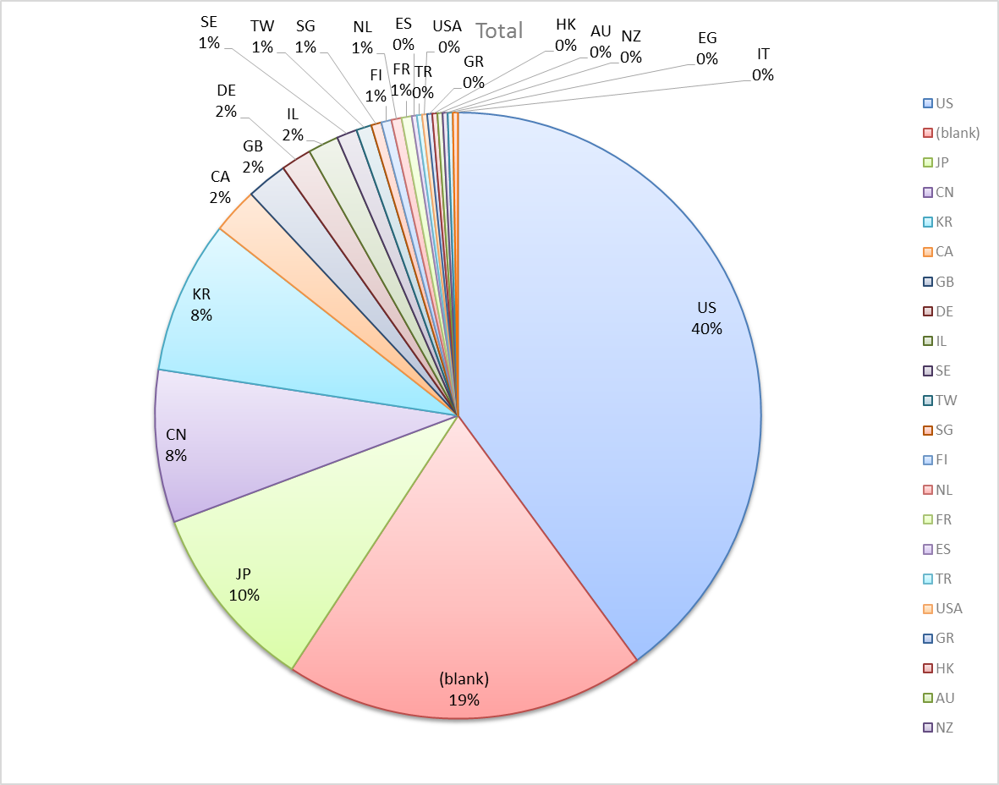
Attendance by Country

Slide 7
Type of Groups
Type of Group | Description
WG | Working Group
SC | Standing Committee
TG | Task Group
SG | Study Group

Slide 8
Groups
Type | Group | Description | Chair
WG | WG11 | The IEEE 802.11 Working Group | Adrian Stephens
SC | PUB | Publicity | Stephen McCann
SC | WNG | Wireless Next Generation | Clint Chaplin
SC | ARC | Architecture | Mark Hamilton
SC | JTC1 | ISO/IEC/JTC1/SC6 shadow committee | Andrew Myles
SC | PAR | Project Authorization Request | Jon Rosdahl
SC | REG | Regulatory | Richard Kennedy
TG | MC | Maintenance (Revision C) | Dorothy Stanley
TG | AH | Operation in 900 MHz bands | Yongho Seok
TG | AI | Fast Initial Link Setup | Hiroshi Mano
TG | AJ | China Millimeter Wave (CMMW) | Xiaoming Peng
TG | AK | General Link Setup | Donald Eastlake 3rd
TG | AQ | Pre-association Discovery | Stephen McCann
TG | AX | High Efficiency Wireless LAN (HEW) | Osama Aboul-Magd
TG | AY | Next Generation 60 GHz | Edward Au
SG | NGP | Next Generation Positioning | Jonathan Segev

Slide 9
802.11 WG Editor’s Meeting (July ‘15)
Date: 2015-05-03
Authors:
from slide 1/6 of 11-15-0825 by Peter Ecclesine (Cisco Systems)
Notes:
July 2007

Slide 10
Volunteer Editor Contacts
TGmc – Adrian Stephens – adrian.p.stephens@intel.com, Edward Au – edwardau@marvell.com, Emily Qi – emily.h.qi@intel.com
TGah – Yongho Seok yongho.seok@gmail.com, Alfred Asterjadhi – aasterja@qti.qualcomm.com
TGai – Lee Armstrong – LRA@tiac.net, Ping FANG Ping.FANG@huawei.com
TGaj – Jiamin CHEN – jiamin.chen@mail01.huawei.com
TGak – Donald Eastlake – d3e3e3@gmail.com, Norm Finn – nfinn@cisco.com
TGaq –
  TGax – Robert Stacey – robert.stacey@intel.com
Editors Emeritus:
  TGaa – Alex Ashley – alex.ashley@hotmail.co.uk
  TGac – Robert Stacey – robert.stacey@intel.com
  TGad – Carlos Cordeiro – carlos.cordeiro@intel.com
  TGae – Henry Ptasinski – henry@LOGOUT.COM
  TGaf – Peter Ecclesine – pecclesi@cisco.com
  TGaq – Dan Gal – ddrgal@gmail.com
from slide 2/6 of 11-15-0825 by Peter Ecclesine (Cisco Systems)
Notes:
July 2007

Slide 11
802.11 Style Guide
See 11-09-1034-11-0000-wg11-style-guide.doc
  We updated 802.11 WG Style Guide based on 2012 IEEE Standards Style Manual and consistency changes in final publication of the 802.11 standard
Editor’s responsibility includes checking the 2014 IEEE Standards Style Manual when creating or updating drafts. https://development.standards.ieee.org/myproject/Public/mytools/draft/styleman.pdf
Submissions with draft text should conform to both the WG11 Style Guide and IEEE Standards Style Manual
Note that the Style Guide evolves with our practice
from slide 3/6 of 11-15-0825 by Peter Ecclesine (Cisco Systems)

Slide 12
Editor Amendment Ordering
Data as of July 2015
See http://grouper.ieee.org/groups/802/11/Reports/802.11_Timelines.htm
In Nov 2014, Editors changed the running order and will revisit in November 2015, maintaining this order in the interim
Amendment Number | Task Group | Projected REVCOM Date
802.11REVmc | TGmc - 3640 | Mar 2016
802.11-2016 Amendment 1 | TGai - 129 | Mar 2016
802.11-2016 Amendment 2 | TGah - 581 | Mar 2016
802.11-2016 Amendment 3 | TGaq - 15 | Nov 2016
802.11-2016 Amendment 4 | TGak - 48 | Jan 2017
802.11-2016 Amendment 5 | TGaj - 109 | Jun 2016***
802.11-2016 Amendment 6 | TGax | Mar 2019
Amendment numbering is editorial! No need to make ballot comments on these dynamic numbers!
from slide 4/6 of 11-15-0825 by Peter Ecclesine (Cisco Systems)
Notes:
July 2007

Slide 13
Draft Development Snapshot
TG | Published or Draft Baseline Documents |  |  |  |  |  |  |  | Source | MDR | Style Guide | Editor | Snapshot Date
 | Published | mc | ai | ah | aq | ak | aj | ax
mc | Y | 4.1 |  |  |  |  |  |  | Frame 12.0 | Yes | 2012 | Adrian Stephens Edward Au, Emily Qi | 14-July
ai | N | 4.0 | 6.0 |  |  |  |  |  | Frame 12.0 | Yes | 2012 | Lee Armstrong Ping FANG | 15-July
ah | N | 4.0 |  | 5.0 |  |  |  |  | Frame 11.0 | Yes | 2012 | Yongho Seok Alfred Asterjadhi | 10-May
aq | N |  |  |  | 1.2 |  |  |  | Word | No | 2012 |  | 12-July
ak | N | 4.0 |  |  |  | 1.1 |  |  | Word | No | 2012 | Donald Eastlake Norm Finn | 16-July
aj | N |  |  |  |  |  | 0.5 |  | Frame 10.0 | No | 2012 | Jiamin Chen | 14-July
ax | Y |  |  |  |  |  |  |  |  | No | 2012 | Robert Stacey | 12-May
Changes from last report shown in red.
Most current doc shaded green.
from slide 5/6 of 11-15-0825 by Peter Ecclesine (Cisco Systems)
Notes:
July 2009
July 2007
Peter Ecclesine (Cisco Systems)
Page 13

Slide 14
MIB style, Visio and Frame practices
I’m going to suggest going forward we use a single style with appropriately set tabs, and use leading Tabs to distinguish the syntax and description parts. (Adrian Stephens Feb 9, 2010)
Figure in an anchored frame within a table, and use a table caption as a figure caption
Keep embedded figures using visio as long as possible
  Near the end of sponsor ballot, turn these all into .wmf (windows meta file) format files (you can do this from visio using “save as”). Keep separate files for the .vsd source and the .wmf file that is linked to from frame. There is likelihood we should use .emf
Frame templates for 11aa, 11ac, 11af
Text version of MIB is available (2012, ae2012, aa2012, ad2012, acD5.0, afD5.0. mcD3.0)
from slide 6/6 of 11-15-0825 by Peter Ecclesine (Cisco Systems)

Slide 15
ARC Closing Report
Date: 2015-07-16
Authors:
from slide 1/6 of 11-15-0959 by Mark Hamilton (Ruckus Wireless)

Slide 16
Abstract
This document is the closing report for ARC SC,
July 2015, Waikoloa meeting
from slide 2/6 of 11-15-0959 by Mark Hamilton (Ruckus Wireless)

Slide 17
Work Completed
802.11 as a component
  Presentation: 11-15-0842-01-0arc-ieee-802-11-in-5g.pptx
MIB Design Pattern work item
  Presentation: 11-15-0355-03-0arc-mib-truthvalue-usage-patterns.docx (Delta document: 11-15-0891-00-0arc-delta-r2r3-of-mib-truthvalue-usage-patterns.docx)
  Led to discussion about the value of the MIB, how to best model or describe external management interfaces, and whether this whole topic is part of “802.11 as a component”
  To be continued…
Annex R
  Approved update of document being considered by TGmc, to make Annex R normative, and add the “DSAF” concept (11-15-0555-04-0arc-normative-ds-sap-proposal.docx)
  [ Further improved the document in TGmc after ARC had adjourned. Will finalize this (with motion in TGmc) in Bangkok. ]
from slide 3/6 of 11-15-0959 by Mark Hamilton (Ruckus Wireless)

Slide 18
Work Completed
REVmc Figure 5-1 (11-15/0540)
  Continued review of Figures 5-1, et seq, in REVmc D4.0, in response to Sponsor Ballot comment
  Discussion about “An AP doesn’t have a MAC SAP!”
  Also to be continued …
IETF/802 coordination update
  No news
Joint meeting with TGak/802.1
  Reviewed comment resolutions on 802.1AC and 802.1Qbz ballots. Both are now complete and agreed, and will recirc.
from slide 4/6 of 11-15-0959 by Mark Hamilton (Ruckus Wireless)

Slide 19
Teleconference(s)
None planned.
Will schedule with 10 days notice, if 802.1 ballots need discussion
from slide 5/6 of 11-15-0959 by Mark Hamilton (Ruckus Wireless)

Slide 20
September 2015 Plans
Two standalone meeting slots planned:
  802.11 as a component in a larger eco-system
  Design Pattern for MIB attribute use
  802.11 Architecture topics: Figure 5-1 et seq
  DS/AP/Portal architecture discussions
One joint session with TGak
  802.11ak architecture discussions:
    GLK ESS concept
    “Where are a DS’s brains?”
from slide 6/6 of 11-15-0959 by Mark Hamilton (Ruckus Wireless)

Slide 21
802-11 PAR Review July 2015
Date: 2015-07-16
Authors:
from slide 1/34 of 11-15-0753 by Jon Rosdahl, CSR

Slide 22
Abstract-Snapshot
Review of Proposed 802 PAR documents -- Jul 12-17, Waikoloa, Hawaii
  802.1CM- Standard: Time-Sensitive Networking for Fronthaul, PAR and CSD
  802.1Qcl- Amendment, YANG Data Model, PAR and CSD
  802.1Qcn- Amendment, VSI/VDP extensions for NVO3, PAR and CSD
  802.1Xck- Amendment, YANG Data Model, PAR and CSD
  802.3bq- Amendment, Addition of 25GBASE, PAR Modification Request and CSD
  802.11az- Amendment: Positioning Enhancements, PAR and CSD
  802.15.3- Revision, PAR and CSD
  802.15.9- Amendment, Recommended Practice for Transport of Key Management Protocol (KMP) Datagrams, PAR Modification and 5C
  802.19.1a - Amendment, Coexistence Methods for geo-location capable devices operating under general authorization, PAR and CSD.
  Privacy Recommendation EC Study Group - Recommended Practice, Privacy Considerations for IEEE 802 Technologies, PAR (pdf) and PAR / CSD (PPTx)
Meeting times: Monday PM2, Tuesday AM2, Thursday AM2
from slide 2/34 of 11-15-0753 by Jon Rosdahl, CSR

Slide 23
PAR Review SC – July 2015
Chair: Jon Rosdahl
Draft Agenda:
Monday Agenda:
  Welcome
  Determine order of review
  Review PARs/CSD posted for review this week.
  Recess
Tuesday Agenda:
  Complete review of PARs/CSD and post comments to 802 WGs
  Recess
Thursday Agenda:
  Review Response to Comments
  Prepare Report for 802.11 WG closing plenary
  Adjourn
from slide 3/34 of 11-15-0753 by Jon Rosdahl, CSR

Slide 24
PAR Review SC minutes
Monday: Meeting called to order at 10:30am
  Draft Agenda Approved without objection
  Review and discussion of PARs submitted
  (802.15, 802.19, Privacy, 802.1)
  Recess at 12:30pm
Tuesday July 14, 2015 - Meeting called to order at 10:30am
  Review the 802.1 and 802.3 PARs
  Review comments to post to 802 WGs
  Recess at 11:20am
Thursday July 16, 2015 – Meeting called to order at 10:38am
  Review all responses received to 802.11 comments.
  Prepared rebuttal to 802.15 response
  Motion to approve rebuttal on slide 18 of doc11-15/753r3.
  Moved: Adrian S, 2nd Stuart K. Passed 3-0-0.
  Adjourned at 11:35am.
from slide 4/34 of 11-15-0753 by Jon Rosdahl, CSR

Slide 25
802.1CM- Standard: Time-Sensitive Networking for Fronthaul, PAR and CSD
8.1 – Note “(Item Number and Explanation)” is missing
Why would this statement not be included in 7.2?
Is the closeness not a joint effort?
Current text: “This work will be done in close collaboration with CPRI Cooperation.”
Expand abbreviation – “ CPRI”
Note from your url: The Common Public Radio Interface (CPRI™) – so do you need to use the “TM”.
It may be better to just not include the sentence?
from slide 5/34 of 11-15-0753 by Jon Rosdahl, CSR

Slide 26
802.1Qcl- Amendment, YANG Data Model, PAR and CSD
1.1 Project number – suggest that “l” not be used in the project number as it is often confused with “1”.
8.1 - include the full titles of standards called out in the PAR..i.e “IEEE Std 802.1Q, IEEE Std 802.1AX and IEEE Std 802.1X.”
7.3a – does not show up in the PAR PDF – This should have been marked with a yes, and then it might show up in the PDF?
5.2b – expand acronyms on first use in PAR
(TPMR, VLAN, UML, etc.)
5.5 – expand acronyms on first use in PAR
(SDO, IETF, RFC, etc.)
Add explanation of what is “NETCONF” to 8.1
from slide 6/34 of 11-15-0753 by Jon Rosdahl, CSR

Slide 27
802.1Qcn- Amendment, VSI/VDP extensions for NVO3, PAR
2.1 – why the “3” in the acronym?
2.1 Is it “Network Virtualization Overlays (NVO3)” or “Network Virtualization over Layer 3” (NVO3) (See RFC7365)
2.1 “extension” should be capitalized in title.
Why define NV03 in the title and then redefine it in 5.2b (all caps) and then again in 5.5 (all lower case) ?
VDP seems to be defined in the Title and then used as VDP in the rest of the PAR…this is different from the definition and use of the other TLAs defined in the Title.
from slide 7/34 of 11-15-0753 by Jon Rosdahl, CSR

Slide 28
802.1Qcn- Amendment, VSI/VDP extensions for NVO3, CSD
CSD:
In Distinct Identity it says that there is nothing like this, then in Technical feasibility it says that there is something similar (802.1Qbg)?
Technical Feasibility: the response to “a)” is not clear. Should be reworded at best.
Economic Feasibility
- This seems to imply that this is a possible amendment to 802.1Qbg?
from slide 8/34 of 11-15-0753 by Jon Rosdahl, CSR

Slide 29
802.1Xck- Amendment, YANG Data Model, PAR and CSD
8.1 - include the full titles of standards called out in the PAR..i.e “IEEE Std 802.1AE, and IEEE Std 802.1X.”
7.3a – does not show up in the PAR PDF – This should have been marked with a yes, and then it might show up in the PDF?
5.5 – expand acronyms on first use in PAR
(SDO, IETF, etc.)
Add an explanation of what is “NETCONF” to 8.1
5.5 – Add “(RFC 6020)” after YANG
from slide 9/34 of 11-15-0753 by Jon Rosdahl, CSR

Slide 30
802.3bq- Amendment, Addition of 25GBASE, PAR Modification Request and CSD
8.1 – Editorial note – there is a duplication of the 8.1 header.
Delete the unnecessary “Additional Explanatory Notes (Item Number and Explanation):”
from slide 10/34 of 11-15-0753 by Jon Rosdahl, CSR

Slide 31
802.11az- Amendment: Positioning Enhancements, PAR and CSD
802.11 NGP is processing this PAR and CSD
from slide 11/34 of 11-15-0753 by Jon Rosdahl, CSR

Slide 32
802.15.3- Revision, PAR and CSD
2.1 The title is ambiguous, the new title should still have some definition or indication that this is a WPAN standard.
5.2 The scope is very ambiguous and does not provide a boundary for the reader to determine what is covered by this standard.
from slide 12/34 of 11-15-0753 by Jon Rosdahl, CSR

Slide 33
802.15.9- Amendment, Recommended Practice for Transport of Key Management Protocol (KMP) Datagrams, PAR Modification and 5C
8.1 for a PAR modification, an explanation of what changes are being made shall be included.
5.3 Can this be updated as part of the PAR Modification?
from slide 13/34 of 11-15-0753 by Jon Rosdahl, CSR

Slide 34
802.19.1a - Amendment, Coexistence Methods for geo-location capable devices operating under general authorization, PAR and CSD.
No Comment
from slide 14/34 of 11-15-0753 by Jon Rosdahl, CSR

Slide 35
Privacy Recommendation EC Study Group - Recommended Practice, Privacy Considerations for IEEE 802 Technologies, PAR (pdf) and PAR / CSD (PPTx)
5.4 – Delete the Purpose statement. The current statement does not add to what is in the scope already.
5.4 Alternate #2: change the purpose statement to state “why” you would want to use this document. Replace 5.4 with the following:
  “The purpose of this recommend practice is to promote a consistent approach by IEEE 802 protocol developers to mitigate Internet privacy threats identified in the defined privacy threat model and provide a privacy guideline.”
  Alternate #2 is the preferred choice.
CSD: The CSD should be reformatted to be a stand alone document as outlined in the LMSC OM
from slide 15/34 of 11-15-0753 by Jon Rosdahl, CSR

Slide 36
Responses
Responses from the 802 WGs to the comments/feedback from 802.11.
from slide 16/34 of 11-15-0753 by Jon Rosdahl, CSR

Slide 37
Response from 802.15.3
From 802.11: 2.1 The title is ambiguous, the new title should still have some definition or indication that this is a WPAN standard.
Response: 802.15 moved beyond a purely PAN oriented group well over 10 years ago. This title reflects todays reality and is consistent with the titles now in use on other 802.15 Standards. We appreciate the comment but plan to stay with the current title.
From 802.11: 5.2 The scope is very ambiguous and does not provide a boundary for the reader to determine what is covered by this standard.
Response: This scope has been approved by the EC and NesCom on two previous occasions over the last 18 months. We appreciate the comment but are staying with the scope as submitted.
from slide 17/34 of 11-15-0753 by Jon Rosdahl, CSR

Slide 38
802.11 Rebuttal
We disagree with your assessment, the title is too vague.
The suggested new title does not provide enough clarity to differentiate this new title from any other IEEE wireless standard, and a reader would not be able to tell from the title and/or scope which particular wireless technology they were selecting when presented with just the title and scope.
Within 802, the title does not suggest that this standard belongs to 802.15 and could equally apply to an 802.11 Standard.
from slide 18/34 of 11-15-0753 by Jon Rosdahl, CSR

Slide 39
Motion to approve Rebuttal
Move to approve the Rebuttal to 802.15 regarding the 802.15.3 Revision PAR as shown on slide 18 of doc 11-15/753r3.
Moved: Stuart KERRY 2nd: Adrian STEPHENS
PAR Review SC Results: 3-0-0
from slide 19/34 of 11-15-0753 by Jon Rosdahl, CSR

Slide 40
Response from 802.3bg
Received one comment in respect to the IEEE P802.3bq 40GBASE-T PAR modification request from IEEE 802.11 that read '8.1 - Editorial note - there is a duplication of the 8.1 header. Delete the unnecessary "Additional Explanatory Notes (Item Number and Explanation):"'.
Our response to the comment is to accept it, and we have deleted the unnecessary text. The updated IEEE P802.3bq draft PAR is attached and can be accessed at <http://www.ieee802.org/3/25GBASET/draft_P802_3bq_PAR_150715.pdf>.
from slide 20/34 of 11-15-0753 by Jon Rosdahl, CSR

Slide 41
Response from 802.1Qcp (802.1Qcl)
1.1 Project number – suggest that “l” not be used in the project number as it is often confused with “1”.
  Changed to 802.1Qcp
8.1 - include the full titles of standards called out in the PAR..i.e “IEEE Std 802.1Q, IEEE Std 802.1AX and IEEE Std 802.1X.”
  IEEE Std 802.1Q - IEEE Standard for Local and metropolitan area networks — Bridges and Bridged Networks
  IEEE Std 802.1AX - IEEE Standard for Local and metropolitan area networks — Link Aggregation
  IEEE Std 802.1X – IEEE Standard for Local and metropolitan area networks – Port-Based Network Access Control
from slide 21/34 of 11-15-0753 by Jon Rosdahl, CSR

Slide 42
Response from 802.1Qcp (802.1Qcl)
7.3a – does not show up in the PAR PDF – This should have been marked with a yes, and then it might show up in the PDF?
  Yes, item 7.3a is marked as Yes. However, it does not show up in the generated PDF form.
  Additionally, we have contacted IEEE staff for assistance and resolution of the problem.
5.2b – expand acronyms on first use in PAR
(TPMR, VLAN, UML, etc.)
  Media Access Control (MAC)
  Two-Port MAC Relay (TPMR)
  Unified Modeling Language (UML)
  Virtual Local Area Network (VLAN)
from slide 22/34 of 11-15-0753 by Jon Rosdahl, CSR

Slide 43
Response from 802.1Qcp (802.1Qcl)
5.5 – expand acronyms on first use in PAR
(SDO, IETF, RFC, etc.)
  Will change SDO to standards development organization
  Request For Comment (RFC)
  Internet Engineering Task Force (IETF)
Add explanation of what is “NETCONF” to 8.1
  NETCONF (RFC6241) is a network configuration protocol that provides mechanisms to install, manipulate, and delete the configuration of network devices.
from slide 23/34 of 11-15-0753 by Jon Rosdahl, CSR

Slide 44
Response from 801.1Xck
8.1 - include the full titles of standards called out in the PAR..i.e “IEEE Std 802.1AE, and IEEE Std 802.1X.”
  IEEE Std 802.1AE – IEEE Standard for Local and metropolitan area networks Media Access Control (MAC) Security
  IEEE Std 802.1X – IEEE Standard for Local and metropolitan area networks – Port-Based Network Access Control
7.3a – does not show up in the PAR PDF – This should have been marked with a yes, and then it might show up in the PDF?
  Yes, item 7.3a is marked as Yes. However, it does not show up in the generated PDF form.
  Additionally, we have contacted IEEE staff for assistance and resolution of the problem.
from slide 24/34 of 11-15-0753 by Jon Rosdahl, CSR

Slide 45
Response from 802.1Xck
5.5 – expand acronyms on first use in PAR
(SDO, IETF, etc.)
  Will change SDO to standards development organization
  Request For Comment (RFC)
  Internet Engineering Task Force (IETF)
Add an explanation of what is “NETCONF” to 8.1
  NETCONF (RFC6241) is a network configuration protocol that provides mechanisms to install, manipulate, and delete the configuration of network devices.
5.5 – Add “(RFC 6020)” after YANG
  RFC 6020 reference added.
from slide 25/34 of 11-15-0753 by Jon Rosdahl, CSR

Slide 46
Response from P802.1Qcn
2.1 – why the “3” in the acronym?
  Is it “Network Virtualization Overlays (NVO3)” or “Network Virtualization over Layer 3” (NVO3) (See RFC7365)
  We will add “over Layer 3” – in the published RFCs that is the expansion, but in the Working Group title and some drafts that is omitted but it is better to match the RFCs.
2.1 “extension” should be capitalized in title.
  Will capitalize
from slide 26/34 of 11-15-0753 by Jon Rosdahl, CSR

Slide 47
Response from P802.1Qcn
Why define NV03 in the title and then redefine it in 5.2b (all caps) and then again in 5.5 (all lower case) ?
  We will expand just in the first use
  •For 5.5. use: “between the virtualized end device (end station) and the external network virtualization edge (e.g. bridge or router) in an NVO3 network.“
VDP seems to be defined in the Title and then used as VDP in the rest of the PAR…this is different from the definition and use of the other TLAs defined in the Title.
  We will make the other acronyms consistent with the way VDP is handled (only expand first use).
from slide 27/34 of 11-15-0753 by Jon Rosdahl, CSR

Slide 48
Response from 802.1Qcn - CSD
CSD:
• In Distinct Identity it says that there is nothing like this, then in Technical feasibility it says that there is something similar (802.1Qbg)?
  Nothing provides this capability for carrying the information needed by NVO3 networks (e.g. layer 3 context such as IPv4 or IPv6 addresses) so Distinct identity is correct.
  •The VDP protocol defined initially in IEEE 802.1Qbg carries similar context for layer 2, so it demonstrates technical feasibility. This project extends the protocol to carry layer 3 information.
from slide 28/34 of 11-15-0753 by Jon Rosdahl, CSR

Slide 49
Response from 802.1Qcn - CSD
Technical Feasibility: the response to “a)” is not clear. Should be reworded at best. (updated wording)
  a) There are existing implementations of VDP. VDP carries layer 2 context between an end station and a bridge. The technology used by the current VDP protocol will be reused by project to add layer 3 context to the information carried. There isn’t a significant difference in the technical feasibility of carrying layer 2 context versus layer 3 context
  b) Mechanisms similar to what is being proposed exist in VDP and have been shown to be reasonably testable.
from slide 29/34 of 11-15-0753 by Jon Rosdahl, CSR

Slide 50
Response from 802.1Qcn - CSD
Economic Feasibility
–This seems to imply that this is a possible amendment to 802.1Qbg?
  802.1Qbg was an amendment to IEEE 802.1Q. You can’t amend amendments. You do an additional amendment to the base standard. However, IEEE 802.1Qbg was rolled into the latest revision of IEEE 802.1Q so we should probably use the name of the feature rather than the project name for better clarity. Replace IEEE 802.1Qbg with VDP
from slide 30/34 of 11-15-0753 by Jon Rosdahl, CSR

Slide 51
Updated 802.1CM section 8.1
8.1 – Note “(Item Number and Explanation)” is missing.
Why would this statement not be included in 7.2?
Is the closeness not a joint effort?
  It is not a joint development effort. It is an IEEE-SA
  development with input from CPRI.
Current text: “This work will be done in close collaboration with CPRI Cooperation.”
Expand abbreviation – “ CPRI”
Note from your url: The Common Public Radio Interface (CPRI™) – so do you need to use the “TM”.
  Done
It may be better to just not include the sentence?
  It is better to make the collaboration clear.
from slide 31/34 of 11-15-0753 by Jon Rosdahl, CSR

Slide 52
Updated to 802.1CM section 8.1
5.2: The transport link between the radio equipment and
the radio equipment controller is referred to as fronthaul. A fronthaul network is a bridged network providing the fronthaul.
7.2: This is not joint development, however, this work will be done in close collaboration with Common Public Radio Interface (CPRITM) Cooperation (http://www.cpri.info/).
from slide 32/34 of 11-15-0753 by Jon Rosdahl, CSR

Slide 53
Privacy EC SG Response to 802.11
5.4 – Delete the Purpose statement. The current statement does not add to what is in the scope already.
5.4 Alternate #2: change the purpose statement to state “why” you would want to use this document. Replace 5.4 with the following:
  “The purpose of this recommend practice is to promote a consistent approach by IEEE 802 protocol developers to mitigate Internet privacy threats identified in the defined privacy threat model and provide a privacy guideline.”
    Alternative #2 has been accepted with editorial modifications. This is captured in privecsg-15-0030-00.
CSD: The CSD should be reformatted to be a stand alone document as outlined in the LMSC OM.
  The CSD is now a standalone document (privecsg-15-0029-01) separate from the PAR (privecsg-15-0030-00).
from slide 33/34 of 11-15-0753 by Jon Rosdahl, CSR

Slide 54
References
IEEE 802 PARs Under consideration Webpage:
  http://grouper.ieee.org/groups/802/PARs.shtml
from slide 34/34 of 11-15-0753 by Jon Rosdahl, CSR

Slide 55
Publicity Closing Report
Date: 2015-07-17
Authors:
from slide 1/3 of 11-15-0946 by Stephen McCann, BlackBerry

Slide 56
Abstract
Closing report for the Publicity SC for July 2015, Waikoloa, Hawaii, USA
from slide 2/3 of 11-15-0946 by Stephen McCann, BlackBerry

Slide 57
Discussion topics
  “What’s IEEE 802.11 doing” Presentation
    Requires checking to determine current status
      http://www.ieee802.org/11/presentation.html
IEEE 802.11 25th Anniversary Press Releases
  Productive discussion with IEEE marketing.
  https://mentor.ieee.org/802.11/dcn/15/11-15-0844-01-0000-draft-25th-anniversary-press-release.docx
  Approval motion and then forward to EC
Plans for September 2015
  Meet if required.
from slide 3/3 of 11-15-0946 by Stephen McCann, BlackBerry

Slide 58
IEEE 802.11/15 Regulatory SC
Waikoloa Closing Report
Date: 2015-07-17
Authors:
from slide 1/6 of 11-15-0730 by Rich Kennedy, MediaTek

Slide 59
Abstract
This presentation is the closing report for the July 2015 IEEE 802.11/15 Regulatory Standing Committee meeting in Waikoloa.
from slide 2/6 of 11-15-0730 by Rich Kennedy, MediaTek

Slide 60
Agenda
Review and approve the agenda
Administrative items and approve the minutes from Vancouver
Introduction
The regulatory summaries
The Regulatory SC and the 802 EC
Actions required
AOB and Adjourn
from slide 3/6 of 11-15-0730 by Rich Kennedy, MediaTek

Slide 61
Regulatory Updates
ETSI TC BRAN June update
  Progress made towards coexistence with LAA-LTE
  October and December meetings should finalize LBT method(s) and RED compliance details
ETSI ERM TG11 June update
  RED compliance details uncertain; regulators to clarify by 8/15
  WIA proposal fails to get support; will revise and try again Sept.
Ofcom PSSR consultation
  Awaiting response to WFA request for relief at 2390 MHz
FCC 15-47 (3.5 GHz) update
  Submitted Comments Monday
(NEW this week) ECC Decisions
  Several issues related to 802.11/15; details forthcoming
from slide 4/6 of 11-15-0730 by Rich Kennedy, MediaTek

Slide 62
Actions
Discussed preparations for ETSI ERM TG11 (Sept.) and ETSI TC BRAN#84 (Oct.) meetings
Discussed status of new proposal for DFS changes that support use of 5350-5470 MHz band
  Submitted to ETSI; should carry over to WRC19 agenda
  US will make changes and support it in WRC19
Discussed modified path for regulatory submissions
  With 75% approval in WG, will go as IEEE 802.11 (or 802.15) submission
  EC can block, but cannot modify
from slide 5/6 of 11-15-0730 by Rich Kennedy, MediaTek

Slide 63
Teleconferences
Bi-weekly on Thursdays, 12:30 to 13:30 ET
  Starting on July 23rd
  Through November 30th
from slide 6/6 of 11-15-0730 by Rich Kennedy, MediaTek

Slide 64
Closing Report
Date: 2015-07-17
Authors:
from slide 1/3 of 11-15-0961 by Clint Chaplin, Chair (Imagicon)

Slide 65
Abstract
Closing report for WNG SC for July 2015, Waikoloa, Hawaii, Hawaii, USA
from slide 2/3 of 11-15-0961 by Clint Chaplin, Chair (Imagicon)

Slide 66
Presentations at July 2015 meeting
  Traffic steering between 802.11 and LTE on Self-Organizing Networks use case from SEMAFOUR (11-15-0847-01-0wng-SEMAFOUR_LTE_WiFi_Network_Access_Selection.pdf) – Thomas Kuerner
  Integrated Long Range Low Power Operation for IoT (11-15-0775-01-0wng-integrated-long-range-low-power-operation.pptx) – Tim Godfrey
  Regulatory frame work for the expansion of 802.11ac to 6-10GHz (11-15-0776-02-0wng-regulatory-framework-for-expansion-of-802-11ac-to-6-10ghz.pptx) – Friedbert Berens
Minutes
  11-15-0912-00-0wng-july-2015-wng-meeting-minutes-waikoloa.doc
Plans for September 2015
  1 2 hour session
from slide 3/3 of 11-15-0961 by Clint Chaplin, Chair (Imagicon)

Slide 67
IEEE 802 JTC1 SC closing report
(July 2015)
Date: 2015-7-17
Authors:
from slide 1/7 of 11-15-0960 by Andrew Myles, Cisco

Slide 68
Abstract
Closing report for IEEE 802 JTC1 SC
for July 2015 in Hawaii
from slide 2/7 of 11-15-0960 by Andrew Myles, Cisco

Slide 69
The SC did not have a great deal of work this week and only one session was required
Reviewed status of PSDO pipeline
  802.3.1, 802.11ac and 802.11af passed FDIS
  Comments are required on 802.11ac and 802.11af
Recommended a Vice Chair
  The candidate (Peter Yee) will hopefully be appointed by the EC
Heard report from SC6 meeting in Belgium in May
  Thank you to Adrian Stephens and Jodi Haasz for attending on behalf of IEEE 802 and IEEE-SA
  Not much happened of interest to IEEE 802
  Next meeting in Xi’an, China in February 2016 – we will need a volunteer to attend on behalf of IEEE 802
from slide 3/7 of 11-15-0960 by Andrew Myles, Cisco

Slide 70
IEEE 802 has pushed 13 standards completely through the PSDO ratification process …
July 2015
IEEE 802 standard | 60 day pre-ballot | 5 month FDIS ballot
802.11 | 2012 | 2012
802.1X | 2013 | 21 Oct 2013
802.1AE | 2013 | 21 Oct 2013
802.1AB | May 2013 | 18 Dec 2013
802.1AR | May 2013 | 18 Dec 2013
802.1AS | May 2013 | 18 Dec 2013
802.3 | 2013 | 16 Feb 2014
802.11aa | Feb 2013 | 28 Jan 2014
802.11ad | Feb 2013 | 28 Jan 2014
802.22 | May 2014 | Feb 2015
802.1AEbw | Jan 2014 | Feb 2015
802.1AEbn | Jan 2014 | Feb 2015
from slide 4/7 of 11-15-0960 by Andrew Myles (Cisco)

Slide 71
… and has ten standards in the pipeline for ratification under the PSDO
July 2015
IEEE 802 standard | 60 day pre-ballot | 5 month FDIS | Comments resolved
802.11ac | Passed | Passed | Ready for approval
802.11af | Passed | Passed | Ready for approval
802 | Passed | Closes | Sent in Feb 2015
802.1Xbx | Closed | Waiting | Sent in Jun 2015
802.1Q-Rev | Closed | Waiting | Sent in Jun 2015
802.1AX | Closed | Closes | No comments
802.1BA | On hold | - | -
802.1BR | On hold | - | -
802.3.1 | Passed | Passed | No comments
802.22a | On hold | - | -
from slide 5/7 of 11-15-0960 by Andrew Myles, Cisco

Slide 72
The SC will focus in Bangkok on executing PSDO processes
Continue executing PSDO processes
Review any SC6 activities
from slide 6/7 of 11-15-0960 by Andrew Myles, Cisco

Slide 73
The SC recommended resolutions for the FDIS comments on 802.11ac & 802.11af
The SC developed resolutions for the FDIS comments on 802.11ac & 802.11af
It is the responsibility of the WG to approve the resolutions and forward them to EC for approval
Motion:
  The IEEE 802.11 WG recommends to the IEEE 802 EC that the resolutions of comments in the FDIS ballots as documented in IEEE 802.11-15/0958r0 be forwarded to ISO/IEC JTC1/SC6
  Moved: Myles
  Seconded:
from slide 7/7 of 11-15-0960 by Andrew Myles, Cisco

Slide 74
IEEE 802.11mc Closing Report for
July 2015
Date: 2015-07-16
Authors:
from slide 1/5 of 11-15-0966 by Dorothy Stanley, HP- Aruba Networks

Slide 75
Abstract
This document contains the TGmc closing report for July 2015.
from slide 2/5 of 11-15-0966 by Dorothy Stanley, HP- Aruba Networks

Slide 76
Status
Continued comment resolution on Initial SB comments
Agenda, includes motions
  https://mentor.ieee.org/802.11/dcn/15/11-15-0726-07-000m-tgmc-agenda-july-2015.pptx
Comment resolution spreadsheet
  https://mentor.ieee.org/802.11/dcn/15/11-15-0532-11-000m-revmc-sponsor-ballot-comments.xls
from slide 3/5 of 11-15-0966 by Dorothy Stanley, HP- Aruba Networks

Slide 77
TGmc Plan of Record - modified
20 July 2012 – 12 Sept 2012 – Call for Comment/Input
29-30 Aug 2012 – NesCom, SASB PAR Approval
Sept 2012 – Begin to process CC input, 11aa, 11ae integration
Dec 2012 – March/May 2013 – 11ad integration
Jan 2013 – First WG Letter ballot - without 11ad – on D1.0
Sept 2013 – Letter ballot on D2.0
Dec 2013 – May 2014 – 11ac, 11af integration – D3.0 in May 2014
July 2014 – Mandatory Draft Review
Jan 2015 – D4.0 Recirculation, goal to follow with D4.0 unchanged
Form Sponsor Pool: Open through Feb 20th good for 6 months (end of July 2015)
EC conditional SB approval March 2015
BRC meeting August 19-21, Cambridge UK
March 2016 – WG/EC Final Approval
June 2016 – RevCom/SASB Approval
from slide 4/5 of 11-15-0966 by Dorothy Stanley, HP- Aruba Networks
Notes:
doc.: IEEE 802.11-10/0503r4
May 2010
Michael Montemurro, Research in Motion
Page 77

Slide 78
Teleconferences and next steps
July, August 2015
  Continue initial Sponsor Ballot comment resolution as Comment Resolution Committee
Conference Calls 10am Eastern (2 hours)
  July 31, August 7, 14, 28
BRC meeting August 19-21, Cambridge UK
from slide 5/5 of 11-15-0966 by Dorothy Stanley, HP- Aruba Networks

Slide 79
IEEE 802.11ah Closing Report for
July 2015
Date: 2015-07-16
Authors:
from slide 1/6 of 11-15-0950 by Yongho Seok (NEWRACOM)

Slide 80
Abstract
July 2015
This presentation is the closing report for the Big Island Hawaii meeting of the IEEE 802.11 TGah.
from slide 2/6 of 11-15-0950 by Yongho Seok (NEWRACOM)

Slide 81
Activity in TGah
Before July 2015 meeting
  Letter Ballot 211 for Draft 5.0 closed April 16th
  107 comments received
  Except for 4 comments related with an intellectual property (IP), all other comments received from LB211 have been resolved
Goal of July 2015 meeting
  Resolve 4 remaining comments (CID 7001, 7002, 7003 and 7012) and go to a sponsor ballot after July meeting
  But, TG could not make a compromised resolution during this meeting and TGah’s timeline moves out 4 months because a sponsor ballot plan is postponed to a next plenary meeting
    Agenda of July 2015 meeting: 11-15/733r5
from slide 3/6 of 11-15-0950 by Yongho Seok (NEWRACOM)

Slide 82
Going forward
Hopefully, resolve 4 remaining comments (CID 7001, 7002, 7003 and 7012) and go to a sponsor ballot
from slide 4/6 of 11-15-0950 by Yongho Seok (NEWRACOM)

Slide 83
Teleconference
September 8, 8PM ET for 2 hour
from slide 5/6 of 11-15-0950 by Yongho Seok (NEWRACOM)

Slide 84
TGah Timeline – Updated
Internal Task Group Ballot : May 2013
Initial Letter Ballot : September 2013
Initial Recirculation Letter Ballot : September 2014
Initial Sponsor Ballot : July 2015 November 2015
Initial Recirculation Sponsor Ballot : November 2015 March 2016
EC Approval : January 2016 July 2016
Revcom Approval : March 2016 July 2016
from slide 6/6 of 11-15-0950 by Yongho Seok (NEWRACOM)

Slide 85
IEEE 802.11TGai
Closing Report
July 2015
Date: 2015-7-17
Authors:
Name | Company | Address | Phone | email
Hiroshi MANO | Koden Techno Info K.K. | Fuji Blg 28 2F, 2-7-26 Kita-Aoyama, Minato-ku, Tokyo, 107-0061, Japan | +81-3-6890-0594 | mano@koden-ti.com hiroshi@manosan.org
from slide 1/12 of 11-15-0948 by Hiroshi Mano (KDTI)

Slide 86
Abstract
This presentation is the closing report for the Waikoloa meeting of the IEEE 802.11 TGai.
from slide 2/12 of 11-15-0948 by Hiroshi Mano (KDTI)

Slide 87
IEEE 802.11 FILS TGai – July 2015 Waikoloa
Goals for the Meeting:
  Approve minutes of past meeting and teleconference
  Comment resolution of WG Recirc LB
  Approve to forward the draft to Sponsor Ballots
  Approve Timeline
  Approve Teleconference schedule
  Approve Plan for Sep/Nov
from slide 3/12 of 11-15-0948 by Hiroshi Mano (KDTI)

Slide 88
Accomplishments TGai 1/2
1Adhoc + 3 regular slots
Approve TGai Meeting Minutes for the IEEE 802.11 Vancouver meeting:
  15-11/655r1 May 2015 Vancouver Session Minutes
Approve TGai teleconference meeting minutes of Vancouver to Waikoloa meeting.
  11-15/0759r2 May-July Teleconference Minutes
from slide 4/12 of 11-15-0948 by Hiroshi Mano (KDTI)

Slide 89
Accomplishments TGai 2/2
Received all of 35 comments byWG LB213
Approved comment resolutions for all of the comments received during Working Group Letter Ballot 213.
Approved a 15 day Working Group Recirculation Ballot.
Approved Plan for July
Approved Time line
Approved Teleconference schedule
from slide 5/12 of 11-15-0948 by Hiroshi Mano (KDTI)

Slide 90
Plan for Sep/Nov
September
  No any meeting of TGai on September Interim.
  If EC approve the conditional sponsor ballot, otherwise prepare for EC approval.
  And resolve the comments from WG Recirc LB by Teleconference.
November
  Approve the past meeting minutes.
  Resolve the received comment from 1st sponsor ballot.
  Approve the time line.
  Approve the teleconference schedule.
  Approve the plan for Jan 2016.
from slide 6/12 of 11-15-0948 by Hiroshi Mano (KDTI)

Slide 91
Time line of Tgai(Updated)
  PAR Approved, Modified, or Extended 2010-12-08
  WG Letter Ballots Initial / Recirc Mar14/Sep14/Jan15/
  Mar15/Jul15/Aug15
  MEC Done Nov14
  Form Sponsor Ballot Pool / Reform Mar15
  IEEE-SA Sponsor Ballots Initial / Recirc Sep 15/Mar 16/Jul 16/Sep 16
  Final 802.11 WG Approval Aug 15
  final or Conditional 802 EC Approval July 15
  RevCom & Standards Board Final or
  Continuous Process Approval Sep 16
  ANSI Approved N/A
from slide 7/12 of 11-15-0948 by Hiroshi Mano (KDTI)

Slide 92
Teleconference Schedule
Motion:
  Approve the following schedule of weekly teleconferences between Aug 11th and Nov 17^{th.}
  Tuesday 10:30 ET
  Duration 1.0Hour
  Using WEB-EX that will be provided by Task Group Chair
Moved: George Calcev
Seconded: Lee Armstrong
Approved by unanimous consent
Approved by unanimous consent
from slide 8/12 of 11-15-0948 by Hiroshi Mano (KDTI)

Slide 93
Motion to go to the recirc WG LB
Having approved comment resolutions for all of the comments received during Working Group Letter Ballot 213 on TGai D5.0 as contained in document 11-15/0772r6,
  Instruct the editor to incorporate the resolutions with the D5.0 and create D6.0.
  Approve a 15 day Working Group Recirculation Ballot asking the question “Should TGai D6.0 be forwarded to Sponsor Ballot?”.
Moved: Ping Fang
Seconded: Lee Armstrong
Result (11/0/0)
from slide 9/12 of 11-15-0948 by Hiroshi Mano (KDTI)

Slide 94
Motion for EC Approval on P802.11ai D6.0
Approve document 11-15-0926r2 as the report to the IEEE 802 Executive Committee on the requirements for conditional approval to forward P802.11ai D6.0 to sponsor ballot, granting the chair editorial license and
Request the IEEE 802 Executive Committee to conditionally approve forwarding P802.11ai D6.0 to sponsor ballot.
Moved:Peter Yee
Seconded:Lee Armstrong
Result: (Yes 9 No 0 Abstain 0)
from slide 10/12 of 11-15-0948 by Hiroshi Mano (KDTI)

Slide 95
Reference
TGai-Motion-deck
  https://mentor.ieee.org/802.11/dcn/13/11-13-1186-29-00ai-tgai-motion-deck.pptx
LB213comments for Draft 5.0
  https://mentor.ieee.org/802.11/dcn/15/11-15-0772-08-00ai-lb213comments-for-draft-5-0.xlsx
802.11ai Report to EC on Conditional Approval to go to Sponsor Ballot
  https://mentor.ieee.org/802.11/dcn/15/11-15-0926-02-00ai-p802-11ai-report-to-ec-on-conditional-approval-to-go-to-sponsor-ballot.pptx
from slide 11/12 of 11-15-0948 by Hiroshi Mano (KDTI)

Slide 96

Thanks to all who participated!
from slide 12/12 of 11-15-0948 by Hiroshi Mano (KDTI)

Slide 97
IEEE 802.11aj July 2015 Closing Report
Date: 2015-07-14
Authors:
from slide 1/6 of 11-15-0932 by Jiamin Chen (Huawei/HiSilicon), Xiaoming Peng (I2R)

Slide 98
Abstract
This document is the closing report for TGaj for the July 2015 session.
from slide 2/6 of 11-15-0932 by Jiamin Chen (Huawei/HiSilicon), Xiaoming Peng (I2R)

Slide 99
Work Completed
Technical Editor report:
    11-14/1091r5 – TGaj Editor Report for CC20
    11-14/1706r3 – D0.5 comment database
  Presentations for 45GHz
    11-15/0903r0 – complete proposal for IEEE 802.11aj (45GHz)
  Open up a position of sub-editor for 45GHz
from slide 3/6 of 11-15-0932 by Jiamin Chen (Huawei/HiSilicon), Xiaoming Peng (I2R)

Slide 100
Motion
To approve the complete proposal (11-15/0903r0) as baseline proposal for IEEE 802.11aj (45 GHz) draft specification
Moved by: Jianhan Liu
Seconded by: Bo Sun
Results: Y-11 N-0 A-1
Motion passed
from slide 4/6 of 11-15-0932 by Jiamin Chen (Huawei/HiSilicon), Xiaoming Peng (I2R)

Slide 101
Goals for September 2015 Meeting
Collecting comments for 45GHz after July meeting
Resolving all comments received for 45Ghz
Election of sub-editor for 45GHz
from slide 5/6 of 11-15-0932 by Jiamin Chen (Huawei/HiSilicon), Xiaoming Peng (I2R)

Slide 102
Conference call times
  3rd September 9pm ET
  (4th September 9am Beijing Time)
from slide 6/6 of 11-15-0932 by Jiamin Chen (Huawei/HiSilicon), Xiaoming Peng (I2R)

Slide 103
TGak July Closing Report
Date: 2015-07-16
Authors:
from slide 1/5 of 11-15-0954 by Donald Eastlake, Huawei Technologies

Slide 104
Abstract
Closing Report of IEEE 802.11 Task Group AK at the IEEE 802.11 Meeting, July 2015, held in Waikoloa, Big Island, Hawai‘i.
from slide 2/5 of 11-15-0954 by Donald Eastlake, Huawei Technologies

Slide 105
TGak Closing Report
Accomplishments
  Approved resolutions of an additional 157 comments so that now 263 of our 437 comments from LB212 are resolved.
  Received and discussed the technical submissions listed on the next page.
  Met jointly with 802.1 IWK and ARC SC Thursday AM1.
  An annotated agenda is in 11-15/0734r10.
  The minutes will be in 11-15/964.
    Thanks to Stephen Pope who was temporary Secretary for one TGak session and to Michael Fisher who was temporary Secretary for many sessions.
from slide 3/5 of 11-15-0954 by Donald Eastlake, Huawei Technologies

Slide 106
TGak Closing Report
Technical Submissions
  11-15/791, “Addressing Simplifications”, David Kloper
  11-15/795, “Addressing Comment Resolutions”, David Kloper
  11-15/725, “11ak PICS Fix”, Donald Eastlake (Huawei)
  11-15/798, “11ak Vancouver Resolution Fixes”, Donald Eastlake (Huawei)
  11-15/939, “Ra! Ra! SYNRA”, Donald Eastlake, David Kloper
  11-15/724 (doc), “Solutions to some GLK-GCR related Comments (Part 1)”, Ganesh Venkatesan (Intel)
  11-15/796 (doc), “Solutions to some GLK-GCR related Comments (Part 2)”, Ganesh Venkatesan (Intel)
  11-15/931, “MAH Assigned Comments”, Mark Hamilton (Rucks Wireless)
from slide 4/5 of 11-15-0954 by Donald Eastlake, Huawei Technologies

Slide 107
TGak Closing Report
Teleconferences
  Decided to hold 1 ½ hour teleconferences, to be joint with 802.1Qbz if mutually convenient, on Monday, August 3rd, 10th, 24th and 31st, all at 10am Eastern US time.
September 2015 Plans
  Resolve comments from Letter Ballot 212.
  Joint meeting with 802.11 ARC.
from slide 5/5 of 11-15-0954 by Donald Eastlake, Huawei Technologies

Slide 108
TGaq Closing Report
Date: 2015-07-15
Authors:
from slide 1/3 of 11-15-0945 by Stephen McCann, BlackBerry

Slide 109
Abstract
Closing report for TGaq (Pre-Association Discovery) for July 2015, Waikoloa, Hawaii, USA.
from slide 2/3 of 11-15-0945 by Stephen McCann, BlackBerry

Slide 110
Secretary has 1 nomination (September 2015)
Technical Editor (possible volunteer)
Letter Ballot 208
  702 comments
  Resolved 293 technical and 1 editorial comments
  43 technical remaining
Internal Review
  Use D1.3 during August - September
  Remove inconsistencies
  Address missing issues
4 Teleconferences
Plans for September 2015
  Internal review comment resolution
  Prepare D2.0 for letter ballot
from slide 3/3 of 11-15-0945 by Stephen McCann, BlackBerry

Slide 111
TGax July 2015 Closing Report
Date: 2015-07-16
Authors:
from slide 1/6 of 11-15-0963 by Osama Aboul-Magd (Huawei Technologies)

Slide 112
Abstract
This document is the closing report for the TGax for the July 2015 session.
from slide 2/6 of 11-15-0963 by Osama Aboul-Magd (Huawei Technologies)

Slide 113
Work Completed – TG Documents
Passed a number of PHY, MAC, and MU motions affecting the TG Specification Framework.
  PHY: SIG-A, SIG-B, Pilots, etc.
  MAC: trigger frame is a MAC frame, etc.
  MU: Trigger frame for random access, MU CTS, etc.
Latest revision of the Specification Framework is available at;
  https://mentor.ieee.org/802.11/dcn/15/11-15-0132-06-00ax-spec-framework.docx
Approved new revisions of the Evaluation Methodology TG documents.
  https://mentor.ieee.org/802.11/dcn/14/11-14-0571-10-00ax-evaluation-methodology.docx
  https://mentor.ieee.org/802.11/dcn/14/11-14-0980-14-00ax-simulation-scenarios.docx
Other TG documents
  https://mentor.ieee.org/802.11/dcn/14/11-14-0882-04-00ax-tgax-channel-model-document.docx
  https://mentor.ieee.org/802.11/dcn/14/11-14-1009-02-00ax-proposed-802-11ax-functional-requirements.doc
from slide 3/6 of 11-15-0963 by Osama Aboul-Magd (Huawei Technologies)

Slide 114
Work Completed – Technical Presentations
The TG received 71 technical submissions and finished discussion of all of them.
A list of the submissions is available in the agenda document available at:
  https://mentor.ieee.org/802.11/dcn/15/11-15-0735-05-00ax-tgax-july-2015-meeting-agenda.ppt
from slide 4/6 of 11-15-0963 by Osama Aboul-Magd (Huawei Technologies)

Slide 115
September 2015 Goals
Continue to advance the TG documents based on submissions.
  Priority to the TG Specification Framework document.
Technical presentations.
from slide 5/6 of 11-15-0963 by Osama Aboul-Magd (Huawei Technologies)

Slide 116
Conference Call Times
Thursday August 20 10:00 – 12:00 ET
from slide 6/6 of 11-15-0963 by Osama Aboul-Magd (Huawei Technologies)

Slide 117
Task Group AY July 2015 Closing Report
Date: 2015-07-16
Authors:
from slide 1/6 of 11-15-0953 by Edward Au (Marvell Semiconductor)

Slide 118
Abstract
This document is the closing report for Task Group AY for the July 2015 session.
from slide 2/6 of 11-15-0953 by Edward Au (Marvell Semiconductor)

Slide 119
Acknowledgement
Many thanks to Yan Xin as a recording secretrary during this week – MUCH APPRECIATED!
from slide 3/6 of 11-15-0953 by Edward Au (Marvell Semiconductor)

Slide 120
Work Completed
14 submissions were covered during the meeting covering areas related to:
  Channel model
  Usage model
  Functional requirements
  Simulation scenario and evaluation methodology
  Technologies
Task group chair recommendation was conducted
Nominations on TG leadership positions were discussed
from slide 4/6 of 11-15-0953 by Edward Au (Marvell Semiconductor)

Slide 121
Teleconference Schedule
September 1 (Tuesday), 10:00am ET to 11:00am ET
from slide 5/6 of 11-15-0953 by Edward Au (Marvell Semiconductor)

Slide 122
Goals for September 2015 interim
Advance on Task Group documents
Technical presentation
TG leadership structure and election
from slide 6/6 of 11-15-0953 by Edward Au (Marvell Semiconductor)

Slide 123
NGP SG July 2015 Closing Report
Date: 2015-07-16
Authors:
from slide 1/5 of 11-15-0933 by Jonathan Segev (Intel Corporation)

Slide 124
Abstract
This document is the NGP SG closing report for the Waikoloa meeting, July 2015.
from slide 2/5 of 11-15-0933 by Jonathan Segev (Intel Corporation)

Slide 125
Work Completed
Reviewed and motioned changes resulting from WGs and IEEE EC members feedback on PAR and CSD documents.
WG approved PAR and CSD for submittal to IEEE EC approval.
Approve motion to extended SG.
Total of 14 documents reviewed (use case, technical submissions).
Agenda: See 11-15/752
from slide 3/5 of 11-15-0933 by Jonathan Segev, Intel Corporation

Slide 126
Goals for September meeting
Continue development of use case document to better detail necessary metrics and defining use cases.
If needed to, respond to any feedback from IEEE EC or NesCom.
Continue review of technical submissions (performance analysis, positioning techniques, challenges etc.).
from slide 4/5 of 11-15-0933 by Jonathan Segev, Intel Corporation

Slide 127
Conference Call Times
Sep. 2nd 10:00 AM – 11:00 ET.
from slide 5/5 of 11-15-0933 by Jonathan Segev (Intel Corporation)

Slide 128
RR-TAG (802.18) to 802.11 Liaison Report
Date: 2015-07-17
Authors:
from slide 1/8 of 11-15-0732 by Rich Kennedy, MediaTek

Slide 129
Overview
This document summarizes the activities of the IEEE 802.18 Radio Regulatory Technical Advisory Group (RR-TAG) during the July IEEE 802 Plenary Meeting in Waikoloa.
from slide 2/8 of 11-15-0732 by Rich Kennedy, MediaTek

Slide 130
RR-TAG Actions Taken
Reviewed, edited and approved document 18-15/16r0 as the IEEE 802 DSRC Coexistence Tiger Team Report
from slide 3/8 of 11-15-0732 by Rich Kennedy, MediaTek

Slide 131
Documents Reviewed/Discussed (1/2)
Review of PARs
  Due to the limited number of .18 meetings scheduled because of meeting room availability, 802.18 did not undertake a formal review of PARs for this meeting.
18-14/0048r02; status on comments on draft new recommendation ITU-R M.[V2X] and ITU submission process.
18-15/0028r00: FCC NPRM: AMENDMENT OF PARTS 15, 73 AND 74 of the FCC rules for the preservation of one vacant TV band channel for wireless mics and TVWS devices.
  There was discussion about preparing an 802 submission to this proceeding, but, given the limited time frame (comments due August 3) and the limited number of 802.18 meetings scheduled for the July plenary, no action was taken.
18-15/0029r00: NCTA to FCC: LTE-U Will Gravely Harm Wi-Fi; ET Docket No. 15-105.
18-15/0030r00: “Technology trends of active services in the band above 275 GHz” from ITU-R WP 1A.
from slide 4/8 of 11-15-0732 by Rich Kennedy, MediaTek

Slide 132
Documents Reviewed/Discussed (2/2)
18-15/0032r00: Review latest version of the work going on in ITU-R WP1A on ITU-R SM.[SMART_GRID] (Question 236).
  802.18 circulated the latest version of the draft report to the Chairs of 802.11, 802.15, and 802.24 asking if there was interest in further editing the document. 802.24 responded with interest and plans to submit contributions to the document in time for review and approval at the March 2016 Plenary.
18-15/0033r00: Study on Question ITU-R 210-3/1 “Wireless power transmission.
  802.18 contacted EC chairs to see if there was any interest in responding to this document. 802.19 responded with possible interest.
18-15/0035r00: National experience on the implementation of the digital dividend in Brazil.
18-15/0036r00: FCC: Chanel sharing by full power/class A stations outside the broadcast television spectrum incentive auction context.
18-15/0037/39r00: Comment Deadlines Set in Further Citizens Broadband Radio Service Rulemaking, SFNPRM Proceeding No. 12-354 - 3550-3650.
from slide 5/8 of 11-15-0732 by Rich Kennedy, MediaTek

Slide 133
FCC Documents Approved
  No documents for submission to the FCC were created.
from slide 6/8 of 11-15-0732 by Rich Kennedy, MediaTek

Slide 134
ITU-R Documents Approved
No documents for submission to ITU-R were created.
from slide 7/8 of 11-15-0732 by Rich Kennedy, MediaTek

Slide 135
802.18 Meeting Close
The RR-TAG adjourned in AM2 on Thursday. The next face to face meeting of the RR-TAG will be at the September 2015 Plenary Meeting at the Centara Grand Hotel, Bangkok.
from slide 8/8 of 11-15-0732 by Rich Kennedy, MediaTek

Slide 136
802.24 Vertical Applications
Technical Advisory Group
Liaison Report
Date: 2015-07-17
Author:
from slide 1/4 of 11-15-0943 by Tim Godfrey, EPRI

Slide 137
802.24 Overview
802.24 Vertical Applications TAG
802.24.1 Smart Grid TG
802.24.2 IoT TG
802.24.1 Smart Grid Task Group
  Internal / external coordination in matters related application of IEEE 802 standards for Smart Grid
  802.24.1 TG meets at Plenaries and Wireless Interims
802.24.2 IoT Application Task Group
  Coordination related to 802 application in Internet of Things
  802.24.2 TG meets at plenaries
from slide 2/4 of 11-15-0943 by Tim Godfrey, EPRI

Slide 138
802.24 TAG – July 2015
Agenda: 24-15-0019r2
Closing Report 24-15-0021r0
Meetings for the Week
  Monday PM2 TAG and 802.24.1
  Tuesday PM2 802.24.2
  Wednesday PM2 802.24.1 and TAG
802.24 TAG Items
  Vice Chair Election Ben Rolfe
  Continued discussion 802 Student Paper contest
    Propose to EC, plan to announce at September interim.
from slide 3/4 of 11-15-0943 by Tim Godfrey, EPRI

Slide 139
802.24 Task Groups – July 2015
24.1 Smart Grid TG:
  White paper development on Sub 1GHz wireless
    Document outline updated to : 24-15-0009r2
  Companion presentation for the 802 Smart Grid white paper.
    Latest draft presentation is 24-14-0035r7
  ITU-R WP 1A Q236/1 report on Smart Grid - open for comment
    802.24 will provide comments as edits, to be completed at or before the March 2016 Plenary
24.2 IoT TG
  Discussion on IoT White Paper Development
    First topic on IoT for Data Centers, discussion on possible topic on sensors
  P2413 IoT Architecture WG Liaison update
  IoT Liaison planning: Liaison Report Framework
from slide 4/4 of 11-15-0943 by Tim Godfrey, EPRI

Slide 140
IEEE 802.1 OmniRAN TG Status Report to IEEE 802 WGs
Date: 2015-07-16
Authors:
from slide 1/5 of 11-15-0955 by Max Riegel, Nokia Networks

Slide 141
IEEE 802.1 OmniRAN TG Resources
OmniRAN TG maintains a Wiki page on mentor to reflect its status and achievements
  https://mentor.ieee.org/omniran/bp/StartPage
  Also showing meeting announcements and conference call dial-in information
OmniRAN filespace on mentor is used for contributions and meeting documents
  https://mentor.ieee.org/omniran/documents
FYI: OmniRAN P802.1 PAR
  https://development.standards.ieee.org/get-file/P802.1CF.pdf?t=81644900003
from slide 2/5 of 11-15-0955 by Max Riegel, Nokia Networks

Slide 142
July 2015 Achievements
Editorial review of initial draft document for P802.1CF
  Text available on Network Reference Model, Network Discovery and Selection, and SDN Abstraction
    Lots of editorial clean-up and clarifications due to differences among the individual contributors
  Decision to create new revision of draft text for further clean-up at the next meeting
Review of conceptual changes to the Network Reference Model
Text for Dynamic Spectrum Management reviewed and accepted for insertion into draft
from slide 3/5 of 11-15-0955 by Max Riegel, Nokia Networks

Slide 143
July 2015 Achievements, cont.
Participation in tutorial on ‘802.11 as component’
  Relation of P802.1CF for definition of an open management interface for IEEE 802.11
  Discussions and conclusion with 802.11 ARC SC to continue the considerations in next meeting
    Not clear yet, what kind of outcome is expected by industry
Decision to hold OmniRAN interim meeting at 802 wireless interim in Bangkok on Sept 14-17
Review of project plan
  Roughly on track (TG ballot Nov 2015, LB July 2016, SB Mar 2017)
from slide 4/5 of 11-15-0955 by Max Riegel, Nokia Networks

Slide 144
Looking forward to next session in
Bangkok, September 14-17, 2015
Envisioned topics:
  Progressing text of draft P802.1CF
  Review text contributions on open sections
  Proceeding discussions on 802.11 as a component
Conference call:
  September 29th, 10:00 AM ET
  Dial-in details on OmniRAN TG Wiki page on mentor
  https://mentor.ieee.org/omniran/bp/StartPage
from slide 5/5 of 11-15-0955 by Max Riegel, Nokia Networks

Slide 145
IEEE 802 EC Privacy Recommendation SG
Closing Report
802 Plenary Meeting
July 13-17, 2015
Juan Carlos Zuniga, InterDigital Labs
(EC SG Chair)
from slide 1/11 of 11-15-0957 by Juan Carlos Zuniga, Interdigital Labs

Slide 146
July 2015 F2F Meeting
Venue
  Hilton Waikoloa, HI, USA
Sessions
  Tuesday EVE 19:30 – 21:30, Kings 1
  Wednesday PM1 13:30 – 15:30, Kings 1
  Thursday AM1, 8:00 – 10:00, Queens 5
from slide 2/11 of 11-15-0957 by Juan Carlos Zuniga, Interdigital Labs

Slide 147
IEEE Press Release and Media Coverage (1/2)
IEEE Press Release
  IEEE Announces Successful Wireless Privacy Trials at IETF and IEEE 802® Meetings
  http://standards.ieee.org/news/2015/wireless_privacy_trials.html
MAC Address Privacy Inches Towards Standardisation "IEEE hums along to IETF anti-surveillance tune"
  The Register, June 26, 2015, http://www.theregister.co.uk/2015/06/26/mac_address_privacy_inches_towards_standardisation/
MAC Address Randomization Gets Closer to Becoming a Standard
  Softpedia, June 26, 2015, http://news.softpedia.com/news/mac-address-randomization-gets-closer-to-becoming-a-standard-485372.shtml
from slide 3/11 of 11-15-0957 by Juan Carlos Zuniga, Interdigital Labs

Slide 148
IEEE Press Release and Media Coverage (2/2)
IEEE said it successfully tested improved privacy features for Wi-Fi at field trials.
  RCR Wireless, Kelly Hill, June 26, 2015, http://www.rcrwireless.com/20150626/test-and-measurement/test-and-measurement-keysight-to-work-with-korea-telecom-on-5g-tag6
IEEE Group Recommends Random MAC Addresses for Wi-Fi Security
  CSO, July 8, 2015 , http://www.csoonline.com/article/2945044/cyber-attacks-espionage/ieee-groups-recommends-random-mac-addresses-for-wi-fi-security.html
IEEE Study Group Recommends Improvements in Wi-Fi Security
  FierceWireless, July 9, 2015, http://www.fiercewireless.com/tech/story/ieee-study-group-recommends-improvements-wi-fi-security/2015-07-09
from slide 4/11 of 11-15-0957 by Juan Carlos Zuniga, Interdigital Labs

Slide 149
IEEE 802 Privacy Recommendation PAR/CSD (1/2)
PAR/CSD pre-circulated with 802 EC
  PAR/CSD Proposal
  https://mentor.ieee.org/privecsg/dcn/15/privecsg-15-0004-04-0000-privacy-recommendation-par-csd-proposal.pptx
  PAR Text
  https://mentor.ieee.org/privecsg/dcn/15/privecsg-15-0006-01-ecsg-privacy-recommendation-par-proposal.pdf
Received comments and responses
  https://mentor.ieee.org/privecsg/dcn/15/privecsg-15-0031-00-ecsg-response-to-par-and-csd-comments.pptx
from slide 5/11 of 11-15-0957 by Juan Carlos Zuniga, Interdigital Labs

Slide 150
IEEE 802 Privacy Recommendation PAR/CSD (2/2)
PAR/CSD updated after comment resolution
  PAR proposal
  https://mentor.ieee.org/privecsg/dcn/15/privecsg-15-0030-00-ecsg-privacy-ec-sg-par-proposal.pdf
  CSD proposal
  https://mentor.ieee.org/privecsg/dcn/15/privecsg-15-0029-01-0000-privacy-ec-sg-csd-proposal.docx
from slide 6/11 of 11-15-0957 by Juan Carlos Zuniga, Interdigital Labs

Slide 151
Privacy EC SG Motion #1
To accept documents:
  https://mentor.ieee.org/privecsg/dcn/15/privecsg-15-0030-00-ecsg-privacy-ec-sg-par-proposal.pdf
  https://mentor.ieee.org/privecsg/dcn/15/privecsg-15-0029-01-0000-privacy-ec-sg-csd-proposal.docx
as the proposed PAR / CSD for consideration by 802.1 WG and approval at the 802 EC closing meeting.
Moved by: Dan Harkins
Seconded by: Karen Randall
Motion passed unanimously
from slide 7/11 of 11-15-0957 by Juan Carlos Zuniga, Interdigital Labs

Slide 152
Privacy EC SG Motion #2
To accept document https://mentor.ieee.org/privecsg/dcn/15/privecsg-15-0031-00-ecsg-response-to-par-and-csd-comments.pptx as the response to the PAR / CSD comments received from 802.3 and 802.11.
Moved by: Paul Nikolich
Seconded by: Dan Harkins
Motion passed unanimously
from slide 8/11 of 11-15-0957 by Juan Carlos Zuniga, Interdigital Labs

Slide 153
Technical Presentations
Carlos Bernardos (UC3M)
  Wi-Fi Privacy network experiment at IEEE 802 May plenary and IETF91 meetings
  https://mentor.ieee.org/privecsg/dcn/15/privecsg-15-0028-00-0000-wifi-privacy-network-experiment-at-ieee-802-may-plenary-and-ietf91-meetings.pptx
Threat Model Discussions
  IETF/IAB Privacy and Security Program
  https://www.iab.org/activities/programs/privacy-and-security-program/
  Confidentiality in the Face of Pervasive Surveillance: A Threat Model and Problem Statement
  https://wiki.tools.ietf.org/html/draft-iab-privsec-confidentiality-threat-07
from slide 9/11 of 11-15-0957 by Juan Carlos Zuniga, Interdigital Labs

Slide 154
Proposed Next Steps
Extend EC SG for one more cycle to continue working until the PAR gets approved
  Work on draft contribution capturing the main concepts that have been discussed so far
  Continue discussions about privacy threat model (e.g. IETF/IAB draft), functionalities to improve privacy, etc.
Group would like to continue working with different groups in IEEE 802 as well as external communities (e.g. IETF, Academia, etc.). In order to facilitate the work, the group would like to:
  Maintain document archive
  Maintain stds-802-privacy@listserv.ieee.org email reflector
  Meet preferably during IEEE 802 plenaries to take advantage of the colocation of different WGs
from slide 10/11 of 11-15-0957 by Juan Carlos Zuniga, Interdigital Labs

Slide 155
Future Plans
Upcoming meetings (if SG is renewed)
  Teleconferences
    2 September 2015 (10:00 AM ET), Teleconference
    30 September 2015 (10:00 AM ET), Teleconference
    21 October 2015 (10:00 AM ET), Teleconference
  9-13 November, 2015, IEEE 802 Plenary meeting in Dallas, TX, USA
from slide 11/11 of 11-15-0957 by Juan Carlos Zuniga, Interdigital Labs

Slide 156
IEEE 802.11-IETF Liaison Report
Date: 2015-07-16
Authors:
from slide 1/17 of 11-15-0749 by Dorothy Stanley, HP-Aruba Networks

Slide 157
Abstract
This presentation contains the IEEE 802.11 – IETF liaison report for July 2015.
from slide 2/17 of 11-15-0749 by Dorothy Stanley, HP-Aruba Networks

Slide 158
IETF- IEEE 802 Liaison Activity
Joint meetings, agenda and presentations
  http://www.iab.org/activities/joint-activities/iab-ieee-coordination/
  2015-06-18 teleconference held; No new 802.11 work items
  Next teleconference is Tuesday September 9th, 2015 noon-2pm Eastern
RFC 7241, “The IEEE 802/IETF Relationship” has been published (RFC4441 update)
  https://datatracker.ietf.org/doc/rfc7241/
IEEE 802 Liaisons list is available
  http://ieee-sa.centraldesktop.com/802liaisondb/FrontPage
802 EC “IETF/IAB/IESG” 802 EC Standing Committee
  Formed March 2014, Pat Thaler as chair
from slide 3/17 of 11-15-0749 by Dorothy Stanley, HP-Aruba Networks

Slide 159
IETF Meetings
Meetings:
  July 19-24, 2015 – Prague
  November 1-6, 2015 – Yokahama
  April 3-8, 2016 – Buenos Aires
  July 17-22, 2016 - Berlin
http://www.ietf.org
  Newcomer training: https://www.ietf.org/edu/process-oriented-tutorials.html#newcomers
  Tutorials (process and technical); Wireless Tutorial (Donald Eastlake) : https://www.ietf.org/edu/tutorials.html
from slide 4/17 of 11-15-0749 by Dorothy Stanley, HP-Aruba Networks

Slide 160
July IETF Meeting BOFs
Interface to Network Security Functions
Deterministic Networking
Simplified Use of Policy Abstraction
CAPtive PORTal interaction: The Captive Portal (CAPPORT) Working Group will define a standard mechanism for clients to interact with Captive Portals, including how to discover and connect, and how to communicate with it to obtain status information such as remaining access time, purchased bandwith class, etc. This working group will seek participation and input from browser / operating system vendors, captive portal developers and operators. One of the known challenges is that some captive portal operators may not want to use a standard interaction protocol, preferring to perform more intrusive interception and interactions. We are hoping that the benefits to CP standardization outlined here are sufficient to not only encourage input from CP developers and operators, but also aid in deployment. https://datatracker.ietf.org/doc/draft-wkumari-capport-icmp-unreach/
Education and Mentoring Next Generation
See https://datatracker.ietf.org/wg/bofs/
from slide 5/17 of 11-15-0749 by Dorothy Stanley, HP-Aruba Networks

Slide 161
Protocol to Access White Space database (paws) WG
Received request for IEEE 802.11 review of paws protocol draft document: https://datatracker.ietf.org/doc/draft-ietf-paws-protocol/
  Held IEEE 802.11 Call for Comments
  No comments received
Paws Charter and problem statement documents:
  Charter, see https://datatracker.ietf.org/wg/paws/charter/
  Problem Statement, see https://datatracker.ietf.org/doc/draft-patil-paws-problem-stmt/
  Use Cases and requirements, published as RFC 6953: https://datatracker.ietf.org/doc/rfc6953/
Update [July 2015]
  PAWS protocol document published as RFC 7545, https://tools.ietf.org/html/rfc7545
from slide 6/17 of 11-15-0749 by Dorothy Stanley, HP-Aruba Networks

Slide 162
RADEXT WG
See http://datatracker.ietf.org/wg/radext/
RADIUS Extensions
  The RADIUS Extensions Working Group will focus on extensions to the
  RADIUS protocol required to define extensions to the standard attribute space as well as to address cryptographic algorithm agility and use over new transports.
  In addition, RADEXT will work on RADIUS Design Guidelines and define new attributes for particular applications of authentication, authorization and
  accounting such as NAS management and local area network (LAN) usage.
Updates [July 2015]
  New version, submitted to IESG for publication: NAI-based Dynamic Peer Discovery for RADIUS/TLS and RADIUS/DTLS, see http://datatracker.ietf.org/doc/draft-ietf-radext-dynamic-discovery/
  New version of RADIUS extensions for IP Port Configuration and Reporting, see http://datatracker.ietf.org/doc/draft-ietf-radext-ip-port-radius-ext/ in WGLC
  Also note individual submission: https://tools.ietf.org/html/draft-harkins-salted-eap-pwd-01
from slide 7/17 of 11-15-0749 by Dorothy Stanley, HP-Aruba Networks

Slide 163
Emergency Context Resolution with Internet Technologies (ECRIT)
Working Group website: http://www.ietf.org/dyn/wg/charter/ecrit-charter.html
Emergency Services
  Framework for Emergency Calling using Internet Multimedia, see http://datatracker.ietf.org/doc/rfc6443/
  Describing boundaries for Civic Addresses, see http://tools.ietf.org/id/draft-thomson-ecrit-civic-boundary-02.txt
Updates [July 2015]
  New version, Submitted to IESG for publication: Additional Data Related to an Emergency Call, see http://datatracker.ietf.org/doc/draft-ietf-ecrit-additional-data/
  Individual submission on Indoor Location Mechanisms for Emergency Services , see http://datatracker.ietf.org/doc/draft-marshall-ecrit-indoor-location/
  New version Next-Generation Vehicle-Initiated Emergency Calls, see https://datatracker.ietf.org/doc/draft-ietf-ecrit-car-crash/
  New version Next-Generation Pan-European eCall, see https://datatracker.ietf.org/doc/draft-ietf-ecrit-ecall/
from slide 8/17 of 11-15-0749 by Dorothy Stanley, HP-Aruba Networks

Slide 164
Home Networking (homenet) WG
See https://datatracker.ietf.org/wg/homenet/
This working group focuses on the evolving networking technology
within and among relatively small "residential home" networks
  The task of the group is to produce an architecture document that outlines how to construct home networks involving multiple routers and subnets.
  This document is expected to apply the IPv6 addressing architecture, prefix delegation, global and ULA addresses, source address selection rules and other existing components of the IPv6
  architecture, as appropriate.
  Home Networking Architecture for IPv6, Published as IPv6 Home Networking Architecture Principle: http://datatracker.ietf.org/doc/rfc7368/
Updates [July 2015] Documents of interest:
  New version: Outsourcing Home Network Authoritative Naming Service , http://datatracker.ietf.org/doc/draft-ietf-homenet-front-end-naming-delegation/
  Submitted for publication and updated: Prefix and Address Assignment in a Home Network: http://datatracker.ietf.org/doc/draft-ietf-homenet-prefix-assignment/
  Submitted for publication and updated: Distributed Node Consensus Protocol, see http://datatracker.ietf.org/doc/draft-ietf-homenet-dncp/
  In WGLC: Home Networking Control Protocol: http://datatracker.ietf.org/doc/draft-ietf-homenet-hncp/
from slide 9/17 of 11-15-0749 by Dorothy Stanley, HP-Aruba Networks

Slide 165
Operations Area Working Group
http://datatracker.ietf.org/wg/opsawg/
  Area WG processes submissions related to Operations Area WGs that have closed
  Control and Provisioning of Wireless Access Points (CAPWAP) Working Group closed in 2009
Responded to requests from OPSAWG chairs for IEEE 802.11 review
  “Alternate Tunnel Encapsulation for Data Frames in CAPWAP” http://www.ietf.org/id/draft-zhang-opsawg-capwap-cds-02.txt , see Slide 5 in https://mentor.ieee.org/802.11/dcn/14/11-14-0368-01-0000-march-2014-liaison-to-ietf-report.pptx
  “IEEE 802.11 MAC Profile for CAPWAP” https://datatracker.ietf.org/doc/draft-ietf-opsawg-capwap-hybridmac/ , see https://mentor.ieee.org/802.11/dcn/14/11-14-0684-01-0000-capwap-hybridmac-liaison-response.docx
  “CAPWAP extension for 802.11n and Power/channel Autoconfiguration” http://datatracker.ietf.org/doc/draft-ietf-opsawg-capwap-extension/ , see https://mentor.ieee.org/802.11/dcn/14/11-14-0913-01-0000-liaison-response-opsawg-capwap-extension.docx
Updates [July 2015] Operations Area Working Group work group items
  CAPWAP Hybrid MAC published as RFC7494, http://datatracker.ietf.org/doc/rfc7494/
  Updated:(r6): http://datatracker.ietf.org/doc/draft-ietf-opsawg-capwap-extension/
  Submitted to IESG: http://datatracker.ietf.org/doc/draft-ietf-opsawg-capwap-alt-tunnel/
  Considering adoption of Individual submission: CAPWAP Control and Data Channel Separation for Multi-provider Scenario, see http://datatracker.ietf.org/doc/draft-you-opsawg-capwap-separation-for-mp/
  Of interest: RFC6632, An Overview of the IETF Network Management Protocols, see https://tools.ietf.org/html/rfc6632
from slide 10/17 of 11-15-0749 by Dorothy Stanley, HP-Aruba Networks

Slide 166
Active Queue Management (AQM)
Active Queue Management and Packet Scheduling Working Group website: http://datatracker.ietf.org/wg/aqm/charter/
IETF Recommendations Regarding Active Queue Management to update https://datatracker.ietf.org/doc/rfc2309/
Updates [July 2015]
  RFC 7567 published: IETF Recommendations Regarding Active Queue Management, see https://tools.ietf.org/html/rfc7567
  Updated: AQM Characterization Guidelines, see http://datatracker.ietf.org/doc/draft-ietf-aqm-eval-guidelines/
  Updated: The Benefits and Pitfalls of using Explicit Congestion Notification (ECN), see http://datatracker.ietf.org/doc/draft-ietf-aqm-ecn-benefits/
from slide 11/17 of 11-15-0749 by Dorothy Stanley, HP-Aruba Networks

Slide 167
Transport Layer Security (TLS)
Transport Layer Security Working Group website: http://datatracker.ietf.org/wg/tls/charter/
Work underway on a new version of TLS (used in EAP methods): Transport Layer Security Protocol Version 1.3
Updates [July 2015]
  RFC 7568 published: Deprecating Secure Sockets Layer Version 3.0, see http://datatracker.ietf.org/doc/rfc7568/
  Submitted to IESG for publication: Negotiated Finite Field Diffie-Hellman Ephemeral Parameters for TLS, see http://datatracker.ietf.org/doc/draft-ietf-tls-negotiated-ff-dhe/
  Updated: TLS version 1.3 http://datatracker.ietf.org/doc/draft-ietf-tls-tls13/
  Updated: Curve25519 and Curve448 for Transport Layer Security (TLS), see http://datatracker.ietf.org/doc/draft-ietf-tls-curve25519/
  Updated: Elliptic Curve Cryptography (ECC) Cipher Suites for Transport Layer Security (TLS) Versions 1.2 and Earlier, see http://datatracker.ietf.org/doc/draft-ietf-tls-rfc4492bis/
from slide 12/17 of 11-15-0749 by Dorothy Stanley, HP-Aruba Networks

Slide 168
Extensions for Scalable DNS Service Discovery (dnssd)
Working Group website: http://datatracker.ietf.org/wg/dnssd/charter/
Charter: Develop scalable DNS-SD/mDNS Extension requirements and standard solutions to address problematic use of mDNS and DNS-SD in networks today
  mDNS discovery of services on other links is not possible
  Multicast transmissions over wireless are very expensive
  Addressed with different ad hoc technologies
Of interest to: Homenet, Zero configuration, Enterprise-grade vendors of 802.11 infrastructure, Multi-link mesh networking
Updates [July 2015]
  Requirements document submitted to IESG for publication: http://datatracker.ietf.org/doc/draft-ietf-dnssd-requirements/
  Updated: Multicast DNS (mDNS) Threat Model and Security Consideration, see http://datatracker.ietf.org/doc/draft-rafiee-dnssd-mdns-threatmodel/
  Updated: On Interoperation of Labels Between mDNS and DNS, http://datatracker.ietf.org/doc/draft-ietf-dnssd-mdns-dns-interop/
from slide 13/17 of 11-15-0749 by Dorothy Stanley, HP-Aruba Networks

Slide 169
Of Interest to Smart Grid
6LOWPAN
  Working Group website: http://datatracker.ietf.org/wg/6lowpan/charter/
  Focus: IPv6 over Low Power PAN: Adaption of IPv6 protocol to operate on constrained nodes and link layers
ROLL
  Working Group website: http://datatracker.ietf.org/wg/roll/
  Focus: Routing over Low Power and Lossy Networks
CORE
  (Constrained RESTful Environments) Working Group website: http://datatracker.ietf.org/wg/core/
  Focus: framework for resource-oriented applications intended to run on constrained IP networks.
from slide 14/17 of 11-15-0749 by Dorothy Stanley, HP-Aruba Networks

Slide 170
Of Interest: Network-Based Mobility Extensions (NETEXT)
NETEXT: http://datatracker.ietf.org/wg/netext/charter/
RFC 7561 published: Mapping PMIPv6 QoS Procedures with WLAN QoS Procedures, see http://datatracker.ietf.org/doc/rfc7561/
Abstract: This document provides guidelines for achieving end to end Quality- of-Service (QoS) in a Proxy Mobile IPv6 (PMIPv6) domain where the access network is based on IEEE 802.11. RFC 7222 describes QoS negotiation between a Mobility Access Gateway (MAG) and Local Mobility Anchor (LMA) in a PMIPv6 mobility domain. The negotiated QoS parameters can be used for QoS policing and marking of packets to enforce QoS differentiation on the path between the MAG and LMA. IEEE 802.11, Wi-Fi Multimedia - Admission Control (WMM-AC) describes methods for QoS negotiation between a Wi-Fi Station (MN in PMIPv6 terminology) and an Access Point. This document provides a mapping between the above two sets of QoS procedures and the associated QoS parameters. This document is intended to be used as a companion document to RFC 7222 to enable implementation of end to end QoS.
from slide 15/17 of 11-15-0749 by Dorothy Stanley, HP-Aruba Networks

Slide 171
Potential Liaison: Protocol Independent Multicast (PIM) Re-charter
PIM: http://datatracker.ietf.org/wg/pim/charter/
  Group has been re-chartered
  The Working Group will work on the following specific items:
  1) Management: YANG models for PIM, IGMP, and MLD will be developed, for both configuration and operational states. If updates to existing MIB modules are necessary, the WG may work on those.
  2) Improve PIM authentication.
  3) Improve and Extend PIM Join Attributes to support different types of multicast applications.
  4) Optimization approaches for IGMP and MLD to adapt to link conditions in wireless and mobile networks and be more robust to packet loss.
from slide 16/17 of 11-15-0749 by Dorothy Stanley, HP-Aruba Networks

Slide 172
References
RFC 4017 - IEEE 802.11 Requirements on EAP Methods
Jan 2012 report (PAWS, Homenet details), https://mentor.ieee.org/802.11/dcn/12/11-12-0122-01-0000-january-2012-liaison-to-ietf.ppt
from slide 17/17 of 11-15-0749 by Dorothy Stanley, HP-Aruba Networks

