Slide 1
1st Vice Chair Report July 2015
Date: 2015-07-17
Authors:

Slide 2
Abstract
This slide contains requested reports and status from the 802.11 1st Vice-Chair:
Monday:
  Meeting room locations
  Next meeting reminder
  Meeting registration
  Recording attendance
  File server
  Breakfast, breaks, social
Friday:
  Straw Poll of membership regarding this meeting location
  Future venues status and discussion

Slide 3
Monday–
802.11 Opening Plenary
802.11 First Vice Chair Report

Slide 4
M3.3 II Other WG meeting plans
802.11 802.15 802.18 802.19 802.21 802.24
Treasurer Report:
  https://mentor.ieee.org/802.11/dcn/15/11-15-0740-00-0000-joint-treasurers-report-july-2015.pptx
Patent policy (in IEEE-SA bylaws), patent policy (slide set), and antitrust guidelines

Slide 5
Online Calendar
This session’s meetings are also shown on the 802.11 calendar on the 802.11 home page (http://www.ieee802.org/11).
This is a Google calendar “802_11_calendar@ieee.org”
There are multiple ways of accessing this information, for example from a cell-phone, or as a remote calendar.
Note: the schedule on this calendar will be updated, but any room changes will probably not be. Online Meeting Schedule is most accurate. Room changes will be posted on rooms.

Slide 6
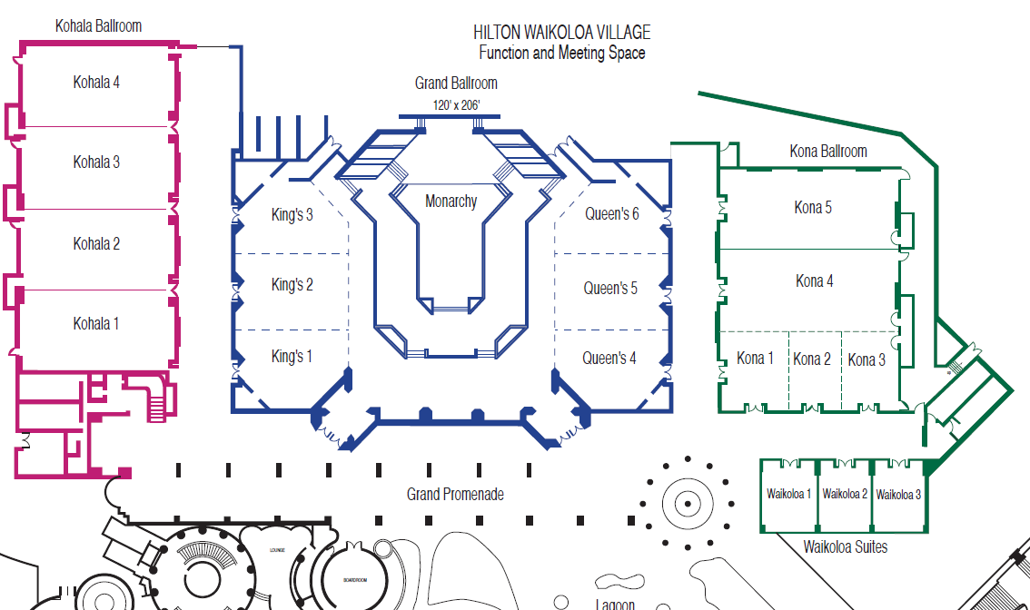
M3.4 Meeting Room Locations

Slide 7
M3.5 Next 2 WG Meetings
Sept 13-18, 2015 -- Centara Grand Hotel, Bangkok (Note - no separate China Interim)
For information and registration links, see
  Registration and Hotel Reservations
Next Plenary Meeting –
  IEEE 802 Plenary session – 9-13 Nov 2015
  Hyatt Regency, Dallas, TX, USA

Slide 8
M3.7 Meeting Registration
IEEE 802 Plenary Session - July 12-17, 2015 Registration Report by Working Group
Working Group | Number
802.11 | 336
802.3 | 250
802.15 | 85
none | 19
802.xx | 6
802.18 | 3
802.16 | 2
802.1 | 41
802.21 | 9
802.19 | 8
802.24 | 1
802.22 | 4
As of 13 July 2015

Slide 9
M3.7 Recording Attendance
It is a requirement that attendees record their participation at an 802.11 session and declare their affiliation. This record is usually made using the IMAT attendance system.
  If you wish to participate without recording attendance, send an email per session to the WG 1st vice chair declaring your participation and affiliation.
    However, You cannot gain or maintain 802.11 voting membership using this method.
You must record 75% attendance of eligible 802.11 slots in a session for that session to count towards gaining or maintaining 802.11 voting membership
  You need a single IEEE-SA web account
    The IEEE SA web account requires a working email address
    do not remove your email address from the account
  Use the email address associated with that web account when registering attendance
    If you change email addresses, update the web account, don’t create a new web account, or your membership status may not be calculated properly.
  Record attendance using this URL: https://imat.ieee.org/attendance

Slide 10
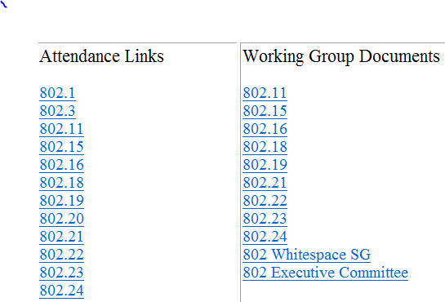
M3.9 Local File Document Server information
Local FTP server: ftp://griffin.events.ieee.org (anonymous)
External Document Server https://mentor.ieee.org/802.11/documents

Slide 11
M3.9 Synchronizing while at the meeting
While Particularly important when external bandwidth is limited and unreliable
Please Use anonymous ftp
  Host: ftp://griffin.events.ieee.org
  User: anonymous
  Password: <your-email-address-here>
  Destination directory: /802.11/15
Freeware tools are available, for example search for “syncback free” **
** Other tools are available. The IEEE does not endorse the use of any particular tool.

Slide 12
M3.10 FOOD & BEVERAGE
Breakfast 07:30 to 09:00 at the Grand Promenade, Lagoon Lanai
Morning Coffee/Tea 10:00 to 11:00
Lunch Service 12:00 to 13:30 at the Grand Promenade, Lagoon Lanai and Water’s Edge Ballroom
Afternoon Coffee/Tea/Snacks 15:00 to 16:00 at the Grand Promenade, Lagoon Lanai

Slide 13
M3.10 Social
WHEN: Wednesday July 15th, 7:00 PM to 9:30 PM
WHERE: Kamehameha Court
  (L14 on Hotel site map and labeled Legends of Hawaii Luau) If it rains we’ll head under cover to the Monarchy Ballroom.
WHAT: Casual reception with Hawaiian entertainment
NOTE: You need a separate ticket to attend the social.
  Tickets are sold out.
Tickets are non refundable but are transferable.
  If you are not going to use your ticket please contact the Registration desk.
Social Event Tickets will be distributed at Registration/Meeting Concierge until 1:30 PM Wednesday, July 15th

Slide 14
Social Plan B – Bad weather
If the weather changes to rain we will change the location to Monarchy Ballroom and Grand Promenade. The start time may also change to allow time for set up. We will send an email if this occurs.
http://802world.org/wireless/onsite-information/

Slide 15
Wednesday –
802.11 Mid-Week Plenary
802.11 First Vice Chair Report

Slide 16
Friday –
802.11 Closing Plenary
802.11 First Vice Chair Report

Slide 17
802.11 Venue Strawpolls
Return to Waikoloa: Y:53 N: 16

Slide 18
Local Venue Information AdHoc
Next Interim: Bangkok, Thailand – 13-18 Sept 2015
Next Plenary: Dallas, Texas – 8-13 Nov 2015
Please suggest Restaurants, methods of getting from Airport to Hotel, local attractions…
Send suggestions to Jon Rosdahl who will forward to the appropriate PCO.

