Slide 1
NGP SG May 2015 Closing Report
Date: 2015-05-15
Authors:

Slide 2
Abstract
This document is the NGP SG short overview as of May 2015.

Slide 3
NGP SG – May 2015
Status:
  Group met for three sessions now.
  SG has approved a motion for PAR and CSD for WG review and approval to submit to EC.
  Main goals met this meeting:
    PAR and CSD approval.
    Continued development of use case document.
    Continued review of technical material.
Supporting material:
  11-14-1464 NG Positioning Overview and Challenges
  11-14-1193 Beyond Indoor Navigation
  11-14-1235 Scalable location
  Simulation results on AoA accuracy in 2.4/5GHz bands

Slide 4
Study Group Timeline
Month | Milestone / Plan of Action
January (i) | Formation meeting Initial discussion on PAR and CSD Presentations on use cases, usage models.
March (p) | Continue discussion on PAR and CSD Discussion supporting presentations. Study Group extension
May (i) | SG Final version of PAR and CSD Discussion on supporting presentations Working Group Approval on PAR and CSD PAR circulated amongst other WGs.
July (p) | Presentations. Resolve EC feedback on PAR and CSD. Executive Committee Approval on PAR and CSD Study Group extension
July (i) | NesCom Approval on PAR and CSD
Sep. (targeted) | Task Group formation meeting

Slide 5
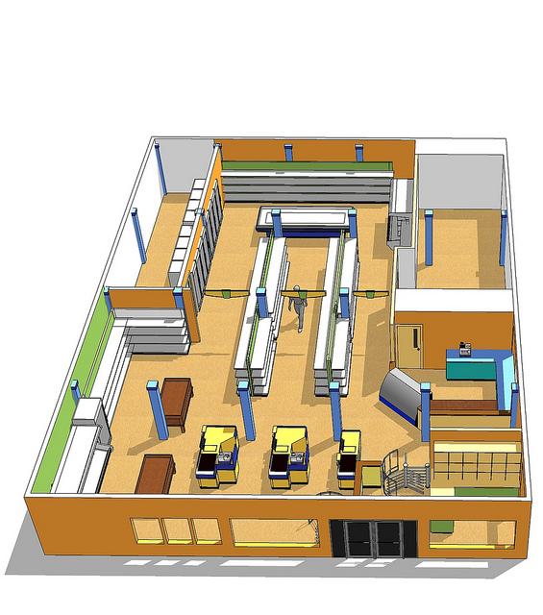

What’s next then?
  Some of the usages NGP SG explores:
    Micro geo-fencing moving from <1m to <0.1m.
    Direction finding.
    Improving scalability and reducing overhead.
    High Accuracy Positioning
  * 11-14-1193/01 – Beyond Indoor Navigation by Jonathan Segev, Carlos Aldana et-al
  11-14-1235/r0 – Scalable Location by Brian Hart, Peter Thornycroft and Mark Rison.
  11-14-1263/r0 – Direction Finding Positioning by James Wang, Gabor Bajko et-al

