Slide 1
Reference Simulation Model for Dynamic CCA / DSC Calibration
Date: 2015/05/12
Authors:
Name | Affiliations | Address | Phone | email
Masahito Mori | Sony Corp |  |  | Masahito.Mori@jp.sony.com
Yuichi Morioka |  |  |  | Yuichi.Morioka@jp.sony.com
Yusuke Tanaka |  |  |  | YusukeC.Tanaka@jp.sony.com
Takeshi Itagaki |  |  |  | Takeshi.Itagaki@jp.sony.com
Graham Smith | SR Technologies |  |  | gsmith@srtrl.com
Sayantan Choudhury | Nokia |  |  | Sayantan.Choudhury@nokia.com
Tuomaala Esa |  |  |  | esa.tuomaala@nokia.com
Kneckt Jarkko |  |  |  | jarkko.kneckt@nokia.com
Chinghwa Yu | MediaTek Inc. | No. 1, Dusing 1st Road, Hsinchu, 300 Taiwan | +886-3-567-0766 | chinghwa.yu@mediatek.com
Knut Odman | Broadcom |  |  | kodman@broadcom.com

Slide 2
Authors (continued):
Name | Affiliations | Address | Phone | email
Kentaro Taniguchi | Toshiba |  |  | kentaro.taniguchi@toshiba.co.jp
David Halls |  |  |  | david.halls@toshiba-trel.com
Guido Hiertz | Ericsson |  |  | guido.hiertz@ericsson.com
Yasuhiko Inoue | NTT | 1-1 Hikari-no-oka, Yokosuka, Kanagawa 239-0847 Japan | +81 46 859 5097 | inoue.yasuhiko@lab.ntt.co.jp
Shoko Shinohara |  |  |  | Shinohara.shoko@lab.ntt.co.jp
Koichi Ishihara |  |  |  | ishihara.koichi@lab.ntt.co.jp
Yasushi Takatori |  |  |  | takatori.yasushi@lab.ntt.co.jp
Yusuke Asai |  |  |  | asai.yusuke@lab.ntt.co.jp
John (Ju-Hyung) Son | WILUS Institute |  |  | john.son@wilusgroup.com
Geonjung Ko |  |  |  | greg.ko@wilusgroup.com
Jinsam Kwak |  |  |  | jinsam.kwak@wilusgroup.com
Sean Coffey | Realtek |  |  | coffey@realtek.com

Slide 3
Abstract
Many simulation results of dynamic CCA / DSC have been presented at TGax
However the simulation conditions were diverse and the results were inconsistent [1]
In order to move forward, interested parties discussed and agreed on a set of common assumptions, to derive consistent simulation results as a reference
The goal of the effort is to build a common ground to do an apples-to-apples comparison between proposals
This simple scenario is presented in this contribution

Slide 4
Reference Simulation Model
The document defines a simple scenario to have consistent reference simulation results
  Deployment scenario (topology)
  Traffic model / MCS selection
  Operational parameters
  Receiver state machine

Slide 5
Reference Deployment Scenario
STA1
STA2
3m
34m
3m
AP1
AP2
STA3
STA4

Slide 6
Reference Traffic Model / MCS Selection
Parameters | Values
Access protocol | [EDCA, AC_BE with default parameters] [CWmin = 15, CWmax = 1023, AIFSn=3 ]
Traffic type | 200Mpbs / STA; UDP
MPDU size | 1536 Bytes (from SSD)
Aggregation | Aggregation: 32 MPDUs with 4-byte MPDU delimiter per A-MPDU No A-MSDU immediate BA
Traffic direction | UL only
PPDU of Data frame | VHT PPDU (MCS 7, fixed),
PPDU of ACK frame | non-HT duplicate PPDU (6Mbps, BPSK(R=1/2), fixed)

Slide 7
Reference Operational Parameters
Parameters | Values
BW | All BSSs at 5GHz [80 MHz, no dynamic bandwidth]
Channel model | TGac D NLOS per link
Shadow fading | No shadowing / No fading
Data Preamble Type | [5GHz, 11ac], duration is considered.
STA TX Power | 15 dBm per antenna
AP TX Power | 20 dBm per antenna
AP / STA number of TX/RX antennas | 1/1
AP antenna gain | 0 dBi
STA antenna gain | -2 dBi
Noise Figure | 7dB
CCA-SD threshold | -76/-66/-56 dBm / 80MHz
CCA-ED (for any signal) threshold | -56dBm/80MHz
PHY abstraction | RBIR, BCC
Channel correlation | Same as defined in the used channel model
Pathloss Model | Exponent of 2 up to 10m, exponent of 3.5 beyond (same as SS3)

Slide 8
Reference Operational Parameters (cont’d)
Parameters | Values
Access protocol | [EDCA, AC_BE with default parameters] [CWmin = 15, CWmax = 1023, AIFSn=3 ]
Queue length | A single queue for each traffic link is set inside AP/STA sized of 2000 packets
Max number of retries | 10
Beacon | Enabled, BI = 100 ms
RTS/CTS | OFF
Throughput metric | Histogram of per non-AP STA throughput (received bits/overall simulation time)

Slide 9
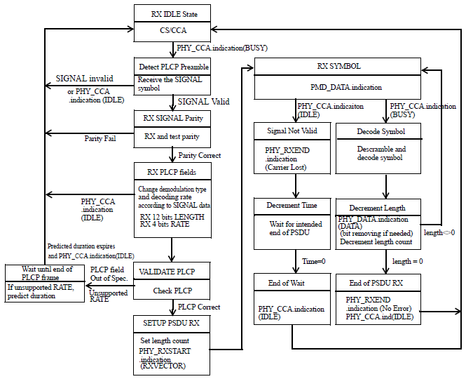
Receiver State Machine
Change CCA-SD threshold
(-76/-66/-56 dBm) to create 3 throughput graphs
The reference model maintains Fig 18-20 PLCP state machine from 802.11-2012
(pre 802.11ah receiver state machine)

Slide 10
Summary
Reference scenario and conditions for dynamic CCA / DSC calibration were presented
Interested parties are encouraged to share simulation results based on this reference model, to start an apples-to-apples comparison

Slide 11
References
[1] 11-14/1580r0, “Perspectives on Spatial Reuse in 11ax”
[2] 11-14/0854r0, “DSC and Legacy Coexistence”
[3] 11-14/0571r8, “11ax Evaluation Methodology”
[4] 11-14/1523r5, “Offline Discussion Minutes of SLS Calibration”
[5] 11-15/0053r2, “Box5 Results of 11ac SS6”

Slide 12
Appendix

Slide 13
Simulation Conditions
(Relation between preamble detection threshold and distance from OBSS)
AP(TxPower 20dBm)
Each STA will receive a signal at about -36dBm from its AP 3m away
STA (TxPower 15dBm)
Each AP will receive a signal at about
-65dBm from the other AP 34m away
In the worst case, each STA will receive a signal at -67dBm from a STA in the other network, 28m away
original CCA-SD level
(-76dBm)

Slide 14
Simulation Conditions
(Relation between preamble detection threshold and distance from OBSS)
AP(TxPower 20dBm)
Each STA will receive a signal at about -36dBm from its AP 3m away
STA (TxPower 15dBm)
20dB margin
With a DSC margin of 20dB, each STA (on the perimeter of the circle) would be setting effective CCA at -56dBm, well below any signal from the other network
CCA-SD level is raised
Each AP will receive a signal at about
-65dBm from the other AP 34m away
In the worst case, each STA will receive a signal at -67dBm from a STA in the other network, 28m away
original CCA-SD level
(-76dBm)

