Slide 1
Relay Enhancements For 802.11ay
Date: 2015-05-11
Authors:

Slide 2
Abstract
This contribution briefly reviews the key features of the relay specification in 802.11ad and proposes two areas for enhancements:
Range extension
Bi-directional relay capability

Slide 3
Relay Use in 802.11ad
IEEE 802.11ad has support for directional relays.
Relay links are seen as back-ups: utilized only when Source-Destination direct link fails.
802.11ad uses fixed 1st and 2nd Periods: channel times for Source-Relay and Relay-Destination data transfer are fixed.
802.11ad relaying procedure is unidirectional – this could be optimized to enable efficient bi-directional data transfer.

Slide 4
Relay modes in 802.11ad
Two types of relay operation:
  Link Switching: R is used if S-D link is disrupted.
  Link Cooperating: S-D frame is simultaneously repeated by R: improves signal quality at D.
Two modes are supported:
  FD/AF: Full-duplex/amplify-and-forward
  HD/DF: Half-duplex/decode-and-forward
Relaying steps (some differences between Link Switching and Link Cooperating relay types):
  Relay setup procedures (common to both types)
  TPA (Transmission time-Point Adjustment) procedure (only Link Cooperating)
  SP request and allocation (different rules for FD/AF and HD/DF modes)
  Data/Frame exchange rules

Slide 5
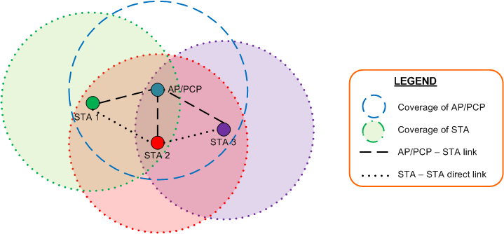
Range extension for relays
Two scenarios could be considered:
  S-REDS and D-REDS are out of direct communication and control messaging range of each other
  S-REDS and D-REDS are out of direct communication range, but within control messaging range of each other
The range extension scenario is shown in the following figure (only data coverage ranges are shown):

Slide 6
Bi-directional data transmission
The 802.11ad relay specification does not have a mechanism for the destination to initiate data transmission to the source using the same relay.
Having this capability would enhance the efficiency and throughput and is an easy extension to the current specification.
Fixed sized 1st and 2nd Periods impose some restrictions:
  Re-transmissions on one of the two hops requires use of a new 1st and 2nd Period pair.
  Transmissions in the reverse direction cannot be scheduled efficiently.
A new relay channel access protocol is needed to increase efficiency for re-transmissions and bi-directional data transmission.

Slide 7
Bi-directional data transmission

Slide 8
Conclusions
We highlighted two areas of the relay specification in 802.11ad that could be extended in 802.11ay to meet the requirements of some of the use cases under consideration.

