Slide 1
Verification of IEEE 802.11ad Channel Model for Enterprise Cubical Environment
Date: 2015-05-11
Authors:

Slide 2
Abstract
The IEEE 802.11ad group proposed Single Input Single Output (SISO) channel models in 60 GHz band for WLAN systems based on the results of experimental measurements.
The developed models include conference room, living room, and enterprise cubicle environments described in [1].
This contribution presents the results of channel model verification for enterprise cubicle environment by means of experimental measurements using Intel product implementing IEEE 802.11ad standard for wireless docking scenario.

Slide 3
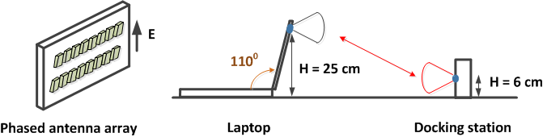
Wireless Docking Scenario
In the considered wireless docking scenario laptop and docking station placed on the table in the cubicle environment establish LOS or NLOS communication link depending on their relative placement and orientation in space.
Laptop antenna is mounted in the lid as shown in the picture below. For the open lid configuration antenna is at the height of H = 25 cm above table surface and the angle between laptop base and lid is equal to 110⁰.
At the docking station side antenna was mounted at the height H = 6 cm above the table level.
Both devices (laptop and dock) use phased antenna arrays with the same rectangular geometry 2 x 8 elements and vertical polarization as shown in the picture (vector E is parallel to the short edge).

Slide 4
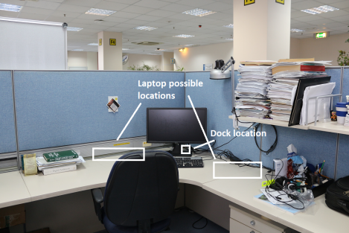
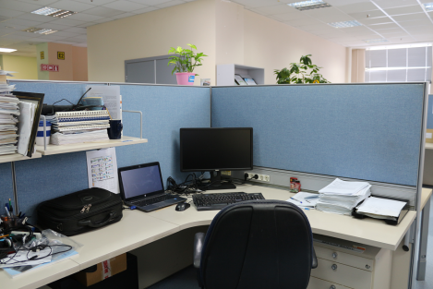
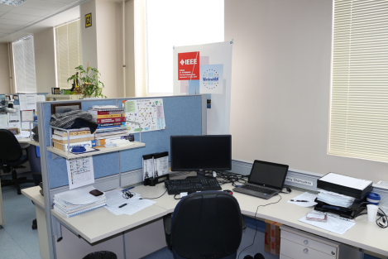
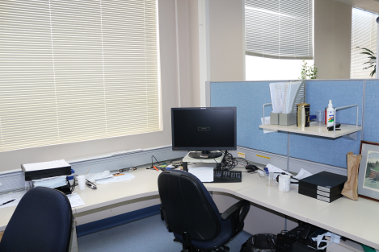
Cubicle Geometry
Area #1
Area #2
Area #3
Area #4

Slide 5
Cubicle Geometry (Cont’d)
The cubicle wall has height H = 1.49 m above the floor comparing to the ceiling height equal to H = 2.92 m.
The table desk is mounted at the height of H = 0.74 m above the floor.
The cubicle wall is composed of plywood boards of width L = 18.0 mm incorporated by metal frames at both ends and spaced by L = 44.0 mm.
Penetration loss is equal to ~5.0 dB.

Slide 6
Measurement Methodology
One position of the docking station in the corner with azimuth angle 45⁰ relatively to X axis was considered.
30 positions for the laptop were considered placed with equidistant step equal to 20 cm along X and Y axes.
All positions are limited by the table perimeter and have ID numbers 1, 2, …, 30. Position 1 is reserved for the docking station.
4 rotations of the laptop 0⁰, 90⁰, 180⁰, and 270⁰ were considered.
4 space orientations covered all space directions (360⁰ full space).

Slide 7
Measured Signal Characteristics
Both devices apply Transmit Sector Sweep (TXSS) beamforming protocol to set up directional link. The number of sectors in the sector sweep was equal to 32. Beam Refinement Protocol (BRP) was not applied.
For directional link the following signal characteristics were measured:
  Signal to Noise Ratio (SNR) per sample in time domain (before equalization);
  Channel impulse response @ 1.76 GHz sample rate;
The total number of measured laptop positions is equal to (30-1)*4 = 116.
All channel realizations were divided into two groups corresponding to the LOS and NLOS environments. There are 35 LOS realizations and 81 NLOS realizations.
LOS/NLOS distinguishing was done applying the following procedure:
  LOS clusters spatial coordinates (azimuth and elevation angles) for both transmitter and receiver were defined using ray-tracing software;
  After application of TXSS beamforming algorithm both devices know the spatial coordinates of the selected sectors and the coordinates of these sectors were compared to ray-tracing ones;
Two LOS and NLOS channels golden set were created containing normalized (to unit power) channel impulse responses.

Slide 8
Signal to Noise Ratio Measurements
Figure shows CDF for the SNR distribution in dB scale for the NLOS environment. Mean SNR is equal to ~13.7 dB.
Mean SNR for the LOS environment is equal to ~ 25.6 dB.
Hence the difference between LOS and NLOS environments is about ~11.9 dB.
Table 1: Summary of distances between docking station and laptop antennas inside the cubicle for area #1
Min distance | Mean distance | Maximum distance
29.0 cm | 81.0 cm | 143.0 cm

Slide 9
IEEE 802.11ad Model Verification
IEEE 802.11ad model for cubicle environment was simulated with the following parameters (this model corresponds to the channel golden set #9) , [2], [3]:
  Far STA location, NLOS;
  Directional TX antenna to directional RX antenna with 30⁰ Half power Beam Width (HPBW), w/o polarization support;
  Max Power Ray (MPR) ideal beamforming with 360⁰ beam search (full space);
To compare statistical properties of measured channel to the IEEE 802.11ad model the following signal characteristics were estimated:
  Peak to Total Power Ratio (PTPR);
  RMS delay spread;
  Maximum notch depth in frequency domain;
Packet Error Rate (PER) performance was estimated using Link Level Simulation (LLS) platform for the set of measured realizations and IEEE 802.11ad model.

Slide 10
Channel Properties Comparison
Figures below show comparison of PTPR and RMS delay spread CDF functions for measured channel realizations and IEEE 802.11ad model for NLOS environment.
Peak to Total Power Ratio
RMS delay spread

Slide 11
Channel Properties Comparison (Cont’d)
Maximum notch depth in frequency domain
Figure shows comparison of maximum notch depth CDF functions for measured channel realizations and IEEE 802.11ad model for NLOS environment.

Slide 12
Packet Error Rate Performance Comparison
LOS channel
NLOS channel
Maximum difference for PER = 10⁻² level is ~0.2 dB
Maximum difference for PER = 10⁻² level is ~0.6 dB

Slide 13
Conclusions
This work presents the results of experimental measurements of the channel in the enterprise cubicle environment using Intel product implementing IEEE 802.11ad standard.
The statistical properties of the measured channel and Packet Error Rate (PER) performance were compared to the IEEE 802.11ad NLOS model in cubicle environment with directional antennas at both ends.
The presented results exhibit good matching between PER performance for the measured channel set with “real life” devices and IEEE 802.11ad model.
The results of this work prove the feasibility of the IEEE 802.11ad model for SISO systems which can be used in the next generation of WLAN standards.
Propose to extend the IEEE 802.11ad for cubicle environment to support MIMO and channel bonding for NG60.

Slide 14
References
A. Maltsev et al, “Channel Models for 60 GHz WLAN Systems,” IEEE doc. 11-09/0334r8.
R. Maslennikov, et al, “Implementation of 60 GHz WLAN Channel Model,” IEEE doc. 11-09/0854r3.
A. Maltsev et al, “PHY Performance Evaluation with 60 GHz WLAN Channel Models,” IEEE doc. 11-10/0489r1.

