Slide 1
Using 802.11 for Locating Purposes in the Vehicle Environment
Authors:

Slide 2
Abstract
In This submission Automotive use cases for the NGP are discussed

Slide 3
The Premise
Wi-Fi is ubiquitous and can be found in every phone/tablet
Vehicles are expected to have multiple Wi-Fi nodes for various purposes, e.g. Infotainment, connection to external infrastructure, etc.
Why not to leverage these opportunities and be able to locate users (drivers and passengers) inside and outside of vehicles?

Slide 4
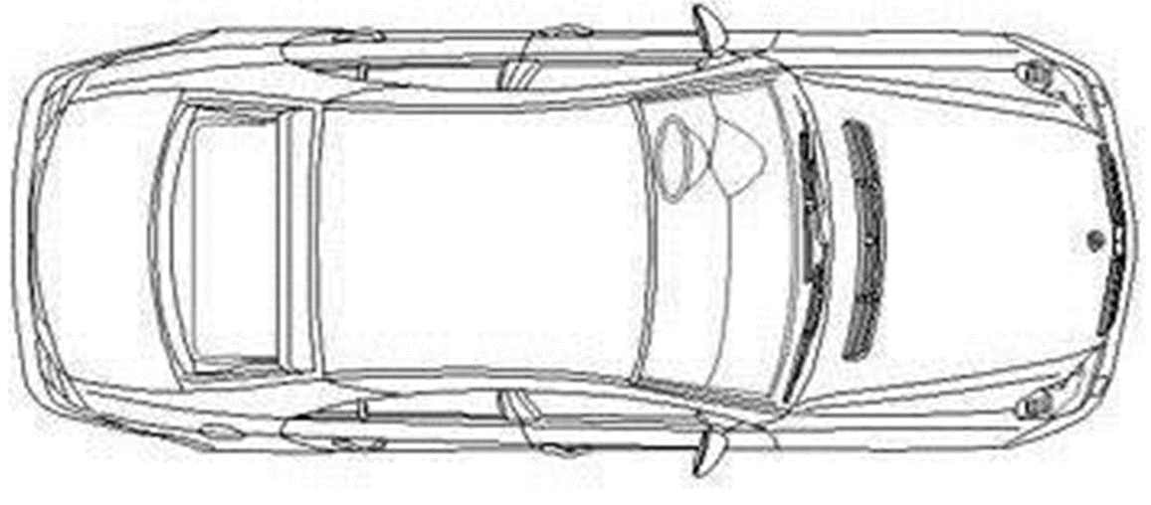
Possible Locations of WiFi Nodes in the Vehicle
Wi-Fi

Slide 5
Automotive Related Use Cases
Access and Security:
approach detection
locking/unlocking
starting
Comfort:
locating misplaced devices inside the vehicle
finding a vehicle in a parking lot

Slide 6
Technical Challenges
Accuracy: depends on how close to the vehicle and on inside vs. outside – 10 cm to 1 m+ (e.g. starting the vehicle requires fob present inside of cabin)
Power consumption: needs to have a mode that is comparable with ‘remote control’ devices
Reliability: near 100%

Slide 7
Positioning Requirements (according to terminology of 11-15/0388r0)
 | Access and Security use case | Comfort use case
Horizontal accuracy | <= 10cm @ 90% | <= 10cm @ 90% 1m @ 90%
Vertical accuracy | 4m @ 99% | 4m @ 99%
Latency | <= 100ms | 300ms 500ms
Refresh rate | 2-3 per second | 2 per second 1 per second
Number of simultaneous users | <=5 | 1
Frequency | All 802.11 bands | All 802.11 bands
AP density | <= 4 per 6 sq. meters | <= 4 per 6 sq. meters
AP height | 1m | 1m

