Slide 1
Using 802.11 for Locating Purposes in the Vehicle Environment
Authors:

Slide 2
Abstract
In This submission Automotive use cases for the NGP are discussed

Slide 3
The Premise
Wi-Fi is ubiquitous and can be found in every phone/tablet
Vehicles are expected to have multiple Wi-Fi nodes for various purposes, e.g. Infotainment, connection to external infrastructure, etc.
Why not to leverage these opportunities and be able to locate users (drivers and passengers) inside and outside of vehicles?

Slide 4
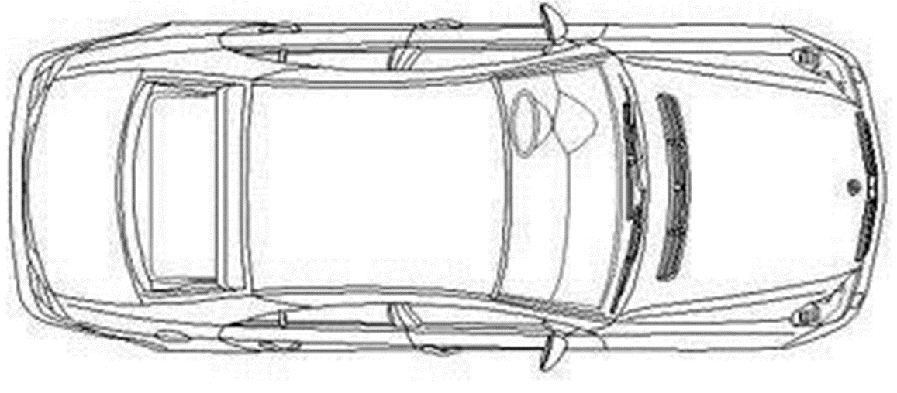

Possible Locations of WiFi Nodes in the Vehicle
Wi-Fi

Slide 5
Automotive Related Use Cases
Access and Security:
  approach detection
  locking/unlocking
  starting
Safety:
  occupant detection
Comfort:
  locating misplaced devices inside the vehicle
  finding a vehicle in a parking lot

Slide 6
Technical Challenges
Accuracy: depends on how close to the vehicle and on inside vs. outside – 10 cm to 1 m+ (e.g. starting the vehicle requires fob present inside of cabin)
Power consumption: needs to have a mode that is comparable with ‘remote control’ devices
Reliability: near 100%

