Slide 1
IEEE 802.11 TGay Use Cases
Date: 2017-07
Authors:

Slide 2
Authors (Continued):

Slide 3
Abstract
This document discusses the use cases for 11ay which are in line with requirements within 11ay proposed PAR/CSD documents.

Slide 4
Usage Model 1: Ultra Short Range (USR) Communications
Pre-Conditions:
User has WLAN connectivity between a portable/mobile device (e.g., tablet, smart phone) and a fixed device (e.g., tollgate, kiosk).
Application:
Users can download mass data (e.g. video/audio clip, e-magazine, picture library etc.) from a fixed device. 100 jpeg (picture) files of 5MB takes 0.6 second over a single hop 10Gbps link.
Jitter is not critical. The key metric is the user’s time spent to do a transfer. Less than 1 second is acceptable. 1-5 seconds may be acceptable. More than 5 seconds may not be acceptable.
Environment:
Environments can be variable, e.g., crowded public space such as train stations, airports, shopping mall, office.
Link distance can typically be up to 10 cm.
Typically transmissions are Line of Sight.
All devices will typically be stationary during usage.
Traffic Conditions:
Only a single portable/mobile device can access to a fixed device at a time with simply best-effort rates.
There is typically minimum interference from other mm-wave links due to ultra short link distance.
Traffic is unidirectional.
Use Case:
User places a portable/mobile device in a definite position relative to a fixed device.
Secure pairing between the portable/device device and the fixed device is completed without user configuration.
The pre-selected application is launched and the pre-selected task (e.g., download video clip) is started.
The application exits when task is complete.

Slide 5
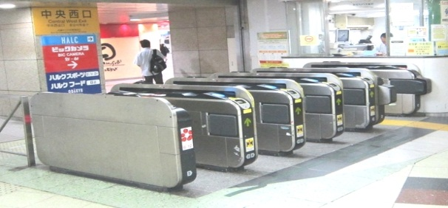

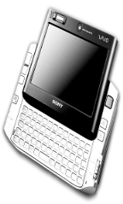


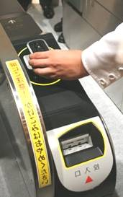





Usage Model 1: USR Communications
Rapid content transfer between a portable /mobile device (e.g., tablet, smart phone) and a fixed device or between two portable/mobile devices within a ultra short separation
  Assumption: 1:1
  Fast link setup: < 100msec
  Transaction time: <1sec
  Ultra short link distance: <10cm
  Very low power consumption for portable/mobile device: < 400mW
  Target data rate: 10 Gbps
@ 70% MAC-App efficiency | Size | 11ay Device | 11ad Device
4K UHD movie | 60 GB | 1.1 min @ 10Gbps | 11.4 min@1Gbps
HD movie | 5 GB | 5.7 sec @ 10Gbps | 57.1 sec @ 1Gbps
SD movie | 1.5 GB | 1.7 sec @ 10Gbps | 17.1 sec @ 1Gbps
Picture library | 1 GB | 1.1 sec @ 10Gbps | 11.4 sec @ 1Gbps
4K movie trailer | 1.2 GB | 1.4 sec @ 10Gbps | 13.7 sec @ 1Gbps
HD movie trailer | 100 MB | 0.1 sec @ 10Gbps | 1.1 sec @ 1Gbps
E-magazine | 250 MB | 0.3 sec @ 10Gbps | 2.8 sec @ 1Gbps
Train Station
Kiosk
Movie, video/audio clip, magazine, newspaper, etc.
Movie, video/audio clip, picture library, etc.
Video/audio clip, magazine, newspaper, etc.

Slide 6
Usage Model 2: 8K UHD Wireless Transfer at Smart Home
Pre-Conditions:
11ay is interfaced between a source device (e.g. set-top box, blu-ray player, tablet, smart phone) and a sink device (e.g. smart TV, thin display) to stream 8K UHD contents at home.
Environment:
Devices are operating in close proximity at home. Typical distance between devices are < 5m.
When it comes to the link between a set-top box and a thin display (or smart TV), the set-top box can be inside a table which may provide some SNR loss.
Application:
At least 28 Gbps data rate is required for a link to stream uncompressed 8K UHD streaming (60 frames per second, 24 bits per pixel, 4:2:2 Chroma sampling at minimum).
Jitter <5ms, delay<5ms.
Traffic Conditions
Only a single link may exist at a time.
There is typically minimum interference from other mm-wave links at home.
Traffic is mostly unidirectional.
Use Case
Split TV: TV is on the wall as a thin display and set-top box works as a controller, wirelessly interfaced by 11ay to replace wired interfaces.
Smart display (Mirroring): Uncompressed 8K UHD streaming is through smart TV. 8K UHD video can be real-time transferred from Smartphone/tablet to smart TV. When user enters home, the video which the user is watching in his/her smart phone is seamlessly played in the smart TV.

Slide 7
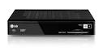
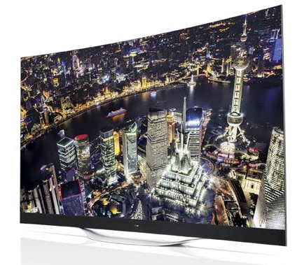
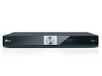

Usage Model 2: 8K UHD Wireless Transfer at Smart Home
Requirements
- Provides full rate >28 Gbps
- High QoS/QoE (latency < 5ms, jitter<5ms)
- P2P
8K UHD
Service
Replacement
of wired interface
Set-top box
(TV controller)
Wireless Transfer
from fixed device
Blu-ray player
TV or Display
Wireless Transfer
from mobile device
Smart phone/Tablet

Slide 8
Usage Model 3: Augmented Reality/Virtual Reality Headsets and Other High-End Wearables
Pre-Conditions:
The high-end wearable (e.g. augmented reality/virtual reality headsets, high-def glasses, etc.) and its managing device (e.g. gaming console, smartphone, etc.) are equipped with 11ay interfaces and form a PBSS. All desired media content, processing power, and control needed by the high-end wearable resides on the managing device (i.e. internet connectivity not required).
Application:
User plays a game, watches a movie, etc. using his high-end wearable, which is communicating with the managing device (e.g. gaming console, smartphone). Both devices must be able to tolerate moderate user movement.
Data rate at ~20 Gbps, latency < 5 ms, jitter <5 ms, PER<10E-2.
Environment:
The high-end wearable may be used at home or in public.
At home, there are less than 4 interferers. In public (e.g. commuter train) there can be up to 120 interferers. Interferers have varying QoS requirements.
Transmissions (both desired signal and interference) can be LOS or NLOS. The D2D link between the high-end wearable and its managing device < 5 m.
Traffic Conditions:
The D2D link may be obstructed (i.e. NLOS) and there may be significant interference from other 11ay users (e.g. other wearables, access points, etc.)
Devices may be stationary or moving (pedestrian speed) while in use.
Use Case:
A passenger on a crowded commuter train is playing a game using his AR/VR headset and smartphone.
Some percentage of his fellow passengers are also playing a game using their AR/VR headsets and smartphones.
All passengers are semi-stationary, i.e. they shift and move in response to the game.
The QoS/QoE requirements of the gaming application are met.

Slide 9

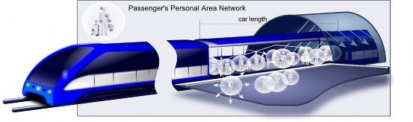
Usage Model 3: Augmented Reality/Virtual Reality Headsets and Other High-End Wearables
High-end wearables can be used at home and in public
High-end wearable and its managing device may both be subject to low level movement
Operating environment is usually indoor < 5 m
AR/VR headsets touting close-to-reality user experience with 3D video and 7.1 audio
    Video quality can support up to 3D 4K
    Current products include Sony HMZ-T3 goggles and Oculus VR headsets
Features | Requirements | Notes
Distance | 5 m
Video Quality | 3D 4K [1] | HDMI 2.0
Range of Motion for head-worn wearable | Neck Roll [2] | 0.17 (s/60deg)
 | Neck Pitch[2] | 0.14(s/60deg)
 | Neck Yaw[2] | 0.13 (s/60deg)
Device mobility | Pedestrian speeds | < 4km/hr

Slide 10
Usage Model 4: Data Center 11ay Inter-Rack Connectivity
Pre-Conditions:
Data Center employs the 11ay interfaces as the secondary/tertiary interfaces in lieu of fiber optics failure. The Data Center is fully operational with high demands of 99.99% of reliability and availability
Application:
The ToR switch can transmit /receive via the 11ay interface to reach the EoR switch through multiple hops. The EoR switch can reach the hub switch through the 11ay interfaces. The data being stored transfers at ~40 Gbps, disruption tolerance is <100msec, PER<10E-2 [1].
The data could traversal multiple hops (<=5) in order to reach the EoR switches, and the end to end Latency<50ms
Environment:
Devices are operating in specialized environments with sustainable temperature, humidity and other physical quality of air flow. Transmissions are mostly LOS. Distances between adjacent racks are standard rack width and distance between adjacent rows are ~4’
Traffic Conditions:
Potential interference from environmental factors and noise.
Use Case:
The main fiber 10GEthernet interface is down
The ToR switch quickly detects the failure and wakes up the dormant 11ay interface ASAP
Data continuously flows over the 11ay interface to the next EoR switch within 100ms
No administrator’s intervention to restore the Network

Slide 11
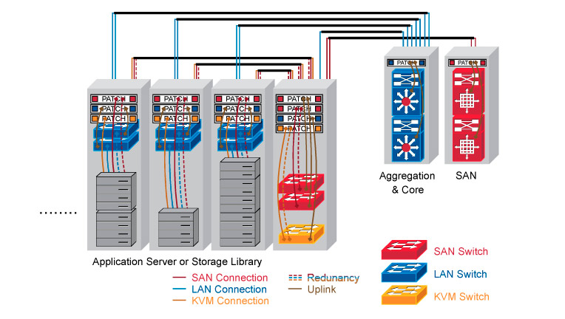
Usage Model 4: Data Center
Links | Link Capacity | Link Description | PER< [3] | Distance | Link Setup time | Security (Confidentiality/Integrity)
A<->B | >10Gbps | ToR connects to EoR | 10^-2 | 20’’ [5] | <100ms | C/I
A<->C | >10Gbps | ToR connects to EoR | 10^-2 | 40’’ | <100ms | C/I
A<->D | >10Gbps | ToR connects to EoR | 10^-2 | 60’’ | <100ms | C/I
A<->E | >20Gbps | EoR to Aggregated Switch (Multi-hop) | 10^-2 | 4 ‘ | <100ms | C/I
E<->F | >20Gpbs | Aggregated Switch to SAN switch | 10^-2 | 4’ | <100ms | C/I
E
F
D
C
B
A
11ay interfaces are best suit for backup interfaces when the fiber links are failed during emergency or network devices maintenances,
As back up interfaces, no active link up are needed all the time but when the failure is occurred, the backup links are required to be quickly setup (<100 msec [4] setup time)
Some of 11ay interfaces function as multi-hop links, i.e A<->E, Maximum # of hops <=5

Slide 12
Usage Model 5: Video/Mass-Data Distribution/Video on Demand System
Pre-Conditions:
The 11ay interfaces are deployed in ceilings of large room/space.
Multiple users have 11ay connectivity between user-devices (fixed or portable) and The 11ay interfaces.
Application:
The HD video/mass-data information can be distributed to the individual users simultaneously (broadcast). For example, there are multiple screens that show the same video in a exhibition or gymnasium. Students watch the same courseware on the screen of their own device.
Users can use VOD system to watch moves/videos in which they are interested.
Environment:
Environment can be highly variable, e.g. crowded public place, classroom, waiting room at train station/airport, in flight, train, ship, bus, exhibition, gymnasium, etc.
A ceiling installation for 11ay AP is recommended because the mm-wave links might be easily blocked by obstacles such as furniture, human body on the floor.
The device can be a potable or mobile device, or can be fixed deployed such as large-screen TV, touch screens in the back of the seat in flight/train, etc.
Transmissions can be LOS or NLOS. Distance between far corners of the room are <100m.
Traffic Conditions:
One or more devices can access to a 11ay interface to form a service set. Multiple links and data streams have varying QoS, reliability, and throughput requirements, some with simply best-effort rates (downloading), others with a certain data rate and QoS requirements(video, VoIP, etc.)
Data steam can be broadcast (one point to multiple point).
The devices might be stationary or might be used with low-mobility during usage.
The traffic could be transmitted in the point to multipoint fashion.
Use Case:
One or more communication links are set up between user devices and 11ay interfaces.
Users receive the same video/massive-data in broadcast mode or request video/video gaming/audio via VOD system respectively.

Slide 13
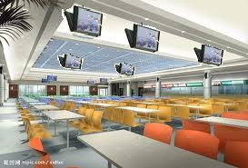
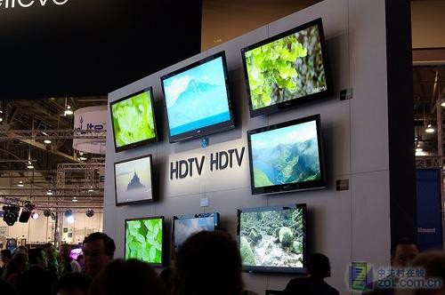
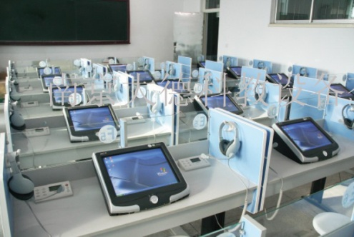
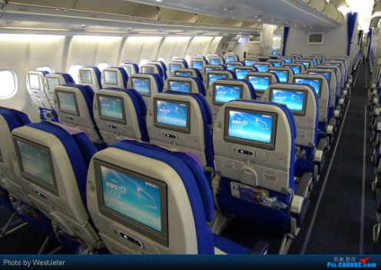
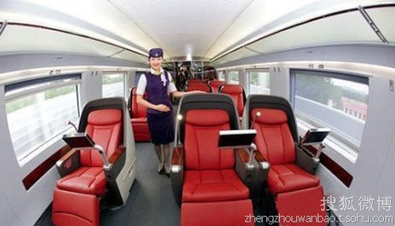
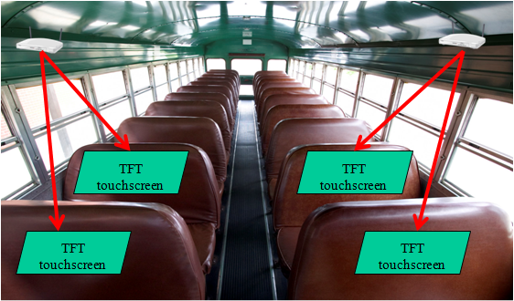
Usage Model 5: Video/Mass-Data Distribution/Video on Demand System
APs are located in ceilings and seats.
Users interact with AP through touch screens in front of them or wireless controllers.
Video streaming, VOD, video gaming, audio, downloading courseware in classroom, etc.
HD-Video distribution in dining-hall, exhibition etc.; in-Flight/Train/Ship/Bus entertainment.[6]
Dining-Hall
Exhibition
Classroom
Flight
High-Speed Rail
Bus

Slide 14
Usage Model 6: Mobile Offloading and Multi-Band Operation (MBO)
Pre-Conditions:
Mobile devices are equipped with Cellular interface and Wi-Fi interfaces
Mobile devices are equipped with multiple Wi-Fi bands (2.4Ghz,5Ghz and 60Ghz)
Application:
Mobile device is capable of off-load the video traffic from cellular interface to the high throughput 60Ghz interface. In tri-band scenario, offloading can also occur with traffic being switched to higher throughput 60Ghz band for band efficiency.
The data transfers at ~20 Gbps, with some low mobility (5km/h etc) Handoff disconnection <100ms, PER<10E-2.
Environment:
Devices are operating in both outdoor and indoor environment with some potential LOS obstruction objects or interference from other sources. Transmissions are mostly LOS. Distance between far corners of the room are <100m
Traffic Conditions:
Potential interference from environmental factors and obstruction of the LOS.
The devices might be stationary or might be used with low-mobility during usage.
Use Case:
User is using his smart phone to join a video conference over the cellular interface
He walks into an Mobile Hotspot which has the 11ay interface
By auto-detecting the mobile hotspot in proximity, his smart phone automatically initiate the offloading.
Without even noticing the smooth transition, user is able to keep his video conference going without any disruption.
-----
User is using his tablet within office building to retrieve some large documents
His device is equipped with tri-band wifi chips
His device initiates the SFTP connectivity through the 11ac interface
But the device automatically switch to the 11ay at the best range to speed up the file downloading.
When file downloading is finished, 11ay interface is put as idle state.

Slide 15



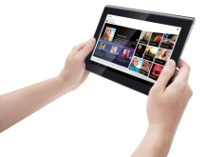
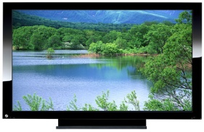
Usage Model 6– Mobile Offloading and MBO
WiFi Offloading
Based on an analysis [7], by the end of 2013 there exist about 1.4-billion smart phones and 420-million tablets used worldwide.
Mobile devices like smart phones and tablets may operate multiple functions (call, internet access, data transfer and/or video streaming etc.) simultaneously, some of which require very high data rate transmission.
WiFi can offload high-speed data through the 60 GHz band and relatively low-speed data through the 2.4/5 GHz bands.
Individual mobile users require good user experience with low mobility and/or a change of gesture.
Cellular
Offloading (60GHz)
Offloading (2.4/5GHz)
Mobile Display
3D, HD
Uncompressed video

Slide 16
Usage Model 7: Mobile Fronthauling
Pre-Conditions:
RRHs (Remote Radio Heads) are located around Base Band Unit (BBU) which is connected to mobile core network.
Application:
Generally BBU and RRHs are connected by optical fibers. However, especially in rural areas or in disaster areas, optical fibers are unavailable. In such areas, cellular areas can be easily expanded by using 11ay links.
The data transfers at ~20 Gbps. High reliability and availability (99.99%).
Environment:
Devices are operating in outdoor environment with LOS. Distance is <200m.
Traffic Conditions:
RRHs and BBU are static.
Number of RRHs may be increased due to traffic load increasing.
QoS support is necessary for cellular traffic to carry real-time traffic such as voice and video.
Use Case:
Mobile operators deploy BBU/RRHs with 11ay I/Fs to expand 5G/4G coverages, especially in an area without optical fiber.
Mobile phone users can access to mobile core NW by RRH with 11ay I/Fs.

Slide 17
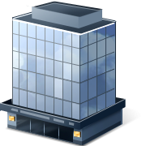

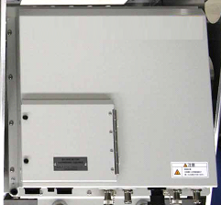
Usage Model 7: Mobile Fronthauling
Requirements
- Provides full rate ~20 Gbps ,
less than 200m LOS @60GHz band
- QoS
- 99.99% of availability
Similar use-case discussed in [8]
RRH
BBU
RRH
RRH
EPC
[1]

Slide 18
Usage Model 8: Wireless Backhauling
Pre-Conditions:
A number of 11ay APs forms a point-to-point or point-to-multiple-point wireless outdoor backhaul connectivity. The communications between APs may be over single hop or multiple hops.
Application:
The Wireless Backhaul may be used for small cell backhauling deployment in lieu of expensive fiber networks to access networks, inter buildings or so.
Configuration 1: Single hop with distance <1km
Data rate is >2 Gbs per STA, aggregated data rate >20 Gbs
Configuration 2: Multiple hop with each link distance <150m , with up to 5 hops
Data rate is >2Gbps per STA, aggregated data rate >20Gbps
Both configurations support high availability (99.99%) .
High requirements for QoS/QoE [9], where the overall latency over the wireless backhaul links is less than 35ms for both configurations.
Environment:
Devices operate in outdoor environment with LOS under most conditions. For single hop wireless backhauling devices , distance between the APs is <1000m. For multiple hop wireless backhauling devices, distance per hop between the paired APs is 150m
Traffic Conditions:
-Potential interference from environmental factors and obstruction of the LOS, beam un-alignment.
- Street canyon effect
Use Case:
Alice fire up her laptop at the bus stop to download some UHD movie while waiting
The bus stop mounted the 11ay AP and connected wirelessly to another 11ay Portal AP mounted on the outside curb light-pole.
The internet connectivity are transmitted over the
The QoS/QoE are met with the user’s applications.

Slide 19



Usage Model 8: Wireless Backhaul
Requirements
Backhaul @60GHz
 | Single Hop Wireless Backhauling | Multiple Hop Wireless Backhauling
# of hops | 1 | <5
Distance per link | <1km | <150m
Data Rate | ~2-20Gbps | ~2-20Gbps
Latency | <35ms | <35ms (total )
QoS/QoE | Yes | Yes
Availability | 99.99% | 99.99%
11ay AP
11ay AP
N-LOS Access
LOS Access
BUS STOP
Wireless backhauling with single hop
Backhaul @60GHz
Backhaul @60GHz
Backhaul @60GHz
11ay AP
11ay AP
11ay AP
11ay AP
N-LOS Access
N-LOS Access
BUS STOP
BUS STOP
POP
Wireless backhauling with Multiple hops

Slide 20
Usage Model 9: Office docking
Pre-Conditions:
Office docking enables a wireless docking experience for office and home. Mobile device (Notebook, tablet, smartphone, small form factor) may communicate wirelessly with multiple peripheral devices - monitors, camcorders, web cameras, hard drives, printers, Internet AP/Router, etc. and/or another mobile device,
Scenarios include a single device in a home scenario as well as in a dense office environment with multiple mobile devices where each mobile device has its own or shared dock/peripherals, or multiple mobile devices sharing a dock. A single wireless link that connects a mobile device with its dock, where the dock is wire-connected to multiple other devices, as well as multiple wireless links to connect the mobile with many devices should be supported.
Application:
Productivity applications
Support of two monitors of 8K resolution
Wireless support of USB devices with different traffic characteristics: isochronous, human interface and others
Gigabit Ethernet
Mass storage devices
3D webcams
Dynamic composition
Connecting mobile to 2-5 peripheral devices
Mobile device should be able to sustain full working day w/o recharging battery
Connecting multiple mobile source devices to dock
Environment:
Typical office scenarios - open space, cubicles, meeting room, and standalone home office usage. Range between mobile and dock and peripherals will typically be < 3m. Dense environment with multiple docking may or may not be wall isolated. Most of the devices are semi-static that may be moved intentionally or unintentionally.
Traffic Conditions:
Typically one to one and one to many links, many to one links (multiple source devices to one dock with shared peripheral devices)
Multiple simultaneous high performance links, some with low latency requirements, others with best-effort rates.
Some flows are unidirectional and others are bidirectional.
- Multiple uncoordinated ad hoc networks
Use Case:
Mobile device is wirelessly connected to a docking station, and/or wirelessly connected to multiple wireless peripherals directly
Mobile device may be wirelessly connected to other mobile devices separately or simultaneously with (1)
Mobile device may be simultaneously connected to wireless LAN
Devices may be simultaneously connected to Bluetooth and other radio
Dense office environment with multiple mobile devices where each one may be docked simultaneously with different docks
Some data flows have significant latency, throughput and QoS requirements (monitors under productivity applications, Dynamic composition, HID)
Multiple mobile devices (for example a PC and a smartphone) wirelessly connected to a docking station and sharing the peripherals that are connected to dock.

Slide 21
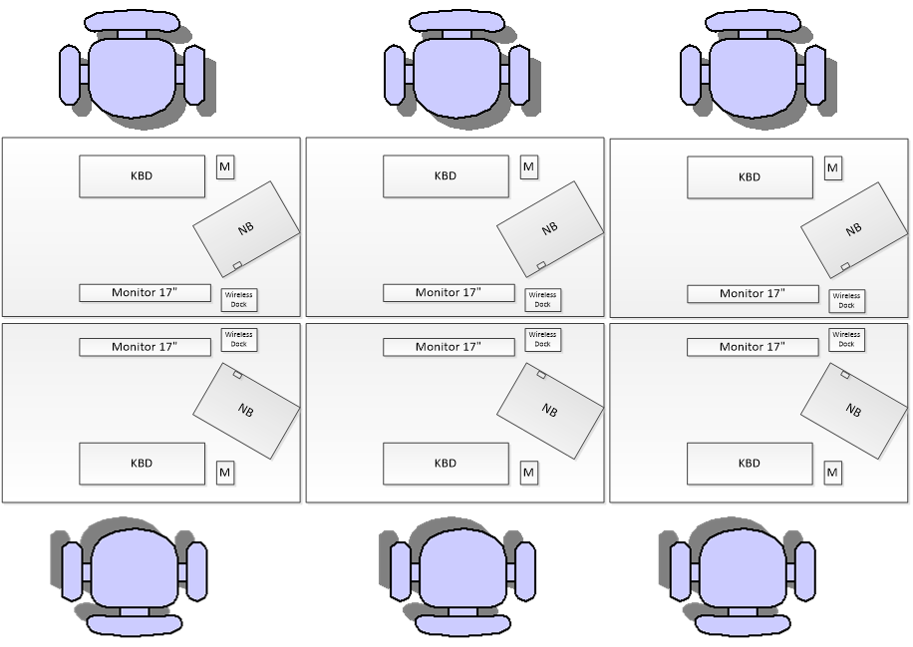
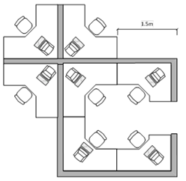
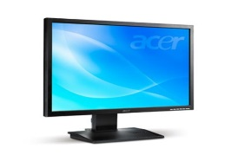





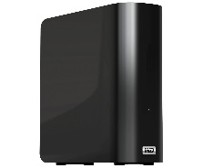


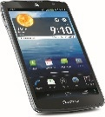
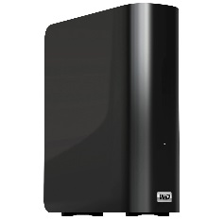
Usage Model 9: Office docking exmples
Open space example 2
Open space example 1
Office docking with
single wireless link
Dock
Office docking with multiple wireless links

Slide 22
Usage Model 10: mmWave Distribution Network
Pre-Conditions:
A number of 11ay DNs forms a wireless outdoor mmWave Distribution network over multiple hops in order to reach coverage. In addition to the wireless backhaul network, also a point-to-multipoint mmWave access network is build to serve homes, buildings, WiFi-AP and small cells.
Application – WTTH Access:
The mmWave distribution network will be used for backhauling of WTTH DNs, which are placed at street poles (e.g. lamppost). The WTTH DNs serve the individual homes/ flats via a window AP at client side instead of deploying expensive fiber networks in the building branch and inhouse. The WTTH radio links work on the same or optional on different mmWave frequency than the mmWave backhaul links.
Application – WTTB Access:
The mmWave distribution network will be used for backhauling of WTTB DNs, which are placed at street poles (e.g. lamppost) or at walls or rooftops. The WTTB links work on the same mmWave frequency as the mmWave backhaul links. If street poles are used, the WTTB DNs serve the buildings via an outdoor-wall AP. In case of Wall-to-Wall or Roof-to-Roof backhaul, it serves at the same time as mmWave building access network without usage of additional street poles. The WTTB scenario requires an additional wireless or fixed inhouse network to serve the individual flats.
Application – WiFi-AP & Small cell Backhaul:
The mmWave distribution network will be used for backhauling of Small Cells and Wi-Fi APs, which are e.g. placed at street poles. Traffic of mobile and nomadic services will be aggregated and carried towards the mobile core. The sub-6 GHz NLOS operation of the Small Cells and Wi-Fi APs imposes less challenges compared to WTTH/B to reach inhouse (mobile) users, however does not reach the capacity level of the WTTH/B solutions.
Environment:
Devices operate in outdoor environment with LOS under most conditions. For multiple hop wireless backhauling devices, distance per hop between the paired DNs is < 300 m (street-poles), < 1000 m (rooftop), and the distance between DNs and WTTH/B Home/Building APs is < 100 m.
Interference Conditions:
Interference from environmental conditions or other mmWave operations in the same area.
Obstructions of the LOS and beam un-alignments.
Use Case:
The mmWave WTTH/B DNs, which offer FTTH-like broadband access for residential customers as well as Small cells and WiFi-APs (e.g. 802.11ac), which offer mobile and nomadic services, are connected to a mmWave distribution network.
The 11ay mmWave distribution network connects by optical fiber to 1 or more fiber-PoPs towards the Telco / Service Provider network.
Redundancy of active radio equipment via mesh topology and redundant central WBH DN at “first” pole near the fiber-PoP (no Single-Point-of-Failure)
The Internet connectivity QoS/QoE and latency requirements are met with the user’s applications.

Slide 23
Usage Model 10: Operational Requirements
The mmWave distribution network will be formed by a number of 11ay outdoor DNs, which are used for backhauling of the proposed applications.
In addition to the mmWave distribution network, also a PtMP mmWave access network is build to serve the homes/buildings.
The mmWave distribution network need to support a transmission over multiple hops in order to reach area coverage.
Distance per hop between paired DNs is up to 300 m and distance between DN sites and WTTH/B Home/Building APs is up to 100 m.
The number of hops in a daisy-chain is limited by area topology constraints, resulting in < 5 hops typically.
The system have the capability to support up to 15 hops to meet region specific requirements.
The mmWave DNs have to operate in outdoor environments with LOS under most conditions, taking into account potential constraints.
  Interference from environmental conditions or other mmWave operations in the same area
  Obstructions of the LOS and beam un-alignments.
  The network has to support different DN placement options such as street poles (e.g. lamppost), house-walls and rooftops.
Redundancy will be achieved via the mesh topology
Single-Points-of-Failure have to be avoided, either by redundant active equipment at the “first” pole next to the fiber-PoP or alternative via connection of the distribution network to 2 or more fiber-PoPs
The mmWave distribution network connects by optical fiber towards the Telco / Service Provider network.
Requirements (operator example) | mmWave Distribution Network | mmWave Home/ Building Access
# of hops (outdoor)* | < 5 (typically) < 15 (system capability) | 1
LOS distance / link | < 300 m (street-poles) < 1000 m (rooftops) | < 100 m
# of DN | < 80 / km² | home/building density
Topology support | Mesh, PtMP, Daisy chain | PtP, PtMP
Data Rate (DL sustainable) | > 4 Gbps / DN site | > 1 Gbps / Home AP > 2 Gbps / Building AP
Antenna features | Beam-forming/tracking; Auto-alignment
Latency (RTT) | < 15 ms (WTTH/B, WiFi AP BH) (e-t-e)** < 5 ms (5G Small cell BH) (e-t-e)** < 2 ms (per hop latency)
QoS, Security, Sync. | QoS/QoE, Security C/I and Sync. support
Availability of sust. data rate | No guarantees in an unlicensed environment. > 99% should be aimed (e-t-e mmWave)
‘ * of hops depends on latency requirements
** may differ based on operator deployments

Slide 24

Usage Model 10: mmWave Distribution Network
Use cases:
a) WTTH
Fiber PoP
fiber
Provider
Network
b) WTTB
mmWave
Distribution
Network
Fiber PoP
c) Wi-Fi AP/ Small Cell
fiber
Legend:
mmWave sector
mmWave Distribution Node,
one or more collocated mmWave sectors
Fiber PoP
optical fiber
termination node

Slide 25
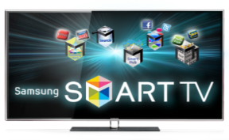

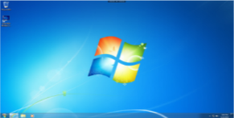




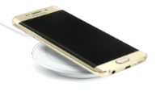
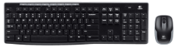
Usage Model 11: USR Wireless Docking
Pre-Conditions:
The 11ay interfaces are deployed both in a smartphone and in a (wireless charging) pad. The smartphone is placed on the pad for USR communication. The pad may have wired/wireless connection to several peripherals (e.g., a monitor, a keyboard, a mouse, etc.)
Application:
Gigabit Docking w/ Wireless Charging Service
    Data rate: 1~10 Gbps
    Alignment-free placement on the pad (e.g., users can place their smartphone on the pad without worrying about precise orientation of the smartphone)
Link Remote Desktop and Cloud PC
    Data rate: 1~10 Gbps (visually lossless for text/line)
Interactive Game Docking Station
  Data rate: 1~10 Gbps (supporting low latency codec w/ compression rate 1/3~1/4 at least)
  Latency: 10~50 ms (from user event to screen update)
Environment:
The USR wireless docking may be used at home, in a typical office, and in public. The distance between a smartphone and a pad will be < 0.2 m, where the smartphone is placed on the pad.
Traffic Conditions:
Typically, only one smartphone device can be placed on a wireless docking pad. A single link between a smartphone and a pad is typically supported.
Traffic is bi-directional. From the smartphone to the pad, low latency video stream transfer may be supported. In the other direction, i.e. from the pad to the smartphone, peripheral inputs may be delivered.
Use Case:
A smartphone user approaches a pad. The pad has wired/wireless connection to several peripherals (e.g., a monitor, a keyboard, a mouse, etc.)
The smartphone device is placed on the pad
The smartphone is wirelessly connected to the pad
The connection between the smartphone and peripherals is set up.
A video stream transfer from the smartphone to the pad may enable real-time monitor display of the smartphone (i.e. the smartphone display is mirrored on to the monitor)
Mouse and keyboard input can be transferred to the smartphone with low latency
Video stream transfer
& Data transfer
Wireless Power
Charging
Side View

Slide 26
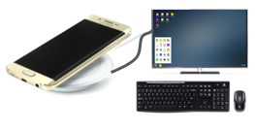
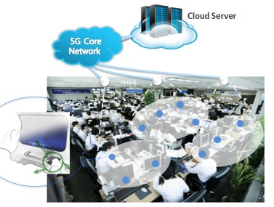
Usage Model 11: USR Wireless Docking
Interactive Game Docking Station
  Latency: 10~50 ms (from user event to screen update)
  Data rate: 1~10 Gbps (supporting low latency codec w/ compression rate 1/3~1/4)
Remote Desktop/Cloud PC
  Data rate: 1~10 Gbps (visually lossless for text/line)
  Traffic: bi-directional (Mobile Phone ↔ Peripheral)
Gigabit Docking w/ Wireless Charging Service
  Alignment-free placement on the pad
Low Power Consumption
  ~ 200 mW (peak power consumption for 1 Gbps)
  ≤ 0.5mW for discovery phase
Form Factor
  Close to today’s NFC
Range
  ≤ 0.2 m
Wireless Docking Pad
(Monitor/Keyboard/Mouse/LAN)
Wireless Cloud Office
Notes:
September 2012
doc.: IEEE 802.11-09/0301r1
March 2009
Stephen McCann, RIM
Page 26

Slide 27
Summary of Key metrics (I)
UC # | Indoor (I)/ Outdoor (O) | Environment | Throughput | Topology | Latency | Security | Availability | Applications and Characteristics
 |  | LOS/ NLOS
1 | I | <10cm | ~10Gbps | P2P | <100ms |  |  | -Static,D2D, -Streaming/Downloading
2 | I | <5m | >28Gbps | P2P | <5ms |  |  | -Uncompressed 8K UHD Streaming
3 | I | <5m | ~20Gbps | P2P | <100ms |  |  | -Low Mobility, D2D -3D UHD streaming
4 | I | <10m | ~20Gbps | P2P/P2MP | <100ms | C/I | 99.99% | -Indoor Backhaul with multi-hop*
5 | I | <100m | >20Gbps | P2P/P2MP | <100ms | C/I |  | -Multicast -Streaming/Downloading - Dense Hotspot

Slide 28
Summary of Key metrics (II)
UC # | Indoor (I)/ Outdoor (O) | Environment | Throughput | Topology | Latency | Security | Availability | Applications and Characteristics
 |  | LOS/ NLOS
6 | I/O | <100m | >20Gbps | P2P/P2MP | <100ms | C/I | 99.99% | -Multi-band -Multi-RAT operation Hotspot
7 | O | <200m | ~20Gbps | P2P/P2MP |  | C/I | 99.99% | -Fronthauling
8 | O | <1km with single hop <150m per hop with multiple hops | ~2Gbps | P2P/P2MP | <35ms | C/I | 99.99% | -Small Cell Backhauling - Single hop or multiple hop
9 | I | <3m | ~20Gbps | P2P/P2MP | <10ms
10 | O | <300m (street-poles) <1000m (rooftops) | >4Gbps /DN site >1Gbps /Home AP >2Gbps /Building AP | P2P/P2MP | < 15 ms (WTTH/B, WiFi AP BH) (e-t-e)** < 5 ms (5G Small cell BH) (e-t-e)** < 2 ms (per hop latency) | C/I | 99% | - mmWave distribution network
11 | I | <3m | ~20Gbps | P2P/P2MP | <10ms |  |  | - USR wireless docking

Slide 29
References
[1] http://www.forbes.com/fdc/welcome_mjx.shtml.
[2] http://www.wpi.edu/Pubs/ETD/Available/etd-050112-072212/unrestricted/Fitzpatrick.pdf
Table 1: Serve Moto Speeds Obtained from output Link speeds
[3] The PER is based on requirements of 11ad, sub-clause 21.3.3.8
[4] The average CISCO Catalyst switch over time is between 35msec to 280msec,
http://www.cisco.com/c/en/us/products/collateral/switches/catalyst-6500-series-switches/prod_white_paper0900aecd801c5cd7.html
[5] IEC 60297 mechanical structures for electronic equipment with 19’’ cabinet plus some spacing
[6] https://mentor.ieee.org/802.11/dcn/14/11-14-0606-00-0wng-next-generation-802-11ad.pptx
[7] http://www.businessinsider.com/smartphone-and-tablet-penetration-2013-10
[8] 15-14-0304-11-003d-applications-requirement-document-ard.docx
[9] 3GPP TR 36.932 V12.1.0 (2013-03): Scenarios and requirements for small cell enhancements for E-UTRA and E-UTRAN
29

Slide 30
References
[10] 11-14-1185-00-11ay-11ay-usage-scenarios
[11] 11-14-1166-01-11ay-11ay-use-cases
[12] 11-14-1160-00-11ay-ultra-short-range-usr-communications-usage-models-for-11ay
[13] 11-14-1249-01-11ay-backhaul-support-in-ng-60
[14] 11-14-1151-05-11ay-11ay-proposed-par
[15] 11-14-1152-06-11ay-11ay-proposed-csd
[16] 11-15-0345-00-8K-UHD-Wireless-Transfer-Usage-Model-for-11ay
[17] 11-15-0830-00-00ay-docking-usage-model
[18] 11-16-0666-00-00ay-usr-wireless-docking-usage-mode
[19] 11-17-1019-02-00ay-mmwave-mesh-network-usage-mode

