Slide 1
TGax simulation scenario “Box 5” – calibration results
Date: 2015-05-11
Authors:

Slide 2
Abstract
This submission presents our results of the TGax “Box 5” [1] simulation tool calibration test. We follow [2] and simulate scenario 6 (“Enterprise Network with OBSS”) of [3]. As with previous studies [4] the results reveal that our simulation tool behaves equal to other tools.

Slide 3
Standalone operation of BSS B – Downlink traffic per STA in Mb/s

Slide 4
Standalone operation of BSS B – Uplink traffic per STA in Mb/s

Slide 5
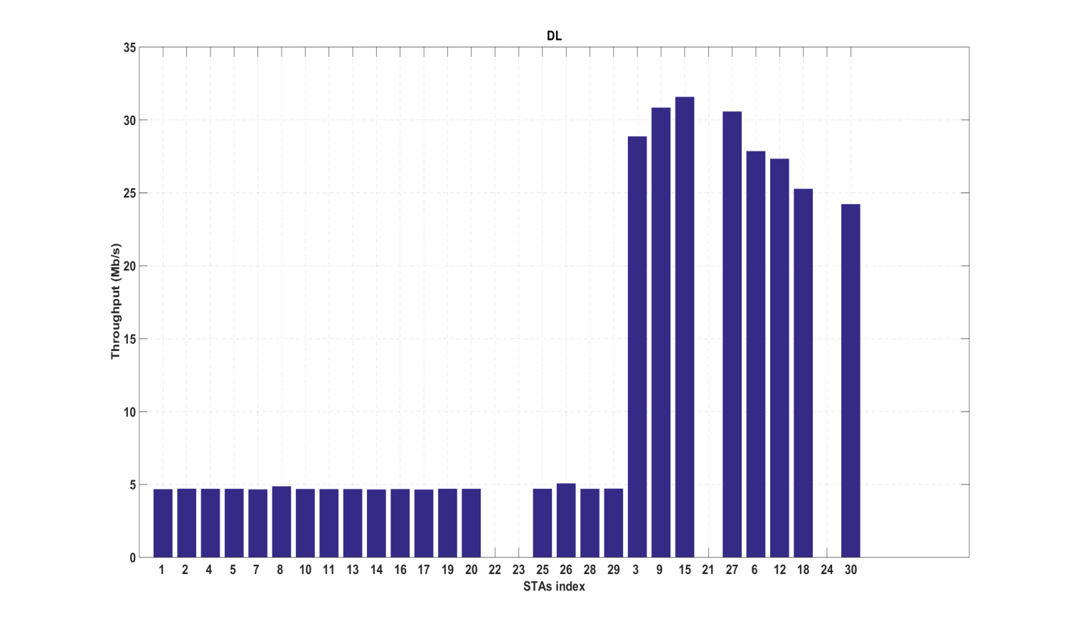
Simultaneous operation of all three BSSs – Downlink only traffic results
Throughput (Mb/s):
BSS A: 84.3
BSS B: 122.7
BSS C: 104.6
Total: 311.6
BSS A (STAs 1, 2, 4, 5, 7, 8, 10, 11, 13, 14, 16, 17, 19, 20, 25, 26, 28, 29)
BSS B (STAs 3, 9 ,15, 27)
BSS C (STAs 6, 12,18, 30)

Slide 6
Simultaneous operation of all three BSSs – Downlink only traffic results comparison
Throughput (Mb/s) | Ericsson | ZTE | HUAWEI | LGE | MARVELL
BSS A | 84.3 | 71.87 | 70.6 | 15.87 | 74.70
BSS B | 122.7 | 127.96 | 107.1 | 178.01 | 128.71
BSS C | 104.6 | 111.62 | 118.4 | 172.28 | 101.34
Total | 311.6 | 311.45 | 296.1 | 366.16 | 313.56

Slide 7
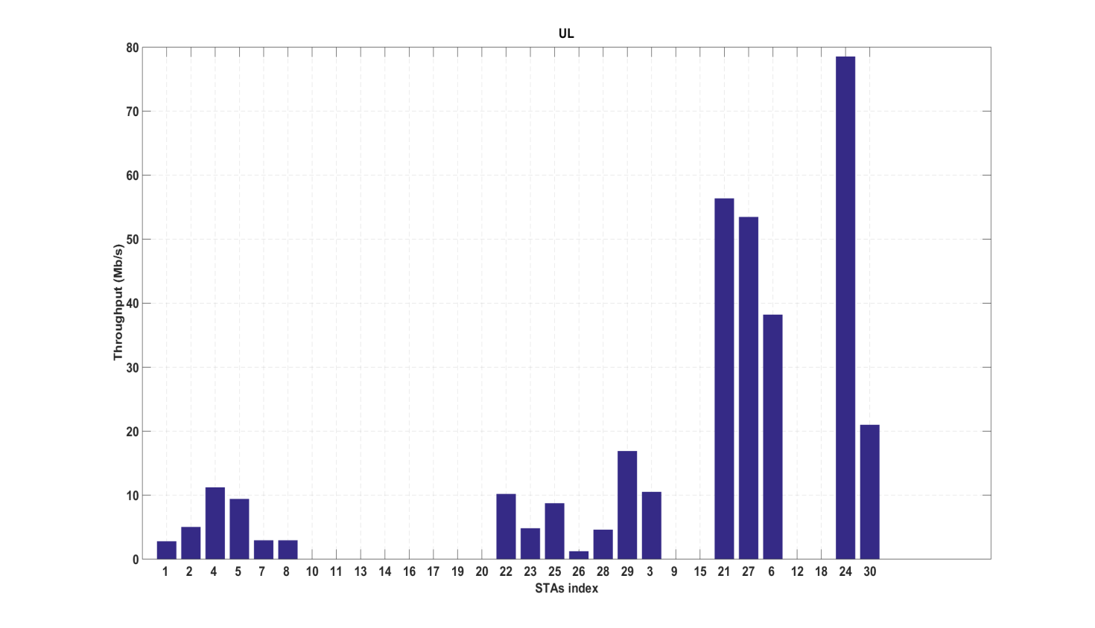
Simultaneous operation of all three BSSs – Uplink only traffic results
Throughput (Mb/s):
BSS A: 80.9
BSS B: 120.4
BSS C: 137.8
Total: 339.1
BSS A (STAs 1, 2, 4, 5, 7, 8, 10, 11, 13, 14, 16, 17, 19, 20, 25, 26, 28, 29)
BSS B (STAs 3, 9 ,15, 27)
BSS C (STAs 6, 12,18, 30)

Slide 8
Simultaneous operation of all three BSSs – Uplink only traffic results comparison
Throughput (Mb/s) | Ericsson | ZTE | HUAWEI | LGE | MARVELL
BSS A | 80.9 | 65.02 | 80.45 | 83.84 | 149.94
BSS B | 120.4 | 105.21 | 81.96 | 112.87 | 121.44
BSS C | 137.8 | 138.01 | 123.21 | 148.61 | 139.27
Total | 339.1 | 308.24 | 285.62 | 345.32 | 410.65

Slide 9
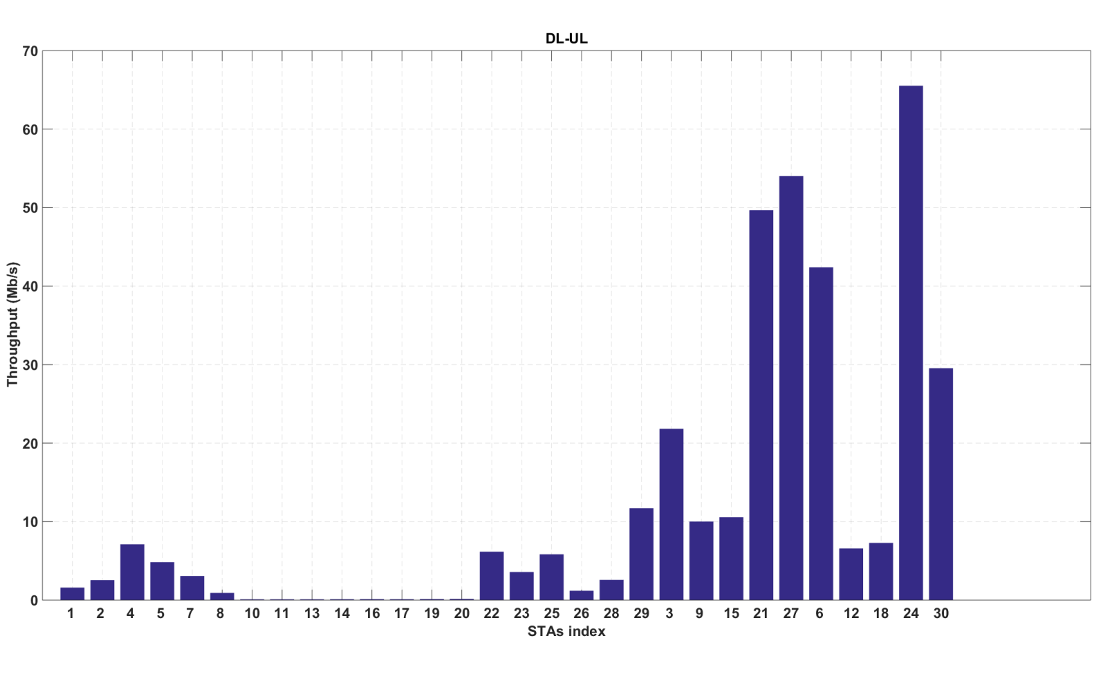
Simultaneous up- & downlink operation of all three BSSs – Throughput in Mb/s
BSS A: 51.9
DL: 2.0, UL: 49.9
BSS C: 151.5
DL: 28.3, UL: 123.2
Total: 349.5
DL: 70.7, UL: 278.8
BSS B: 146.1
DL: 40.4, UL: 105.7

Slide 10
Simultaneous up- & downlink operation of all three BSSs – Comparison
Throughput (Mb/s) | Ericsson | ZTE | HUAWEI | LGE
BSS A | 51.9 | 60.89 | 50.67 | 49.18
BSS B | 146.1 | 129.75 | 100.53 | 152.38
BSS C | 151.5 | 130.31 | 117.41 | 148.39
Total | 349.5 | 320.95 | 268.61 | 349.95

Slide 11
Observations
BSS | STA index | SNR, UL (dB)
A | 1 | 42,88
 | 2 | 32,21
 | 4 | 40,22
 | 5 | 37,28
 | 7 | 32,76
 | 8 | 42,59
 | 10 | 45,66
 | 11 | 27,48
 | 13 | 46,83
 | 14 | 35,11
 | 16 | 30,64
 | 17 | 43,84
 | 19 | 38,58
 | 20 | 47,84
 | 22 | 40,32
 | 23 | 37,67
 | 25 | 39,30
 | 26 | 29,48
 | 28 | 35,39
 | 29 | 39,35
B | 3 | 30,02
 | 9 | 32,48
 | 15 | 43,64
 | 21 | 34,58
 | 27 | 41,47
C | 6 | 31,64
 | 12 | 30,63
 | 18 | 32,61
 | 24 | 38,33
 | 30 | 32,24
Simulation results similar to other submissions
Little distance variation leads to limited pathloss variation in BSS B
Right table shows SNR in UL direction per STA
5 dB higher SNR in DL because of higher output power of AP
Fixed Modulation and Coding Scheme selection as required by “Box 5” test results in equal throughput distribution in BSS A

Slide 12
References
R. Porat et al., “11ax Evaluation Methodology,” 11-14/0571r8
J. Pang et al., “Discussion about Box5 Calibration,” 11-14/1177r2
P. Loc et al., “TGac Functional Requirements and Evaluation Methodology,” 11-09/00451r16
Y. Li, “MAC calibration results comparison,” 11-14/1192r6
S. Merlin et al., “TGax Simulation Scenarios,” 11-14/0980r10

