Slide 1
NG60 channel modeling plan
Authors:
Name | Affiliation | Address | Phone | Email
Alexander Maltsev | Intel |  | +7(962)5050236 | alexander.maltsev@intel.com
Andrey Pudeyev | Intel |  |  | andrey.pudeyev@intel.com
Ilya Bolotin | Intel |  |  | ilya.bolotin@intel.com
Carlos Cordeiro | Intel |  |  | carlos.cordeiro@intel.com

Slide 2
Agenda
Channel model requirements
NG60 use cases and modeling scenarios
Experimental measurements
  Overview
  Plans
Q-D channel model methodology
  Brief introduction
  Open area, Street canyon and Hotel lobby models
  802.11ad and Q-D model application to NG60: areas for further development
Summary / Next steps
References

Slide 3
NG60 Channel model requirements
Accurate space-time characterization of the propagation channel for main use cases
  mmWave propagation features
  3-dimensional model
Support of steerable directional antennas with no limitations on the antenna technology
  Phased antenna arrays, modular antenna arrays
  Lens antennas / other prospective technologies
MIMO modes support
  Both for SLS and LLS analysis
Support of polarization characteristics of antennas and signals
  Antenna polarizations
  Polarization changes during reflections
Support of non-stationary characteristics of the propagation channel.
  Mobility effects: Doppler effect from TX/RX motion, non-stationary environment
  Path blockage (probability)
Channel model applicability to both system level simulation (SLS) and PHY level (LLS) analysis

Slide 4
System level and Link (PHY) level models
System level models
  Universal approach for any type/number of antennas
  Channel characteristics depend on the given TX/RX positions
  Should be used to produce PHY level model database (DB)
PHY level models
  Explicit DB of channel impulse responses (CIR) realizations for all required scenarios
  MIMO implementation
    Option #1: SISO channel extension to MIMO case. Correlation parameters determined from SLS model and verified by experiments (3GPP SCM and TGn -alike methodology)
    Option #2: Extend DB by inclusion additional CIR pairs for typical MIMO setups (2x2 arrays and other)

Slide 5
NG60 use cases summary [1]
# | Applications and Characteristics | Propagation conditions | Throughput | Topology | Priority (TBD)
1 | Ultra Short Range (USR) Communications -Static,D2D, -Streaming/Downloading | LOS only, Indoor <10cm | ~10Gbps | P2P | Medium
2 | 8K UHD Wireless Transfer at Smart Home -Umcompressed 8K UHD Streaming | Indoor, LOS with small NLOS chance, <5m | >28Gbps | P2P | High
3 | Augmented Reality and Virtual Reality -Low Mobility, D2D -3D UHD streaming | Indoor, LOS with small NLOS chance <10m | ~20Gbps | P2P | Low
4 | Data Center NG60 Inter-Rack Connectivity -Indoor Backhaul with multi-hop* | Indoor, LOS only <10m | ~20Gbps | P2P P2MP | Low
5 | Video/Mass-Data Distribution/Video on Demand System - Multicast Streaming/Downloading - Dense Hotspots | Indoor, LOS/NLOS <100m | >20Gbps | P2P P2MP | Medium
6 | Mobile Wi-Fi Offloading and Multi-Band Operation (low mobility ) -Multi-band/-Multi-RAT Hotspot operation | Indoor/Outdoor, LOS/NLOS <100m | >20Gbps | P2P P2MP | High
7 | Mobile Fronthauling | Outdoor, LOS <200m | ~20Gbps | P2P P2MP | Low
8 | Wireless Backhauling with Single Hop -Small Cell Backhauling with single hop | Outdoor, LOS <1km | ~20Gbps | P2P P2MP | Medium
9 | Wireless Backhauling with Multi-hop -Small Cell Backhauling with multi-hop* | Outdoor, LOS <150m | ~2Gbps | P2P P2MP | Low

Slide 6
Use cases vs. channel scenarios
Use cases differs not only by environment, but also by throughput / latency / topology parameters, from the other hand, the same use cases may be realized in the different environments
Channel modeling scenario | Use cases | Channel modeling approaches, comments
Ultra-short range | 1 | Direct EM near-field calculation and measurements Los and device to device reflections – new approach needed
Living room | 2, 3 | IEEE 802.11ad model [2] as a base Enhancements: MIMO modes, Doppler and mobility effects, TX-Rx positions are changing
Data center | 4 | New static LOS scenario: Metallic constructions, ceiling reflections. No experimental data.
Enterprise/Mall/Exhibition Transportation | 5 | LOS/NLOS, frequent human blockage, multiple reflections IEEE 802.11ad models for cubicle and conference room. Experimental measurements and ray tracing simulations required for models development (analysis of METIS, AIRBUS data, etc.)
Open area (Access/Fronthaul/Backhaul) | 6,7,8,9 | Open area channel model in MiWEBA Q-D methodology with extension to MIMO
Street canyon (Access/Fronthaul/Backhaul) | 6,7,8,9 | Street canyon channel model in MiWEBA Q-D methodology with extension to MIMO

Slide 7
Experimental measurements
Existing experimental measurements
  MiWEBA experimental campaigns (data available) [3,4]
    HHI measurements (street canyon, omni, 250 MHz BW) [5]
    IMC measurements (open area, directional, 800 MHz BW), [6]
  METIS experimental campaigns (raw data availability - TBD) ][7]
    Ericsson (indoor/office, directional, 2 GHz BW)
    Aalto (indoor: shopping mall, cafeteria; outdoor: dense urban omni/directional, 4 GHz BW),
    HHI (outdoor, omni, 250 MHz BW)
  Other experimental data may be available: NIST, Huawei, universities [8]
Desirable additional experimental measurements
  Indoor/Outdoor data with high time domain resolution (2-4 GHz BW) for Intra-cluster time parameters identification: High priority
  Indoor/Outdoor data with high angular domain resolution (synthesized aperture, very large antennas, etc.) for Intra-cluster angular parameters identification: Low priority
  Indoor/Outdoor data for closely placed antennas for SU-MIMO channel analysis: High priority

Slide 8
Q-D channel model basics
Joint map-based and statistical approach [9,10]
Parameters of the most strongest rays (D-rays) in the given scenario explicitly obtained via ray-tracing, reflection coefficients and pathloss calculations (Fresnel formulas and Friis equation)
Random / weaker rays (R-rays) parameters taken from the pre-defined statistical distributions (Poisson ToA, exponentially-decaying PDP, etc.)
Intra-cluster structure of the D- and R-rays built on the base of statistical distributions
Currently three basic scenarios were implemented in MiWEBA project: open-area, street canyon, hotel lobby, with access and backhaul links support (open-area model used for MU-MIMO performance evaluation in a small cells environment [11,12])

Slide 9
Open-area access channel model: D-rays
D-rays: Direct LOS ray and Ground-reflected ray
D-Rays calculated from geometry, taking into account pathloss, reflection loss (Fresnel + scattering), and polarization

Slide 10
Open-area access channel model: R-rays
R-rays
  R-rays are generated as Poisson processes with exponentially decaying profile
  AoA and AoD are uniformly distributed within limits
Intra-cluster components
  Applied to both D-rays and R-rays
  Arrival also modeled as Poisson process
  AoA and AoD modeled as independent normally distributed random variables around the central ray with RMS equal to 5⁰
*
*
*Note: Parameters may be refined by new experimental measurement results

Slide 11
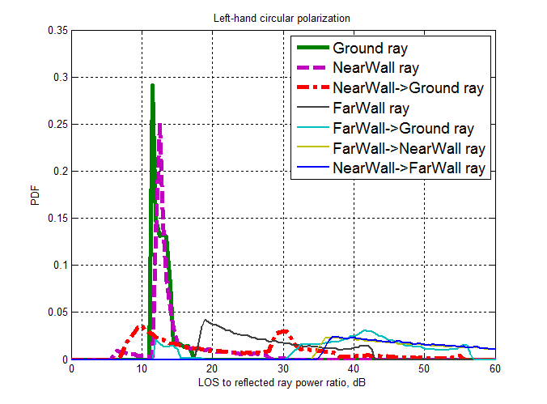
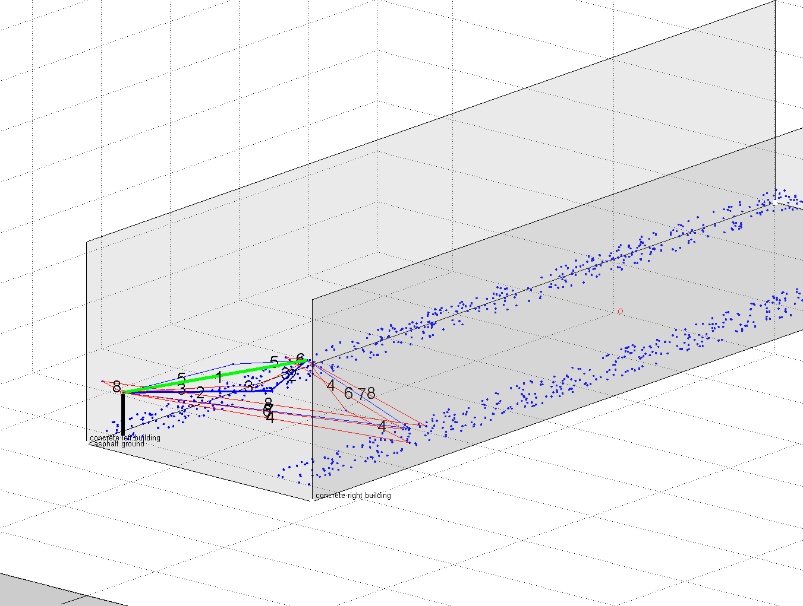
Street canyon access channel model
The ray-tracing analysis shows that in street canyon scenario only 4 rays have significant impact on the signal power (D-rays):
  Direct LOS ray
  Ground ray
  Nearest wall ray
  Ground-Nearest wall ray
Reflected rays power PDF

Slide 12
Street canyon access channel model
D-ray parameters definition is similar to Open-area case: Direct ray, two first order reflections and one second-order reflection are calculated from the geometry and material parameters (see table)
R-rays: Poisson
Intra-cluster components: Poisson

Slide 13
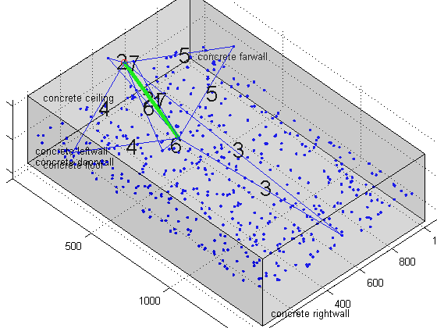
Hotel lobby access
The ray tracing analysis of the hotel lobby shows that in such bordered area all rays up to second order are significant and should be treated as D-rays
R-rays represents reflections from various objects in the room. Modeled as Poisson distribution with specified parameters
Intra-cluster parameters are taken from 802.11ad 60GHz indoor channel model.

Slide 14
Backhaul and D2D channel models
ART Backhaul scenario
  Backhaul link between two ART relay stations typically armed with very high gain and high directional antennas. This leads to the absolute dominance of the direct LOS ray, and the other rays (which may present in this environment) are much weaker.
  D-Ray: LOS component plus small cluster
Street canyon backhaul/fronthaul
  The Street canyon backhaul/fronthaul channel model is derived from the Street canyon access channel models by setting RX antenna height equal to AP height. The other parameters are not changed.
D2D channel models
  D2D channel models for Open area, Street canyon and Hotel lobby are derived from the corresponding access channel models by setting TX antenna height equal to UE height. The other parameters are not changed.

Slide 15
802.11ad and Q-D model application for NG60: areas for development
Update 802.11ad and Q-D model to support all NG60 use cases
MIMO mode support
  D-rays parameters are calculated on the base of antenna positions
  R-rays parameters correlation for closely spaced antennas need to be defined
Channel bonding
  Check for potential issues for double-band channels (4GHz)
Intra-cluster parameters update
  For now, all intra-cluster parameters are taken directly from IEEE 802.11ad channel model
  Intra-cluster parameters need to be refined for all new scenarios and use cases on the base of experimental measurements and ray-tracing

Slide 16
Summary / Next steps
Organization issues
  Summary of existing models
  Summary of available measurement results
  Identifying required experimental campaigns
Q-D channel model update
  New scenarios
  Intra-cluster structure verification
  MIMO mode / antenna signals correlation support

Slide 17
References
“NG60 usage scenarios”, http://mentor.ieee.org/802.11/dcn/14/11-14-1185-00-ng60-ng60-usage-scenarios.pptx
"Channel Models for 60 GHz WLAN Systems," IEEE 802.11ad 09/0334r8, 2010.
MiWEBA Project #608637 homepage: http://www.miweba.eu, FP7-ICT-2013-EU-Japan, 2013
MiWEBA project #608637, ‘Deliverable D5.1, Channel Modeling and Characterization’, Public Deliverable, Intel Editor, June 2014.
R. J. Weiler, M. Peter, W. Keusgen, H. Shimodaira, K. T. Gia and K. Sakaguchi, "Outdoor Millimeter-Wave Access for Heterogeneous Networks – Path Loss and System Performance," in PIMRC, 2014.
A. Maltsev, A. Pudeyev, I. Karls, I. Bolotin, G. Morozov , R.J. Weiler, M. Peter, W. Keusgen, M. Danchenko, A. Kuznetsov, WWRF’ 33, 2014, Guildford, GB, “Quasi-Deterministic Approach to MmWave Channel Modeling in the FP7 MiWEBA Project”
METIS 2020 channel model deliverable 1.4:http://www.metis2020.com/documents/deliverables
T. S. Rappaport, et.al., "Broadband Millimeter-Wave Propagation Measurements and Models Using Adaptive-Beam Antennas for Outdoor Urban Cellular Communications," IEEE Trans. on Antennas and Propagation, vol. 61, pp. 1850-1859, 2013.
“Channel models for NG60”, http://mentor.ieee.org/802.11/dcn/14/11-14-1486-00-ng60-channel-models-in-ng60.pptx
A. Maltsev, A. Pudeyev, I. Karls, I. Bolotin, G. Morozov , R.J. Weiler, M. Peter, W. Keusgen “Quasi-deterministic Approach to mmWave Channel Modeling in a Non-stationary Environment”, IEEE GLOBECOM 2014, Austin, Texas, USA
“MU-MIMO-schemes for NG60”, http://mentor.ieee.org/802.11/dcn/15/11-15-0356-00-ng60-mu-mimo-schemes-for-ng60.pptx
A. Maltsev, A. Sadri, A. Pudeyev, A. Davydov, I. Bolotin, G. Morozov, “Performance evaluation of the MmWave Small Cells communication system in MU-MIMO mode”, EuCNC’2015

