Slide 1
Box 5 Calibration Result
Date: 2015-05-08
Authors:

Slide 2
Abstract
This presentation describes MediaTek’s Box 5 calibration results.
  Applying 1 BSS UL test case.

Slide 3
Background
  Performance differences are found and results are not aligned since members providing results from Sep. 2014.
  Box 5 simulation members agreed to focus on aligning single BSS UL test case in the Mar. 2015 IEEE meeting.

Slide 4
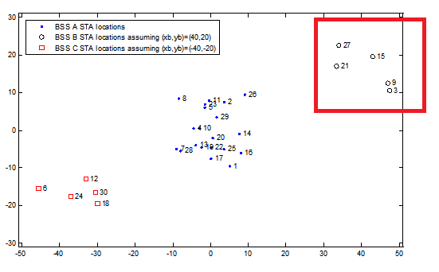
Single BSS Calibration Case
No Shadowing:
  Require one simulation drop.
Fixed MCS 5:
  To avoid path-loss dependent transmission failure due to using MCS 7.
5 Combinations:
  STA 3, STA9.
  STA 3, STA 27.
  STA 3, STA 15.
  STA 3, STA 9, STA 27.
  STA 3, STA 9, STA 15.
BSS B, UL traffic.
AP B | (40,20)
STA3 | (7.5+xb, ‑9.5+yb)
STA9 | (7+xb, -7.5+yb)
STA15 | (3+xb, -0.5+yb)
STA21 | (-6.5+xb, -3+yb)
STA27 | (‑6+xb, 2.5+yb)

Slide 5
PHY Parameters
PHY parameters
BW | All BSSs at 5GHz [80 MHz, no dynamic bandwidth]
Channel model | TGac D NLOS per link
Shadow fading | iid log-normal shadowing (5 dB standard deviation) per link
Data Preamble Type | [5GHz, 11ac], always decoded correctly after successful reception, duration is considered.
STA TX Power | 15 dBm per antenna
AP TX Power | 20 dBm per antenna
AP number of TX/RX antennas | 1/1
STA number of TX /RX antennas | 1/1
AP antenna gain | 0 dBi
STA antenna gain | -2 dBi
Noise Figure | 7dB
CCA threshold | -56 dBm (measured across the entire bandwidth after large-scale fading)
Rx sensitivity | -76 dBm
Link Adaption | Fixed MCS =5 (234.0 Mbps)
Channel estimation | ideal
PHY abstraction | RBIR, BCC [1, 5]
Channel correlation | Independent or time-correlated channel per packet

Slide 6
MAC Parameters
MAC parameters
Access protocol | [EDCA, AC_BE with default parameters] [CWmin = 15, CWmax = 1023, AIFSn=3 ]
Queue length | A single queue for each traffic link is set inside AP/STA sized of 2000 packets
Traffic type | UDP CBR with rate 10^8bps (may not enough to model full buffer)
MPDU size | 1538 Bytes (1472 Data + 28 IP header + 8 bytes LLC + 30 MAC header)
Aggregation | [A-MPDU / max aggregation size / BA window size, No A-MSDU, with immediate BA], Max aggregation: 64 MPDUs with 4-byte MPDU delimiter
Max number of retries | 10
Beacon | Disabled
RTS/CTS | OFF
Traffic direction | UL Only
Output metric | -CDF or Histogram of per non-AP STA throughput (received bits/overall simulation time) -PER of all AP/STA (1 - # of success subframes / # of transmitted subframes)

Slide 7
Simulation Results
Test Case | Throughput [Mbps]
1 (2 STAs) | STA 3: 98.16
 | STA 9: 100.92
2 (2 STAs) | STA 3: 93.46
 | STA 27: 97.77
3 (2 STAs) | STA 3: 98.48
 | STA 15: 101.22
4 (3 STAs) | STA 3: 83.67
 | STA 9: 88.47
 | STA 27: 21.23
5 (3 STAs) | STA 3: 62.68
 | STA 9: 60.10
 | STA 15: 72.15

Slide 8
Conclusions
Provide MTK’s Box 5 calibration results on single BSS test case.

Slide 9
References
R. Porat et al, “Evaluation Methodology”, IEEE 11-14/571r6.
S. Merlin et al, “Simulation Scenarios”, IEEE 11-14/980r10.
P. Loc et al, “TGac Functional Requirements and Evaluation Methodology”, IEEE 11-09/0451r16.

