Slide 1
Calibration Results for PSP and U-APSD
Date: 2015-05-08
Authors:
Name | Affiliations | Address | Phone | Email
Dmitry Akhmetov | Intel | 2200 Mission College Blvd., Santa Clara, CA, 95054 | +1-415-244-8904 | dmitry.akhmetov@intel.com
Ghosh Chittabrata | Intel |  |  | chittabrata.ghosh@intel.com

Slide 2
Abstract
The Simulations Scenario document [1] described 3 existing power save mechanisms in 802.11-2012 as baseline for energy efficiency evaluation in scenarios for TGax
Power save mode (PSM)
Power save polling (PSP)
Unscheduled automatic power save delivery (U-APSD)
This contribution provides power save calibration test results for
PSP
U-APSD
This contribution also provides differences in power consumption for PSP and U-APSD when state transitions time and power consumptions are considered additionally

Slide 3
Various Power States Definition
Simulation Scenarios document [1] of IEEE 802.11ax specifies the following common power model parameters for all simulation scenarios
Power State | Average Current Consumption [mA]
Transmit [mA] | 280
Receive [mA] | 100
Listen [mA] | 50
Shallow Sleep [mA] | 0.9
Deep Sleep [mA] | 0.003
Deep Sleep [2] power state is defined as a sleep state with the least (non-zero) power consumed and the longest transition time to Listen state.
Shallow Sleep [2] power state is defined as a sleep state when the STA consumes more power but transitions faster to Listen state when compared to the Deep Sleep power state
Simulation results in this contribution use Shallow Sleep power state as Sleep state

Slide 4
PSP Test
The MSDU 1500 bytes DL traffic transmitted every 200ms
PPDU length = 1920 us
Beacon transmitted using PIFS
Regular contention for PS-Poll & DATA
STA wakes at TBTT boundary
PS-Poll triggers AP to TX in DL
STA enter SLEEP after it received DATA with more_frag bit set to zero
Parameters
RTS/CTS | OFF
AIFS= DIFS | 34us
Control rate/Data rate | 6 Mbps/ 6.5Mbps
MCS | 0
No A-MPDU aggregation
Simulation time | 300s
Beacon size(Byte) | 80
BI | 102.4ms
DTIM | 3

Slide 5
Calibration Test Results for PSP
PSP-Time
 |  | STA(%) |  |  |  | AP(%)
Power save ON/OFF | DTIM | Listen | RX | TX | Sleep | Listen | RX | TX | Sleep
Active | 3 | 98.82 | 1.12 | 0.02 | 0.00 | 98.86 | 0.02 | 1.12 | 0.00
PSP | 3 | 0.09 | 1.03 | 0.04 | 98.78 | 98.80 | 0.04 | 1.14 | 0.00
PSP-Energy
 |  | STA(%) |  |  |  | AP(%)
Power save ON/OFF | DTIM | Listen | RX | TX | Sleep | Listen | RX | TX | Sleep
Active | 3 | 97.67 | 2.22 | 0.11 | 0.00 | 93.98 | 0.04 | 5.98 | 0.00
PSP | 3 | 2.28 | 49.52 | 5.33 | 42.87 | 93.88 | 0.08 | 6.05 | 0.00

Slide 6
U-APDS Test
Bidirectional traffic, MSDU 120 bytes every 40ms
AP buffer DL traffic while STA is in SLEEP
STA wakes at UL frame arrival from LLC
Regular contention for each DATA TX
STA enter sleep after it receive DATA with more_frag bit set to zero & STA TX buffer is empty
Parameters
RTS/CTS | OFF
AIFS= DIFS | 34us
Control rate/Data rate | 6 Mbps/ 6.5Mbps
MCS | 0
No A-MPDU aggregation
Simulation time | 300s
Beacon | Not modeled
BI | N/A
DTIM | N/A

Slide 7
Calibration Test Results for U-APSD
U-APSD-Time
 | STA(%) |  |  |  | AP(%)
Power save ON/OFF | Listen | RX | TX | Sleep | Listen | RX | TX | Sleep
Active | 98.70 | 0.65 | 0.65 | 0.00 | 98.70 | 0.65 | 0.65 | 0.00
UAPSD | 0.84 | 0.65 | 0.65 | 97.85 | 98.69 | 0.65 | 0.65 | 0.00
U-APSD-Energy
 | STA(%) |  |  |  | AP(%)
Power save ON/OFF | Listen | RX | TX | Sleep | Listen | RX | TX | Sleep
Active | 95.23 | 1.25 | 3.51 | 0.00 | 95.23 | 1.25 | 3.51 | 0.00
UAPSD | 11.11 | 17.24 | 48.28 | 23.37 | 95.23 | 1.25 | 3.51 | 0.00

Slide 8
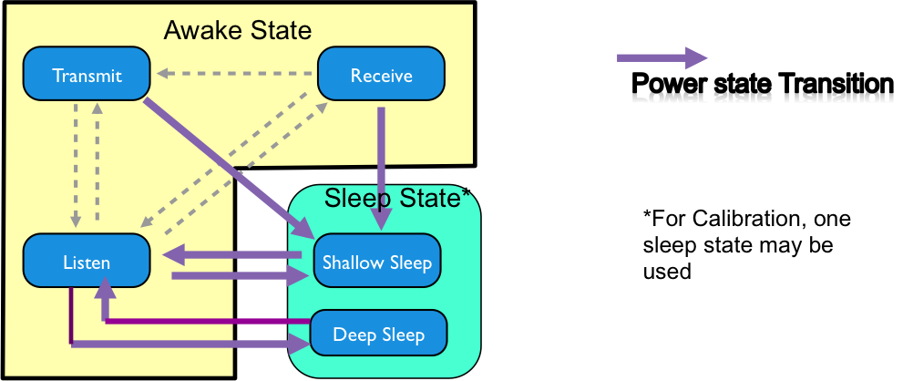
Different State Transitions in 802.11ax

Slide 9
Power and Latency Transitions Among States in IEEE 802.11ax [3]
Power Consumption and Latency Values in State Transitions
State Transitions | Transition Time (ms) | Power Consumption (mW)
Transmit ⬄ Listen | T_{TL} = 0.010ms | 75mW
Receive ⬄ Listen | 0ms | 55mW
Receive Transmit | T_{RT} = 0.004ms | P_{RT} = 100mW
Transmit Shallow Sleep | T_{TS} = 0.01ms | P_{TS} = 15mW
Receive Shallow Sleep | T_{RS} = 0.2ms | P_{RS} = 15mW
Listen Shallow Sleep | T_{LS} = 0.2ms | P_{LS} = 5mW
Shallow Sleep Listen | T_{SL} = 0.5ms
Listen Deep Sleep | T_{LD} = 0.01ms | P_{DS} = 5mW
Deep Sleep Listen | T_{SDL}= 3ms

Slide 10
PSP with Power Consumption and Latency Comparison during Transitions
Power Save: Enable Total energy per state, W
STA |  |  |  | AP
 | NO TR | TR | % diff |  | NO TR | TR | % diff
Listen | 0.02 | 0.01 | 6.99 | Listen | 16.30 | 16.30 | 0.01
RX | 0.34 | 0.34 | 0.00 | RX | 0.01 | 0.01 | 0.00
TX | 0.04 | 0.04 | 0.00 | TX | 1.05 | 1.05 | 0.00
Sleep | 0.29 | 0.29 | 0.17 | Sleep | 0.00 | 0.00 | 0.00
Power save : Disable Total energy per state, W
STA |  |  |  | AP
 | NO TR | TR | % diff |  | NO TR | TR | % diff
Listen | 16.31 | 16.31 | 0.00 | Listen | 16.31 | 16.31 | 0.01
RX | 0.37 | 0.37 | 0.00 | RX | 0.01 | 0.01 | 0.00
TX | 0.02 | 0.02 | 0.00 | TX | 1.04 | 1.04 | 0.00
Sleep | 0.00 | 0.00 | 0 | Sleep | 0.00 | 0.00 | 0.00
Power Save: Enable Total time per state, s
STA |  |  |  | AP
 | NO TR | TR | % diff |  | NO TR | TR | % diff
Listen | 0.28 | 0.26 | 6.99 | Listen | 296.40 | 296.36 | 0.01
RX | 3.08 | 3.08 | 0.00 | RX | 0.12 | 0.12 | 0.00
TX | 0.12 | 0.12 | 0.00 | TX | 3.41 | 3.41 | 0.00
Sleep | 296.35 | 295.85 | 0.17 | Sleep | 0.00 | 0.00 | 0.00
Power Save: Disable Total time per state, s
STA |  |  |  | AP
 | NO TR | TR | % diff |  | NO TR | TR | % diff
Listen | 296.47 | 296.46 | 0.00 | Listen | 296.57 | 296.53 | 0.01
RX | 3.37 | 3.37 | 0.00 | RX | 0.06 | 0.06 | 0.00
TX | 0.06 | 0.06 | 0.00 | TX | 3.37 | 3.37 | 0.00
Sleep | 0.00 | 0.00 | 0 | Sleep | 0.00 | 0.00 | 0.00

Slide 11
U-APSD with Power Consumption and Latency Comparison during Transitions
Power Save: Enable Total energy per state, J
STA |  |  |  | AP
 | NO TR | TR | % diff |  | NO TR | TR | % diff
Listen | 0.14 | 0.13 | 4.78 | Listen | 16.28 | 16.28 | 0.04
RX | 0.21 | 0.21 | 0.00 | RX | 0.21 | 0.21 | 0.00
TX | 0.60 | 0.60 | 0.00 | TX | 0.60 | 0.60 | 0.00
Sleep | 0.29 | 0.29 | 1.30 | Sleep | 0.00 | 0.00 | 0.00
Power Save: Disable Total energy per state, J
STA |  |  |  | AP
 | NO TR | TR | % diff |  | NO TR | TR | % diff
Listen | 16.29 | 16.28 | 0.04 | Listen | 16.29 | 16.28 | 0.04
RX | 0.21 | 0.21 | 0.00 | RX | 0.21 | 0.21 | 0.00
TX | 0.60 | 0.60 | 0.00 | TX | 0.60 | 0.60 | 0.00
Sleep | 0.00 | 0.00 | 0 | Sleep | 0.00 | 0.00 | 0.00
Power Save: Enable Total time per state, s
STA |  |  |  | AP
 | NO TR | TR | % diff |  | NO TR | TR | % diff
Listen | 2.51 | 2.39 | 4.78 | Listen | 296.06 | 295.94 | 0.04
RX | 1.95 | 1.95 | 0.00 | RX | 1.95 | 1.95 | 0.00
TX | 1.95 | 1.95 | 0.00 | TX | 1.95 | 1.95 | 0.00
Sleep | 293.55 | 289.72 | 1.30 | Sleep | 0.00 | 0.00 | 0.00
Power Save: Disable Total time per state, s
STA |  |  |  | AP
 | NO TR | TR | % diff |  | NO TR | TR | % diff
Listen | 296.10 | 295.98 | 0.04 | Listen | 296.10 | 295.98 | 0.04
RX | 1.95 | 1.95 | 0.00 | RX | 1.95 | 1.95 | 0.00
TX | 1.95 | 1.95 | 0.00 | TX | 1.95 | 1.95 | 0.00
Sleep | 0.00 | 0.00 | 0 | Sleep | 0.00 | 0.00 | 0.00

Slide 12
Conclusion
In this submission we have provided
power save calibration test results
provided results for enhanced power state modelling with consideration of power consumption and latency values during state transitions

Slide 13
References
[1] S. Merlin et. al., “TGax Simulation Scenarios,” IEEE 11-14-980r6, Jan 2015
[2] C. Ghosh et. al., “Sleep states in-IEEE 802.11ax Simulation Scenarios,” IEEE 11-15-314r2, March 2015
[3] C. Ghosh et. al., “Power Consumption and Latency Values in State Transitions for IEEE 802.11ax Simulation Scenarios,” IEEE 11-15-0576r0, May 2015

Slide 14
Back-up Slides

Slide 15
Some reference timing
PSPOLL: 60us at 6Mbps
ACK: 40us at 6Mbps
Data, 1.5K (PSP test) 1920us at 6.5Mbps
Data, 120bytes (UAPSD test) 220us at 6.5Mbps
Beacon, 80bytes 168us at 6Mbps

