Slide 1
HE-LTF Sequence for UL MU-MIMO
Date: 2015-05-11
Authors:
Name | Affiliation | Address | Phone | Email
Qinghua Li | Intel | 2111 NE 25th Ave, Hillsboro OR 97124, USA | +1-408-765-9698 | quinghua.li@intel.com
Xiaogang Chen |  |  |  | xiaogang.c.chen@intel.com
Robert Stacey |  |  |  | robert.stacey@intel.com
Po-Kai Huang |  |  |  | po-kai.huang@intel.com
Chitto Ghosh |  |  |  | chittabrata.ghosh@intel.com
Rongzhen Yang |  |  |  | rongzhen.yang@intel.com
Hongyuan Zhang | Marvell | 5488 Marvell Lane, Santa Clara, CA, 95054 | +408-222-2500 | hongyuan@marvell.com
Yakun Sun |  |  |  | yakunsun@marvell.com
Lei Wang |  |  |  | Leileiw@marvell.com
Liwen Chu |  |  |  | liwenchu@marvell.com
Jinjing Jiang |  |  |  | jinjing@marvell.com
Yan Zhang |  |  |  | yzhang@marvell.com
Rui Cao |  |  |  | ruicao@marvell.com

Slide 2
Authors (continued)
Name | Affiliation | Address | Phone | Email
Jie Huang | Marvell (Cont’d) | 5488 Marvell Lane, Santa Clara, CA, 95054 | 408-222-2500 | jiehuang@marvell.com
Sudhir Srinivasa |  |  |  | sudhirs@marvell.com
Saga Tamhane |  |  |  | sagar@marvell.com
Mao Yu |  |  |  | my@marvel..com
Edward Au |  |  |  | edwardau@marvell.com
Hui-Ling Lou |  |  |  | hlou@marvell.com
Ron Porat | Broadcom |  |  | rporat@broadcom.com
Matthew Fischer |  |  |  | mfischer@broadcom.com
Sriram Venkateswaran
Tu Nguyen
Vinko Erceg
Brian Hart | Cisco Systems | 170 W Tasman Dr, San Jose, CA 95134 |  | brianh@cisco.com
Pooya Monajemi |  |  |  | pmonajem@cisco.com

Slide 3
Authors (continued)
Name | Affiliation | Address | Phone | Email
Wookbong Lee | LG Electronics | 19, Yangjae-daero 11gil, Seocho-gu, Seoul 137-130, Korea |  | wookbong.lee@lge.com
Kiseon Ryu |  |  |  | kiseon.ryu@lge.com
Jinyoung Chun |  |  |  | jiny.chun@lge.com
Jinsoo Choi |  |  |  | js.choi@lge.com
Jeongki Kim |  |  |  | jeongki.kim@lge.com
Giwon Park |  |  |  | giwon.park@lge.com
Dongguk Lim |  |  |  | dongguk.lim@lge.com
Suhwook Kim |  |  |  | suhwook.kim@lge.com
Eunsung Park |  |  |  | esung.park@lge.com
HanGyu Cho |  |  |  | hg.cho@lge.com
Thomas Derham | Orange |  |  | thomas.derham@orange.com
Qinghua Li, Xiaogang Chen, et al.

Slide 4
Authors (continued)
Name | Affiliation | Address | Phone | Email
Fei Tong | Samsung | Innovation Park, Cambridge CB4 0DS (U.K.) | +44 1223 434633 | f.tong@samsung.com
Hyunjeong Kang |  | Maetan 3-dong; Yongtong-Gu Suwon; South Korea | +82-31-279-9028 | hyunjeong.kang@samsung.com
Kaushik Josiam |  | 1301, E. Lookout Dr, Richardson TX 75070 | (972) 761 7437 | k.josiam@samsung.com
Mark Rison |  | Innovation Park, Cambridge CB4 0DS (U.K.) | +44 1223 434600 | m.rison@samsung.com
Rakesh Taori |  | 1301, E. Lookout Dr, Richardson TX 75070 | (972) 761 7470 | rakesh.taori@samsung.com
Sanghyun Chang |  | Maetan 3-dong; Yongtong-Gu Suwon; South Korea | +82-10-8864-1751 | s29.chang@samsung.com
Yasushi Takatori | NTT | 1-1 Hikari-no-oka, Yokosuka, Kanagawa 239-0847 Japan |  | takatori.yasushi@lab.ntt.co.jp
Yasuhiko Inoue |  |  |  | inoue.yasuhiko@lab.ntt.co.jp
Yusuke Asai |  |  |  | asai.yusuke@lab.ntt.co.jp
Koichi Ishihara |  |  |  | ishihara.koichi@lab.ntt.co.jp
Akira Kishida |  |  |  | kishida.akira@lab.ntt.co.jp
Akira Yamada | NTT DOCOMO | 3-6, Hikarinooka, Yokosuka-shi, Kanagawa, 239-8536, Japan |  | yamadaakira@nttdocomo.com
Fujio Watanabe |  | 3240 Hillview Ave, Palo Alto, CA 94304 |  | watanabe@docomoinnovations.com
Haralabos Papadopoulos |  |  |  | hpapadopoulos@docomoinnovations.com

Slide 5
Authors (continued)
Name | Affiliation | Address | Phone | Email
Phillip Barber | Huawei | The Lone Star State, TX |  | pbarber@broadbandmobiletech.com
Peter Loc |  |  |  | peterloc@iwirelesstech.com
Le Liu |  | F1-17, Huawei Base, Bantian, Shenzhen | +86-18601656691 | liule@huawei.com
Jun Luo |  | 5B-N8, No.2222 Xinjinqiao Road, Pudong, Shanghai |  | jun.l@huawei.com
Yi Luo |  | F1-17, Huawei Base, Bantian, Shenzhen | +86-18665891036 | Roy.luoyi@huawei.com
Yingpei Lin |  | 5B-N8, No.2222 Xinjinqiao Road, Pudong, Shanghai |  | linyingpei@huawei.com
Jiyong Pang |  | 5B-N8, No.2222 Xinjinqiao Road, Pudong, Shanghai |  | pangjiyong@huawei.com
Zhigang Rong |  | 10180 Telesis Court, Suite 365, San Diego, CA 92121 NA |  | zhigang.rong@huawei.com
Rob Sun |  | 303 Terry Fox, Suite 400 Kanata, Ottawa, Canada |  | Rob.Sun@huawei.com
David X. Yang |  | F1-17, Huawei Base, Bantian, Shenzhen |  | david.yangxun@huawei.com
Yunsong Yang |  | 10180 Telesis Court, Suite 365, San Diego, CA 92121 NA |  | yangyunsong@huawei.com
Zhou Lan |  | F1-17, Huawei Base, Bantian, SHenzhen | +86-18565826350 | Lanzhou1@huawei.com
Junghoon Suh |  | 303 Terry Fox, Suite 400 Kanata, Ottawa, Canada |  | Junghoon.Suh@huawei.com
Jiayin Zhang |  | 5B-N8, No.2222 Xinjinqiao Road, Pudong, Shanghai | +86-18601656691 | zhangjiayin@huawei.com

Slide 6
Authors (continued)
Name | Affiliation | Address | Phone | Email
Albert Van Zelst | Qualcomm | Straatweg 66-S Breukelen, 3621 BR Netherlands |  | allert@qti.qualcomm.com
Alfred Asterjadhi |  | 5775 Morehouse Dr. San Diego, CA, USA |  | aasterja@qti.qualcomm.com
Bin Tian |  | 5775 Morehouse Dr. San Diego, CA, USA |  | btian@qti.qualcomm.com
Carlos Aldana |  | 1700 Technology Drive San Jose, CA 95110, USA |  | caldana@qca.qualcomm.com
George Cherian |  | 5775 Morehouse Dr. San Diego, CA, USA |  | gcherian@qti.qualcomm.com
Gwendolyn Barriac |  | 5775 Morehouse Dr. San Diego, CA, USA |  | gbarriac@qti.qualcomm.com
Hemanth Sampath |  | 5775 Morehouse Dr. San Diego, CA, USA |  | hsampath@qti.qualcomm.com
Menzo Wentink |  | Straatweg 66-S Breukelen, 3621 BR Netherlands |  | mwentink@qti.qualcomm.com
Richard Van Nee |  | Straatweg 66-S Breukelen, 3621 BR Netherlands |  | rvannee@qti.qualcomm.com
Rolf De Vegt |  | 1700 Technology Drive San Jose, CA 95110, USA |  | rolfv@qca.qualcomm.com
Sameer Vermani |  | 5775 Morehouse Dr. San Diego, CA, USA |  | svverman@qti.qualcomm.com
Simone Merlin |  | 5775 Morehouse Dr. San Diego, CA, USA |  | smerlin@qti.qualcomm.com
Tevfik Yucek |  | 1700 Technology Drive San Jose, CA 95110, USA |  | tyucek@qca.qualcomm.com
VK Jones |  | 1700 Technology Drive San Jose, CA 95110, USA |  | vkjones@qca.qualcomm.com
Youhan Kim |  | 1700 Technology Drive San Jose, CA 95110, USA |  | youhank@qca.qualcomm.com

Slide 7
Authors (continued)
Name | Affiliation | Address | Phone | Email
James Yee | Mediatek | No. 1 Dusing 1st Road, Hsinchu, Taiwan | +886-3-567-0766 | james.yee@mediatek.com
Alan Jauh |  |  |  | alan.jauh@mediatek.com
Chingwa Hu |  |  |  | chinghwa.yu@mediatek.com
Frank Hsu |  |  |  | frank.hsu@mediatek.com
Thomas Pare | Mediatek USA | 2860 Junction Ave, San Jose, CA 95134, USA | +1-408-526-1899 | thomas.pare@mediatek.com
ChaoChun Wang |  |  |  | chaochun.wang@mediatek.com
James Wang |  |  |  | james.wang@mediatek.com
Jianhan Liu |  |  |  | Jianhan.Liu@mediatek.com
Tianyu Wu |  |  |  | tianyu.wu@mediatek.com
Russell Huang |  |  |  | russell.huang@mediatek.com
Eric Wong | Apple | Cupertino, CA | +1-408-9745967 | ericwong@apple.com
Chris Hartman
Aon Mujtaba
Joonsuk Kim |  |  |  | joonsuk@apple.com
Guoqing Li |  |  | +1-408-974-9164 | guoqing_li@apple.com

Slide 8
Authors (continued)
Name | Affiliation | Address | Phone | Email
Weimin Xing | ZTE Corp. |  |  | Xing.weimin@zte.com.cn
Kaiying Lv |  |  |  | lv.kaiying@zte.com.cn
Ke Yao |  |  |  | Yao.ke@zte.com.cn
Bo Sun |  |  |  | Sun.bo1@zte.com.cn
Yonggang Fang | ZTE TX |  |  | yfang@ztetx.com

Slide 9
Background
P matrix coded HE-LTF was adopted in last meeting [1]
  Maximize legacy reuse
Adding details, we propose HE-LTF sequences for uplink multiuser MIMO

Slide 10
Problem Statement
In uplink multiuser MIMO, different UL users have different carrier frequency offsets
AP needs to estimate the CFOs for demodulating data and mitigate multiuser interference
For the CFO estimation, phase responses at different LTF symbol instants need to be obtained

Slide 11
Proposed Solution
Reuse existing P matrix design
Define orthogonal LTF sequences for UL MU-MIMO
Assign orthogonal LTF sequences to different streams within the UL MU-MIMO burst
  Exploit frequency domain correlation
  Individual channel responses can be estimated for each LTF symbol
  CFO can be estimated by checking the phase difference between the channel estimates obtained at different LTF symbols
Additional benefit — no pilot tones needed in LTF

Slide 12
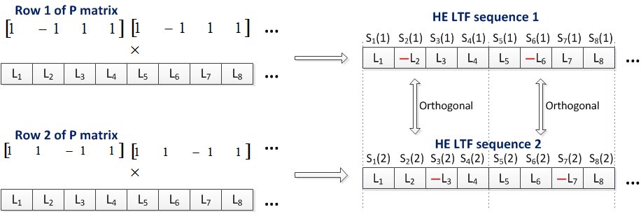
Generating LTF sequences
Generated from P matrix
  Scramble a common sequence by different rows of P matrix
Piecewise orthogonal
  Sub-sequences with any K (e.g. 4) contiguous entries are orthogonal

Slide 13


Cyclic Orthogonality
Orthogonal sequences of any length can be generated by exploiting cyclic orthogonality among P matrix rows
  E.g. 2 users with 26 tones and K=4
[1 -1]
X
X
X
User 1
L1 | L2 | L3 | L4
…
L21 | L22 | L23 | L24
L25 | L26
[1 1]
X
X
X
User 2
L1 | L2 | L3 | L4
…
L21 | L22 | L23 | L24
L25 | L26
orthogonal

Slide 14
Orthogonal Tone Blocks
By exploiting cyclic orthogonality, we have many orthogonal tone blocks generating data samples for CFO estimation
User 1
S1(1) | S1(2) | S1(3) | S1(4) | S1(5) | S1(6) | S1(7) | S1(8) | S1(9)
…
User 2
S2(1) | S2(2) | S2(3) | S2(4) | S2(5) | S2(6) | S2(7) | S2(8) | S2(9)
…
Orthogonal tone block 1
Orthogonal tone block 2
…

Slide 15
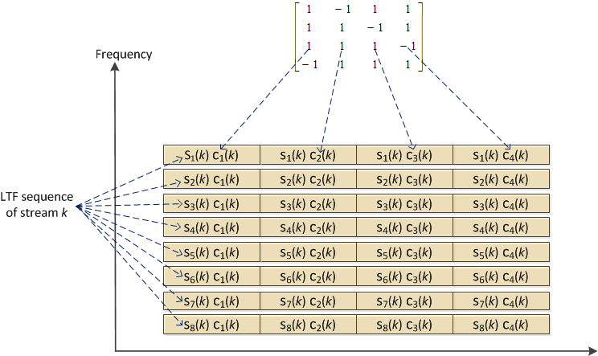
LTF symbols of stream k
Stream index
S_{i}(k) C_{j}(k)
Subcarrier index
LTF symbol index
Subcarrier 1
Subcarrier 2
Time
LTF symbol 1
LTF symbol 2

Slide 16
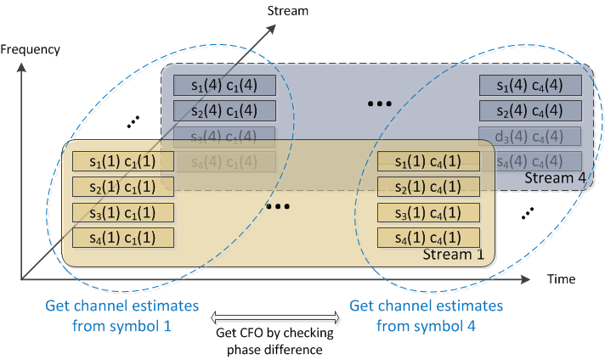
LTF symbols of multiple streams
Orthogonal sequences are applied to different streams on each tone block
Orthogonal sequences

Slide 17
CFO Estimation
Channel remains roughly unchanged (i.e. correlated) over tone block but varies over time due to CFO
Phase rotation across LTF symbols is observed from each tone block
Phase rotation is averaged over tone blocks and Rx antennas
Averaged rotation rate is the CFO estimate
Orthogonal sequences

Slide 18
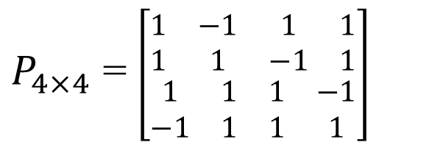
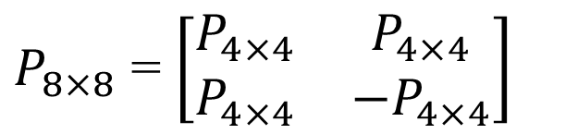
One P matrix for all
Since the 8x8 P matrix consists of orthogonal 2x2 and 4x4 sub-matrixes, we can use the rows of 8x8 P matrix to define LTF sequences for up to 8 streams
$P_{8×8}$ = $\left[\begin{matrix}P_{4×4} & P_{4×4} \\ P_{4×4} & {−P}_{4×4}\end{matrix}\right]$
$P_{4×4}$ = $\left[\begin{matrix}\begin{matrix}1 & −1 \\ 1 & 1\end{matrix} & \begin{matrix}1 & 1 \\ −1 & 1\end{matrix} \\ \begin{matrix}1 & 1 \\ −1 & 1\end{matrix} & \begin{matrix}1 & −1 \\ 1 & 1\end{matrix}\end{matrix}\right]$

Slide 19
Simulation Assumptions
Uplink MU-MIMO
8 Rx antennas at AP, 4/6 STAs each sending 1 stream
MCS7/MCS4; 20 MHz bandwidth; ChDNLoS/UMiNLoS
CFO error is modeled as +CFO/-CFO with fixed value
Timing offset is uniformly distributed over [0, T_{off} ns] for each STA
CSD value follows 11ac & 11ax larger CSD(TBD)
Per STA pilot tracking is enabled
CFO is estimated and compensated for the proposed new LTF sequence
Channel smoothing is not applied
4x/2x (3.2us/1.6us GI) LTF is used

Slide 20
CFO Tolerance
Tolerate +/- 400 Hz CFO within negligible degradation to ideal and >3 dB improvement over legacy

Slide 21
Timing Offset Tolerance
3 dB
Within 1 dB
Tolerate 1 μs timing offset at 10% PER with sub-dB degradation to ideal and 3 dB improvement over legacy

Slide 22
Robust to Frequency Selectivity
Work fine in outdoor channels

Slide 23
With per-stream CSD
Work fine with CSD

Slide 24
2x LTF
Work fine with 2x LTFs

Slide 25
Summary
The CFO problem in UL MU-MIMO can be solved by assigning orthogonal LTF sequences to different streams
  Optimal performance
  Maximum reuse of legacy design
  Low complexity
Propose to use the rows of 8x8 P matrix as the masking sequences for generating the orthogonal HE-LTF sequences for UL MU-MIMO

Slide 26
Reference
[1] “Specification Framework for Tgax,” doc.: IEEE 802.11-15/0132r4, Section 3.2, March 2015
Qinghua Li, Xiaogang Chen, et al.

Slide 27
Straw Poll
Do you agree generating the HE-LTF sequences for UL MU-MIMO as follows?
  For each stream, a common sequence is masked repeatedly by a distinct row of the 8x8 P matrix. The last M elements of the LTF sequence, where M is less than 8, are masked by the first M elements of the P matrix row.
  Yes
  No
  Abstain
Qinghua Li, Xiaogang Chen, et al.

