Slide 1
Non-Uniform Constellations for 64-QAM
Date: 2015/05/11
Authors:

Slide 2
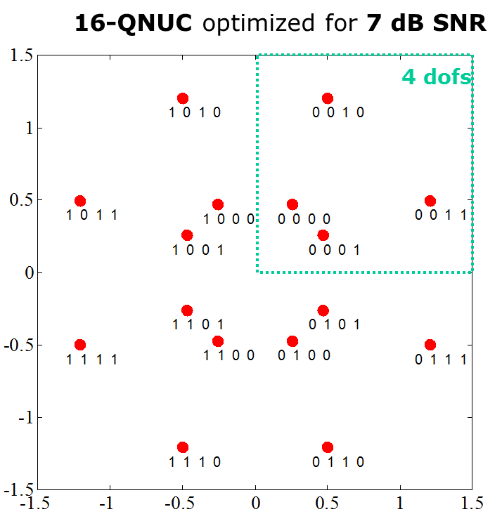
Motivation
Higher order QAMs discussed in e.g. [1]-[4] as potential technology for 802.11ay
OFDM: 128-QAM, 256-QAM (up to 64-QAM in ad)
SC: 64-QAM (up to 16-QAM in ad)
Non-uniform constellations (NUCs) provide increased performance compared to uniform constellations (UCs) [3]-[4]
Especially for higher order QAMs [3]
Gain up to 0.7dB for 256-QAM (OFDM)
APSK for 64-QAM (SC) [4]
Moderate (2D NUC) or no (1D NUC) increase in demapper complexity
1-D NUC: 16-QAM
2-D NUC: 16-QAM

Slide 3
Outline
NUCs for 64-QAM and single carrier (SC) modulation
Performance results
AWGN channel with and without phase noise

Slide 4
NUCs for 64-QAM
2-dimenionsal (2D) NUCs
Improved performance compared to 1D NUCs
Reasonably demapper complexity (especially for < 256-QAM)
Quadrant symmetry
Different NUCs for each code rate
Optimized for operating point of FEC with specific code rate
Bit labeling optimized
Matches optimally to existing .11 WLAN system
No changes at FEC or other blocks required
No need for a dedicated bit interleaver

Slide 5
64-QAM NUCs
CR=1/2
CR=5/8
Details of
constellation
points and
bit labeling
see Appendix
CR=3/4
CR=13/16
Bit labeling: $b_{0}…b_{5}$:
See Appendix

Slide 6
Simulations Parameters
Regular UCs and NUCs
Single carrier modulation
Focus on 64-QAM
Message Length: 1000bytes
Channel: AWGN
AWGN (channel is very close to AWGN in the LOS case)
With and without phase noise
Phase noise model according to .11ad evaluation methodology [5]
Gain compared to UC evaluated at FER=10⁻²
modulation | bit/symbol | coderate
64-QAM | 6 | 1/2
64-QAM | 6 | 5/8
64-QAM | 6 | 3/4
64-QAM | 6 | 13/16

Slide 7
Simulation Results: without phase noise
Up to 0.4dB gain

Slide 8
Simulation Results: with phase noise (PN)
Different demappers
Regular demapper
Demapper which takes PN into account
No influence
of PN aware
demapper
NUC gain
without PN
with PN

Slide 9
Simulation Results: with phase noise (PN)
Increased NUC gain in the presence of phase noise

Slide 10
Conclusions
Investigation of non-uniform constellation for 64-QAM
~0.4dB gain compared to uniform constellations
Simulations in the presence of phase noise
NUC gain is maintained or even increased
~0.5dB gain compared to uniform constellations
Optimization of QAM promising technology for .11ay
Improved performance
Moderate complexity increase
Next steps: further optimizations of NUCs

Slide 11
References
11-14-1378-00-ng60 PHY rate for NG60
11-14-0652-00-0wng-wng Next Generation 802.11ad
11-15-0096-01-ng60 Non-uniform Constellations for higher Order QAMs
11-15-0339-00-ng60 SC-64APSK for 11ay
11-09-0296-16-00ad Evaluation Methodology

Slide 12
Appendix

Slide 13
NUC: 1-D vs 2D
1-D NUC: 16-QAM
1-D NUC
I/Q symmetry
1-D demapping as for uniform constellations (UC), i.e. same demapping complexity as for regular QAMs
2-D NUC
Symmetric quadrants
Higher gain compared to 1-D NUC
2-D demapping required
2-D NUC: 16-QAM

Slide 14
64-QAM NUC Definition Code rate 1/2

Slide 15
64-QAM NUC Definition Code rate 5/8

Slide 16
64-QAM NUC Definition Code rate 3/4

Slide 17
64-QAM NUC Definition Code rate 13/16

