Slide 1
U-APSD Enhancements for HE
Date: 2015-04-30
Authors:

Slide 2
Abstract
In March 2015 meeting, submission 15-0326r0 presented two enhancements to U-APSD [1].
This submission presents simulation results to justify the enhancements.

Slide 3
Recap of enhancement 1
AP could end the service period with an acknowledgement frame
  EOSP bit included to ACK or BA frame
AP could end the service period if:
  STA has indicated (more bit) in the data PDU that it has no more UL data and
  AP has no more DL data in its buffers
Gains
  The number of transmitted frames in U-APSD traffic flow is reduced (= less overhead)
  The STA needs to operate shorter time in Awake state (= more power save)

Slide 4
Example of data flow with current U-APSD
In the current U-APSD operation, the transmission of EOSP field in QoS-Null frame may be delayed due to transmissions of other STAs
Depending on the case, this may seriously delay the beginning of operation in Doze state

Slide 5
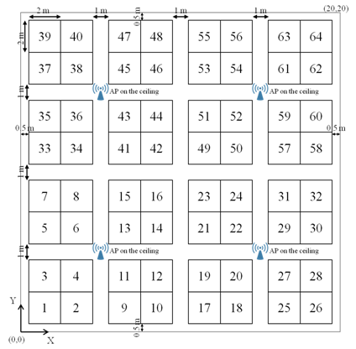
Simulation scenario
A subset of 11ax scenario 2
  2 laptops (STA) and 2 wireless monitors (AP)
Laptops stream UDP 4k video to the corresponding monitors
  250Mbps with 50 packets per second
2x2 MIMO, 80MHz, 256QAM 5/6, TxP 10dBm

Slide 6
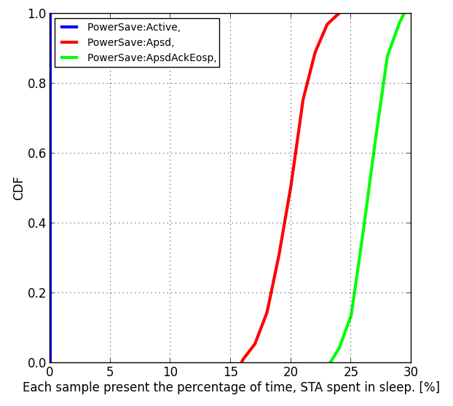
Simulation results
In all the simulation drops, all the data (2x250Mbps) was served
Normal U-APSD and U-APSD with EOSP in ACK have large difference in the proportion of time spent in Doze state

Slide 7
Recap of enhancement 2
STA could control the initiation of the service period
  A trigger / no-trigger field is included to the trigger frame
In many cases, this is results to the same data flow as EOSP in ACK
  In co-existence cases a STA may, the control the operating time in BSS with trigger field
  This is useful in concurrent operation, e.g. when STA should switch to P2P network

Slide 8
Summary
The U-APSD enhancements make power save performance more reliable and tolerable to other STAs transmissions
The U-APSD enhancements are simple and increase the time STAs can operate in sleep state

Slide 9
References
[1] 11-15-0326r0 - U-APSD Enhancements for HE

Slide 10
Strawpoll
Do you agree that the presented U-APSD enhancements reduce power consumption of a non-AP STA in the presented scenario?

