Slide 1
802.11ax Preamble Design and Auto-detection-r4
Date: 2015-09-12
Authors:
Name | Affiliation | Address | Phone | Email
Hongyuan Zhang | Marvell | 5488 Marvell Lane, Santa Clara, CA, 95054 | 408-222-2500 | hongyuan@marvell.com
Yakun Sun |  |  |  | yakunsun@marvell.com
Lei Wang |  |  |  | Leileiw@marvell.com
Liwen Chu |  |  |  | liwenchu@marvell.com
Jinjing Jiang |  |  |  | jinjing@marvell.com
Yan Zhang |  |  |  | yzhang@marvell.com
Rui Cao |  |  |  | ruicao@marvell.com
Bo Yu |  |  |  | jiehuang@marvell.com
Sudhir Srinivasa |  |  |  | sudhirs@marvell.com
Saga Tamhane |  |  |  | sagar@marvell.com
Mao Yu |  |  |  | my@marvel..com
Edward Au |  |  |  | edwardau@marvell.com
Hui-Ling Lou |  |  |  | hlou@marvell.com

Slide 2
Authors (continued)
Name | Affiliation | Address | Phone | Email
Albert Van Zelst | Qualcomm | Straatweg 66-S Breukelen, 3621 BR Netherlands |  | allert@qti.qualcomm.com
Alfred Asterjadhi |  | 5775 Morehouse Dr. San Diego, CA, USA |  | aasterja@qti.qualcomm.com
Arjun Bharadwaj |  | 5775 Morehouse Dr. San Diego, CA, USA |  | arjunb@qti.qualcomm.com
Bin Tian |  | 5775 Morehouse Dr. San Diego, CA, USA |  | btian@qti.qualcomm.com
Carlos Aldana |  | 1700 Technology Drive San Jose, CA 95110, USA |  | caldana@qca.qualcomm.com
George Cherian |  | 5775 Morehouse Dr. San Diego, CA, USA |  | gcherian@qti.qualcomm.com
Gwendolyn Barriac |  | 5775 Morehouse Dr. San Diego, CA, USA |  | gbarriac@qti.qualcomm.com
Hemanth Sampath |  | 5775 Morehouse Dr. San Diego, CA, USA |  | hsampath@qti.qualcomm.com
Menzo Wentink |  | Straatweg 66-S Breukelen, 3621 BR Netherlands |  | mwentink@qti.qualcomm.com
Richard Van Nee |  | Straatweg 66-S Breukelen, 3621 BR Netherlands |  | rvannee@qti.qualcomm.com
Rolf De Vegt |  | 1700 Technology Drive San Jose, CA 95110, USA |  | rolfv@qca.qualcomm.com
Sameer Vermani |  | 5775 Morehouse Dr. San Diego, CA, USA |  | svverman@qti.qualcomm.com
Simone Merlin |  | 5775 Morehouse Dr. San Diego, CA, USA |  | smerlin@qti.qualcomm.com
Tevfik Yucek |  | 1700 Technology Drive San Jose, CA 95110, USA |  | tyucek@qca.qualcomm.com
VK Jones |  | 1700 Technology Drive San Jose, CA 95110, USA |  | vkjones@qca.qualcomm.com
Youhan Kim |  | 1700 Technology Drive San Jose, CA 95110, USA |  | youhank@qca.qualcomm.com

Slide 3
Authors (continued)
Name | Affiliation | Address | Phone | Email
Robert Stacey | Intel | 2111 NE 25th Ave, Hillsboro OR 97124, USA | +1-503-724-893 | robert.stacey@intel.com
Eldad Perahia |  |  |  | eldad.perahia@intel.com
Shahrnaz Azizi |  |  |  | shahrnaz.azizi@intel.com
Po-Kai Huang |  |  |  | po-kai.huang@intel.com
Qinghua Li |  |  |  | quinghua.li@intel.com
Xiaogang Chen |  |  |  | xiaogang.c.chen@intel.com
Chitto Ghosh |  |  |  | chittabrata.ghosh@intel.com
Laurent cariou |  |  |  | laurent.cariou@intel.com
Rongzhen Yang |  |  |  | rongzhen.yang@intel.com
Ron Porat | Broadcom |  |  | rporat@broadcom.com
Matthew Fischer |  |  |  | mfischer@broadcom.com
Sriram Venkateswaran
Andrew Blanksby
Matthias Korb
Tu Nguyen
Vinko Erceg

Slide 4
Authors (continued)
Name | Affiliation | Address | Phone | Email
James Yee | Mediatek | No. 1 Dusing 1st Road, Hsinchu, Taiwan | +886-3-567-0766 | james.yee@mediatek.com
Alan Jauh |  |  |  | alan.jauh@mediatek.com
Chingwa Hu |  |  |  | chinghwa.yu@mediatek.com
Frank Hsu |  |  |  | frank.hsu@mediatek.com
Thomas Pare | Mediatek USA | 2860 Junction Ave, San Jose, CA 95134, USA | +1-408-526-1899 | thomas.pare@mediatek.com
ChaoChun Wang |  |  |  | chaochun.wang@mediatek.com
James Wang |  |  |  | james.wang@mediatek.com
Jianhan Liu |  |  |  | Jianhan.Liu@mediatek.com
Tianyu Wu |  |  |  | tianyu.wu@mediatek.com
Russell Huang |  |  |  | russell.huang@mediatek.com
Joonsuk Kim | Apple |  |  | joonsuk@apple.com
Aon Mujtaba |  |  |  | mujtaba@apple.com
Guoqing Li |  |  |  | guoqing_li@apple.com
Eric Wong |  |  |  | ericwong@apple.com
Chris Hartman |  |  |  | chartman@apple.com

Slide 5
Authors (continued)
Name | Affiliation | Address | Phone | Email
Phillip Barber | Huawei | The Lone Star State, TX |  | pbarber@broadbandmobiletech.com
Peter Loc |  |  |  | peterloc@iwirelesstech.com
Le Liu |  | F1-17, Huawei Base, Bantian, Shenzhen | +86-18601656691 | liule@huawei.com
Jun Luo |  | 5B-N8, No.2222 Xinjinqiao Road, Pudong, Shanghai |  | jun.l@huawei.com
Yi Luo |  | F1-17, Huawei Base, Bantian, Shenzhen | +86-18665891036 | Roy.luoyi@huawei.com
Yingpei Lin |  | 5B-N8, No.2222 Xinjinqiao Road, Pudong, Shanghai |  | linyingpei@huawei.com
Jiyong Pang |  | 5B-N8, No.2222 Xinjinqiao Road, Pudong, Shanghai |  | pangjiyong@huawei.com
Zhigang Rong |  | 10180 Telesis Court, Suite 365, San Diego, CA 92121 NA |  | zhigang.rong@huawei.com
Rob Sun |  | 303 Terry Fox, Suite 400 Kanata, Ottawa, Canada |  | Rob.Sun@huawei.com
David X. Yang |  | F1-17, Huawei Base, Bantian, Shenzhen |  | david.yangxun@huawei.com
Yunsong Yang |  | 10180 Telesis Court, Suite 365, San Diego, CA 92121 NA |  | yangyunsong@huawei.com
Zhou Lan |  | F1-17, Huawei Base, Bantian, SHenzhen | +86-18565826350 | Lanzhou1@huawei.com
Junghoon Suh |  | 303 Terry Fox, Suite 400 Kanata, Ottawa, Canada |  | Junghoon.Suh@huawei.com
Jiayin Zhang |  | 5B-N8, No.2222 Xinjinqiao Road, Pudong, Shanghai | +86-18601656691 | zhangjiayin@huawei.com

Slide 6
Authors (continued)
Name | Affiliation | Address | Phone | Email
Hyeyoung Choi | LG Electronics | 19, Yangjae-daero 11gil, Seocho-gu, Seoul 137-130, Korea |  | hy0117.choi@lge.com
Kiseon Ryu |  |  |  | kiseon.ryu@lge.com
Jinyoung Chun |  |  |  | jiny.chun@lge.com
Jinsoo Choi |  |  |  | js.choi@lge.com
Jeongki Kim |  |  |  | jeongki.kim@lge.com
Giwon Park |  |  |  | giwon.park@lge.com
Dongguk Lim |  |  |  | dongguk.lim@lge.com
Suhwook Kim |  |  |  | suhwook.kim@lge.com
Eunsung Park |  |  |  | esung.park@lge.com
HanGyu Cho |  |  |  | hg.cho@lge.com
Thomas Derham | Orange |  |  | thomas.derham@orange.com
Bo Sun | ZTE | #9 Wuxingduan, Xifeng Rd., Xi'an, China |  | sun.bo1@zte.com.cn
Kaiying Lv |  |  |  | lv.kaiying@zte.com.cn
Yonggang Fang |  |  |  | yfang@ztetx.com
Ke Yao |  |  |  | yao.ke5@zte.com.cn
Weimin Xing |  |  |  | xing.weimin@zte.com.cn
Brian Hart | Cisco Systems | 170 W Tasman Dr, San Jose, CA 95134 |  | brianh@cisco.com
Pooya Monajemi |  |  |  | pmonajem@cisco.com

Slide 7
Authors (continued)
Name | Affiliation | Address | Phone | Email
Fei Tong | Samsung | Innovation Park, Cambridge CB4 0DS (U.K.) | +44 1223 434633 | f.tong@samsung.com
Hyunjeong Kang |  | Maetan 3-dong; Yongtong-Gu Suwon; South Korea | +82-31-279-9028 | hyunjeong.kang@samsung.com
Kaushik Josiam |  | 1301, E. Lookout Dr, Richardson TX 75070 | (972) 761 7437 | k.josiam@samsung.com
Mark Rison |  | Innovation Park, Cambridge CB4 0DS (U.K.) | +44 1223 434600 | m.rison@samsung.com
Rakesh Taori |  | 1301, E. Lookout Dr, Richardson TX 75070 | (972) 761 7470 | rakesh.taori@samsung.com
Sanghyun Chang |  | Maetan 3-dong; Yongtong-Gu Suwon; South Korea | +82-10-8864-1751 | s29.chang@samsung.com
Yasushi Takatori | NTT | 1-1 Hikari-no-oka, Yokosuka, Kanagawa 239-0847 Japan |  | takatori.yasushi@lab.ntt.co.jp
Yasuhiko Inoue |  |  |  | inoue.yasuhiko@lab.ntt.co.jp
Yusuke Asai |  |  |  | asai.yusuke@lab.ntt.co.jp
Koichi Ishihara |  |  |  | ishihara.koichi@lab.ntt.co.jp
Akira Kishida |  |  |  | kishida.akira@lab.ntt.co.jp
Akira Yamada | NTT DOCOMO | 3-6, Hikarinooka, Yokosuka-shi, Kanagawa, 239-8536, Japan |  | yamadaakira@nttdocomo.com
Fujio Watanabe |  | 3240 Hillview Ave, Palo Alto, CA 94304 |  | watanabe@docomoinnovations.com
Haralabos Papadopoulos |  |  |  | hpapadopoulos@docomoinnovations.com

Slide 8
Introduction
Background
  Based 802.11ax SFD [1]:
    An HE PPDU shall include the legacy preamble (L-STF, L-LTF and L-SIG), duplicated on each 20 MHz, for backward compatibility with legacy devices.
    HE-SIG-A and HE-SIG-B fields are included
LSTF
8us
LLTF
8us
LSIG 4us
HE Data Payload
(4x Symbol Duration (GI+12.8us)
Legacy Preamble
HE-Preamble
Highlights of this contribution
  Focus on the 11ax packet autodetection design;
  Propose an LSIG repetition based 11ax packet autodetection scheme.

Slide 9
Desired Attributes of 11ax Preamble Design for 11ax Packet Autodetection
Robust autodetection:
  Backward compatible, allowing legacy spoofing
  High reliability in
    – Dense deployments with high interference
    – All 11ax channels of interests, including outdoor UMI channels.
  Very low false triggers
Early autodetection:
  Differentiate from 11a/n/ac packets as early as possible, to reduce the number of different hypotheses at the receiver.
Simple and unified design

Slide 10
Existing 802.11 OFDM Packet Classifications
Auto-detection based on QBPSK Detection
BPSK
LSTF
(8 usec)
LLTF
(8 usec)
LSIG
(4 usec)
Data
QBPSK
11a
11n-MM
LSTF
(8 usec)
LLTF
(8 usec)
LSIG
(4 usec)
HT-SIG1
HT-SIG2
…
11n-GF
HT-STF
(8 usec)
HT-LTF1
(8 usec)
HT-SIG1
HT-SIG2
…
11ac
LSTF
(8 usec)
LLTF
(8 usec)
LSIG
(4 usec)
VHT-SIGA1
VHT-SIGA2
…
LSTF
(8 usec)
LLTF
(8 usec)
LSIG
(4 usec)
?
11ax

Slide 11
Proposed 11ax Packet Format
Use LSIG repetition for 11ax packet autodetection, i.e,
  Having a 4us symbol repeating the LSIG content, in the 11ax preamble right after the legacy section
  Modulating the R-LSIG (LSIG repetition ) symbol with BPSK and rate ½ BCC.
  The next symbol (HE-SIGA) after RLSIG is also BPSK, legacy devices will detect the packet as 11a/g.
Discussed in separate contributions
BPSK GI=0.8us
BPSK GI=0.8us
BPSK
L-STF
8us
L-LTF
8us
L-SIG 4us
R-LSIG 4us
HE-SIGA
HE-SIGB
(DL)
HE-STF
HE-LTFs
……..
Legacy Preamble
HE-Preamble

Slide 12
Example of Detection Procedure at Rx
Step-1: LSIG and RLSIG repetition detection.
Step-2: LSIG and RLSIG MRC, and demodulate/decode.
Step-3: Content Check: e.g. Parity bit, Rate=6Mbps and L-LENGTH!=3x.
When both steps 1 and 3 passes, 11ax is detected, otherwise jump back to 11a/n/ac state machine.
Note that steps 2 and 3 are required as part of the packet decoding anyways (similar to 11ac)!

Slide 13
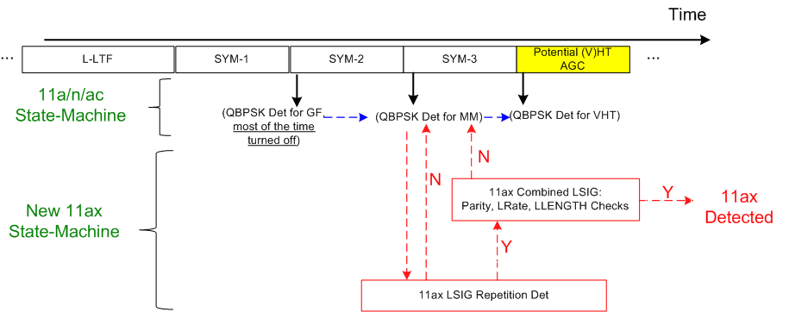
Illustration of the achieved Early 11ax Detection
Early 11ax detection
  • LSIG Rep detection + LSIG Content check finishes approx at 3us after end of R-LSIG
  • Before the potential (V)HT-STF field in 11n/ac
  • No need to revise the old 11a/n/ac detection state-machine.
In the case of repetition false trigger, receiver may still fall back to conventional 11n/ac state-machine on time (for AGC) .

Slide 14
Other Benefits
Reliable detection performance: miss detection is lower than the error rate of combined LSIG+RLSIG field, and with very low false detection probability.
  Refer to the simulation results in subsequent slides.
Improve LSIG field error rate: therefore beneficial for the following cases
  Outdoor (UMI channel).
  High density low SINR.
    Reduce the chance of collision (more reliable CCA determination), therefore reducing the extra overhead caused by re-transmissions.
  Reducing LSIG false positive probability at 11ax receivers.
  Enabling possible range extension.

Slide 15
On Detection Algorithm
It is recommended to conduct the repetition detection in frequency domain (post FFT).
  For better performance.
There are multiple ways of frequency domain repetition detection, some of which are simple and get reliable miss and false detection performances.
  Refer to simulation results.
The LSIG content check (after combining) happens right after the repetition check, therefore serves as an additional checksum.

Slide 16
Simulation Setup
20 MHz.
1/2/4Tx, and 1Rx antennas
UMi-NLOS, and DNLOS channels
  Ensemble normalized
CSD values per Antenna (2/4Tx)
  [0, -50, -100, -150]ns as 11ac
  Or [0, -50, -100, -150]*2 ns
Actual 40ppm CFO and phase/CFO tracking
Actual timing.

Slide 17
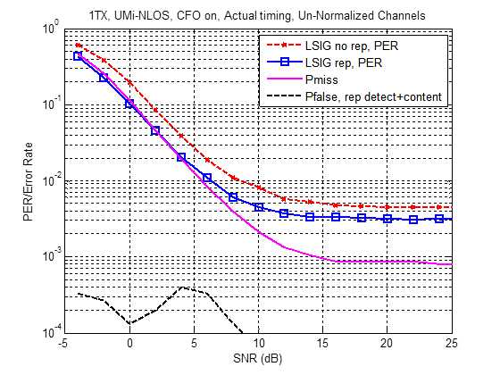
1x1, UMI

Slide 18
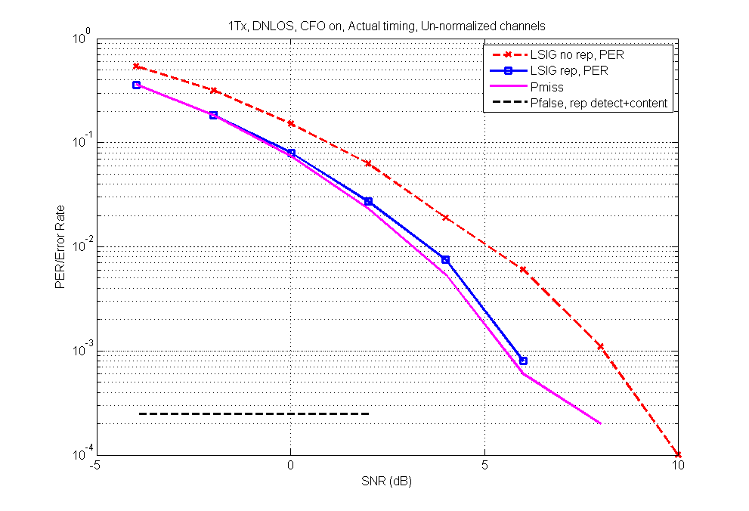
1x1 DNLOS

Slide 19
2x1, UMI
No false trigger happens for 2Tx + 11ac per-antenna CSD.
11ac per-ant CSD values works fine for 2Tx.

Slide 20
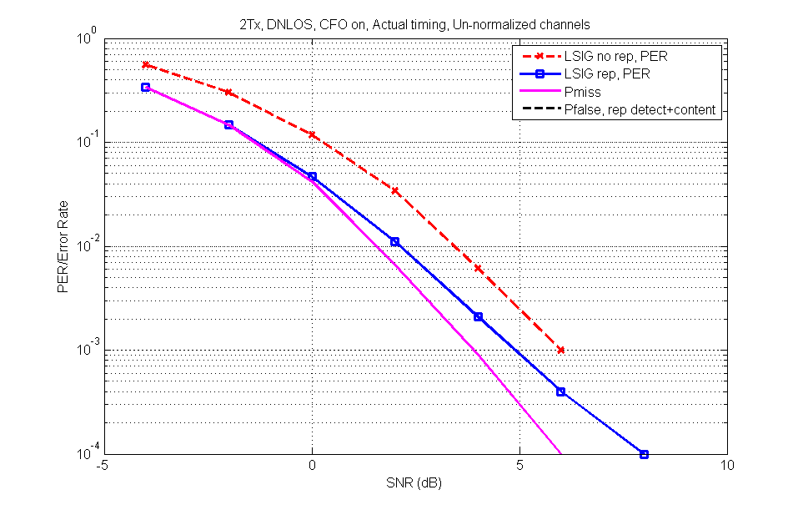
2x1 DNLOS
(Pfalse = 0)

Slide 21
4x1 UMI
11ac per-antenna CSD Value
2x 11ac per-antenna CSD Value
2x CSD values improves detection and decoding performances.
Miss and False triggering probability are still very low for both CSD values.

Slide 22
v1-Updates
The following comments were received when we presented v0 in May meeting:
  Efficiency: “waste” one symbol (RLSIG) solely for autodetection.
  False Detection probability (also discussed by [4])
  Future Extend-ability: How to design future PHY amendments.
Address these comments in subsequent slides.

Slide 23
Benefits of RLSIG
Autodetection:
  Early detection to reduce number of hypothesis during preamble processing.
  Reliable detection performance (see simulations).
Outdoor Reliability, and Range Extension:
  As in [2][3], we prefer a unified normal SIGA design with 2 OFDM symbols, while allowing a SIGA “diversity-repetition” mode for range extension.
  In 11n/11ac, the preamble performance is limited by decoding error of VHT-SIGA.
  In 11ax, RLSIG & SIGA repetition in [3], enables 3~5dB or even higher improvement over 11ac preamble (depending on implementation) for SU.
    Considering 11ac data portion (e.g. MCS0, 20MHz, 32bytes), or 11ax by applying more advanced Tx/Rx implementations (e.g. STF/LTF Boost [3]), the gap could be even larger.
    See Sim results in subsequent slides
  Benefit outdoor and indoor range extension (e.g. for IoT applications), for both 2.4GHz and 5GHz.

Slide 24
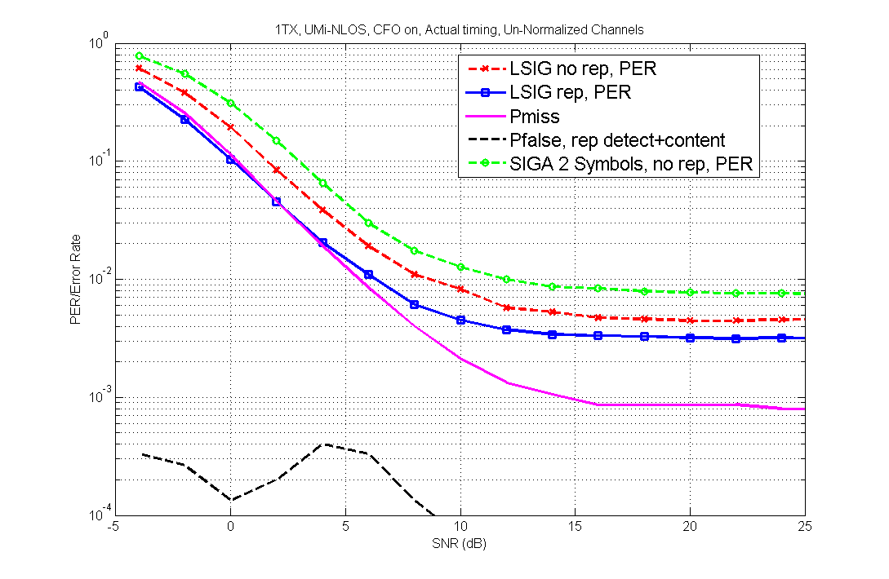
Results-1
UMI-1x1
>5dB Gap @ 1% PER

Slide 25
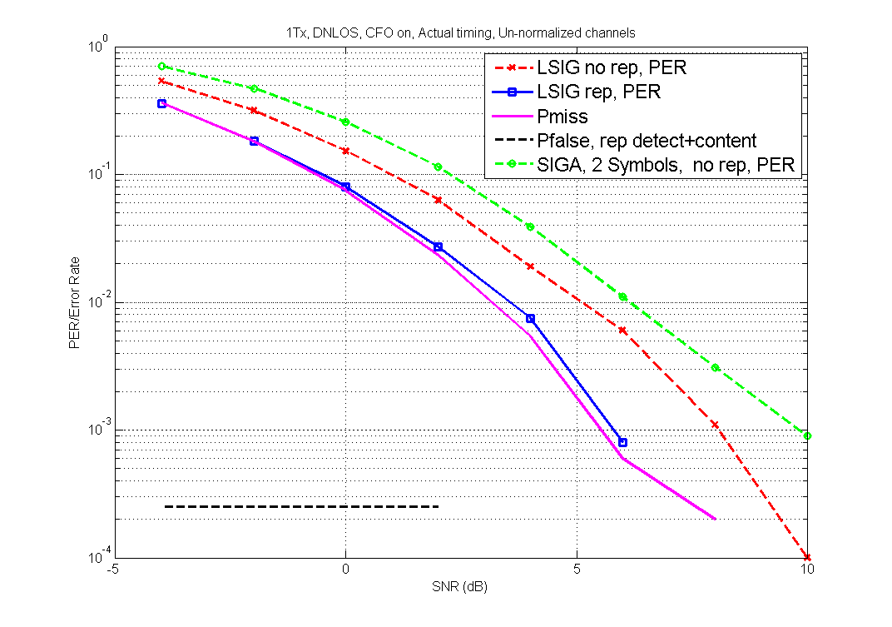
Results-2
DNLOS-1x1
~3dB Gap @ 1% PER

Slide 26
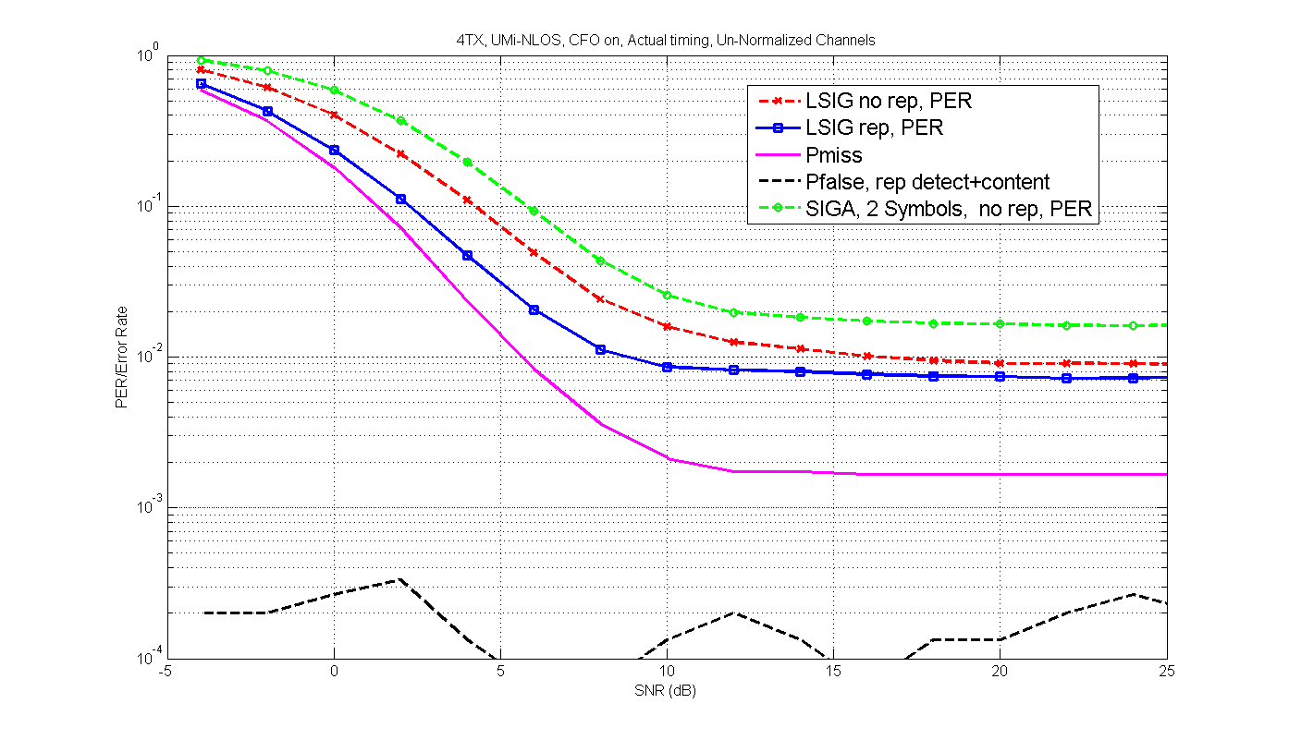
Results-3
UMI-4x1-11ac CSD
5dB Gap @ 10% PER

Slide 27
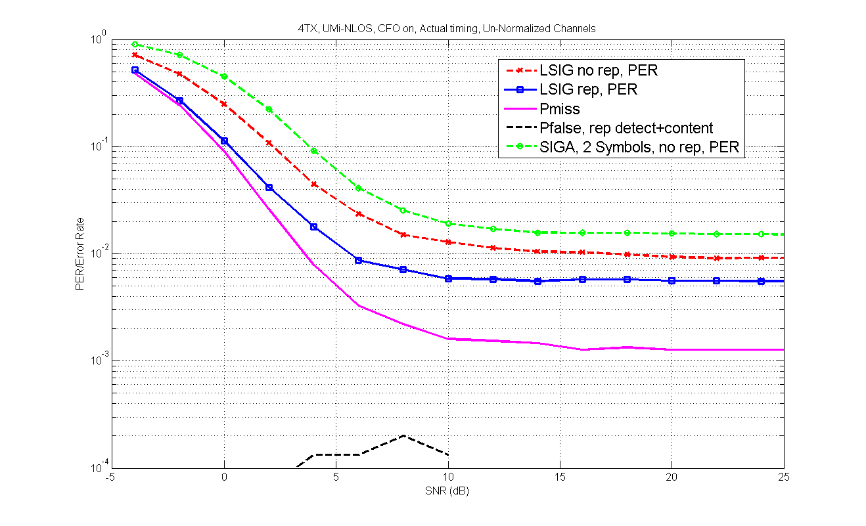
Results-4
UMI-4x1- 2 x 11ac CSD
4dB Gap @ 10% PER

Slide 28
False Detection (1)
11ax classification will detect the repetition of LSIG/RLSIG, and then check content.
A potential 11a packet may cause false triggering if:
  “Combined” LSIG can pass 11ax content check;
  A legitimate first 11a data symbol as below and scrambled by one out of 127 scrambler seed;
  LSIG and the first data symbols needs to be alike to pass repetition check.
Rate
Rsvd
LENGTH
Parity
Tail
1101
0
32~2304 Bytes, and not divided by 3
Even parity
000000
Service (16bits)
Protocol Version
Type
Subtype
0x0
00
00/01/10
0000~1111

Slide 29
False Detection (2)
How Alike 11a LSIG and 1st Data Symbol Are?
Check the Hamming distance of coded bits for a pair of 11ax-content-consistent LSIG symbols and 11a first data symbols.
  The smaller distance, the larger probability of passing repetition check.
Look at the distribution of Hamming distances between all pairs of LSIG and data symbol (~3 million cases).
  Minimal Hamming distance of 5 → 10^-4 @ HD=10.
  Probability of Hamming distance no larger than 8 (more than 20% of identical bits) is about 2x10⁻⁵→ already a very low probability of two symbols alike.
  We applied a rep detection with a constant threshold corresponding to Hamming distance of 8 at high SNR, so the false trigger at very high SNR is only 2x10⁻⁵ even without content check.

Slide 30
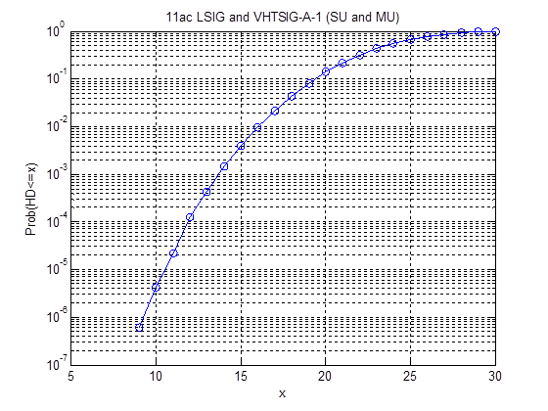
False Detection (3)
Similarly, to check We did another brute force check for 11ac LSIG+VHTSIGA1:
  LSIG: 6Mbps, L-LENGTH%3=0
  VHTSIG-A-1: SU with GID=0 or 63, MU with legitimate Nsts fields (each Nsts <=4, all Nsts sum <=8).
Minimal HD is 9, much larger than 11a, a threshold equivalent to HD=8 will lead to zero Pfalse at high SNR.
  Or equivalently 10^-4 @ HD=12.
Therefore the 11ac false detection to 11ax as mentioned in [4] won’t be an issue

Slide 31
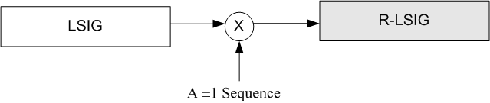
Future “Extend-ability”
Future PHYs are highly dependent on the scope of the future PARs.
  Example-1: For a “higher throughput” PAR, we may design preamble on top of 11ac.
  Example-2: For a “longer range” PAR, we may redesign a new “long range” preamble.
Even assuming we need another “high efficiency & outdoor” PAR similar to 11ax in the future, the current autodetection method is still very extendable.
  Example: in the future amendment, RLSIG may be scrambled by a known sequence on the data tones, while this sequence has a very large hamming distance (HD) from the 11ax RLSIG.
    Negligible false detection as 11ax (by using large HD design).
    Negligible increase on false detection as legacy 11a/n/ac.

Slide 32
v4-Updates
The following comments were received when we presented v1 in July meeting:
  11ac false triggering 11ax RLSIG detection was an issue, large false triggering at high SNR.
  Repetition detection algorithm.
  Content check.
Address these comments in subsequent slides.

Slide 33
1. Simulations for 11ac False Trigger
Add 11ac false trigger prob on top of earlier results.
11ac preamble false triggering 11ax is newly simulated.
  11ac-LSIG: rate = 6Mbps, reserved bit = 0, length %3 = 0 (see 11ac spec).
  11ax-LSIG: rate = 6Mbps, reserved bit = 0, length %3 = 1 or 2.
10000 (DNLOS) to 15000 realization each SNR.
LLTF CE is smoothed, actual timing, actual phase tracking & CFO tracking.
In general, 11ac→11ax false triggering is slightly better than 11a→11ax.

Slide 34
1x1, DNLOS
Pmiss only considers
repetition detection
11ac false trigger is
slight lower than 11a

Slide 35
1x1, UMi
Pmiss only considers
repetition detection
11ac false trigger is
slight lower than 11a

Slide 36
4x1, UMi (1x 11ac CSD Value)
Pmiss only considers
repetition detection
11ac false trigger is
slight lower than 11a

Slide 37
4x1, UMi (2x 11ac CSD Value)
Pmiss only considers
repetition detection
11ac false trigger is
slight lower than 11a

Slide 38
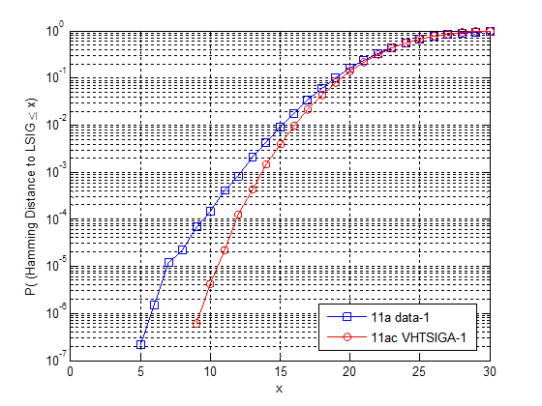
Analysis
Assuming a constant repetition detection threshold, the Hamming Distance (HD) reflects the “tails” of false triggering when SNR goes higher (e.g. >20dB).
We found 11ac LSIG+VHTSIGA1 has larger HD, than the 11a cases—this is reflected by the slightly better false trigger prob in the sims.
Equivalent Threshold that we used
in the sims
HD=12 (11ac) vs HD=10 (11a)
@10^-4

Slide 39
Analysis—Cont’d
Furthermore, 11ac has L-LENGTH being 3x bytes, while we propose 11ax to use L-LENGTH%3=1 or 2, this will further help reducing false trigger after the content check.

Slide 40
2. Repetition Detection Algorithm
[4] mentioned that repetition detection causes large false trigger even at high SNR.
  Plain correlation of freq domain signal (after removing the channel effect) was applied.
There are multiple methods to compare the “similarity” tone-by-tone on the raw signal (without removing channel) between LSIG and the next symbol!
  We chose a simple method with very high accuracy, and low complexity.
  Enabled us to use a low and constant threshold (equivalent HD=8 at high SNR).
  On the other hand, the correlation method is not only more complex, it also requires a much larger threshold, causing large false trigger probability even for high SNR.

Slide 41
3. Content Check
LSIG field content check is part of the decoding process, regardless of auto-detection or not.
  For example, 11n/11ac also conduct LSIG content check to qualify an (V)HT packet before even doing the QBPSK detections.
In RLSIG proposal, the content check happens to start right after repetition check, therefore helps further reducing the false trigger prob.
However, content check is NOT the major reason that brings down our false trigger prob, repetition det with a low threshold is still the most important factor!
  Refer to the Hamming Distance analysis in slide 38.

Slide 42
Content Check—cont’d
Propose L-LENGTH in LSIG and RLSIG NOT being multiple of 3 (L-LENGTH%3 = 1 or 2).
  Different from 11ac.
  Helps differentiate 11ax preamble from 11ac preamble, further reducing false triggering.
  Use L-LENGTH%3 = 1 or 2 as an early indication bit (to signal TBD preamble mode).

Slide 43
Conclusions
We propose to repeat LSIG field and use it as the 11ax autodetection mechanism.
By simulations, this method shows reliable miss detection and false detection performances in both indoor and outdoor channels.
  Low false trigger by both 11a and 11ac packets!
It realizes early 11ax detection, enabling simple and clean receiver design state-machine.
It improves the LSIG performance for outdoor and highly dense deployments—enables range extension.
Future extend-ability is not an issue.

Slide 44
Straw Poll #1
Do you support to add to the SFD as below:
11ax preamble shall have a 4us symbol repeating the L-SIG content, right after the legacy section?
  This symbol shall be modulated by BPSK and rate ½ BCC.
BPSK GI=0.8us
BPSK GI=0.8us
…
…
LSIG
R- LSIG
HE-SIGA Symbols

Slide 45
Straw Poll #2
Do you agree to insert the following in SFD:
  In L-SIG, the L-LENGTH field is set to a value not divisible by 3.
  The value of L_LENGTH mod 3 will be used for signaling of one bit of TBD information.

Slide 46
References
[1] 11-15-0132-02-00ax-spec-framework
[2] 11-15-0822-00-00ax-SIG-A Structure in 11ax Preamble (Jianhan Liu, et al)
[3] 11-15-0826-00-00ac- HE-SIG-A transmission for range extension (Jiayin Zhang, et al)
[4] 11-15-0823-02-00ax-preamble-design-and-auto-detection-for-11ax

