Slide 1
Preamble Structure in 802.11ax
Date: 2015-05-11
Authors:

Slide 2
Background
Structure of legacy preamble and HE-SIG-A has been decided
  The legacy preamble (L-STF, L-LTF and L-SIG) duplicated on each 20MHz for backward compatibility and coexistence with legacy devices operating in the same band
  HE-SIG-A duplicated as well on each 20MHz after the legacy preamble for common control information
  Variable size of HE-SIG-B added in SFD [1]
    3.y.z Downlink HE MU PPDU shall include HE-SIG-B field, and the number of OFDM symbols of HE-SIG-B field is variable
    (Note: HE-SIG-B field includes information required to interpret HE MU PPDU, and detail is TBD)
In this contribution, several options on HE-SIG-B structure are proposed

Slide 3
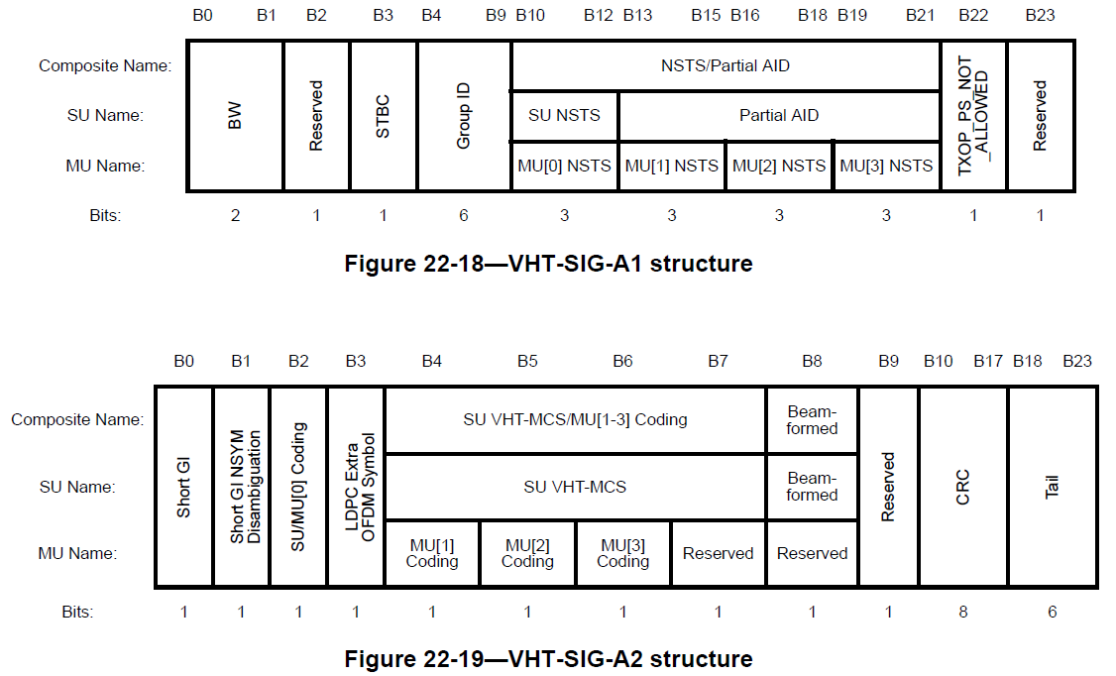
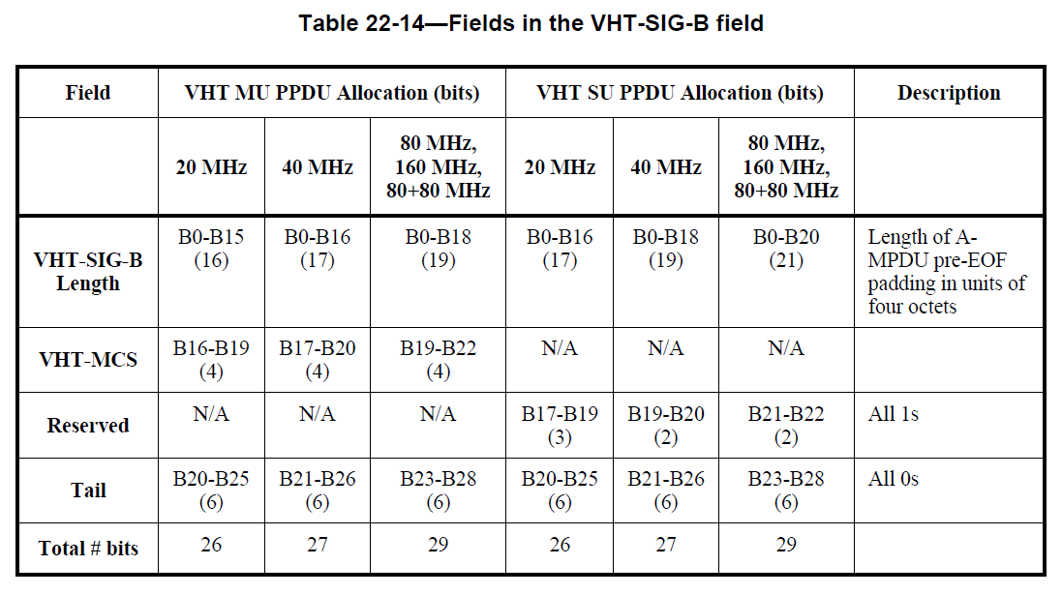
Preamble Structure for 11ac
4µs per VHT-LTF symbol
VHT-SIG-A
  xxx
  xxx
VHT-SIG-B
  xxx
  xxx
L-STF
L-LTF
L-SIG
VHT-
SIG-A
VHT-STF
VHT-LTF
VHT-
SIG-B
Data

Slide 4
HE-SIG-A
Preamble structure for HE-SIG-A
  3.2µs DFT duration, duplicated on each 20MHz
  Fixed number of OFDM symbols
Number of available bits for new features of 11ax
  Assumption: required control information that is common for all STAs
    approx. 24 bits are taken away from total number of available bit in SIG-A
    Common control information: bandwidth, GI, 2x or 4xLTF, BCC tail bits, CRC, etc
  Approx. 24 ~ 48 bits additionally available
    depending on the number of OFDM symbols
4µs per OFDM Symbol
Legacy Preamble
HE-
SIG-A
…
freq.
Legacy Preamble
HE-
SIG-A
time

Slide 5
HE-SIG-B
Option 1
  HE-SIG-B is defined for 20MHz and duplicated on each 20MHz
Duplicated information
frequency
4µs per OFDM Symbol
HE-
SIG-A
HE-
SIG-B
20MHz
…
…
HE-
SIG-A
HE-
SIG-B
20MHz
time
Pros | Cons
Robust to interference - Robust reception of SIG-A, and SIG-B even in case of interference/collision in non-primary channels MRC gain - MRC combining gain of duplicated signals is possible | (Relatively) Larger Overhead - Payload Size per OFDM symbol is limited to 24 bits. May require many OFDM symbols for large per-STA information.

Slide 6
HE-SIG-B
Option 2
  HE-SIG-B is jointly encoded across the entire OFDMA operation bandwidth
frequency
4µs per OFDM Symbol
HE-
SIG-A
HE-
SIG-B
40MHz
…
…
…
HE-
SIG-A
time
Pros | Cons
(Relatively) Less Overhead - More payload bits are available for wider bandwidths, where large per-STA information is more likely. | Additional HE-STF and HE-LTF overhead - Certain implementation/design may require additional STF/LTF symbols because channel estimation only from the primary channel exist.[*] Additional interleaver design - Depending on the number of tones for HE-SIG-B, new BCC interleaver may need to be defined

Slide 7
HE-SIG-B
Option 3
  HE-SIG-B is separately encoded for each assigned subband or STA
frequency
4µs per OFDM Symbol
16µs per OFDM Symbol
HE-
SIG-A
HE-SIG-B
10MHz
…
…
…
HE-SIG-B
10MHz
HE-
SIG-A
HE-SIG-B
20MHz
time
Pros | Cons
Small variation in preamble (SIG-B) length - Number of required bits per subband or STA is likely to be fixed and do not vary as a function of bandwidth or assigned number of STAs. | Large Overhead for small number of assigned STAs - SIG-B OFDM symbol duration is 4x time longer. And this long overhead may exist regardless of number of assigned STAs in OFDMA

Slide 8
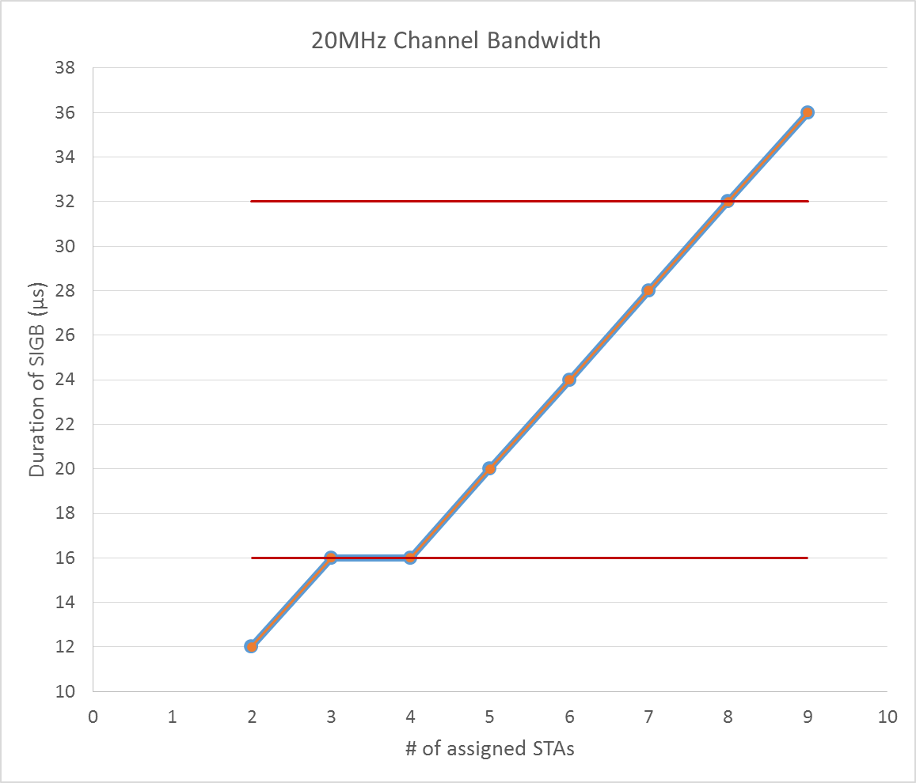

HE-SIG-B (cont.)
DL MU overhead of HE-SIG-B for 20MHz channel bandwidth
Assumption : OFDMA and MU-MIMO are exclusive of each other
: HE-SIG-B consists of user specific information (20 bits) per STA and CRC/Tail
  Opt.1 and Opt.2 has the same overhead
  Opt.3 has fixed duration because HE-SIG-B is separately encoded for each assigned subband or STA
2 OFDM symbols with 32 µs if there may be not enough room
within 1 OFDM symbol on small subband
Opt 1 duplicated on each20MHz
Opt 2 encoded on entire band
Opt 3 encoded on assigned subband
Note: the length of HE-SIG-A and HE-SIG-B can be changed depending on contents in it

Slide 9
HE-SIG-B (cont.)
DL MU overhead of HE-SIG-B for 80MHz channel bandwidth
Assumption : OFDMA and MU-MIMO are exclusive of each other
: HE-SIG-B consists of user specific information (20bits) and CRC/Tail
  Opt.2 is good if 11ax optimizes for small number of STAs
  Opt.3 is good if 11ax optimizes for large number of STAs
Opt 1 duplicated on each20MHz
Opt 2 encoded on entire band
Opt 3 encoded on assigned subband
Note: the length of HE-SIG-A and HE-SIG-B can be changed depending on contents in it

Slide 10
SP 1
Do you agree to add the following sentence to the TG SFD:
  3.y.x. HE-SIG-A field in HE PPDU shall be fixed number of OFDM symbols, the number of OFDM symbols is TBD.
  YES
  NO
  ABS

Slide 11
SP 2
Do you agree to add the following sentence to the TG SFD:
  3.y.x. HE-SIG-B field in DL HE PPDU is a single encoded information mapped to the entire bandwidth.
  YES
  NO
  ABS

Slide 12
SP 3
Do you agree to add the following sentence to the TG SFD:
  3.y.x. HE shall support only two types of HE-SIG, such as HE-SIG-A and HE-SIG-B.
  YES
  NO
  ABS

Slide 13
References
[1] Robert Stacey, Specification Framework for Tgax, 11-15/0132r4, Mar 2015

Slide 14
Appendix – Additional STF/LTF for Option 2
Depending on the implementation or design, additional STF/LTF before SIG-B may be needed
  Some implementation may choose to only buffer samples in the primary 20 MHz channel, and adapt its receiver once bandwidth information is available (typically in first OFDM symbol of SIG-A).
    May require additional STF, if receive bandwidth is also changed during the process
  SIG-B may have more subcarriers than L-LTF subcarriers, in which case channel estimation for the additional subcarriers requires additional LTF.
HE-
SIG-A
HE-STF
HE-LTF
HE-
SIG-B
…
…
HE-
SIG-A
May or may not be required

Slide 15
HE-SIG-B (cont.)
More Example for DL MU overhead of HE-SIG-B
Assumption : OFDMA and MU-MIMO are exclusive of each other
: HE-SIG-B consists of user specific information (10 bits) per STA and CRC/Tail
  Similar trends are shown
Opt 1 duplicated on each20MHz
Opt 2 encoded on entire band
Opt 3 encoded on assigned subband

