Slide 1
Performance of 1x, 2x, and 4x HE-LTF
Date: 2015-05-11
Authors:

Slide 2
Outline
Abstract
Motivation
SU SISO Assumptions and Simulation Results
Uplink MU-MIMO Assumptions and Simulation Results
Conclusions
Reference

Slide 3
Abstract
This contribution analyses the performance of the High Efficiency Long Training Fields (HE-LTF) density options proposed in [1]
The performance is shown for Single-User Single Input Single Output (SU-SISO) and Uplink-Multi-User Multiple Input Multiple Output (UL-MU-MIMO) in the presence of residual CFO

Slide 4
Motivation
HE-LTF structures were presented in [1] and the following was agreed in [2]:
  The HE PPDU shall support the following LTF modes:
    HE-LTF symbol duration of 6.4us excluding GI (2x HE-LTF)
      Equivalent to modulating every other tone in an OFDM symbol of 12.8 µs excluding GI, and then removing the second half of the OFDM symbol in time domain
    HE-LTF symbol duration of 12.8 µs excluding GI (4x HE-LTF)
  However, the following were TBD
    HE-LTF symbol duration of 3.2us excluding GI (1x HE-LTF )
      Equivalent to modulating every 4th tone in an OFDM symbol of 12.8 µs excluding GI, and then removing the last three quarters of the OFDM symbol in time domain
    Details on sub-carrier locations
We present link level PER performance using 4x, 2x, and 1x HE-LTF for both SISO and UL-MU-MIMO transmissions in the presence of residual Channel Frequency Offset (CFO) for different MCSs and different channels

Slide 5
HE-LTF Power Considerations
Power
boosted
normalized
time
4x
2x
Power for 2x LTF
For HE-LTF symbols of duration Ts, the power can be
  Normalized: The energy transmitted per symbol is equivalent to the energy in the 4x HE-LTF
  Boosted: The energy transmitted per symbol is equal to the energy of the 4x HE-LTF multiplied by 12.8/Ts

Slide 6
SISO Simulation Assumptions
Parameter | Value
MCS | 2 (QPSK, ¾) 4 (16 QAM, ¾) 7 (64 QAM, 5/6) 9 (256 QAM, 5/6)
Nss / Ntx/ Nrx | 1 / 1 / 1
Number data / Number pilot tones [1] | 234/8
Number tones in LTF | 242 (4x), 122 (2x), 62 (1x)
Channel Estimation | Realistic (LS)
ChEst Interpolation [1] | Linear (1x, 2x) / Smoothing (4x)
Residual CFO (PPM) [1] | 0.05 (260 Hz)
Packet Size (Bytes) | 1000
Channel [3] | Indoor Channel B,D
Rotation of sub-carriers | No rotation
Coding | BCC

Slide 7
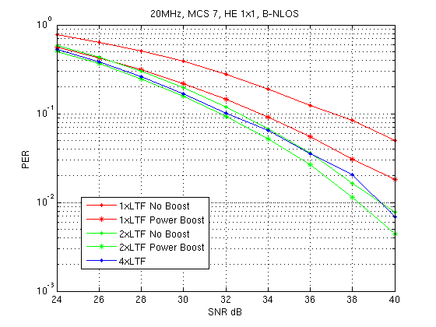
Exemplary Simulation Result – SISO
1x HE-LTF with boosting shows good results

Slide 8
Summary of SISO Results
1x HE-LTF use may be feasible for lower MCS transmissions (Tx)
  Although HE-LTF length reduction is important for high MCS Tx, short packets with low MCS Tx may also benefit from it.
1x HE-LTF use becomes feasible for low delay spread channel or low MCS Tx after LTF boosting.

Slide 9
Uplink MU-MIMO Simulation Assumptions
Parameters | Value
MCS | 2 (QPSK, ¾) 4 (16 QAM, ¾) 7 (64 QAM, 5/6) 9 (256 QAM, 5/6)
Nss / Ntx | [1,1,1,1]
Number STA, Number of HE-LTFs | 4
Nrx | 8
P Matrix [1] | Same as current Used across users
Number data / Number pilot tones | 234/8
Number of tones in LTF | 242, 122, 60
Channel Estimation | Realistic (LS)
ChEst Interpolation [1] | Linear (4x, 2x) / Smoothing (4x)
Realistic Residual CFO Spread (PPM) [1] | 0.05 (260 Hz)
Packet Size (Bytes) | 1000
Channel [3] | Indoor Ch B,D
Rotation of sub-carriers | No rotation
Coding | BCC

Slide 10
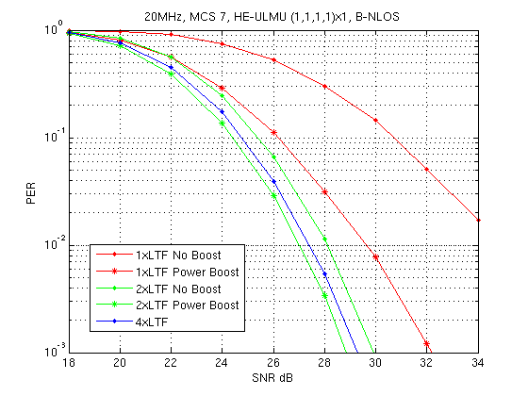
Exemplary Simulation Results
Boosting also shows improved performance for 1x and 2x HE-LTFs

Slide 11
Summary of Uplink MU-MIMO Results
Without boosting, 1x HE-LTF use is not feasible
1x HE-LTF use becomes feasible for low delay spread channel or low MCS Tx after LTF boosting

Slide 12
Conclusions
This contribution presents the link level PER performance for different HE-LTF density options in SU-SISO and UL-MU-MIMO transmission with residual CFO present
The results show that the use of 1x HE-LTF may be feasible in scenarios with either low MCS or low delay spread channels
The results show that the use of 1x HE-LTF becomes feasible with LTF power boosting as it recovers some of the losses experienced by using 1x HE-LTF in both SU-SISO and UL-MU-MIMO transmission

Slide 13
References
[1] IEEE 802.11-15/0349r2, HE-LTF Proposal, Marvell
[2] IEEE 802.11-15/235r7 TGax March 2015 Meeting Agenda, Huawei
[3] IEEE 802.11-14/882r2 TGax, IEEE 802.11ax Channel Model Document, Mediatek

Slide 14
LTF Density Considerations
HE-LTF for 2x designs
  Number of tones to span all 242 data and pilot sub-carriers should be 122
    Can not port 40MHz VHT-LTF Design directly.
  Use 80 MHz LTF design
  Rotation should be identical to 1/2 compressed rotation of data sub-carriers
HE-LTF for 1x designs
  Number of tones to span all 242 data and pilot sub-carriers should be 62
  Can not port 20MHz VHT-LTF Design directly.
  Rotation should be identical to 1/4 compressed rotation of data sub-carriers
For simplicity no-rotation can be considered

Slide 15
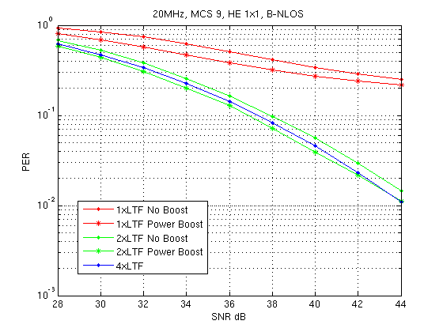
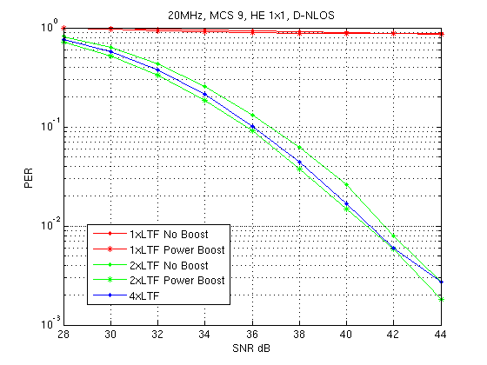
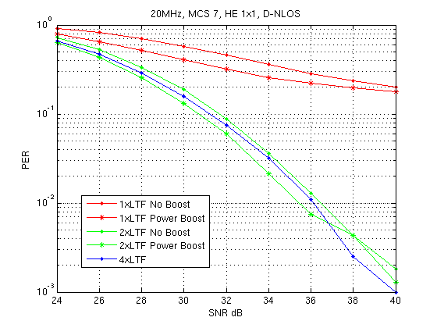
Simulation Results SISO (1/2)

Slide 16
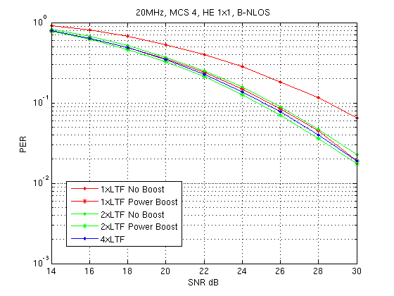
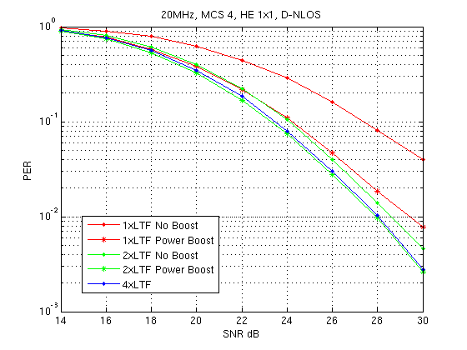
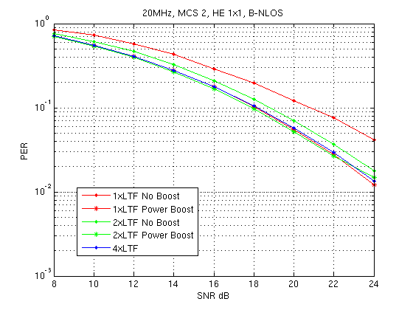
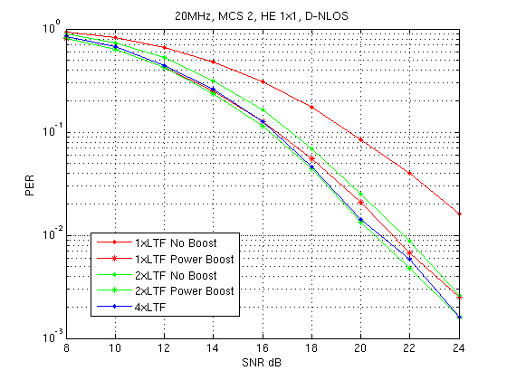
Simulation Results SISO (2/2)

Slide 17
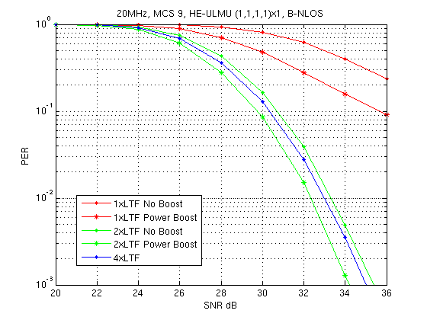
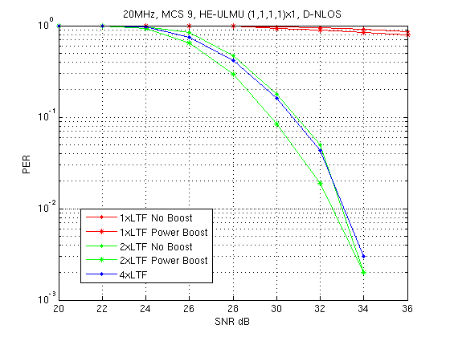
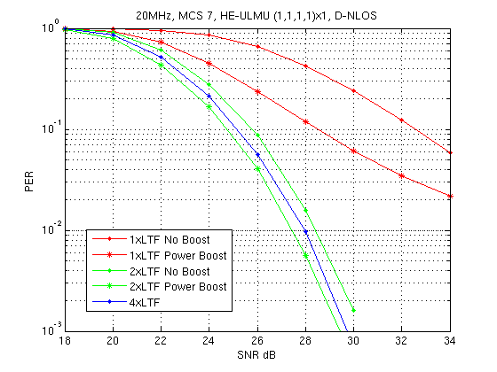
Uplink MU-MIMO (1/2)

Slide 18
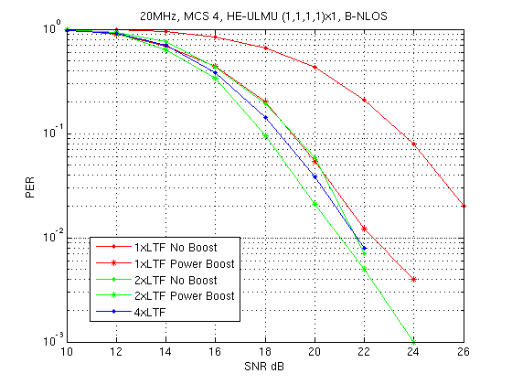
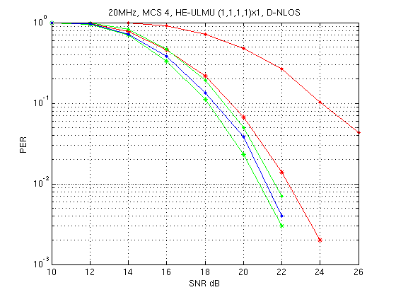
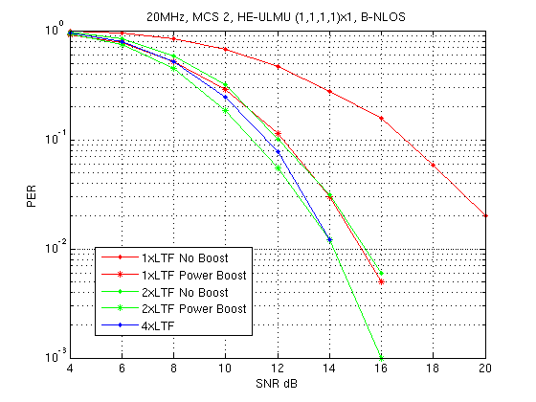
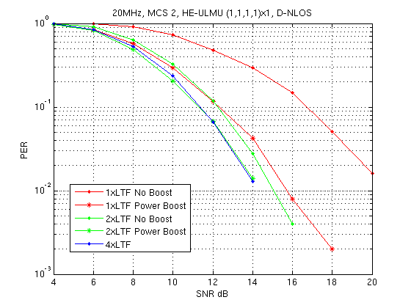
Uplink MU-MIMO (2/2)

