Slide 1
Frequency Selective Scheduling (FSS) for TGax OFDMA
Date: 2015-05-11
Authors:

Slide 2
Outline
Motivation
Channel Selectivity and User Allocation
Channel Selectivity Simulation Results
System Throughput Simulation
System Throughput Results
Conclusions
References

Slide 3
Abstract
This contribution quantifies the potential resource unit (RU) selection gains for OFDMA transmissions using different RU sizes, over a few TGax channels, in all TGax simulation scenarios.
The gains achieved from CSI-based RU selection for TGax OFDMA motivate the need for efficient RU-based feedback.

Slide 4
Motivation
  The 11ax specification framework has already defined UL/DL OFDMA as one of the key 11ax MU features [1].
  OFDMA may exploit the channel selectivity to maximize frequency selective multiplexing gain in dense network conditions [5][6][7].
We quantify the gains for ideal resource unit (RU) selection for OFDMA transmissions
  over different TGax channels [2][3]
  in different TGax simulation scenarios [8]
  using different RU sizes

Slide 5
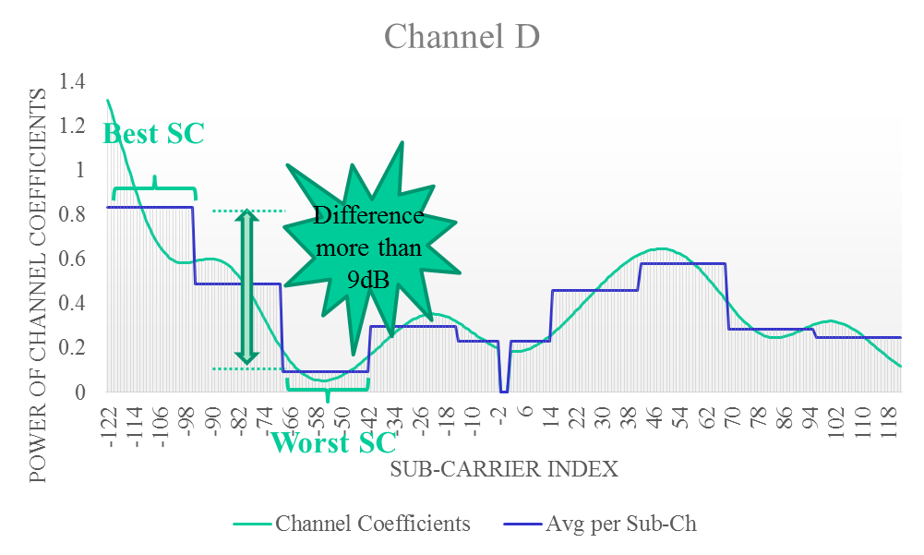
Channel Selectivity and User Allocation
OFDMA could be used to exploit the channel selectivity in the channel:
  In one channel instance (using Channel D model [2]), the maximum gain between best RU and worst RU is as high as 9dB.
With CSI at the transmitter, it can allocate only the “best” sub-channel to a STA and avoid allocating the worst sub-channel to that user
  this may require sounding or signaling between transmitter and receivers

Slide 6
Simulation Methodology and Assumptions
  Simulation Methodology:
    Characterize difference between best and worst user allocation (Instantaneous loss)
      Max_min delta (dB) = Channel power (best RU) – Channel power (worst RU).
    Characterize the difference between a best and a random user allocation (Average loss)
      Ave_delta (dB) = Channel Power (best RU) – Channel power(Averaged)
  Simulation Assumptions:
    20MHz
    Channel-B, Channel-D [2], and UMi channel [3]
    Statistics based on 10000 channel instances
    Numerology derived from [4]

Slide 7
Exemplary Simulation Results – Channel B
  Observations: The smaller the RU size, the more RU selection gain potentially achieved
saturation
Note: Similar results for Channel D and UMi channel may be found in the additional material section

Slide 8
Summary of Channel Gain Analysis
We summarize the gain in RU energy (Ave_delta (dB)) based on channel selection vs random channel allocation Channel B
  Channel D
  UMi
Observations:
  Gain increases as the RU size decreases
  Rate of increase slows as the RU size decreases

Slide 9
System Throughput Simulation Assumptions
No MAC protocol overhead assumed
STAs are located based on specific TGax simulation scenarios [8]
Non-continuous resource allocation was allowed
 | Scenario Name | Topology | Channel Model
1 | Residential | A - Apartment building 10m x 10m apartments in a multi-floor building 5 STAs per BSS | Indoor (B/D)
2 | Enterprise | B - Dense small BSSs with clusters 10m inter AP distance 64 STAs per BSS | Indoor (B/D)
3 | Indoor Small BSS Hotspot | C - Dense small BSSs, uniform 17.32 m inter AP distance 30 STAs per BSS
4 | Outdoor Large BSS Hotspot | D - Large BSSs, uniform 130m inter AP distance 50 STAs per BSS | Outdoor (Umi)
Parameter | Value
Scheduler | 1. Proportional Fair [9] 2. Random
System Throughput Metric | Shannon Capacity based on system SINR
RU allocation | Non-contiguous
RU allocation | Case 1: RU1 Case 2: RU2 Case 3: RU5 Case 4: RU9 Case 5: RU18
Table derived from [8]

Slide 10
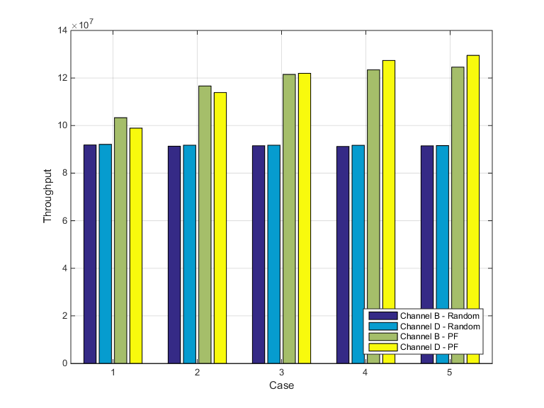
Exemplary Simulation Results : SS3
PF: Proportional fair [9]
Number of stations: 30
Gain of PF scheduling vs Random Scheduling

Slide 11
Summary of System Throughput Analysis
Large system throughput gains for scenarios with low baseline throughputs
  SS3: 41% and SS4: 61%
Behavior correlates to channel selectivity performance observed in previous results
  Channel B has large initial performance increase due to multi-user diversity in RU1 but quickly saturates as the number of RUs increase
  Channel D and UMi channel show much less initial increase and saturation

Slide 12
Observations
  Scheduling for OFDMA transmission provides a gain in the system throughput of 802.11ax
  The scheduling is easily done at the AP when Channel State Information (CSI) is available.
  Currently, 802.11 provides CSI feedback for [10]:
    Fast link adaptation: single MCS feedback sequence identifier for a entire transmission bandwidth
    DL MU-MIMO: compressed feedback of channel coefficients for multiple sub-carriers and average SNR of each Space Time Stream
  The accuracy of the CSI required for DL/UL OFDMA may be more than that required for fast link adaptation and less than that required for DL MU-MIMO

Slide 13
Conclusions
With CSI-based RU selection, OFDMA may maximize the system throughput gain in TGax scenarios.
We quantify the potential resource unit (RU) selection gains for TGax OFDMA transmissions with different RU sizes, for different channels and in different simulation scenarios.
  System throughput gains of up to 41% in indoor scenarios and 61% in outdoor scenarios may be seen by using CSI-based RU selection as opposed to a random allocation method.
CSI specific to OFDMA is needed at the transmitter to realize these gains.

Slide 14
Straw Poll #1
Should we consider adding RU based feedback to the SFD?
Y/N/A

Slide 15
Straw Poll #2
Do you agree to add to the TG Specification Framework?
4.x.y The amendment shall include a mechanism for Resource Unit (RU) based feedback
Y/N/A

Slide 16
References
[1] IEEE 802.11-15/132r4 Spec Framework, Intel
[2] IEEE 802.11-14/882r4, TGax Channel Model Document, Mediatek
[3] Report ITU-R M.2135-1, (12/2009), Guidelines for evaluation of radio interface technologies for IMT-Advanced
[4] IEEE 802.11-15/330r1, OFDMA Numerology and Structure, Intel
[5] IEEE 802.11-14/858r1, Analysis on Multiplexing Schemes exploiting frequency selectivity in WLAN Systems, Samsung
[6] IEEE 802.11-14/1227r2, OFDMA Performance Analysis, Mediatek
[7] IEEE 802.11-15/383r0, Impact of number of sub-channels in OFDMA, Ericsson
[8] IEEE 802.11-15/980r10, Simulation Scenarios, Qualcomm
[9] Zhishui Sun; Changchuan Yin; Guangxin Yue, "Reduced-Complexity Proportional Fair Scheduling for OFDMA Systems,“ Proc. IEEE International Conference on Communications, Circuits and Systems (ICCCAS), vol.2, pp.1221-1225, 2006
[10] IEEE P802.11ac™/D7.0, Draft STANDARD Part 11: Wireless LAN Medium Access Control (MAC) and Physical Layer (PHY) specifications Amendment 4: Enhancements for Very High Throughput for Operation in Bands below 6 GHz
[11] IEEE 802.11-14/571r8, Evaluation Methodologies, Broadcom
[12] IEEE 802.11-15/125r2, Box 1 and Box 2 Calibration Results, Broadcom

Slide 17
Additional Material

Slide 18
Simulation Results – Channel D
  Observations: Similar to Channel B but with less saturation at 13 tones

Slide 19
Simulation Results – Channel UMi
  Observations: Even less saturation as number of RUs reduce

Slide 20
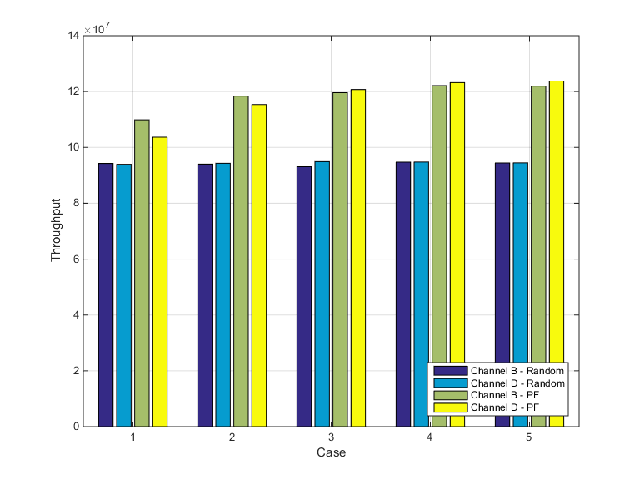
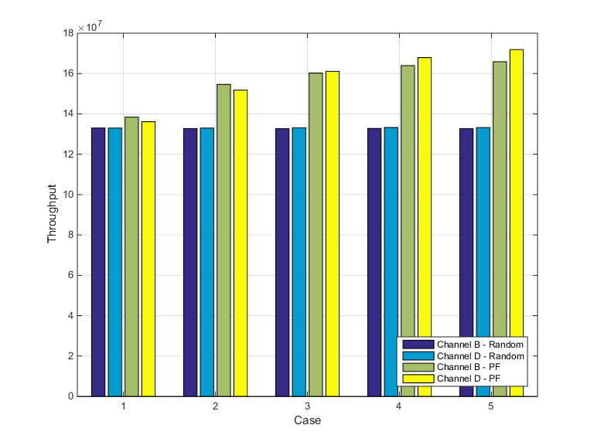
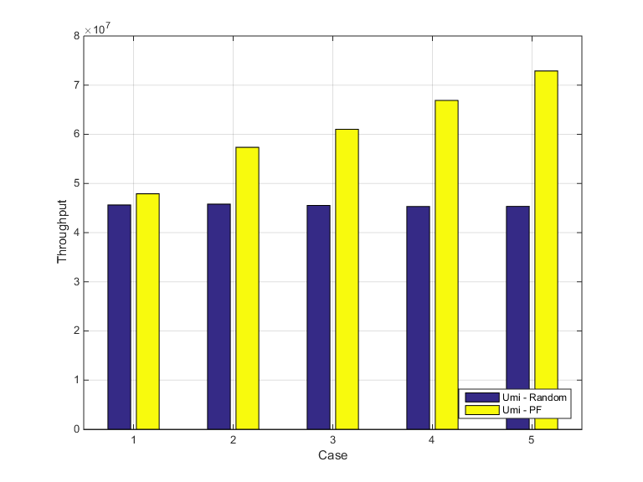
System Throughput Performance for SS1-4
SS1
SS2
SS3
SS4

Slide 21
Simulation Methodology of System Throughput
Obtain per tone SINR of STAs based on path loss and shadowing of specific simulation scenario [12] and fading channel [2]
Estimate effective SINR of sub-channels based on the specific numerology using the capacity mapping in [11]
Perform proportional fair scheduling based on effective SINR of different sub-channels [9]
Assign users to sub-channels
Estimate PHY layer system throughput based on capacity of chosen users
Average over multiple drops

