Slide 1
802.11ax Calibration and Modeling Adjacent Channel Interference
Date: 2015-05-11
Authors:
Slide 1
Naveen Kakani, CSR

Slide 2
Abstract
Box 1 Calibration results for all Simulation of Scenarios (Reference: 11-14-0800-29-00ax-box-1-and-box-2-calibration-results.xlsx)
Adjacent Channel interference modeling and performance numbers
Slide 2
Naveen Kakani, CSR

Slide 3
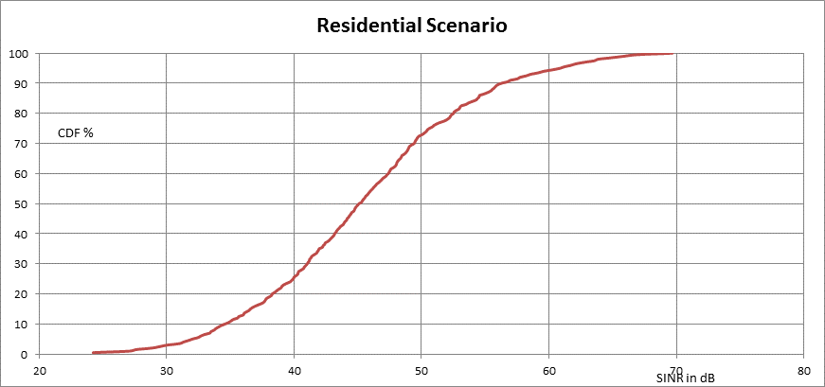
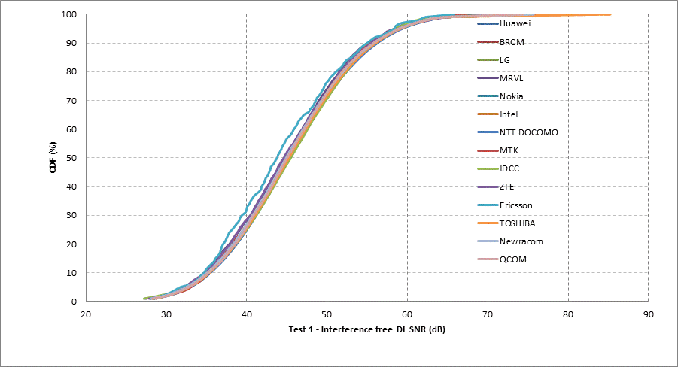
Residential Scenario (SS1)

Slide 4
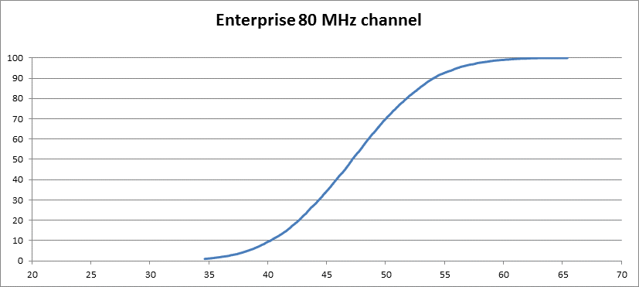
Enterprise Scenario (SS2)

Slide 5
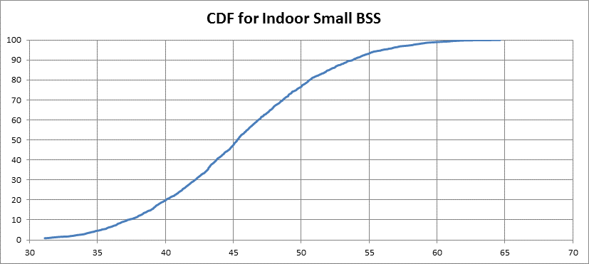
Indoor Small BSS (SS3)

Slide 6
Adjacent Channel Interference
20MHz Interferer:
Noise Power (2.4GHz Band) = Tx Power + Path Loss – 23.77dB
Noise Power (5GHz Band) = Tx Power + Path Loss – 23.72dB
40MHz Interferer:
2.4GHz Band | 5GHz Band
Noise Power in first adjacent 20MHz Channel = Tx Power + Path Loss – 25.02dB | Noise Power in first adjacent 20MHz Channel = Tx Power + Path Loss – 25.02dB
Noise Power in the second adjacent 20MHz Channel = Tx Power + Path Loss – 36.99dB | Noise Power in the second adjacent 20MHz Channel = Tx Power + Path Loss – 35.61dB
Noise Power in the 40MHz Adjacent Channel: TX Power of Interferer + Path Loss – 24.75dB | Noise Power in the 40MHz Adjacent Channel: TX Power of Interferer + Path Loss – 24.65dB
If the 40MHz BSS is interfering with an 80MHz BSS (40MHz operation is on the center 40MHz of the 80MHz BSS), then the adjacent Channel power on the 80MHz BSS is: TX Power of the Interferer + Path Loss – 25.02dB + 3dB | If the 40MHz BSS is interfering with an 80MHz BSS (40MHz operation is on the center 40MHz of the 80MHz BSS), then the adjacent Channel power on the 80MHz BSS is: TX Power of the Interferer + Path Loss – 25.02dB + 3dB

Slide 7
Adjacent Channel Interference
80MHz Interferer: Noise Power in adjacent Channels
Noise Power in first adjacent 20MHz Channel = Tx Power + Path Loss – 26.88dB
Noise Power in second adjacent 20MHz Channel = Tx Power + Path Loss – 31.79dB
Noise Power in third adjacent 20MHz Channel = Tx Power + Path Loss – 36.73dB
Noise Power in fourth adjacent 20MHz Channel = Tx Power + Path Loss – 43.01dB
Noise Power in first adjacent 40MHz Channel (40-80) = Tx Power + Path Loss – 25.67dB
Noise Power in second adjacent 40MHz Channel (60-100)= Tx Power + Path Loss – 30.58dB
Noise Power in third adjacent 40MHz Channel (80-120)= Tx Power + Path Loss – 35.81dB
Noise Power in adjacent 80MHz Channel (40-120)= Tx Power + Path Loss – 25.27dB
Noise Power in adjacent 60MHz Channel (40-100)= Tx Power + Path Loss – 25.34dB (there is a common channel for both the BSS’s)
Noise Power in adjacent 60MHz Channel (60-120)= Tx Power + Path Loss – 30.34dB

Slide 8
Simulation Setup to test impact of Adjacent Channel Interference
The simulation setup for testing the model is as follows -
n2 n3
| |
AP1 -- n1 AP2
|
n4
Continuous downlink traffic from each AP to its stations
Continuous uplink traffic from n1 and n3 to AP1 and AP2 respectively
STA n1 is between AP1 and AP2
MCS5 used on all links, no support for TXOP and A-MPDU
Simulation run for 10 sec
Data rate of application limited to 10 Mbps i.e., offered load in each BSS is 30Mbps
With Adjacent Channel interference:
There will be drop in Throughput at AP2 and AP2 will sense the medium to be busy and will not transmit enough data to STA n3, n4
There will be drop in Throughput at STA n1, and at AP1 because STA n1 will sense the medium to be busy and will not transmit uplink data to AP1

Slide 9
Test Cases Results Distance between station and AP = 20m Distance between AP1 and AP2 = 40m
Test Case 1:
BSS1 – 20 MHz, in channel 1
BSS2 – 20 MHz, in channel 11
throughput at n1 = 5.5776
throughput at n2 = 2.8552
throughput at AP1 = 8.5912
throughput at n3 = 5.7856
throughput at n4 = 2.9576
throughput at AP2 = 8.5216
Aggregate throughput at BSS1 = 17.024
Aggregate throughput at BSS2 = 17.2648
Net throughput = 0.85722 Mbps/MHz
Test Case 2:
BSS1 – 20 MHz, in channel 6
BSS2 – 20 MHz, in channel 11
throughput at n1 = 7.1864
throughput at n2 = 4.088
throughput at AP1 = 5.6568
throughput at n3 = 4.5584
throughput at n4 = 2.32
throughput at AP2 = 9.9728
Aggregate throughput at BSS1 = 16.9312
Aggregate throughput at BSS2 = 16.8512
Net throughput = 0.84456 Mbps/MHz
Test Case 3:
BSS1 – 20 MHz, in channel 1
BSS2 – 40 MHz, in channel 6,11
throughput at n1 = 6.944
throughput at n2 = 3.8376
throughput at AP1 = 6.3224
throughput at n3 = 6.2448
throughput at n4 = 3.788
throughput at AP2 = 9.9816
Aggregate throughput at BSS1 = 17.104
Aggregate throughput at BSS2 = 20.0144
Net throughput = 0.61864 Mbps/MHz
Drop is throughout at AP1 in Test case 2 because STA n1 is not transmitting enough (Energy Detect – Adjacent Channel interference), similarly there is drop in Throughput at STA4 and STA3 because AP2 is transmitting enough
Not a significant drop in BSS throughput with and with out Adjacent Channel Interference, but individual STAs have an impact on their throughput

Slide 10
Test Cases Results Distance between station and AP = 10m Distance between AP1 and AP2 = 20m
Test Case 1:
BSS1 – 20 MHz, in channel 1
BSS2 – 20 MHz, in channel 11
throughput at n1 = 5.6176
throughput at n2 = 2.904
throughput at AP1 = 8.6472
throughput at n3 = 5.7184
throughput at n4 = 2.9056
throughput at AP2 = 8.488
Aggregate throughput at BSS1 = 17.1688
Aggregate throughput at BSS2 = 17.112
Net throughput = 0.85702 Mbps/MHz
Test Case 2:
BSS1 – 20 MHz, in channel 6
BSS2 – 20 MHz, in channel 11
throughput at n1 = 5.0104
throughput at n2 = 2.3824
throughput at AP1 = 4.6472
throughput at n3 = 3.7992
throughput at n4 = 1.768
throughput at AP2 = 6.6688
Aggregate throughput at BSS1 = 12.04
Aggregate throughput at BSS2 = 12.236
Net throughput = 0.6069 Mbps/MHz
Test Case 3:
BSS1 – 20 MHz, in channel 1
BSS2 – 40 MHz, in channel 6,11
throughput at n1 = 6.1328
throughput at n2 = 3.0664
throughput at AP1 = 4.8888
throughput at n3 = 4.0672
throughput at n4 = 2.0528
throughput at AP2 = 7.4448
Aggregate throughput at BSS1 = 14.088
Aggregate throughput at BSS2 = 13.5648
Net throughput = 0.46088 Mbps/MHz
No difference in Test case 1 results when compared to the scenario where the distance between AP and STA is 20m
From test case 1 to Test case 2 and Test case 3, significant drop in “Net Throughput” with Adjacent Channel interference (this can be residential scenario with a wall between two apartments)

Slide 11
Test Cases Results Distance between station and AP = 10m Distance between AP1 and AP2 = 10m
Test Case 1:
BSS1 – 20 MHz, in channel 1
BSS2 – 20 MHz, in channel 11
throughput at n1 = 5.6256
throughput at n2 = 2.896
throughput at AP1 = 8.648
throughput at n3 = 5.7128
throughput at n4 = 2.9
throughput at AP2 = 8.4856
Aggregate throughput at BSS1 = 17.1696
Aggregate throughput at BSS2 = 17.0984
Net throughput = 0.8567 Mbps/MHz
Test Case 2:
BSS1 – 20 MHz, in channel 6
BSS2 – 20 MHz, in channel 11
throughput at n1 = 4.0832
throughput at n2 = 1.2792
throughput at AP1 = 5.624
throughput at n3 = 3.0736
throughput at n4 = 1.528
throughput at AP2 = 4.3744
Aggregate throughput at BSS1 = 10.9864
Aggregate throughput at BSS2 = 8.976
Net throughput = 0.49906 Mbps/MHz
Test Case 3:
BSS1 – 20 MHz, in channel 1
BSS2 – 40 MHz, in channel 6,11
throughput at n1 = 3.9328
throughput at n2 = 1.8688
throughput at AP1 = 6.1384
throughput at n3 = 3.74
throughput at n4 = 1.9512
throughput at AP2 = 4.8536
Aggregate throughput at BSS1 = 11.94
Aggregate throughput at BSS2 = 10.5448
Net throughput = 0.374747 Mbps/MHz
No difference in Test case 1 results when compared to the scenario where the distance between AP and AP is 40m or 20m
Test case 2 and 3 show significant degradation on the same lines when the distance between the AP’s is around 20m

Slide 12
Conclusions
Adjacent Channel interference alone shows degradation in BSS throughput
Recommend to include Adjacent Channel Interference Modeling in Simulation Scenarios

