Slide 1
Enhancing Performance of Hybrid-ARQ with
Linear Constellation Precoding
Date: 2015-05-07
Authors:

Slide 2
Agenda
Abstract
Existing Schemes
  Code Combining
  Constellation Rearrangement
New Scheme LCP-HARQ
Bit Error Rate Comparison
Throuhput Comparison
Conclusion
References

Slide 3
Abstract
In this work we propose a novel hybrid-ARQ scheme, which outperforms Code combining (CC) and Constellation rearrangement (CoRe) in both packet error rate performance and transmission throughput over a wide range of SNR values.
The proposed scheme uses linear constellation precoding (LCP) to construct symbol vectors for transmission and re-transmissions.

Slide 4
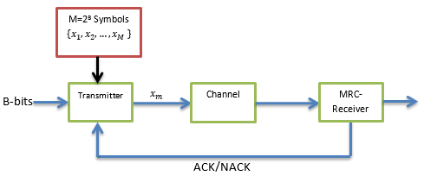
Code combining (CC)-HARQ [Chase1985]
Same information is sent in successive retransmissions and maximal ratio combining (MRC) is done at the receiver to decode the data.

Slide 5
Constellation Rearrangement (CoRe) [Wengerter2004]
Observation:
Different protection levels are offered to different bits in higher order modulations.
Example (16-QAM):
Two of the four bits in a symbol have a higher probability of error than the other two bits.
CoRe:
Average the reliability of different bits over successive transmissions by swapping the position and/or negation of the least signiﬁcant bits (LSB).

Slide 6
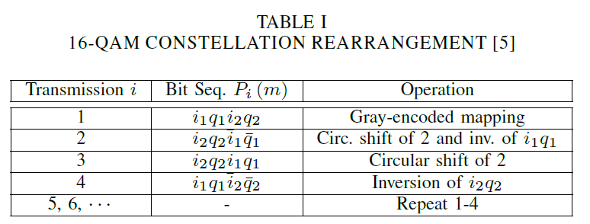
CoRe (cont.)
CoRe Example:
Adopted in 3G and 4G communication standard
  HSDPA transmission mode of the universal mobile telecommunications systems (UMTS) [3GPP],
  WiMax IEEE 802.16m.

Slide 7
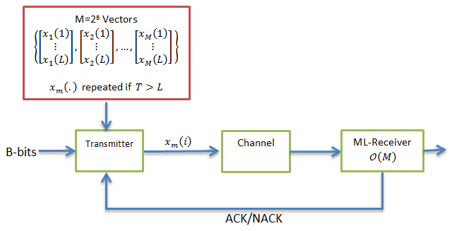
New Scheme LCP-HARQ
A distinct vector is chosen from a pre-constructed codebook for transmission of every B input information bits, and elements of this vector are transmitted one by one in case a NACK is received from the destination.

Slide 8

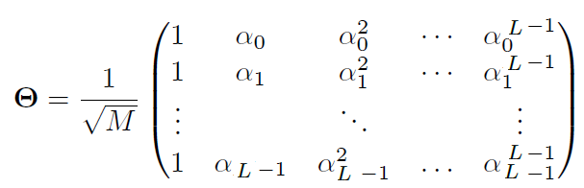
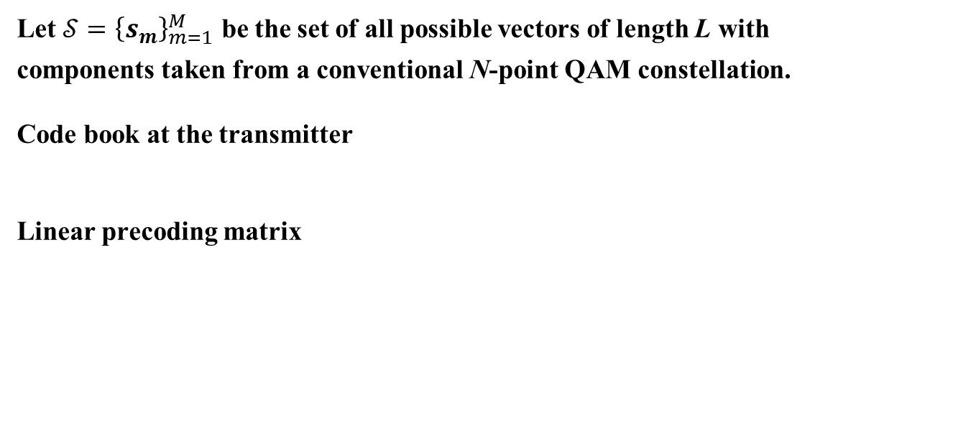
Codebook Construction
Let $𝒮={\left\{s_{m}\right\}}_{m=1}^{M}$ be the set of all possible vectors of length L with
components taken from a conventional N-point QAM constellation.
Code book at the transmitter
Linear precoding matrix

Slide 9
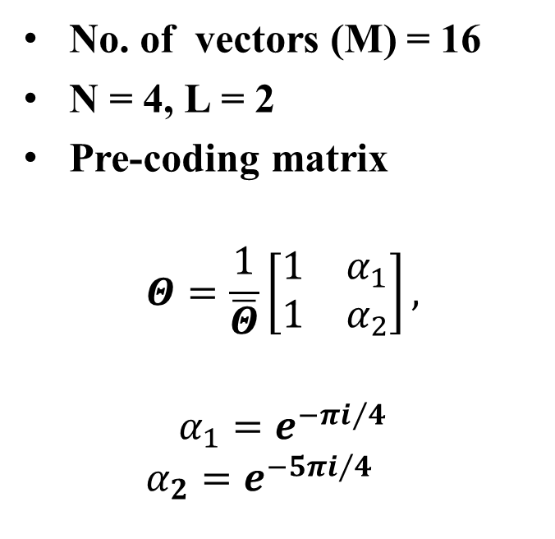
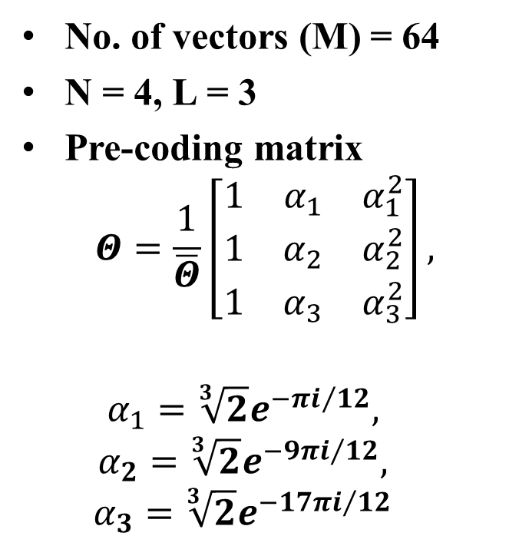
Example
Target: 4 bits/transmission
Target: 6 bits/transmission
No. of vectors (M) = 16
N = 4, L = 2
Pre-coding matrix
$$Θ=\frac{1}{\overline{Θ}}\left[\begin{matrix}1 & α_{1} \\ 1 & α_{2}\end{matrix}\right],$$
$$α_{1}=e^{−{πi}/4}$$
$$α_{2}=e^{−{5πi}/4}$$
No. of vectors (M) = 64
N = 4, L = 3
Pre-coding matrix
$$Θ=\frac{1}{\overline{Θ}}\left[\begin{matrix}1 & α_{1} & α_{1}^{2} \\ 1 & α_{2} & α_{2}^{2} \\ 1 & α_{3} & α_{3}^{2}\end{matrix}\right],$$
$$α_{1}=\sqrt[3]{2}e^{−{πi}/{12}},$$
$$α_{2}={\sqrt[3]{2}e}^{−{9πi}/{12}},$$
$$α_{3}={\sqrt[3]{2}e}^{−{17πi}/{12}}$$

Slide 10
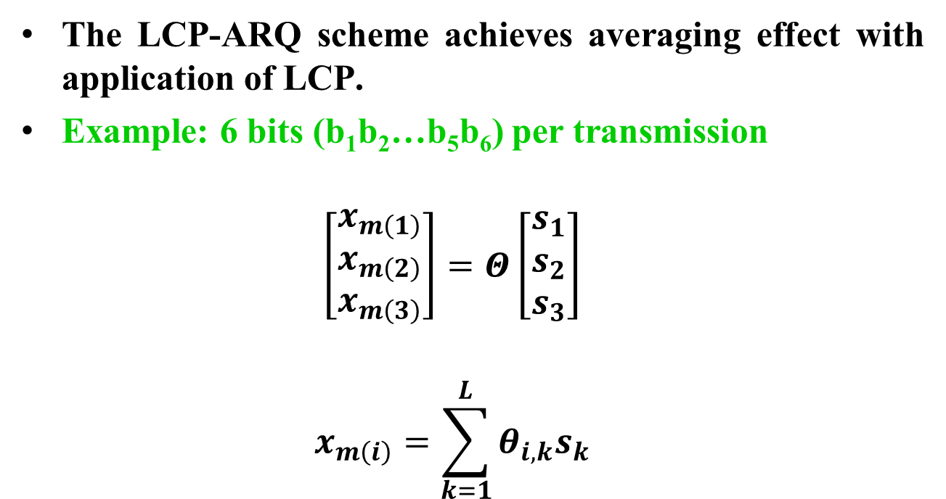
Advantage of LCP-HARQ
The LCP-ARQ scheme achieves averaging effect with application of LCP.
Example: 6 bits (b₁b₂…b₅b₆) per transmission
$$\left[\begin{matrix}x_{m\left(1\right)} \\ x_{m\left(2\right)} \\ x_{m\left(3\right)}\end{matrix}\right]=Θ\left[\begin{matrix}s_{1} \\ s_{2} \\ s_{3}\end{matrix}\right]$$
$$x_{m\left(i\right)}=\sum_{k=1}^{L}{{θ_{i,k}s}_{k}}$$
1st time
b₁b₂
2nd time
b₃b₄
3rd time
b₅b₆

Slide 11
Bit Error Rate Comparison
AWGN Channel
CC and CoRe 64-QAM
LCP-HARQ (N = 4, L = 3)
  New scheme outperforms CC and CoRe schemes by 6.5 dB and 4.2 dB,
  respectively, at target BER = 10⁻³.

Slide 12
Bit Error Rate Comparison (cont.)
Rayleigh Channel
CC and CoRe 64-QAM
LCP-HARQ (N = 4, L = 3)
  New scheme outperforms CC and CoRe schemes by 5 dB and 2.5 dB,
  respectively, at a target BER = 10⁻³.

Slide 13
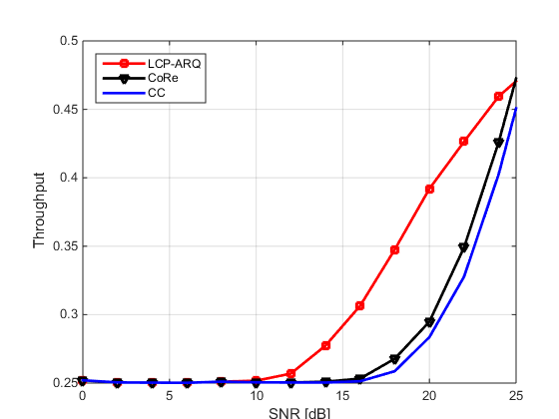
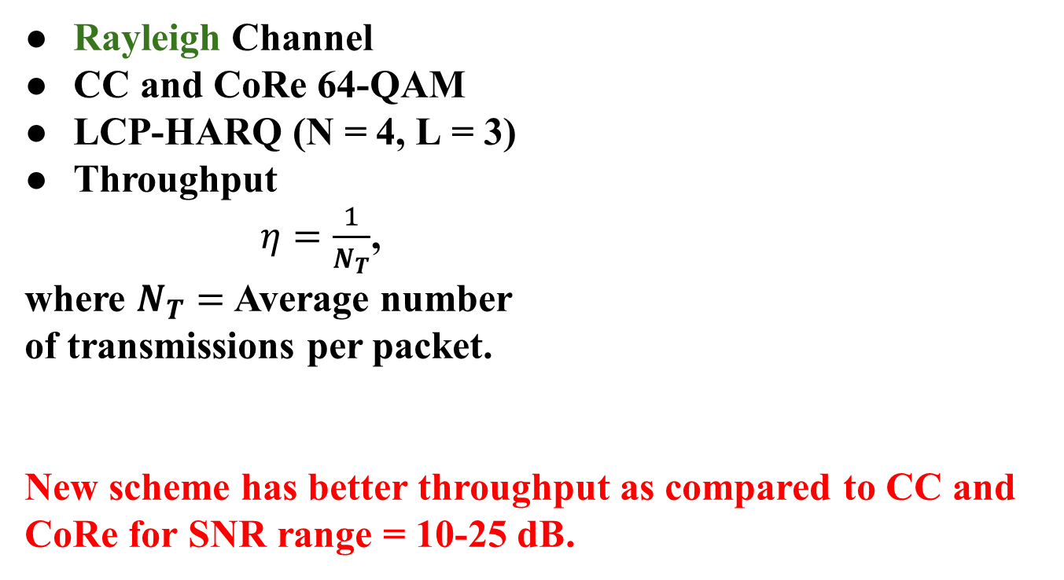
Throughput Comparison
Rayleigh Channel
CC and CoRe 64-QAM
LCP-HARQ (N = 4, L = 3)
Throughput
$η=\frac{1}{N_{T}}$,
where $N_{T}=$ Average number
of transmissions per packet.
New scheme has better throughput as compared to CC and CoRe for SNR range = 10-25 dB.

Slide 14
Conclusion
New scheme with
  ML decoder complexity: M search operations
  (Same as CC-HARQ and CoRe-HARQ )
  Outperforms CC and CoRe schemes by 5 dB and 2.5 dB, respectively, at target BER = 10⁻³ .
  Higher throughput as compared to CC and CoRe schemes.

Slide 15
References
[Chase1985] D. Chase, “Code combining–a maximum-likelihood decoding approach for combining an arbitrary number of noisy packets,” IEEE Trans. Commun., vol. 33, no. 5, pp. 385–393, May 1985.
[Wengerter2004] C. Wengerter, A. von Elbwart, and E. Seidel, “Constellation rearrangement: Enhancement for multilevel modulation formats and transmit diversity,” Wireless Personal Communications, vol. 29, no. 1-2, pp. 35–45, 2004.
3GPP, Universal Mobile Telecommunications System (UMTS);. Multiplexing and Channel Coding (FDD). ETSI, 2002.
Panasonic, “Enhanced HARQ method with signal constellation rearrangement,” in TSG-RAN Working Group 1 Meeting, Las Vegas, USA, February 2001.

Slide 16
Straw Poll
Do you agree to add to the TG SFD:
x.y.z The specification shall include an LCP-ARQ scheme to average the reliability of transmitted bits in M-QAM constellations with M>4 to improve the overall error rate.

