Slide 1
IEEE 802.11 performance in dense, cellular-like, outdoor deployments
Date: 2015-05-11

Slide 2
Abstract
Performance of IEEE 802.11 in dense, out-door, cellular-like deployments is investigated and several issues related to IEEE 802.11 operation in such environments are highlighted.

Slide 3
Overview of the study
Aim: Determining performance of IEEE 802.11 in case of dense, out-door, cellular-like deployments and identifying main bottlenecks for such scenarios
Motivation: Most of existing simulation studies are conducted for small scenarios and neglect different aspects of an out-door wireless channel
Approach: System level simulations with realistic channel models and wrap-around

Slide 4
Simulation tool – overview
Support of IEEE 802.11a/b/g standards
  Based on extended NS-3 Wifi module
  Ongoing validation of IEEE 802.11n implementation
  Ongoing implementation of IEEE 802.11ac
Realistic channel models used for outdoor scenarios
  Different path-loss models for STA-AP, AP-AP and STA-STA links (based on modified ITU-R M.2135 UMi pathloss model [1], [3],[4])
  LOS probability models for STA-AP, AP-AP, and STA-STA links (based on ITU-R M.2135 and 3GPP models [1], [5])
  LOS correlation model (based on the modified 3GPP proposal for relay site planning [2])
  Shadow fading correlation between arbitrary pairs of links (based on the concept of “spatial maps” [6], [7])
  Ongoing validation of fast fading implementation (based on ITU-R M.2135 and 3GPP models [1], [5])

Slide 5
Simulation tool – overview
Wrap-around to minimize border effects
  Variable number of rings to enable simulation of different cell overlaps (e.g. 24 rings for Inter-site distance [ISD] of 12.5m)
  Support for hexagonal (i.e. regular) as well as random (i.e. irregular) network layouts
  Support for RX power calculation and user mobility
4
4
4
3
4
4
4
4
3
3
4
3
3
2
2
2
3
4
4
2
1
2
3
4
4
3
2
1
1
3
3
1
1
2
3
4
4
3
2
2
1
2
2
3
4
4
4
3
3
2
3
3
4
4
3
4
4
4
4
4
Negligible
interference

Slide 6
Main simulation parameter settings
Main simulation parameters
Parameter | Value
IEEE 802.11 standard | IEEE 802.11g (DSSS switched off)
RTS/CTS | Off
Beacon period | 100ms
Rate adaptation algorithm | Adaptive Auto Rate Fallback (AARF) / No Rate Adaptation (54Mbps/24Mbps)
STA/AP Transmit power | 15.0 dBm, 7.0dBm / 18.0.dBm, 10.0 dBm
STA/AP Rx sensitivity | -85.0 dBm / -90.0 dBm (RA scenarios) -74.0 dBm / -79.0 dBm (No RA scenarios)
STA/AP Noise Figure | 7 dB / 4 dB
STA/AP Antenna type | Omni-directional
STA/AP Antenna Gain | -1.5 dBi / 2.0 dBi
Number of orthogonal channels | 1
Carrier frequency | 2.4 GHz
Carrier bandwidth | 20.0 MHz
Main simulation parameters
Parameter | Value
Network layout | Irregular (Random) / Regular (Hexagonal) grid
Wrap-around | Yes (variable number of rings)
STA/AP height | 1.5m / 10 m
STA distribution | Random uniform distribution
Path loss model | ITU-R UMi based model
Shadow fading model | sigma = 3dB (LOS) / 4dB (NLOS), decorr = 10m (LOS) / 13m (NLOS), correlation between arbitrary pairs of links
Fast fading model | Not considered
Mobility | Not considered
Traffic model | Full buffer (saturated model)
Traffic type | Elastic (TCP New Reno), Non-elastic (UDP)
Packet size (size of the packet transmitted on the air interface, i.e. with MAC, IP and TCP overheads) | 1500 bytes (Application layer packet size: 1424 bytes)

Slide 7
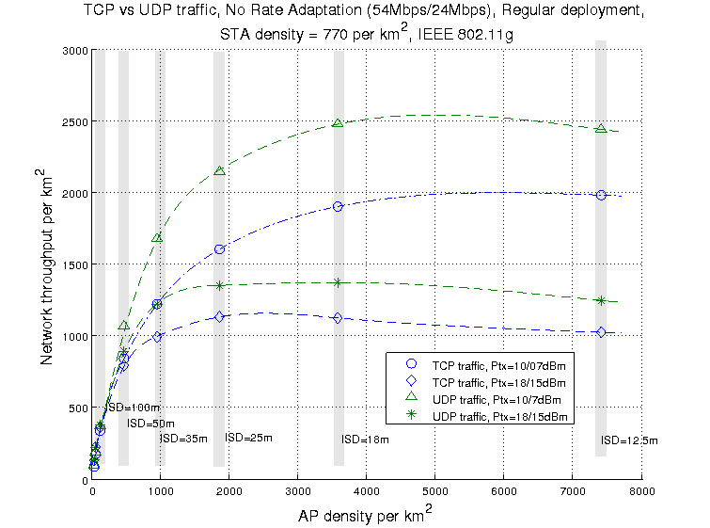
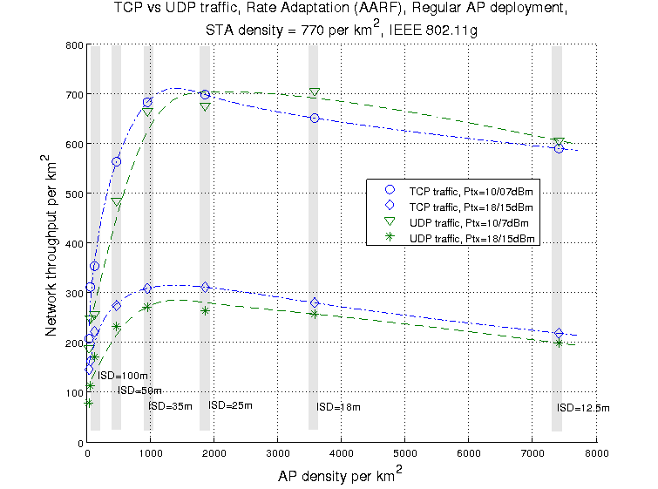
Impact of AP density on the network throughput (TCP and UDP traffic)
Densification of APs can lead to interference & high collision rates (with no further increases in throughput passed the peak capacity)
  Peak capacity varies depending on the power allocation and AP density
  Rate Adaptation significantly degrades performance in case of dense deployment
  TCP congestion control leading to lower throughputs
Saturation density
Saturation density
[Mbps]
[Mbps]
100% DL (AP->STA) traffic
100% DL (AP->STA) traffic
TCP Congestion control leading to lower network throughput
Data rate controlled by RA rather than TCP

Slide 8
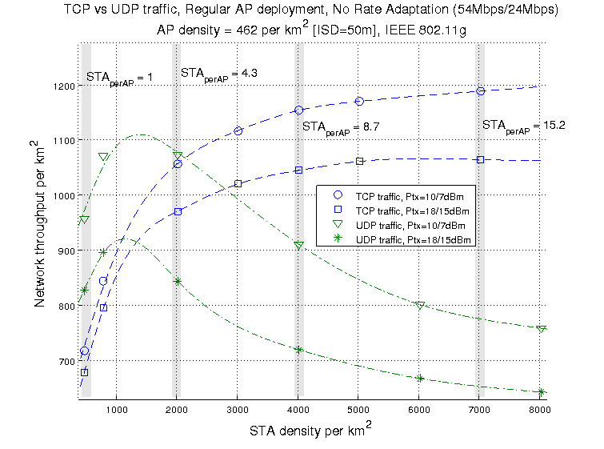
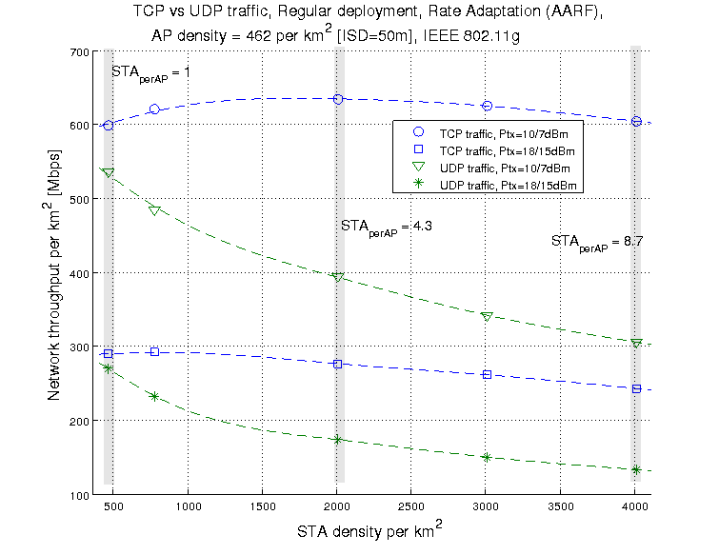
Impact of STA density on the network throughput (TCP and UDP traffic)
STA density affects the network capacity and fairness (in case of TCP traffic)
  Saturation due to high contention and collisions
  Channel dominated by users located in the close proximity to APs leading to unfairness (with TCP)
[Mbps]
100% DL (AP->STA) traffic
100% DL (AP->STA) traffic

Slide 9
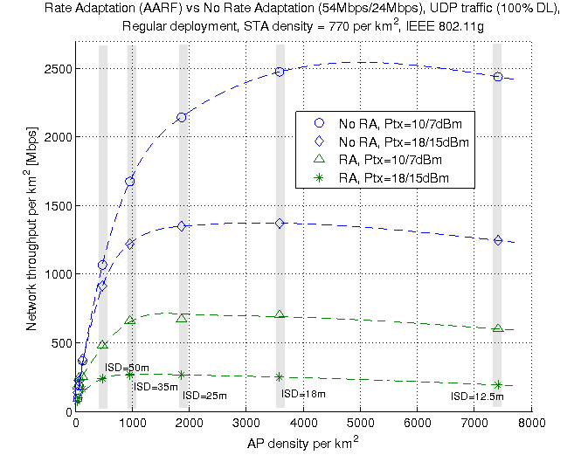
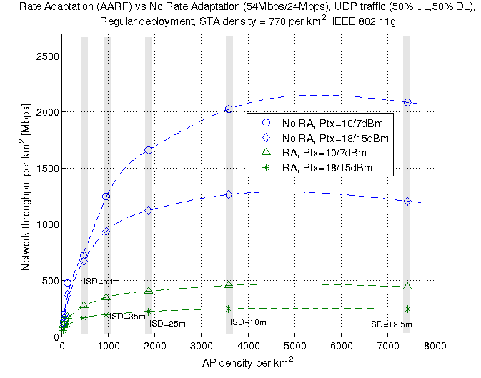
Impact of traffic asymmetry on the network throughput
UL traffic significantly increases level of contention, leading to more collisions and lower throughputs
    Peak capacity varies depending on the power allocation and AP density
    Rate adaptation significantly degrades performance in case of dense deployments
100% DL (AP->STA) traffic 50% DL (AP->STA) + 50% UL (STA->AP) traffic
ISD = Inter-site distance
9

Slide 10
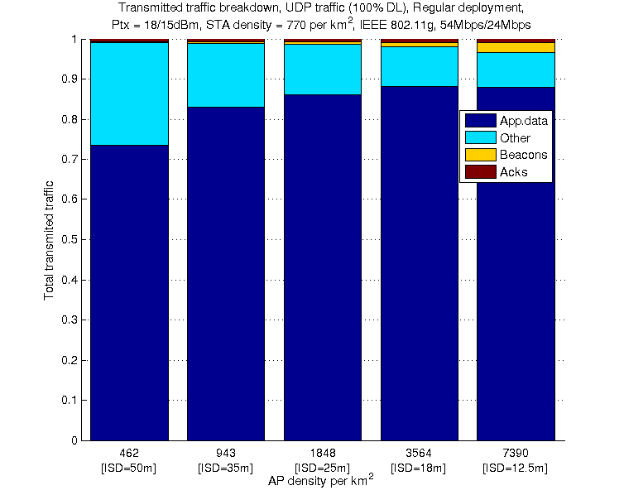
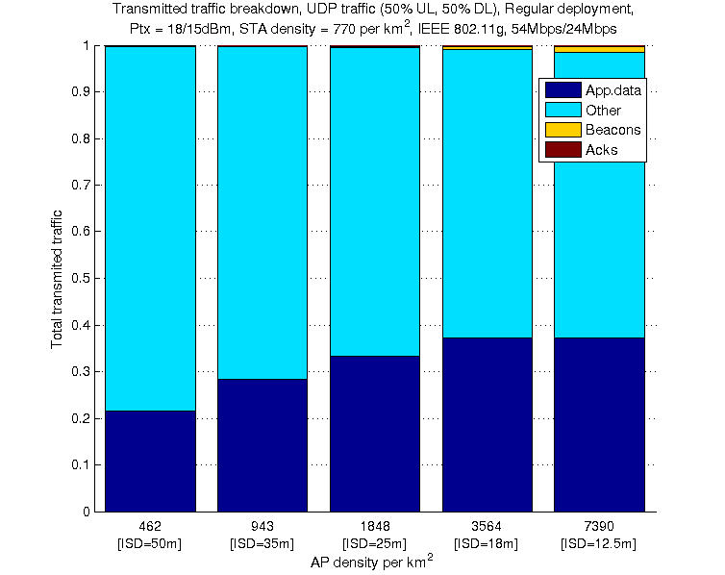
Impact of AP-density on overheads
Overheads decrease with AP density (better channel quality)
Overheads related to background scanning by STAs operating on different channels (not included) and active scanning of unassociated STAs (not included) will significantly increase the overheads, particularly at lower ISDs
Re-transmissions +
Probes + Association req./rsp.
100% DL (AP->STA) traffic 50% DL (AP->STA) + 50% UL (STA->AP) traffic

Slide 11
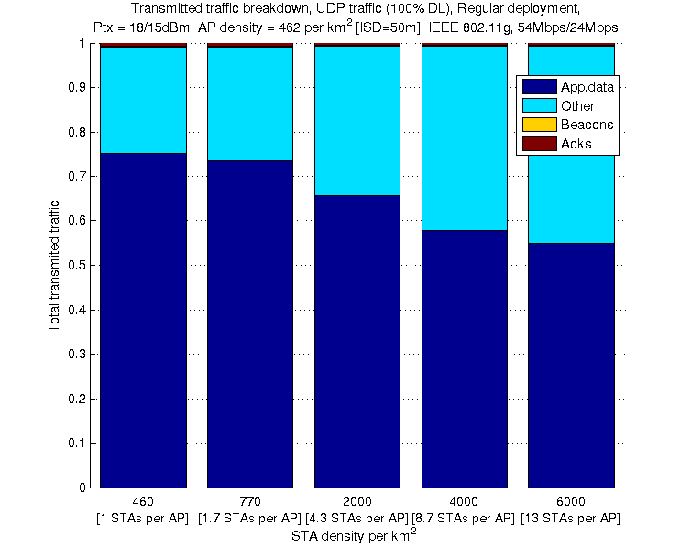
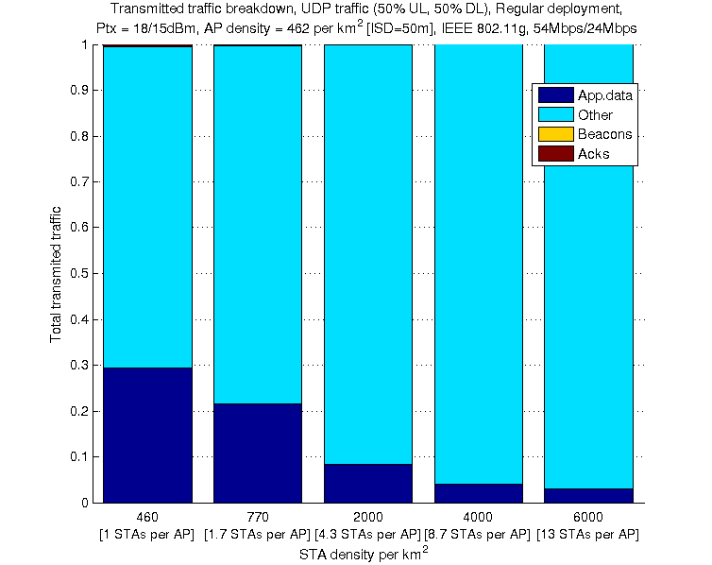
Impact of STA-density on overheads
Overheads increase with STA density
Overheads related to background scanning by STAs operating on different channels (not included) and active scanning of unassociated STAs (not included) will significantly increase the overheads, particularly at lower ISDs
100% DL (AP->STA) traffic 50% DL (AP->STA) + 50% UL (STA->AP) traffic

Slide 12
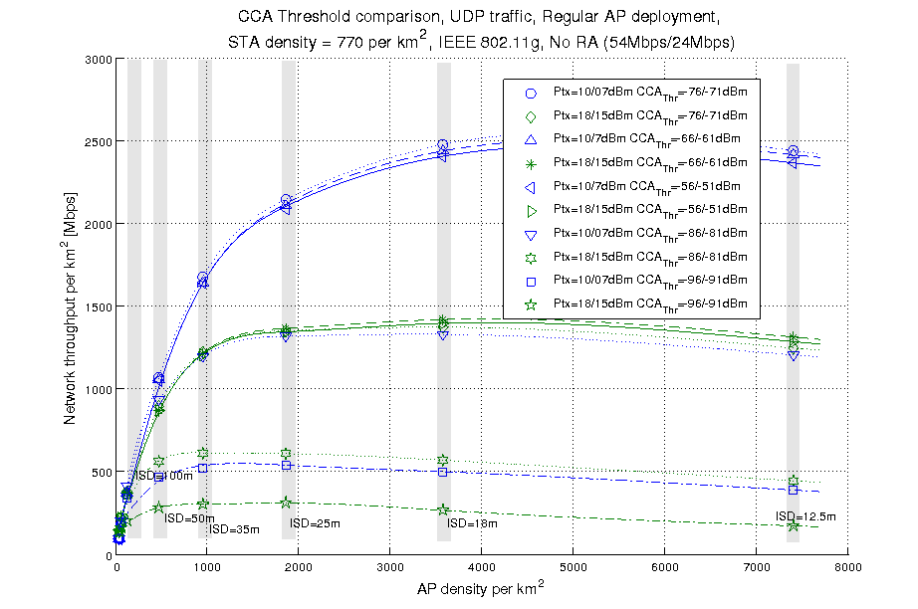
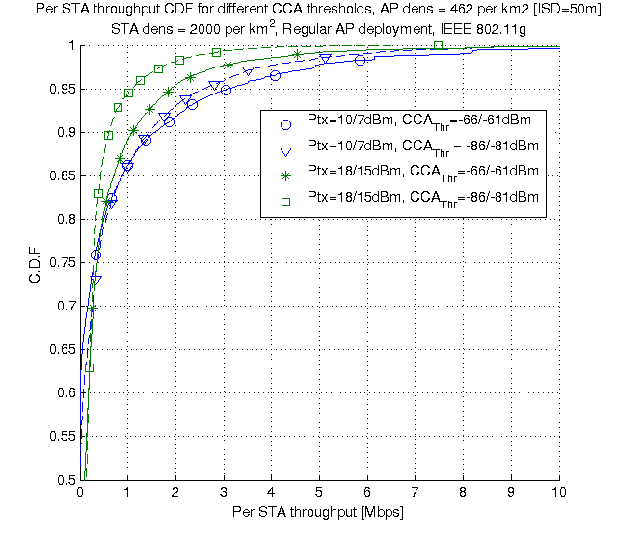
Impact of CCA on the system performance
  CCA threshold settings significantly affect system performance
  “Conservative CCA” : single AP transmission may block a significant portion of network (APs have higher probability of being in LOS with other APs and STAs thus a single AP may silence a considerable part of network)
  “Aggressive CCA” : higher packet loss (and thus lower throughout) for STAs with poor channel conditions/edge
100% DL (AP->STA) traffic
100% DL (AP->STA) traffic

Slide 13
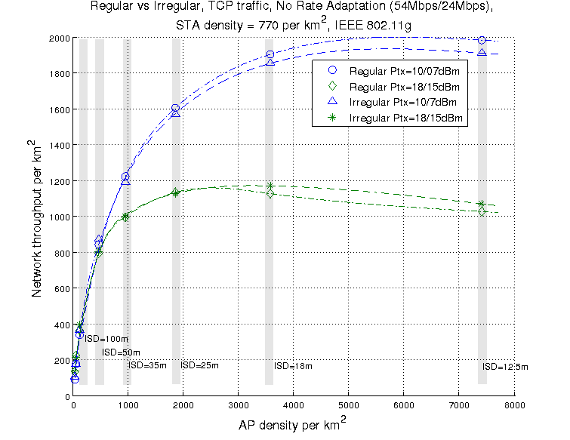
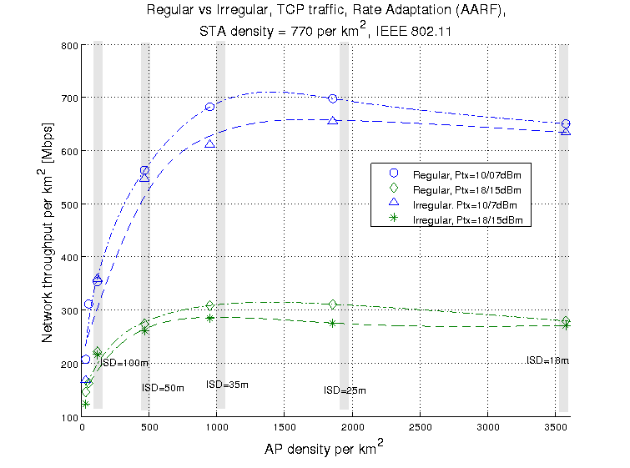
Impact of the network deployment strategy on the network throughput
  Regular (i.e. hex-grid) AP deployment and Irregular (i.e. random) AP deployment exhibit similar performance (under M.2135 modified channel model)
  Results from simple (exponent-only) channel models can be misleading
  And show significant difference between performance of regular (i.e. hex-grid) and irregular (i.e. random) deployments (not shown here)
[Mbps]
100% DL (AP->STA) traffic
100% DL (AP->STA) traffic

Slide 14
Summary
Performance of dense IEEE 802.11 networks can vary significantly depending on a number of parameters which may not always be dynamically tunable
  Tuning parameters on the STA side problematic
  Potential backward compatibility issues caused by different parameter settings across the network
Unfairness issues in case of TCP traffic and the negative impact of rate adaptation
  Only STAs with good channel conditions transmit
  Due to frequent collisions, majority of stations use low transmission rates
Importance of decreasing overheads
  Retransmissions and beacons identified as a main source of overhead
  Background scanning and active scanning can further increase (significantly) the overheads, particularly at lower ISDs
Importance of proper CCA threshold setting
  A single transmission by an AP can block significant portion of network (going into back-off) if threshold is set conservatively
  So called “aggressive CCA” on the other hand can have a negative impact on performance of cell edge STAs
Complexity of IEEE 802.11 optimization
  CSMA based IEEE 802.11 MAC protocol requires different level of fine tuning in order to cope with problems related to dense deployments – potential source of unwanted signaling overhead
  IEEE 802.11 MAC optimisation is a complex task as it is environment dependent

Slide 15
Recommendations
Prevent waste of “air time”
  Dynamic/adaptive carrier sensing threshold settings & beaconing (currently APs beaconing consume a lot of spectrum)
  Need higher data rates for control and management traffic
  Need proven rate-control (taking account of radio conditions etc.), or setting of requirements on rate adaptation algorithms
Reduce overheads due to probe exchanges
  Overheads related to background scanning by STAs operating on different channels and active scanning of unassociated STAs significantly increase the overheads, particularly at lower ISDs
Jointly optimize key system parameters for best performance
  Many adaptations/techniques have been applied in isolation with aim of improving performance in dense scenarios, but majority suffer from fairness issues. The work in [8] represents an attempt (considering only TX power & CS adaptation) to address fairness issues with noticeable improvements reported.
  As part of ongoing research, we are developing similar mechanisms but are taking into account a combination of key parameters such as: TX power, TXOP, Phy/MAC aggregation, dynamic CCA and CS thresholds..
Use of directional antennas at APs to compensate for the problem of a single AP transmission silencing the network
  When mounted at higher elevations, APs have higher probability of being in LOS with other APs and STAs associated with the other AP

Slide 16
References
[1] Report ITU-R M.2135-1 (12/2009) Guidelines for evaluation of radio interface technologies for IMT Advanced
[2] 3GPP R1-093486: Impact of relay site planning on LOS probability of the backhaul link, RAN1 #58, Ericsson, ST-Ericsson, Aug 2009
[3] IEEE 802.11-13/0756 Channel Model (Broadcom)
[4] Report ITU-R M.2146 (05/2009) Coexistence between IMT-2000 CDMA-DS and IMT-2000 OFDMA-TDD-WMAN in the 2 500-2 690 MHz band operating in adjacent bands in the same area
[5] 3GPP TR 36.814 v9.0.0 (03/2010)
[6] Bijan Golkar, “Resource Allocation in Autonomous Cellular Networks”, University of Toronto, 2013
[7] S. Helmle, M. Dehm, M. Kuhn, D. Lieckfeldt, D. Pesch, “A resource efficient model of spatially correlated shadowing in semi-mobile ad-hoc network simulations”, UKSim2013, April 2013
[8] Imad Jamil, et al., “Preserving Fairness in Super Dense WLANs”, WCNC, 2015.

Slide 17
Backup slides

Slide 18
Simulation parameter settings
Main simulation parameters
Parameter | Value
IEEE 802.11 standard | IEEE 802.11g (DSSS switched off)
Network layout | Random / Hexagonal grid
Wrap-around | Yes (variable number of rings)
STA/AP density | Variable / Variable
STA/AP height | 1.5m / 10 m
STA distribution | Random uniform distribution
Path loss model | ITU-R UMi based model
Shadow fading model | sigma = 3dB (LOS) / 4dB (NLOS), decorr = 10m (LOS) / 13m (NLOS), correlation between arbitrary pairs of links
Fast fading model | Not considered
Mobility | Not considered
Number of orthogonal channels | 1
Carrier frequency | 2.4 GHz
Carrier bandwidth | 20.0 MHz
STA/AP Transmit power | 15.0 dBm, 7.0dBm / 18.0.dBm, 10.0 dBm
STA/AP Rx sensitivity | -85.0 dBm / -90.0 dBm (RA scenarios) -74.0 dBm / -79.0 dBm (No RA scenarios)
STA/AP Noise Figure | 7 dB / 4 dB
STA/AP Antenna type | Omni-directional
STA/AP Antenna Gain | -1.5 dBi / 2.0 dBi
STA/AP CCA Mode1 threshold | -82.0 dBm / -87.0 dBm (RA scenarios) -71.0 dBm/ -76.0 dBm (No RA scenarios)
STA-AP allocation rule | Strongest server (STAs always associate with APs with the strongest signal)
Traffic model | Full buffer (saturated model)
Traffic type | Elastic (TCP New Reno), Non-elastic (UDP)
Packet size (size of the packet transmitted on the air interface, i.e. with MAC, IP and TCP overheads) | 1500 bytes (Application layer packet size: 1424 bytes)
Other IEEE 802.11 related parameters
Parameter | Value
Beacon period | 100ms
Probe timeout /Number of probe requests send per scanned channel | 50ms / 2
Scanning period (unassociated state only) | 15s
RTS/CTS | Off
Packet fragmentation | Off
The maximum number of retransmission attempts for a DATA packet | 7
Rate adaptation algorithm | Adaptive Auto Rate Fallback (AARF) / No Rate Adaptation (54Mbps/24Mbps)
MAC layer queue size | 1000 packets
Number of beacons which must be consecutively missed by STA before disassociation | 10
Association Request Timeout / Number of Assoc Req. before entering scanning | 0.5s / 3
Transmission failure threshold for AP disassociation procedure | 0.99

