Slide 1
L-Preamble Issues for UL-OFDMA
Date: 2015-05-10
Authors:

Slide 2
Abstract
The inclusion of the legacy preamble (L-STF, L-LTF and L-SIG) in HE PPDU were agreed at the January 2015 meeting.
However, the legacy preamble part of PPDU for UL-OFDMA sent by multiple STAs will occupy the same band (e.g. 20MHzBW) at the same timing.
This submission analyzes feasibility of this overlapped L-Preamble, especially about L-STF, in the same band at the same timing.

Slide 3
Overlap of L-Preamble
(UL-OFDMA)
RX on the AP side
Data1
UL-Data (STA1)
TX from STA1
UL-Data (STA1)
UL-Data (STA2)
~
UL-Data (STA-n)
TX from STA2
Data2
UL-Data (STA2)
Overlap of preamble will happen.
…
This will also happen in the case of ACK/BA transmission for MU DL-OFDMA if sub-channel based ACK is adopted.

Slide 4
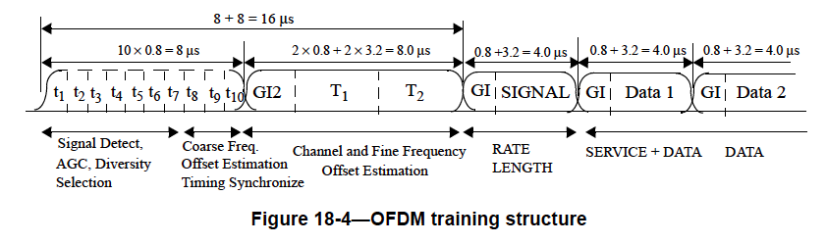
Time Difference of Arrival
(Overlapping L-STF)
Copied from IEEE std. 802.11-2012
8us
From STA1
t₁
t₂
t₃
t₄
t₅
t₆
t₇
t₈
t₉
t₁₀
It’s obvious to have some time differences of arrival among transmitted frames.
From STA2
t2
t₁
t₁₀
What will the mixed L-STF be?
+
From STA3
t3
t₁
t₁₀
....

Slide 5
Signal Arrival Timing Differences in Multi-Path Effect
However, an AP in the current standards also requires to pick up the most suitable signal from received signal with multipath effect for proper demodulation.
This received signals also include delayed signals.
What is this different from UL-OFDMA case?

Slide 6
Timing Detection at the Current Standards
The strongest correlation peak is recognized as the proper timing for synchronization with the direct signal.
L-STF
L-LTF
Direct signal
(the strongest)
GI₂
T₁
t₈
t₉
t₁₀
Output of matched filter
w/ known pattern
Delayed signals
Real output of matched filter
(mixture)
Second peak
Third peak

Slide 7
Issues of Timing Detection for UL-OFDMA by L-Preamble
There are multiple direct signals to be decoded.
Reception power of L-STF is also an issue.
  TX power may be adjusted for equalizing signal levels on the AP side by each transmitting STA. Similar level signals will arrive with some delays.
Arrival time difference may be greater than some 100ns among signals of STAs. (>800ns sometimes)
→ What will be the correlation with overlapped L-STF?

Slide 8
Correlation with the Overlapped L-STF
Correlation with each L-STF (from 4xUL STAs)
  This example is just for direct signals.
Which peak should be the base for synchronization?
time
Summation of received signals
The latest peak =
Proper boundary with L-LTF for getting synchronization?
→ What will happen with consideration of multipath effect?

Slide 9
Synchronization with Each Frame in UL-OFDMA using L-Preamble
Synchronizations will be very coarse in the part after L-STF because overlapped L-STF provides fine synchronization just with one of received frames.
e.g. : Image of synchronization with L-STF of STA4
UL-Data (STA1)
UL-Data (STA2)
Coarse sync.
UL-Data (STA3)
UL-Data (STA4)
Fine sync.
It’s completely infeasible to adjust signal phases among arrived signals. → Wrong decodes

Slide 10
Not Overlapped Frame Header
Header part of PPDUs for UL-OFDMA should not be overlapped in frequency domain. Possible solutions are:
1. To define narrowed L-Preamble
5MHz
N L-preamble
HE header
UL Data (STA1)
Issues:
Detection by legacy devices
Frame reception with arrival timing differences
e.g.
5MHz
N L-preamble
HE header
UL Data (STA2)
5MHz
N L-preamble
HE header
UL Data (STA3)
5MHz
N L-preamble
HE header
UL Data (STA4)
2. Not to use L-Preamble format
Issues:
Frame protection
Frame reception with arrival timing differences
5MHz
HE header
UL Data (STA1)
e.g.
5MHz
HE header
UL Data (STA2)
5MHz
HE header
UL Data (STA3)
5MHz
HE header
UL Data (STA4)

Slide 11
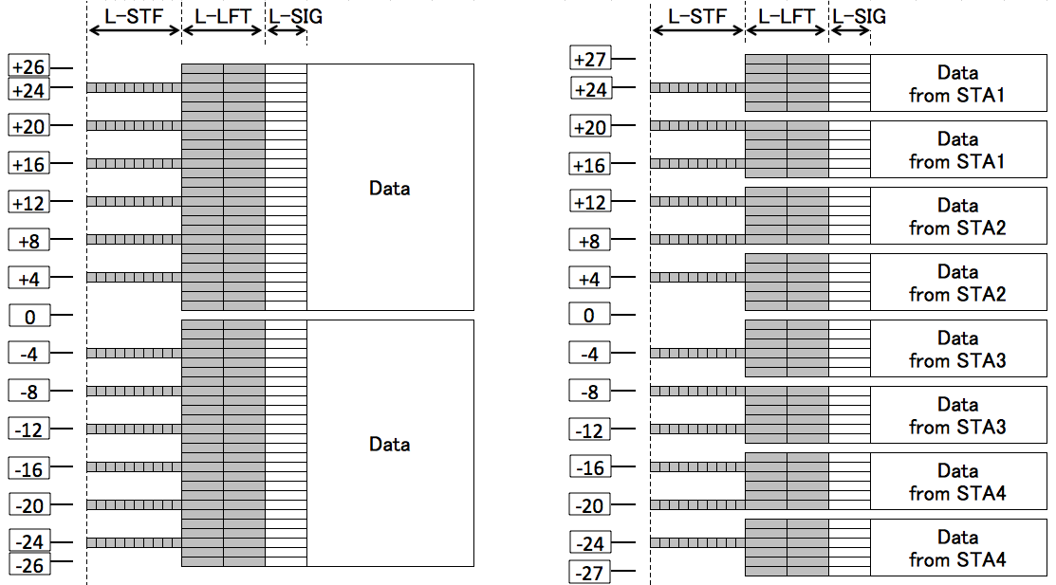
Possible(?) Preamble Design for 5MHzBW
Inheriting L-Preamble Format
Preamble for non-HT (11a)
Possible preamble for 5MHzBW
Subcarrier
Index
Subcarrier
Index
L-LTF
L-LTF
Freq.
Will this design work well for legacy devices to detect these frames ?

Slide 12

Available number of multiplex
An AP needs correlation power for detect and synchronize a narrowed band frame. There may be a limitation for available number of transmitters for UL-OFDMA.
2?
4?
8?

Slide 13
Example of UL-OFDMA Procedure
Necessary header for UL-OFDMA
with
without
L-Preamble format
L-Preamble format
AP
L-Preamble
HE-header
Trigger
frame
L-Preamble
HE-header
ACK/BA for MU
UL Data (STA1)
UL Data (STA2)
UL Data (STA3)
Is this part needed?
STAs
UL Data (STA4)
Time
L-SIG TXOP Protection

Slide 14
Summary
It’s not feasible to use 20MHzBW L-preamble for UL-OFDMA transmission.
  → It is required to define header in narrower bandwidth to avoid overlap in the frequency domain for UL-OFDMA PPDU reception on the AP side.
Further discussions are necessary to reach a TG consensus about requirements for narrowed header.

Slide 15
Straw Poll (1)
Do you agree to modify the current sentence in Spec Framework Document as follows?
An HE PPDU shall include the legacy preamble (L-STF, L-LTF and L-SIG), duplicated on each 20 MHz, for backward compatibility with legacy devices, except the case of narrower bandwidth (<20MHz) transmission for UL-OFDMA.
Y/N/A=
Y/N/A =

Slide 16
Straw Poll (2)
Do you agree to add the following text into Spec Framework Document?
PPDU header for UL-OFDMA transmission shall be defined for narrower bandwidth (<20MHz).
Y/N/A =

Slide 17
Straw Poll (3)
Do you agree to add the following text into Spec Framework Document?
The amendment shall define L-SIG TXOP Protection by a trigger frame(TBD) to mitigate frame collisions during UL-OFDMA procedure.
Y/N/A =

Slide 18
References
11-13/1388r0, “Uplink multi-user transmission”
11-15/0378r1, “Channel Sensing in UL-OFDMA”
11-15/0354r1, “Bandwidth granularity on UL-OFDMA data allocation”
11-15/0132r4, “Specification Framework for TGax”

